Slide 1
Βιβλιογραφική ενημέρωση / EULAR 2016 update
ΝΙΚΟΛΑΟΣ ΚΟΥΓΚΑΣ
ΕΠΙΚ.ΕΠΙΜΕΛΗΤΗΣ Β ΡΕΥΜΑΤΟΛΟΓΙΚΗΣ ΚΛΙΝΙΚΗΣ ΠΑΓΝΗ

Slide 2
Osteoporosis
Abaloparatide
Romosozumab
Long term use of aledronate
Osteoarthritis
Fulranumab
chondroitin sulfate and glucosamine sulfate
Ultrasound and hand OA

Slide 3
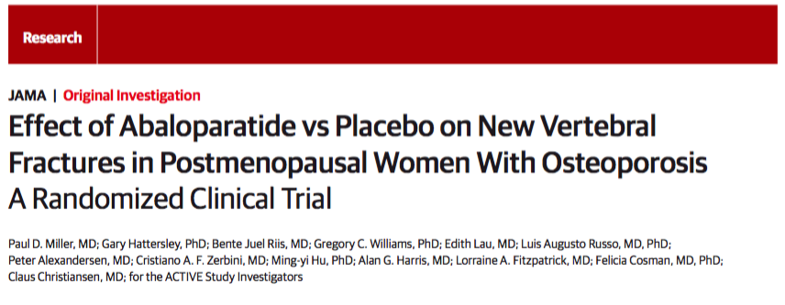

Slide 4
OBJECTIVE-DESIGN
To determine the efficacy and safety of abaloparatide, 80μg, vs placebo for prevention of new vertebral fracture in postmenopausal women at risk of osteoporotic fracture
Phase 3, double-blind, RCT
Postmenopausal women with (BMD) T score −2.5 and >−5.0 at the lumbar spine or femoral neck and radiological evidence >2 mild or >1 moderate lumbar or thoracic vertebral fracture or history of low-trauma nonvertebral fracture within the past 5 years.Women (>65 y) with fracture criteria and a T score −2.0 and >−5.0 or without fracture criteria and a T score −3.0 and >−5.0 could enroll

Slide 5
INTERVENTIONS -OUTCOMES
Blinded, daily s.c. injections of placebo(n=821); abaloparatide, 80 μg (n = 824); or open-label teriparatide, 20 μg (n=818) for 18 months
Primary end point: percentage of participants with new vertebral fracture in the abaloparatide vs placebo groups
Secondary end points: change in BMD at total hip, femoral neck, and lumbar spine in abaloparatide-treated vs placebo participants

Slide 6
RESULTS
BMD increases were greater with abaloparatide than placebo (all P < .001)

Slide 7
CONCLUSION
Subcutaneous abaloparatide, compared with placebo, reduced the risk of new vertebral and nonvertebral fractures over 18 months

Slide 8
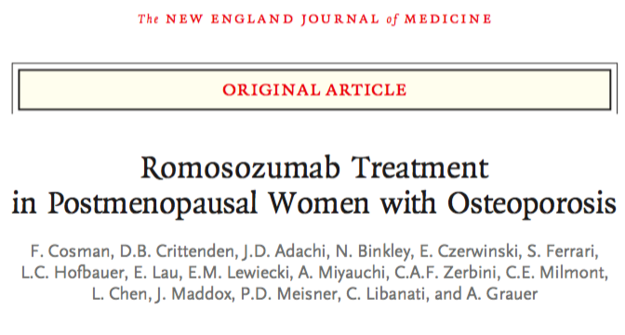

Slide 9
OBJECTIVE-DESIGN
To evaluate the effects of 1 year of romosozumab (a monoclonal antibody that binds sclerostin ) treatment on the risk of fracture among women with postmenopausal osteoporosis
Phase 3 trial double-blind, placebo-controlled, parallel-group trial
7180 postmenopausal women who had a T score of –2.5 to –3.5 at the total hip or femoral neck and up to 2 moderate vertebral fractures

Slide 10
INTERVENTIONS -OUTCOMES
Patients randomly assigned to receive s.c. injections of romosozumab (at a dose of 210 mg) or placebo monthly for 12 months; thereafter, patients in each group received denosumab for 12 months, at a dose of 60 mg, administered s.c. every 6 months
Primary end point: the cumulative incidence of new vertebral fractures at 12 months and 24 months.
Secondary end points: clinical (a composite of nonvertebral and symptomatic vertebral) and nonvertebral fractures

Slide 11
RESULTS
12 MONTHS
24 MONTHS
new vertebral fractures in 16/3321 patients (0.5%) in the romosozumab group, and 59/3322 (1.8%) in the placebo group (representing a 73% lower risk with romosozumab; P<0.001)
Clinical fractures in 58/3589 patients (1.6%) in the romosozumab group and 90/3591 (2.5%) in the placebo group (a 36% lower risk with romosozumab; P=0.008)
Nonvertebral fractures in 56/3589 patients (1.6%) in the romosozumab group and in 75/3591 (2.1%) in the placebo group (P=0.10)
vertebral fractures were significantly lower in the romosozumab group than in the placebo group after each group made the transition to denosumab (0.6% [21 of 3325 patients] in the romosozumab group vs. 2.5% [84 of 3327] in the placebo group, a 75% lower risk with romosozumab; P<0.001)

Slide 12
CONCLUSION
In postmenopausal women with osteoporosis, romosozumab was associated with a lower risk of vertebral fracture than placebo at 12 months and, after the transition to denosumab, at 24 months

Slide 14
OBJECTIVE-DESIGN
To determine the skeletal safety and efficacy of long term (≥10 years) alendronate use in patients with osteoporosis
Open register based cohort study

Slide 15
INTERVENTIONS -OUTCOMES
Treatment with alendronate
Incident fracture of the subtrochanteric femur or femoral shaft (ST/FS) or the hip. Non-fracture controls from the cohort were matched to fracture cases by sex, year of birth, and year of initiation of alendronate treatment

Slide 16
RESULTS
1428 participants sustained a ST/FS (incidence rate 3.4/1000 person years, 95% confidence interval 3.2 to 3.6), and 6784 a hip fracture (16.2/1000 person years, 15.8 to 16.6).
The risk of ST/FS was lower with high adherence to treatment with alendronate (medication possession ratio (MPR, a proxy for compliance) >80%) compared with poor adherence (MPR <50%; odds ratio 0.88, 0.77 to 0.99; P=0.05).
The risk was no higher in long term users (≥10 dose years; 0.70, 0.44 to 1.11; P=0.13) or in current compared with past users (0.91, 0.79 to 1.06; P=0.22). Similarly, MPR >80% was associated with a decreased risk of hip fracture (0.73, 0.68 to 0.78; P<0.001) as was longer term cumulative use for 5-10 dose years (0.74, 0.67 to 0.83; P<0.001) or ≥10 dose years (0.74, 0.56 to 0.97; P=0.03).

Slide 17
CONCLUSION
Long term adherent use of alendronate in excess of 10 dose years was associated with an adjusted 30% lower risk of hip fracture and no increase in the risk of fractures of the subtrochanteric femur or femoral shaft

Slide 18
Long-term Safety and Efficacy of Fulranumab in Patients with Moderate-to-Severe Osteoarthritis Pain: A Randomized, Double-blind, Placebo-controlled Study

Slide 19
OBJECTIVE-DESIGN
To evaluate long-term safety and efficacy of fulranumab (a human anti-nerve growth factor (NGF) monoclonal antibody) in patients with moderate-to-severe chronic osteoarthritis (OA) knee or hip pain
Placebo-controlled, phase-2 double-blind (DB) extension study
Patients aged 40 to 80 years, with OA of hip or knee, on stable regimens of NSAIDs, and/or opioids, entering DB phase with a mean OA pain intensity score of ≥5, averaged over the last 3 days of pain scores before randomization using an 11-point numerical rating scale (NRS)

Slide 20
INTERVENTIONS -OUTCOMES
Patients were equally randomized to 1mgQ4wk, 3mgQ8wk, 3mgQ4wk, 6mgQ8wk, or10mgQ8wk fulranumab (s.c.) or placebo in the 12-week DB efficacy phase, and completing this DB efficacy phase, were eligible to continue the dose throughout a 92-week extension phase followed by a 24-week post treatment follow-up (PFTU)
Safety assessments included evaluation of treatment-emergent adverse events (TEAEs), pre- identified AEs of interest and joint replacements. Efficacy included change from baseline to end of DB extension phase in Patient Global Assessment, Western Ontario and McMaster Universities Osteoarthritis Index pain, and physical function subscale scores.

Slide 21
RESULTS
Long-term sustained improvements were observed in all efficacy parameters following fulranumab treatment (1mgQ4wk, 3mgQ4wk, 10mgQ8wk) versus placebo.
Similar percentage of patients in both groups experienced TEAEs (placebo: 88%; fulranumab: 91%; all phases). Across all fulranumab groups, arthralgia (21%) and OA (18%) were most common TEAEs; most common serious TEAEs were knee (10%) and hip (7%) arthroplasty, with 80% occurring during PTFU. Neurologic-related TEAEs (25%, all phases) were generally mild-to-moderate

Slide 22
CONCLUSION
Long-term fulranumab treatment was generally well-tolerated and efficacious for patients with hip and knee OA
Dosing every 4 weeks is preferred as it showed a better long-term efficacy profile than dosing every 8 weeks.

Slide 23
Chondroitin sulfate plus glucosamine sulfate shows no superiority over placebo in a randomized, double-blind, placebo-controlled clinical trial in patients with knee osteoarthritis

Slide 24
OBJECTIVE-DESIGN
To assess the efficacy and safety of chondroitin sulfate (CS) plus glucosamine sulfate (GS) compared to placebo in patients with symptomatic knee osteoarthritis (KOA)
multicenter, randomized, double-blinded, placebo-controlled study
164 patients with Kellgren-Lawrence stages II-III KOA and moderate to severe pain (VAS: 62.1±11.3 mm)

Slide 25
INTERVENTIONS -OUTCOMES
Patients were randomized to receive either CS (1200 mg) plus GS (1500 mg) or placebo in a single oral daily dose for 6 months.
primary endpoint: the mean change in VAS global pain
Secondary outcomes included the mean change in the investigator global assessment, total WOMAC, pain and function subscales of WOMAC, OMERACT-OARSI 2004 responder rate, and rescue medication use. Adverse events were also recorded

Slide 26
RESULTS
CS+GS was inferior to placebo in reduction of joint pain for the modified intention-to-treat (mITT) population [11.8±2.4 mm (19%) vs 20.5±2.4 mm (33%); ∆= -8.7; -14.2%; p<0.03], but not for per-protocol completers
Placebo and CS+GS similarly improved total WOMAC, as well as pain and function WOMAC subscales in both mITT population and per-protocol completers. Neither the OMERACT-OARSI responder rate nor the use of rescue medication differed between both groups.
Severe adverse events were uncommon and equally distributed.

Slide 27
CONCLUSION
CS+GS failed to demonstrate superiority over placebo in reducing pain and function impairment in patients with symptomatic KOA at 6 months

Slide 29
OBJECTIVE-DESIGN
To examine whether ultrasound predicts radiographic hand osteoarthritis (OA) progression after 5 years.
Participants from the Oslo Hand OA cohort

Slide 30
INTERVENTIONS -OUTCOMES
Ultrasound examination (gray-scale (GS) synovitis and power Doppler (PD) signals) at baseline and conventional radiographs and clinical examination at baseline and 5-year follow-up
Radiographic progression was defined as an increase in global OA according to the Kellgren–Lawrence (KL) scale or progression of individual radiographic OA features
Whether baseline ultrasound features and clinical examination predicted radiographic progression

Slide 31
RESULTS
Radiographic progression occurred in 17.9% joints for KL, 12.1% for joint space narrowing, 11.7% for osteophytes and 4.5% for erosions.
Ultrasound- detected inflammation predicted KL progression, and dose–response associations were observed for GS synovitis grade 1 (OR=2.8, 95% CI 1.8 to 4.2), grade 2 (OR=3.6, 95% CI 2.2 to 5.8) and grade 3 (OR=15.2, 95% CI 6.9 to 33.6), and for PD signal grade 1 (OR=2.9, 95% CI 1.2 to 6.8) and grades 2–3 (OR=12.0, 95% CI 3.5 to 41.0)

Slide 32
CONCLUSION
Ultrasound-detected GS synovitis and PD signals were significantly associated with radiographic progression after 5 years.
Ultrasound could be a useful tooll to detect patients with hand OA who are likely to progress

