Slide 1
Adamantiades – Behcet Disease with vascular involvement
J Joseph
Crete / Cyprus meeting
Presented 2011/2013/2016

Slide 2
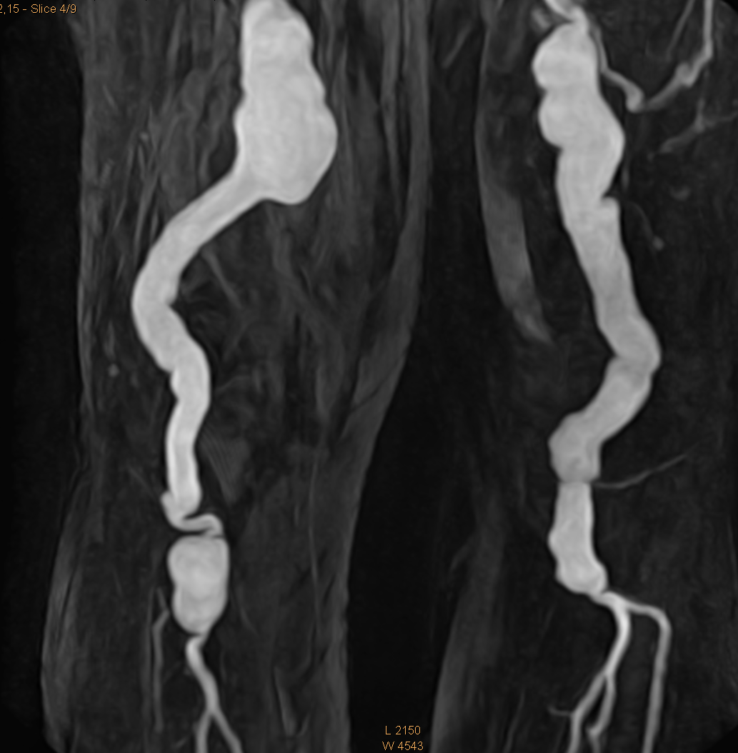

Slide 3
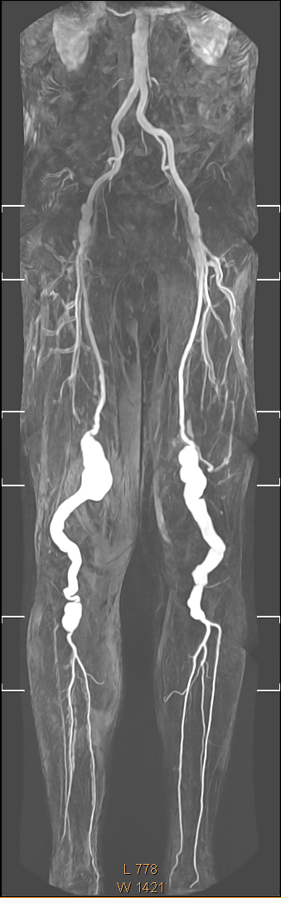

Slide 4
Background
Years of iritis
Years of high inflammatory markers
Occasional EN/pustular lesions/arthritis
‘Abuse’ of corticosteroids
Made own decisions
Then came the popliteal aneurysms

Slide 5
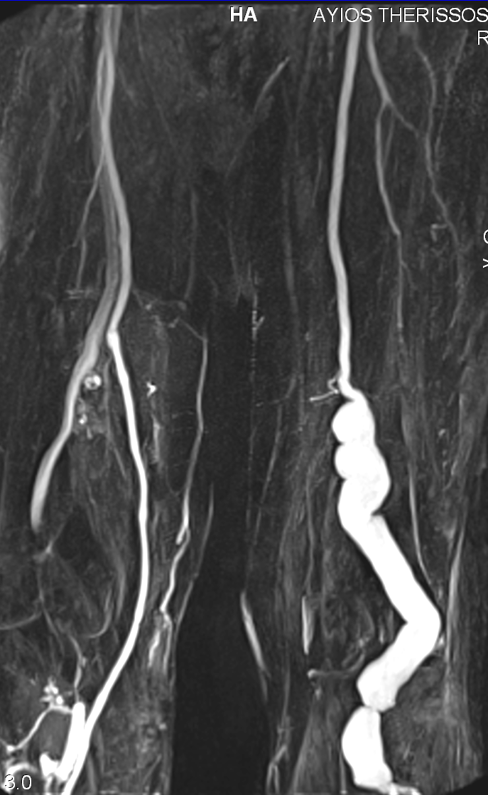
R
L

Slide 6
We discussed in 2011
Left Endovascular stent without further problems
On azathioprine and ciclosporin

Slide 7
Autumn 2013

Slide 8
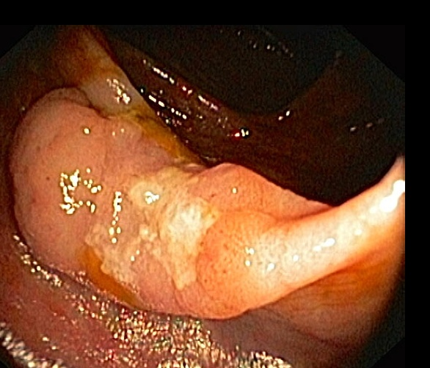
Ca colon – surgery only

Slide 9
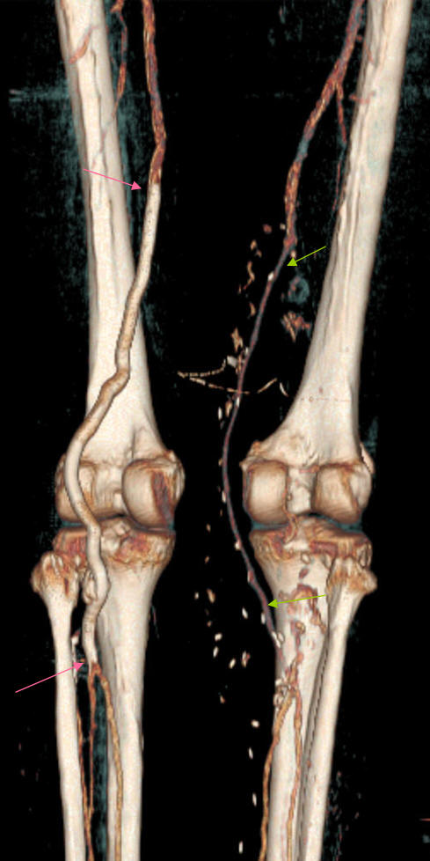
L

Slide 10
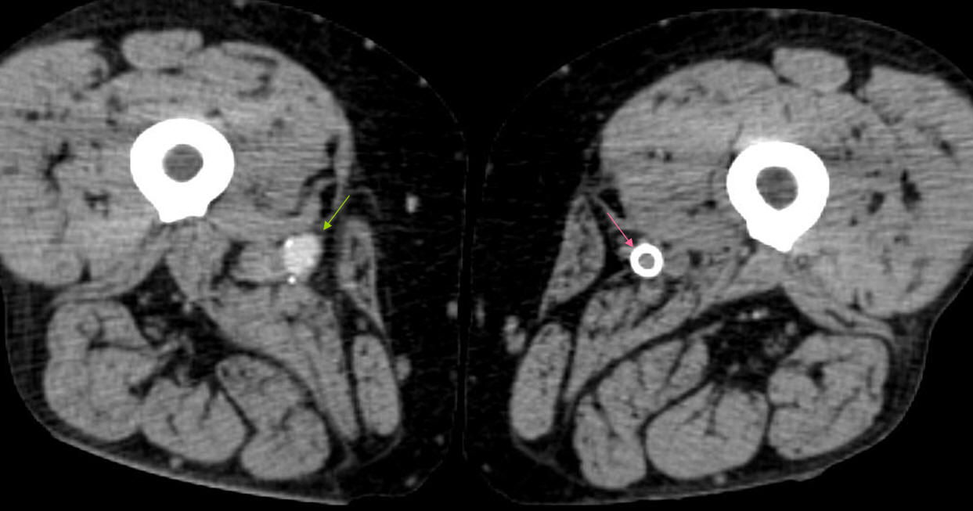
Above knee…
R

Slide 11
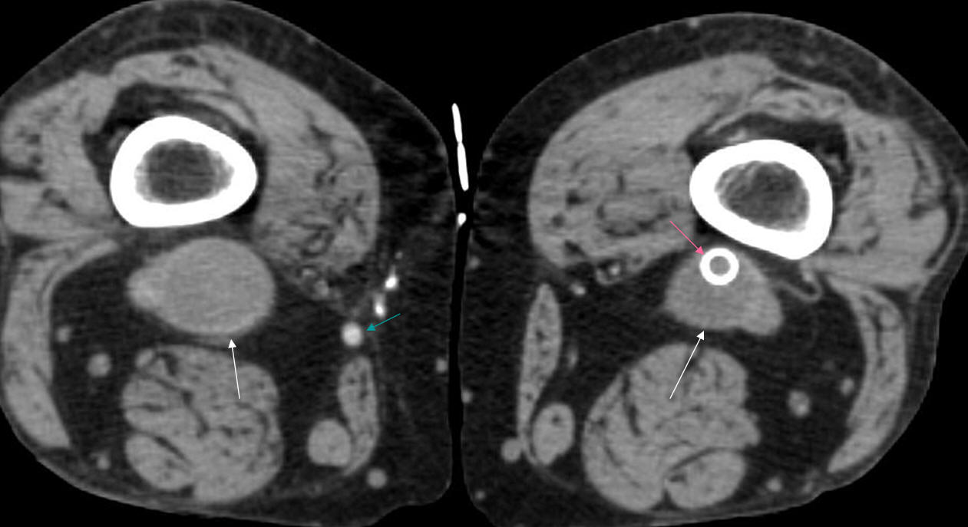
Popliteal fossa
R

Slide 12
Underwent thrombectomy

Slide 13
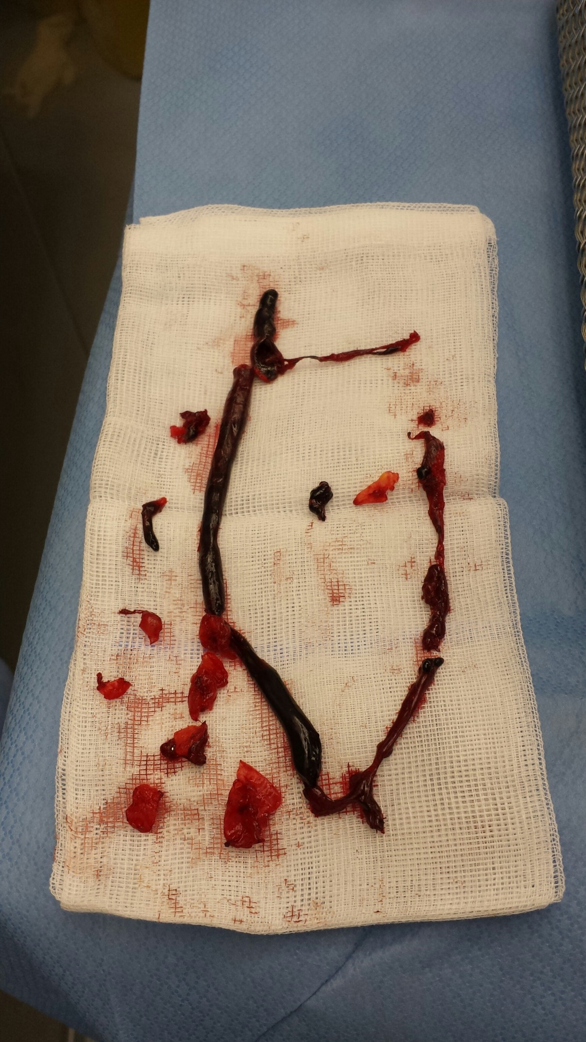

Slide 14
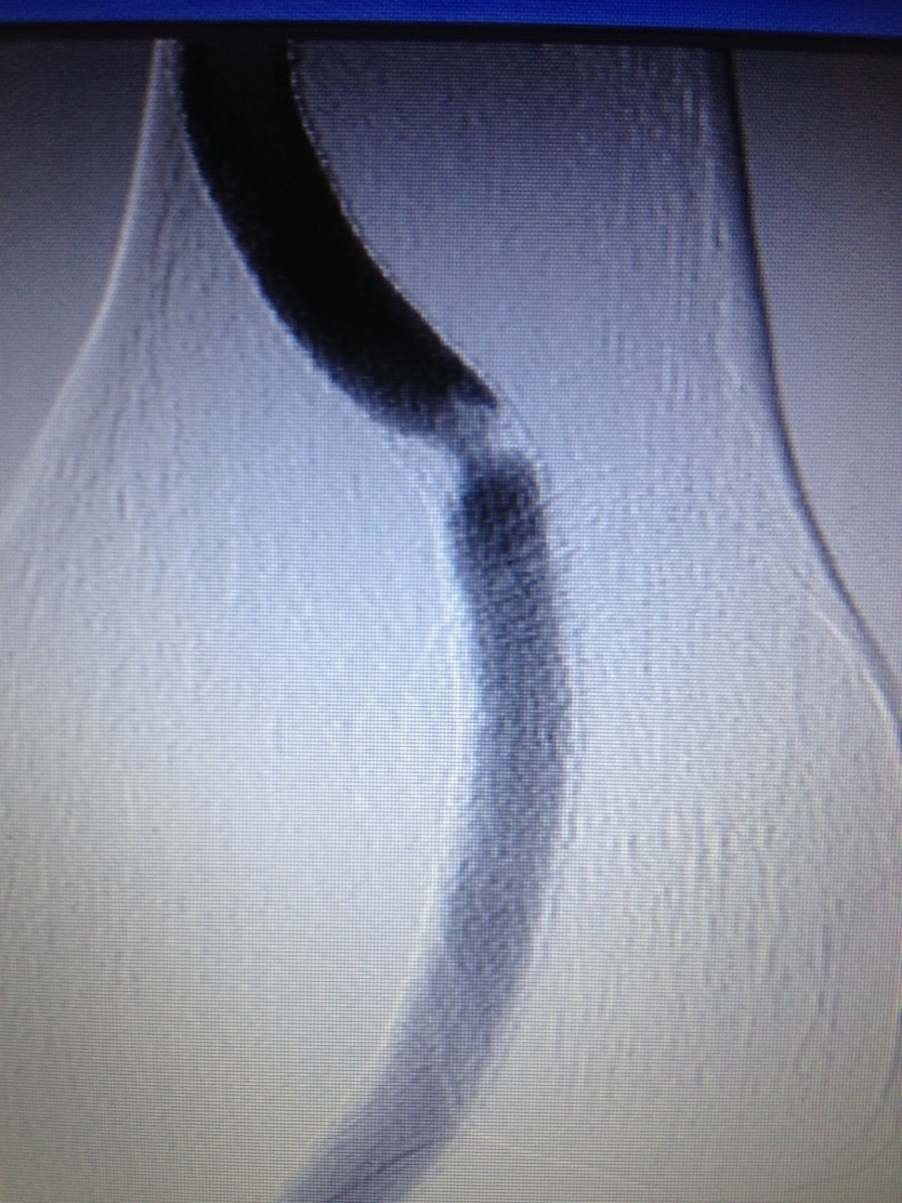

Slide 15
Then angioplasty on stent stenosis

Slide 16
In the past 2 years
Around 10 episodes of fast AF
Cardiac sounding chest pain (previous coronary angiograms normal)
New Coronary Angiography
Overweight
Huge family history
Smoker until 2 years before
Borderline diabetes
Long term steroids
Long term inflammation

Slide 17
Angiography

Slide 18
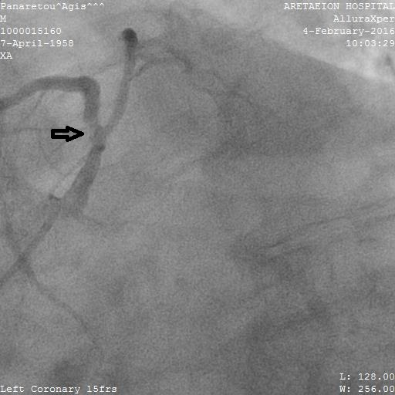
LAD pre stent

Slide 19
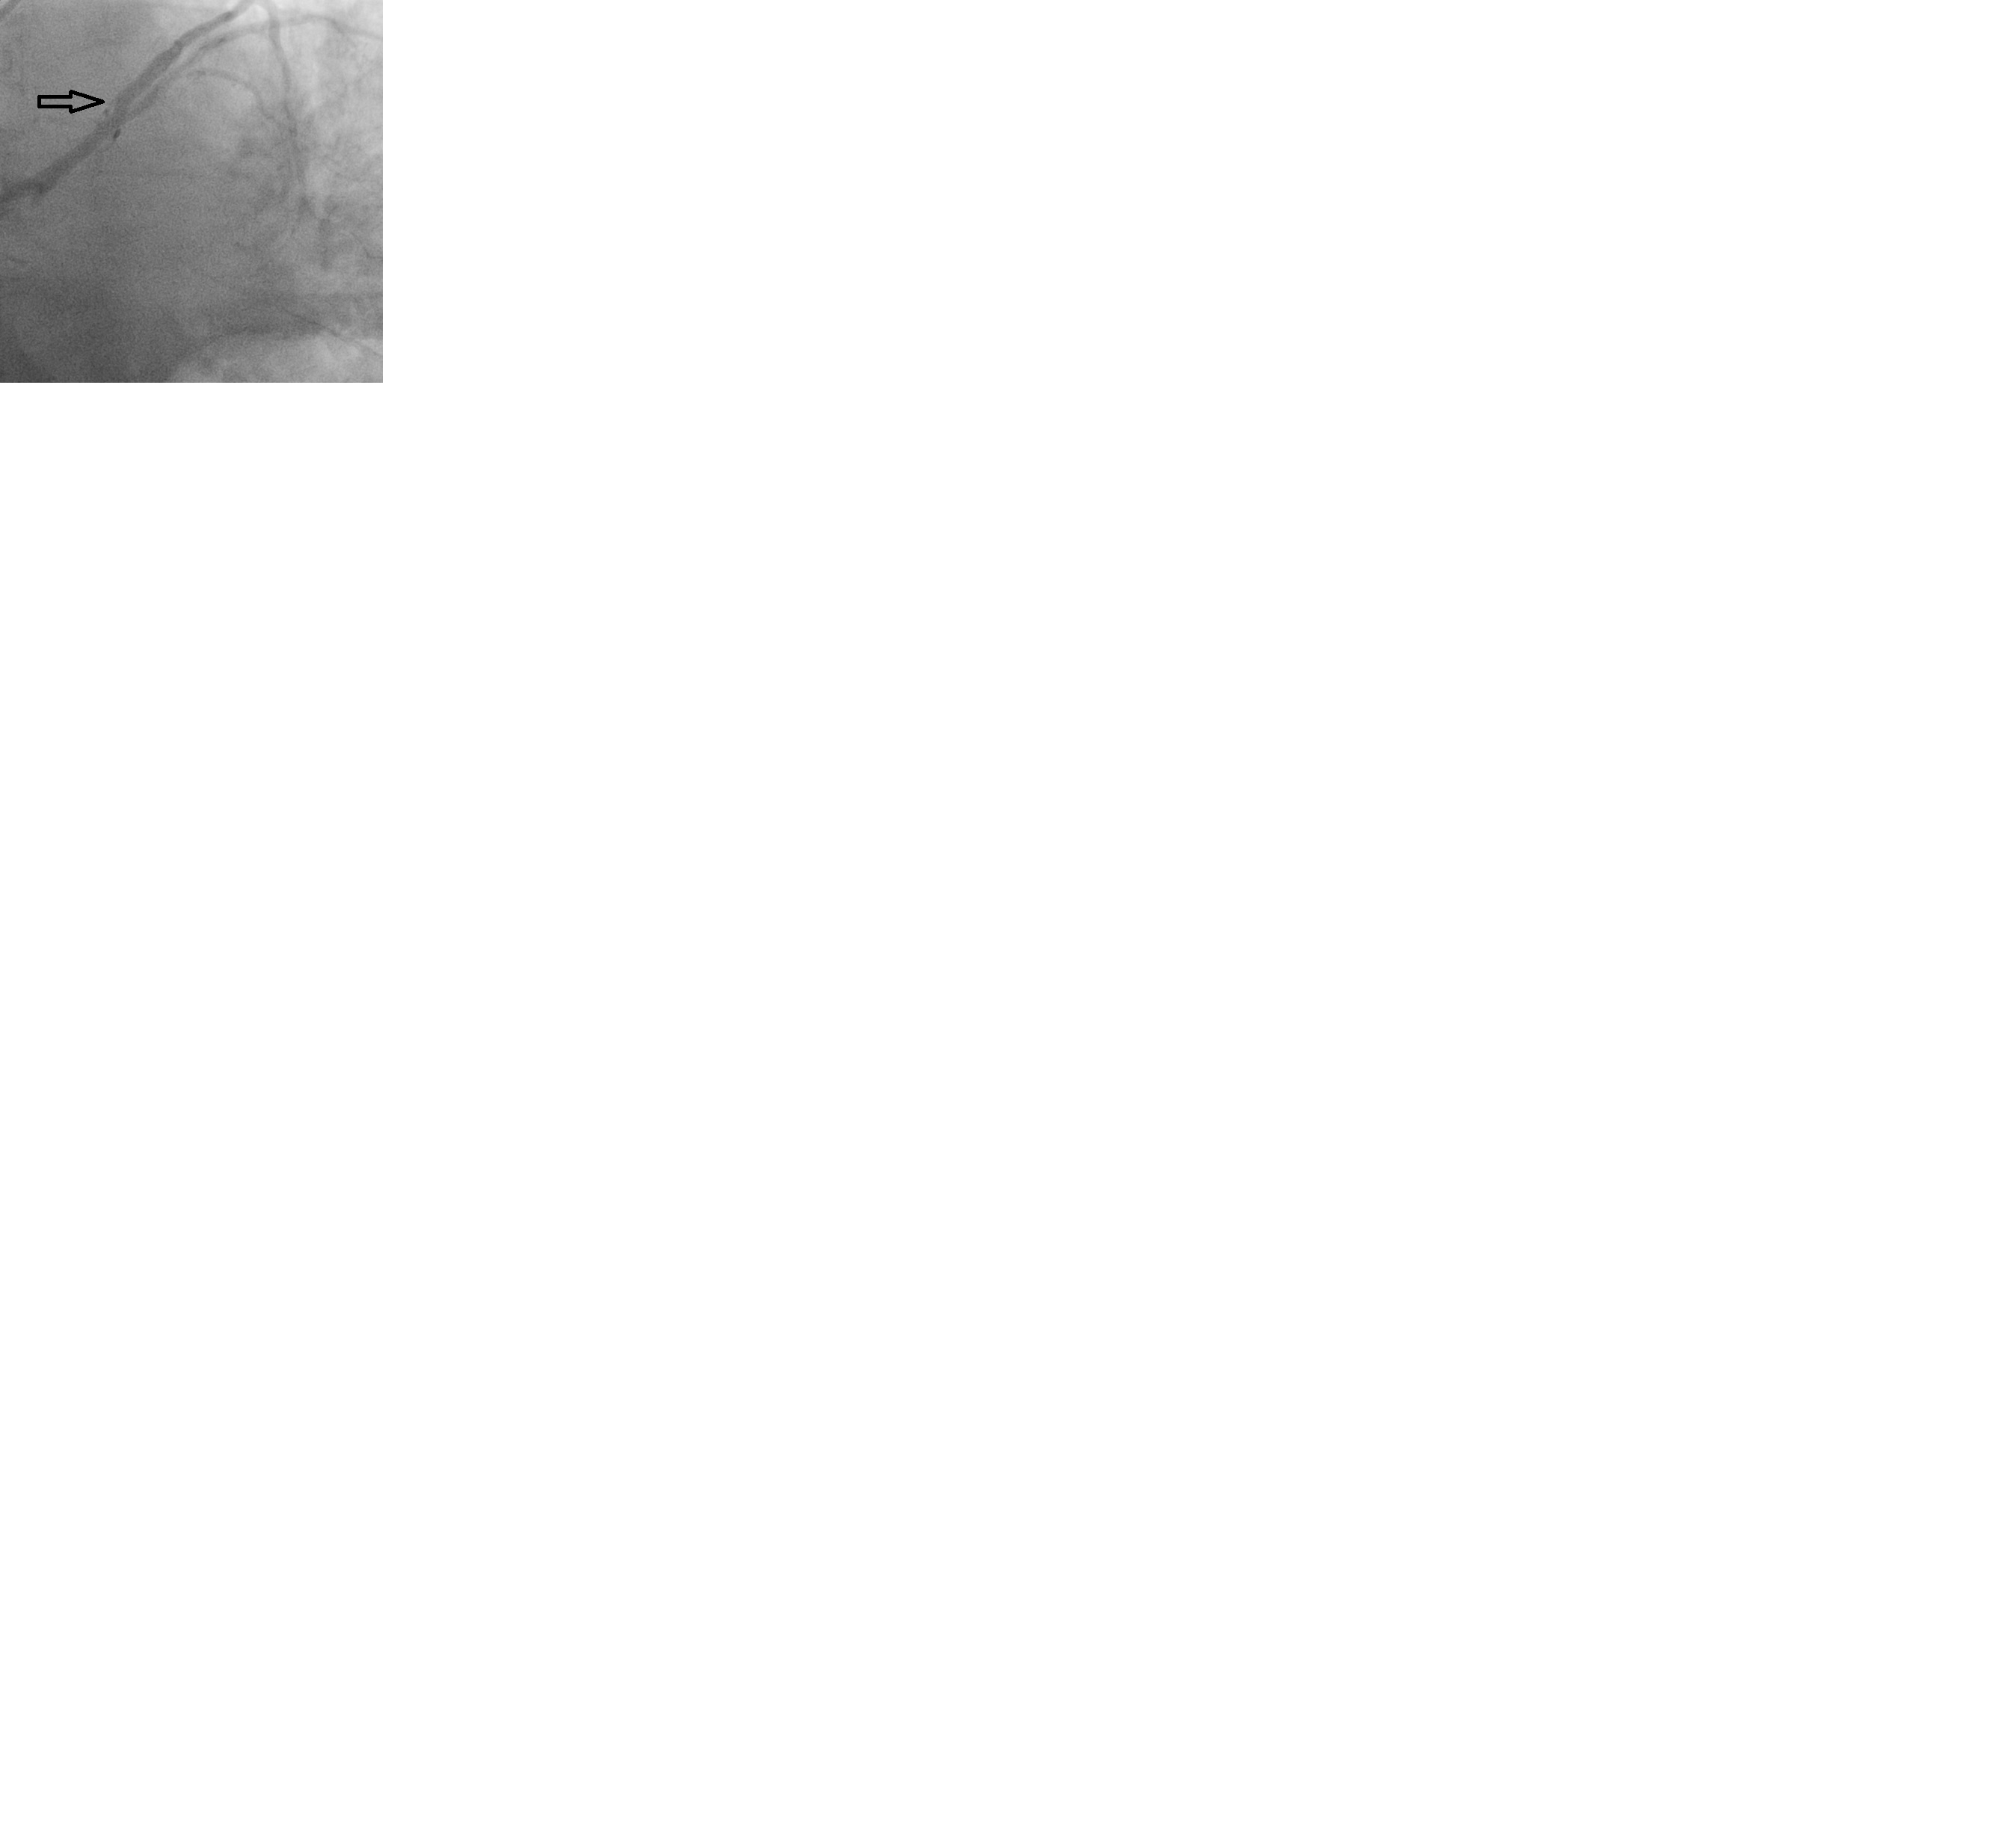
LAD post stent

Slide 20
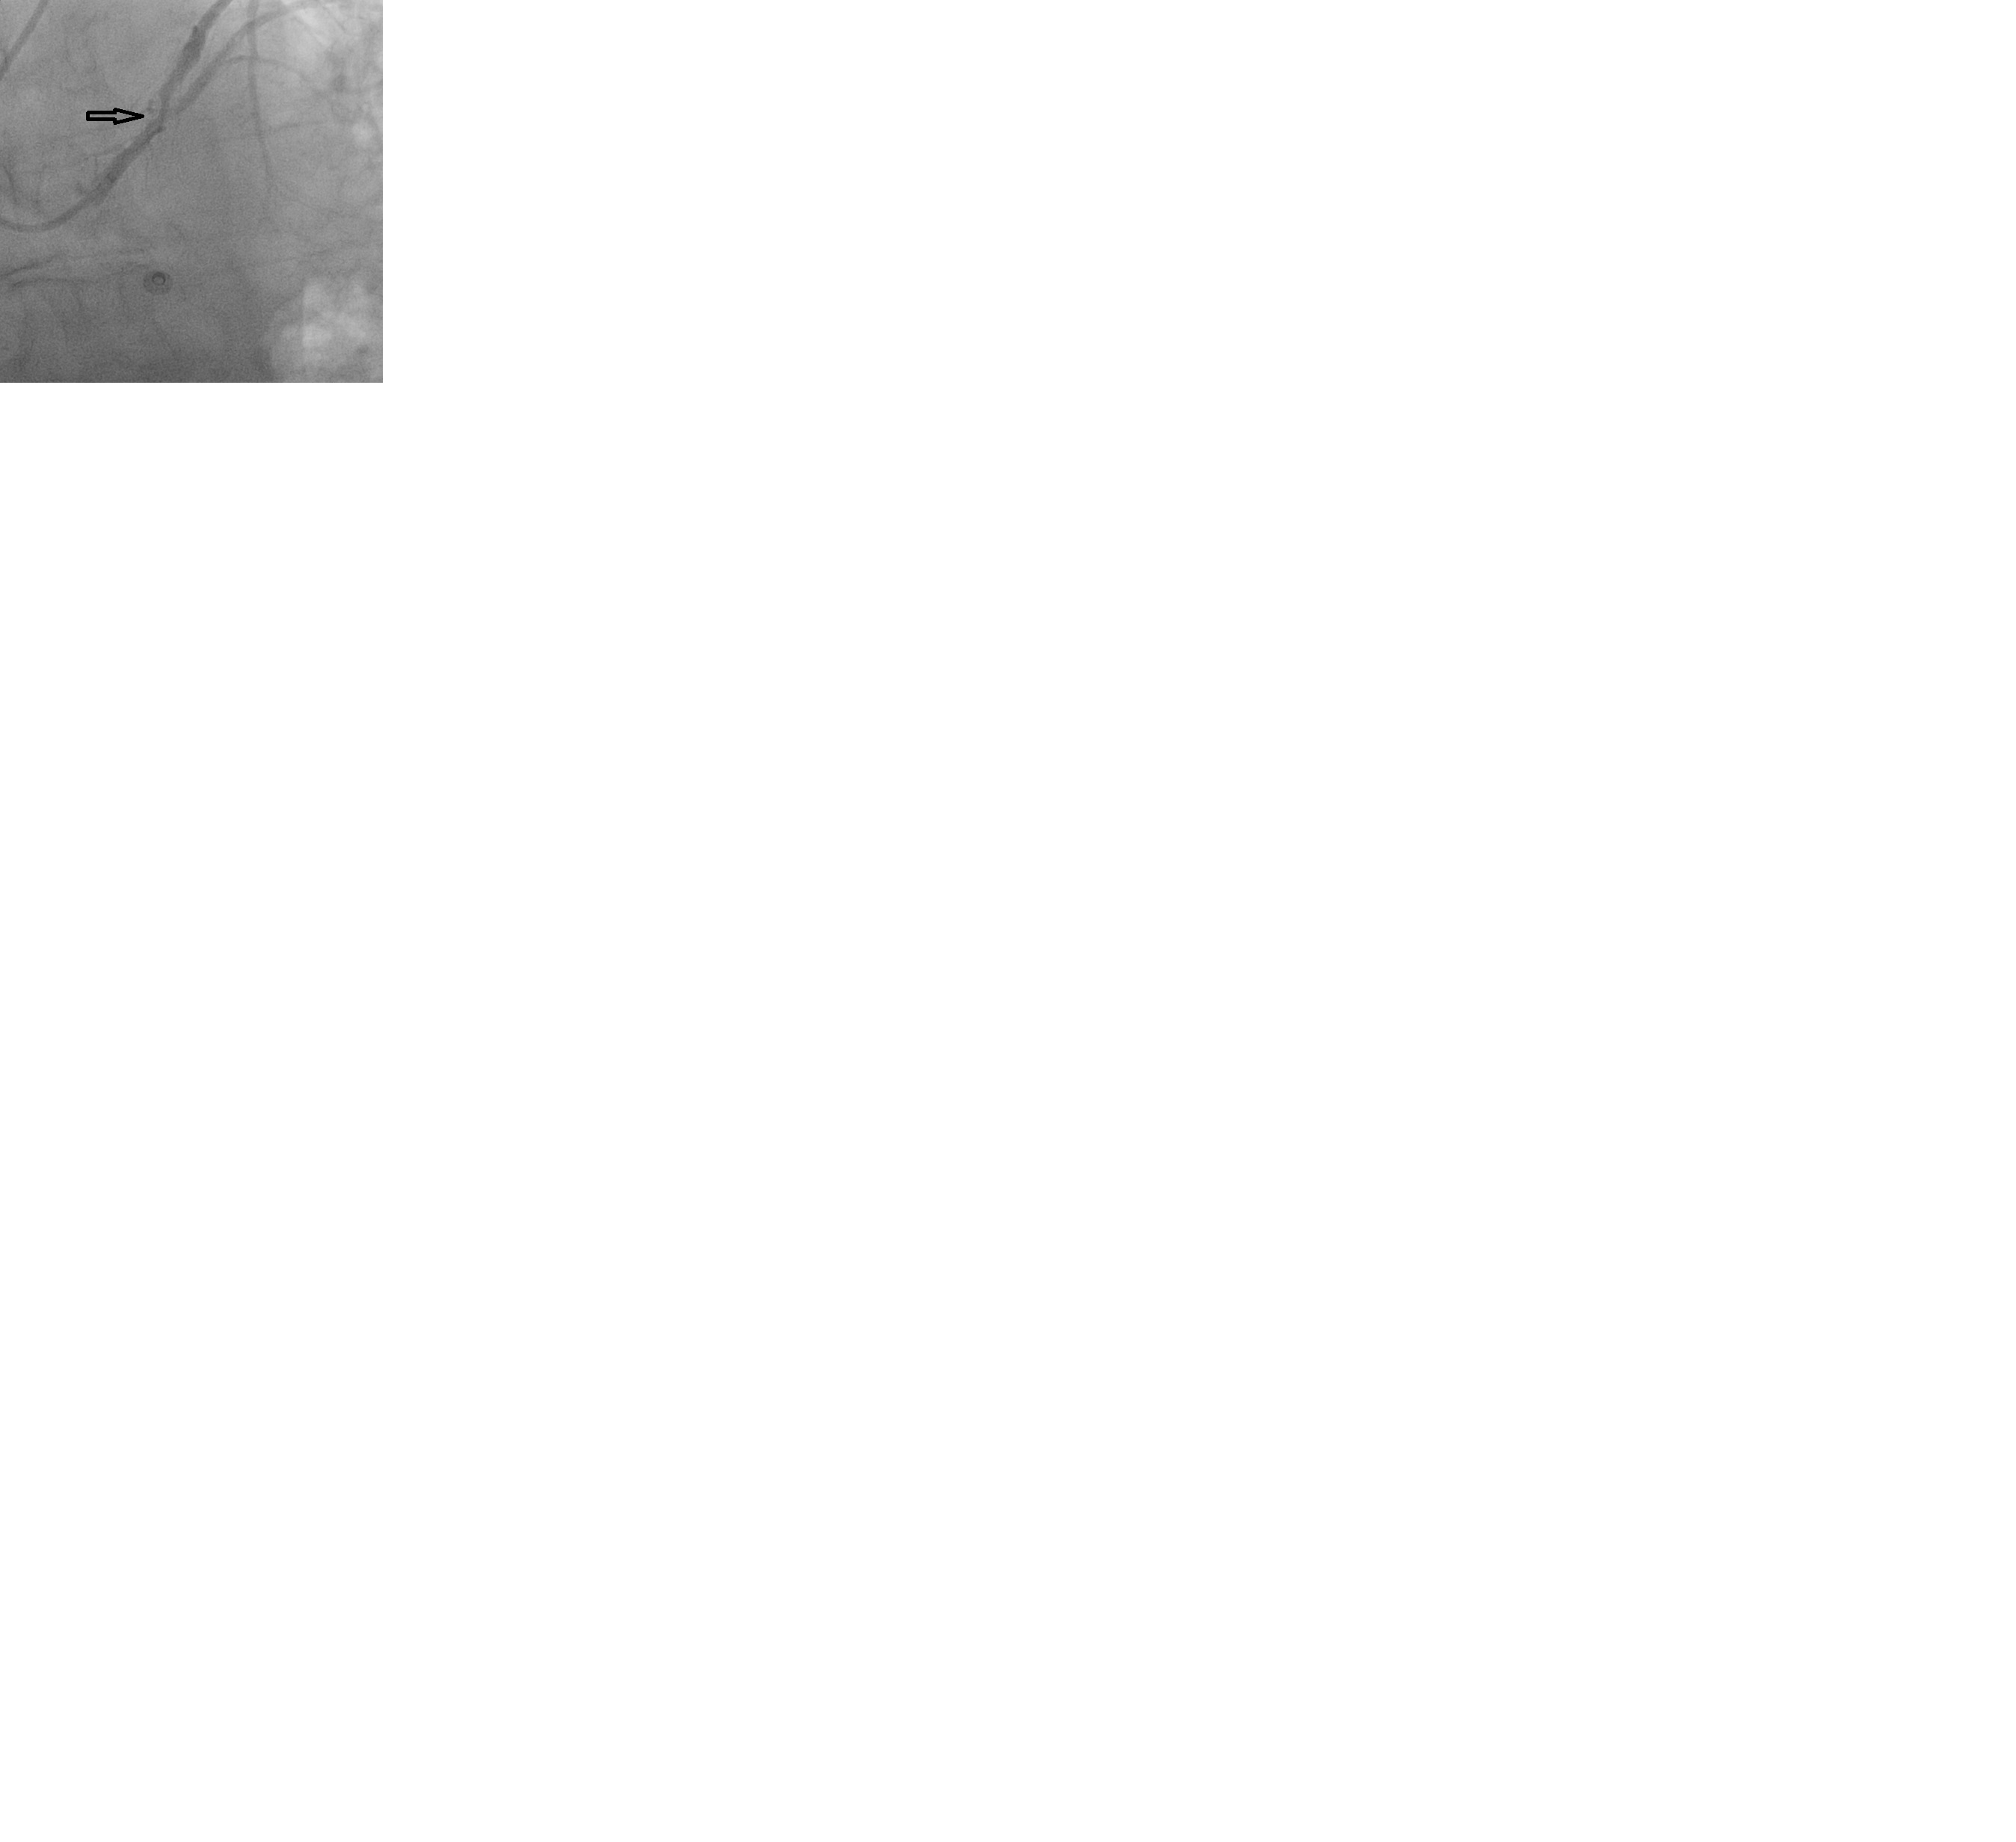
Re-stenosis

Slide 21
Προηγούμενο Ιστορικό
Νόσος του Behcet. Σε ανασοκατασταλτικά και στεροειδή.
Προηγούμενα PCI στα στεφανιαία.
Πολλαπλές ενδαγγειακές θεραπείες στις αρτηρίες των κάτω άκρων.
Επιπλεγμένη αντιμετώπιση κήλης κοιλιακού τοιχώματος.
Σοβαρά αυξημένο ΒΜΙ.
Διαβήτης

Slide 22
Επεισόδια ασταθούς στηθάγχης, κόπωσης και δυσκολίας στην αναπνοή.
Στεφανιογραφία έδειξε σοβαρή στένωση πρόσθιου κατιόντα κλάδου και διαγωνίου. Διαδερμική αντιμετώπιση της στεφανιαίας νόσου κρίθηκε αδύνατη.
Echo (ΤΤΕ, ΤΟΕ) έδειξε σοβαρή ανεπάρκεια αορτικής βαλβίδας. Μειωμένο κλάσμα εξώθησης και διάταση αριστερής κοιλίας (γύρω στα 45%)

Slide 23
Spectrum of cardiac lesions in Behçet disease: a series of 52 patients and review of the literature. Geri G et al
Medicine (Baltimore). 2012 Jan;91(1):25-34. doi: 10.1097/MD.0b013e3182428f49.
Abstract
Cardiac abnormalities in patients with Behçet disease (BD) include pericarditis, myocarditis, endocarditis with valvular regurgitation, intracardiac thrombosis, endomyocardial fibrosis, coronary arteritis with or without myocardial infarction, and aneurysms of the coronary arteries or sinus of Valsalva. Data regarding the clinical spectrum, prevalence, and outcome of cardiac lesions in BD are lacking. In this study, we report the main characteristics, treatment, and long-term outcomes of 52 patients with cardiac lesions from a cohort of 807 (6%) BD patients. Forty-five (86.5%) patients were male, with a mean (±SD) age at BD diagnosis of 29.3 ± 10.3 years.Cardiac involvement was the first feature of BD in 17 (32.7%) patients. Cardiac lesions included pericarditis (n = 20; 38.5%), endocarditis (mostly aortic insufficiency) (n = 14; 26.9%), intracardiac thrombosis (n = 10; 19.2%), myocardial infarction (n = 9; 17.3%), endomyocardial fibrosis (n = 4; 7.7%) and myocardial aneurysm (n = 1; 1.9%). Patients with cardiac involvement were more frequently male (86.5% vs. 64.9%; p < 0.01) and had more arterial (42.3% vs. 11.1%; p < 0.01) and venous lesions (59.6% vs. 35.8%; p < 0.01) compared to those without cardiac manifestations. Factors associated with complete remission of cardiac involvement were treatment regimens with oral anticoagulants, immunosuppressants, and colchicine. The 5-year survival rate was 83.6% and 95.8% (p = 0.03) in BD patients with and without cardiac involvement, respectively. After a median (Q1-Q3) follow-up of 3.0 (1.75-4.2) years, 8 patients had died, in 3 cases directly related to cardiac involvement.In conclusion, cardiac lesions affected 6% of our large cohort of BD patients. The prognosis of cardiac involvement in BD is poor and improves with oral anticoagulation, immunosuppressive therapy, and colchicine.

Slide 24
Korean J Intern Med. 2002 Mar;17(1):51-6.
Aortic valve involvement in Behçet's disease. A clinical study of 9 patients.
Lee C et al
Abstract
OBJECTIVES:
To assess the clinical features, pathologic findings, postoperative results and the effects of immunosuppressive therapy in patients with Behçet's disease (BD).
METHODS:
We reviewed the postoperative course of the 9 BD patients who underwent a total of 17 aortic valve replacement procedures with prosthetic valves.
RESULTS:
Histological examination of the aortic valve commonly revealed diffuse myxoid degeneration (75 percent). Of 17 valve replacement surgeries, 13 surgeries resulted in complications, such as detachment of the prosthetic valve with perivalvular leakage and dehiscence of the sternotomy wound, within an average of 5 months (range from 1 month to 14 months). The rate of prosthetic valve detachment was 76 percent (13 of 17 surgeries). Four of the 9 patients (44 percent) who underwent aortic valve replacement procedures died of heart failure or infection associated with the detachment of the prosthetic valve, and perivalvular leakage within an average of 9 months. Aortic insufficiency associated with dehiscence of the prosthetic valve developed in 11 of 12 surgical cases (92 percent) with a mechanical valve and 2 of 5 surgical cases (40 percent) with tissue valves. Thirteen of 15 surgeries (87 percent) which were not given postoperative immunosuppressive therapy developed complications, while none of 2 surgeries that used postoperative immunosuppressive therapy with prednisolone (1 mg/kg/day) and azathioprine (100 mg/day) had these complications.
CONCLUSION:
The rates of prosthetic valve detachment in BD involving aortic valve were higher than those of other diseases. Aortic valve involvement was also one of the poor prognostic factors in BD. Intensive postoperative immunosuppressive therapy and surgical methods may be important factors for postoperative results.

Slide 25
Αντικατάσταση αορτικής βαλβίδας σε νόσο του Behcet
Συχνά καταλήγει σε αποκόλληση του αορτικού μοσχεύματος που είναι επιπλοκή υψηλού κινδύνου για την ζωή του ασθενή
Διάφορες χειρουργικές στρατηγικές έχουν προταθεί για να μειωθεί η συχνότητα αυτής της επιπλοκής, η αποτελεσματικότητα των οποίων δεν είναι σίγουρη (μικρά νούμερα ασθενών στις μελέτες της βιβλιογραφίας)

Slide 26
Χειρουργική επέμβαση-επείγουσα
(7/9/16)
αντικατάσταση αορτικής βαλβίδας (Medronic Mosaic 21 mm biological) μετά από κάλυψη του αορτικού δακτυλίου με κυκλοτερή ταινία αυτόλογου περικαρδίου για προστασία ενάντια σε μελλοντική αποκόλληση του μοσχεύματος
αορτο-στεφανιαία παράκαμψη Χ 2 (αριστερή έσω μαστική αρτηρία στον πρόσθιο κατιόντα κλάδο, φλεβικό μοσχεύμα στον πρώτο διαγώνιο κλαδο).

Slide 27
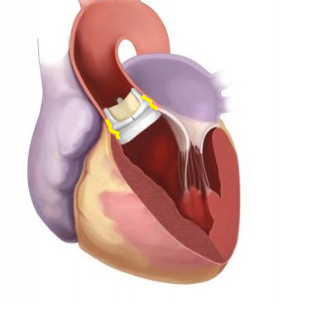
Με κίτρινο είναι η κυκλοτερής επένδυση του αορτικού δακτυλίου με περικάρδιο

Slide 28
Problem list
Adamantiades dis. for years (steroids/weight)
Repeated Iritis
Osteoporotic fractures
Popliteal Aneurysms 40 x 4cm graft / 2 stents
Ischaemic foot x 2
Colon cancer
Atrial fibrillation – anticoagulants - bleeding
Coronary disease – stents – stenosed
Aortic valve regurgitation
CABG and Aortic valve replacement

Slide 29
2 weeks ago calf pain

Slide 30
Angiogram
Leaking popliteal aneurysm and thrombus
Fistula between artery distal to stent and the (old by passed) aneurysm!

Slide 31
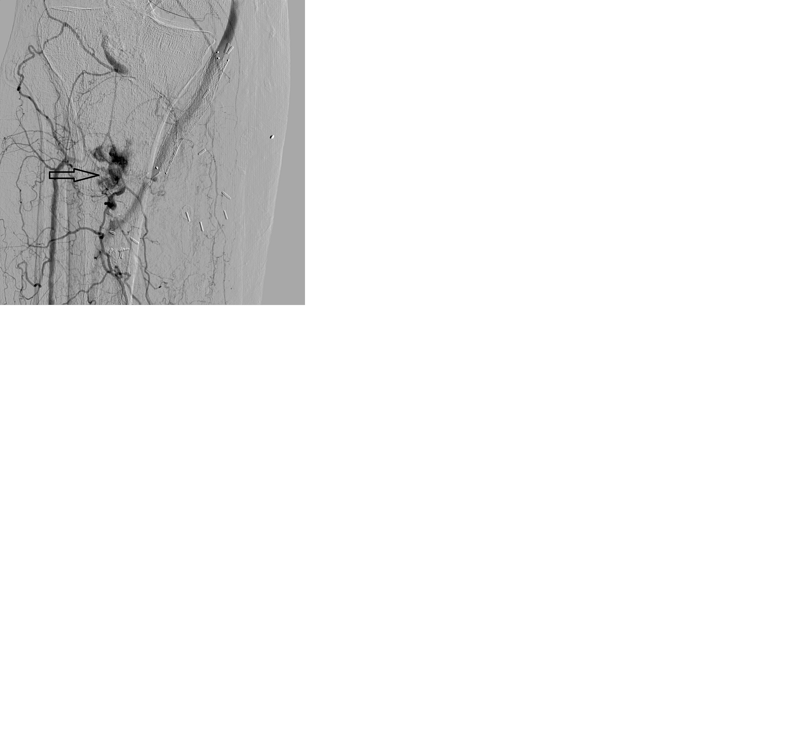

Slide 32
Treated by interventional radiologist

Slide 33
For now OK…

Slide 34
Lessons / questions
Vascular Adamantiades disease difficult
Aneurysms, thromboses, Endocarditis myocarditis pericarditis, M.I
Surgical sites / vessel anastomoses break down or become aneurysmal
Aggressive control of inflammation
This pt had years of ‘inflammation’ and nothing else… but he didn’t follow advice…
Cyclophos/ciclosporin/Azathioprine/steroids +
Now??

Slide 35
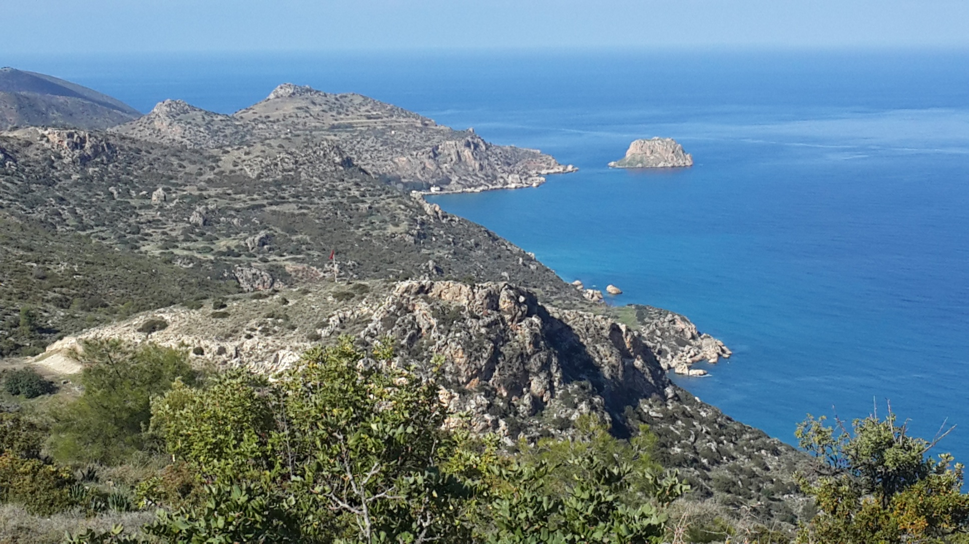

Slide 36
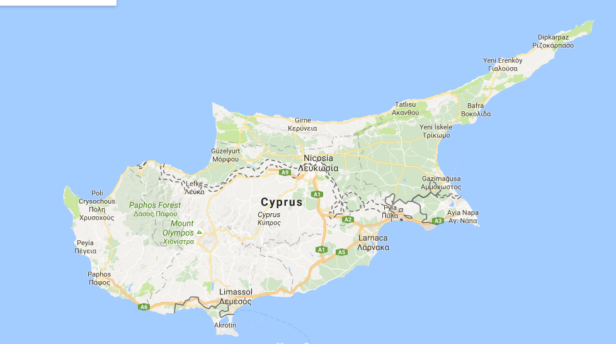

Slide 37
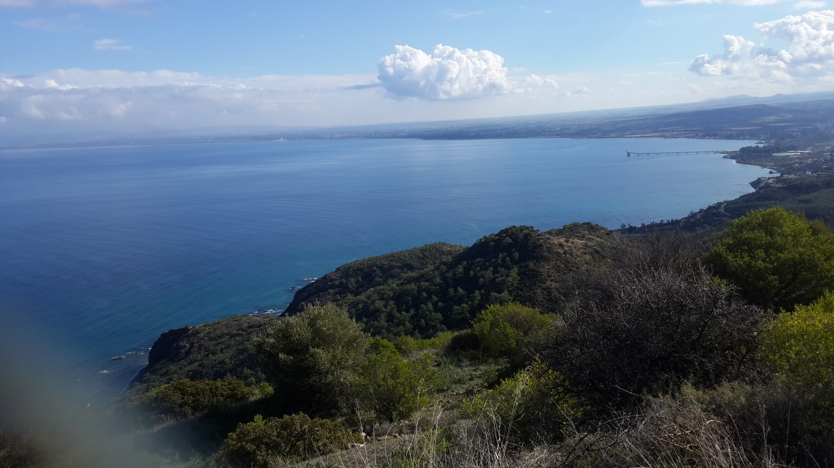

Slide 38
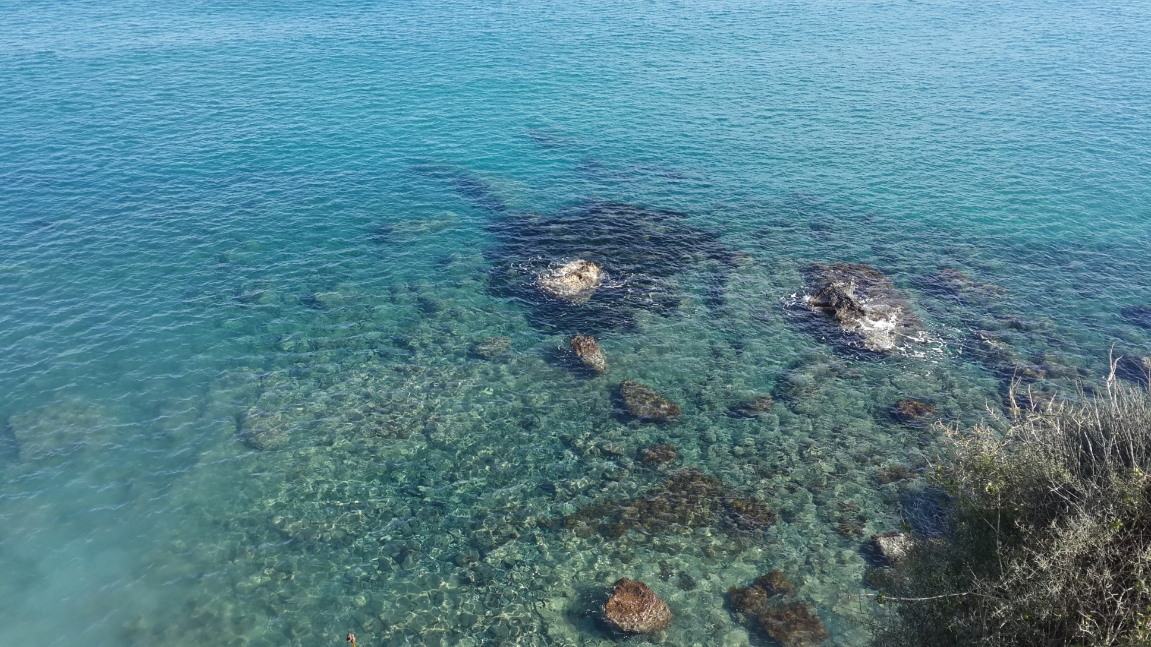

Slide 39
1st visit

Slide 40
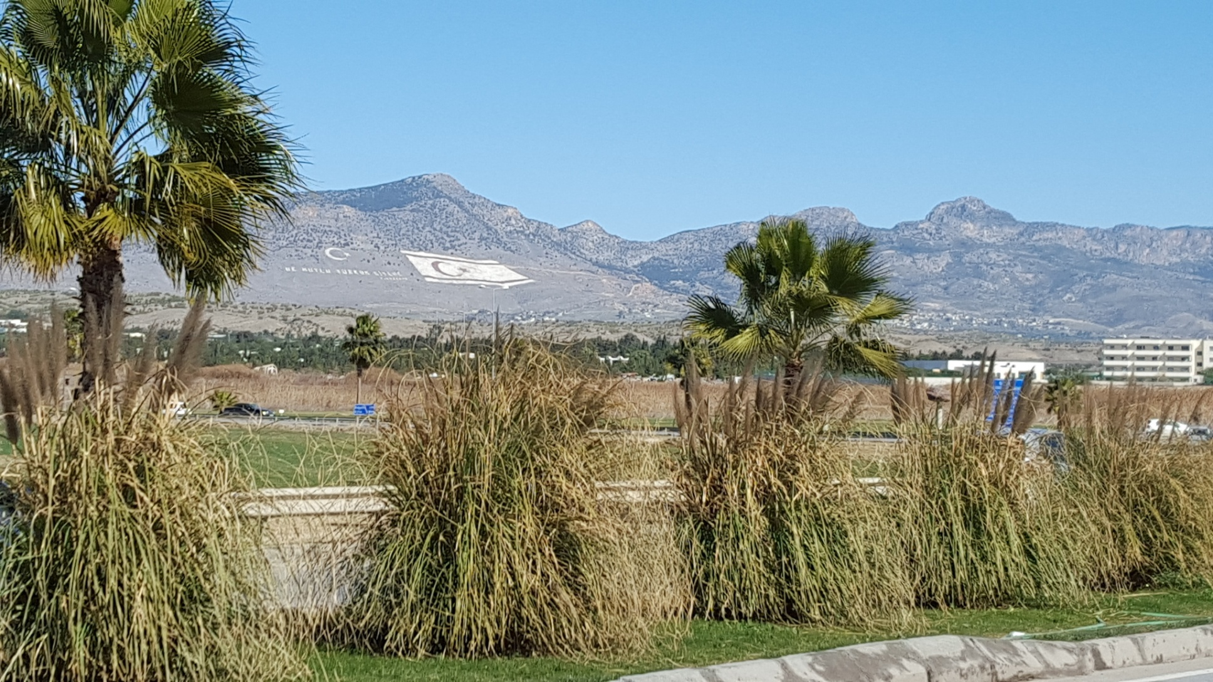

Slide 41
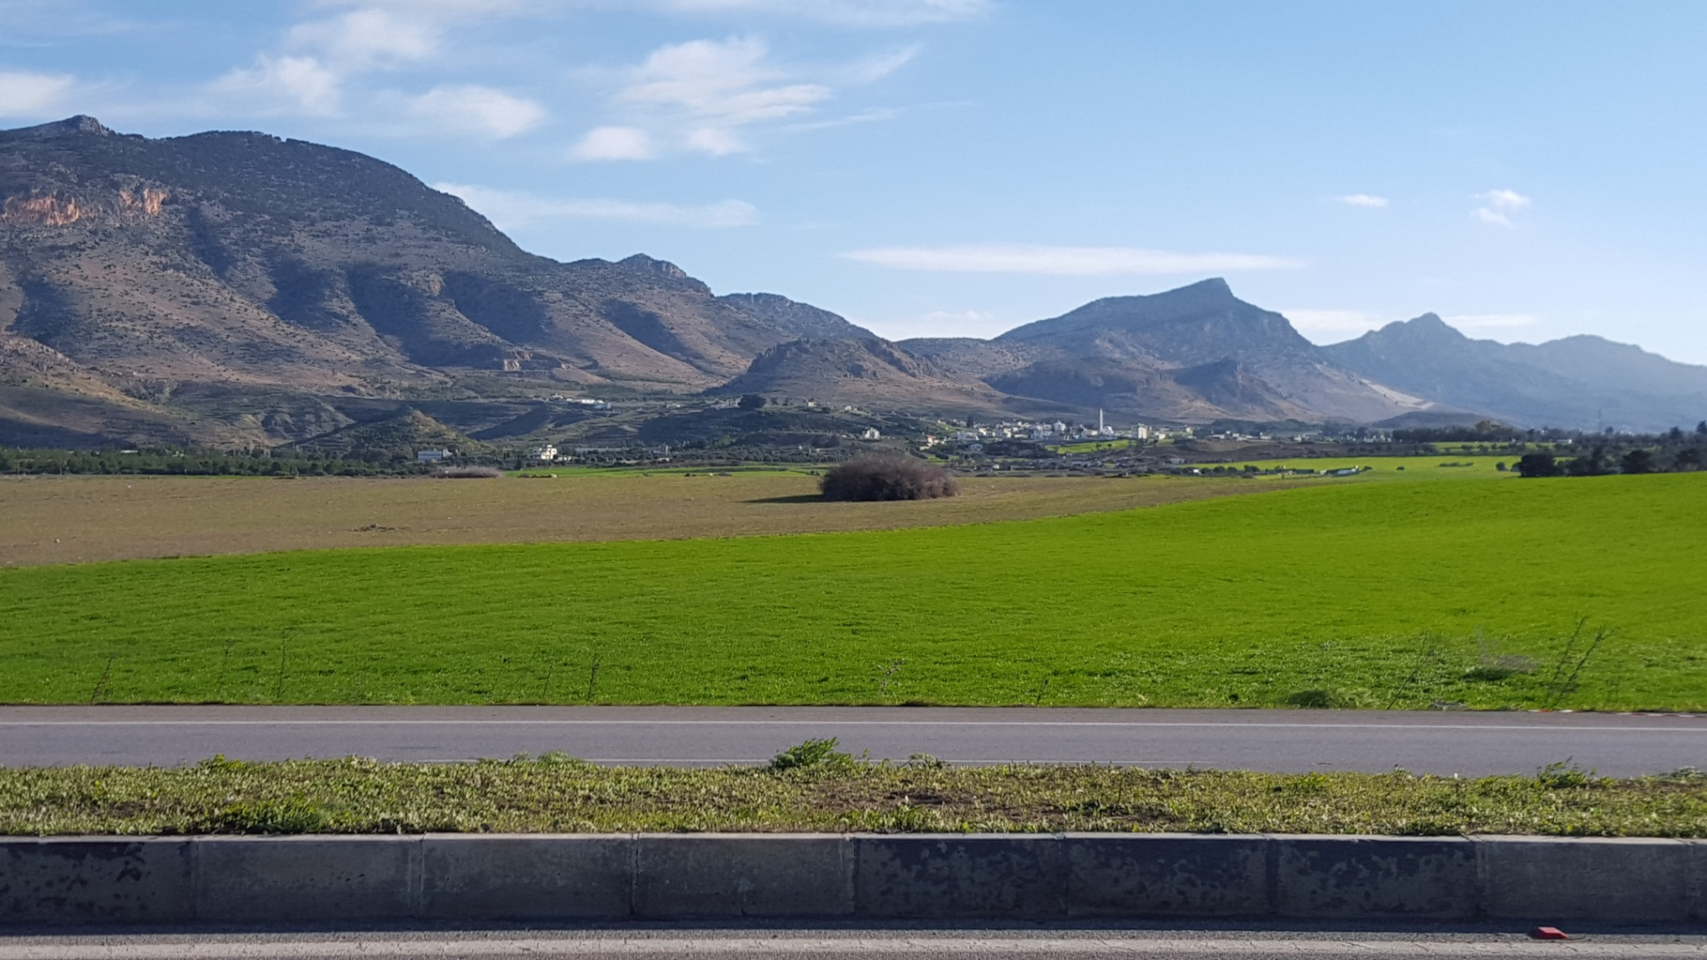

Slide 42
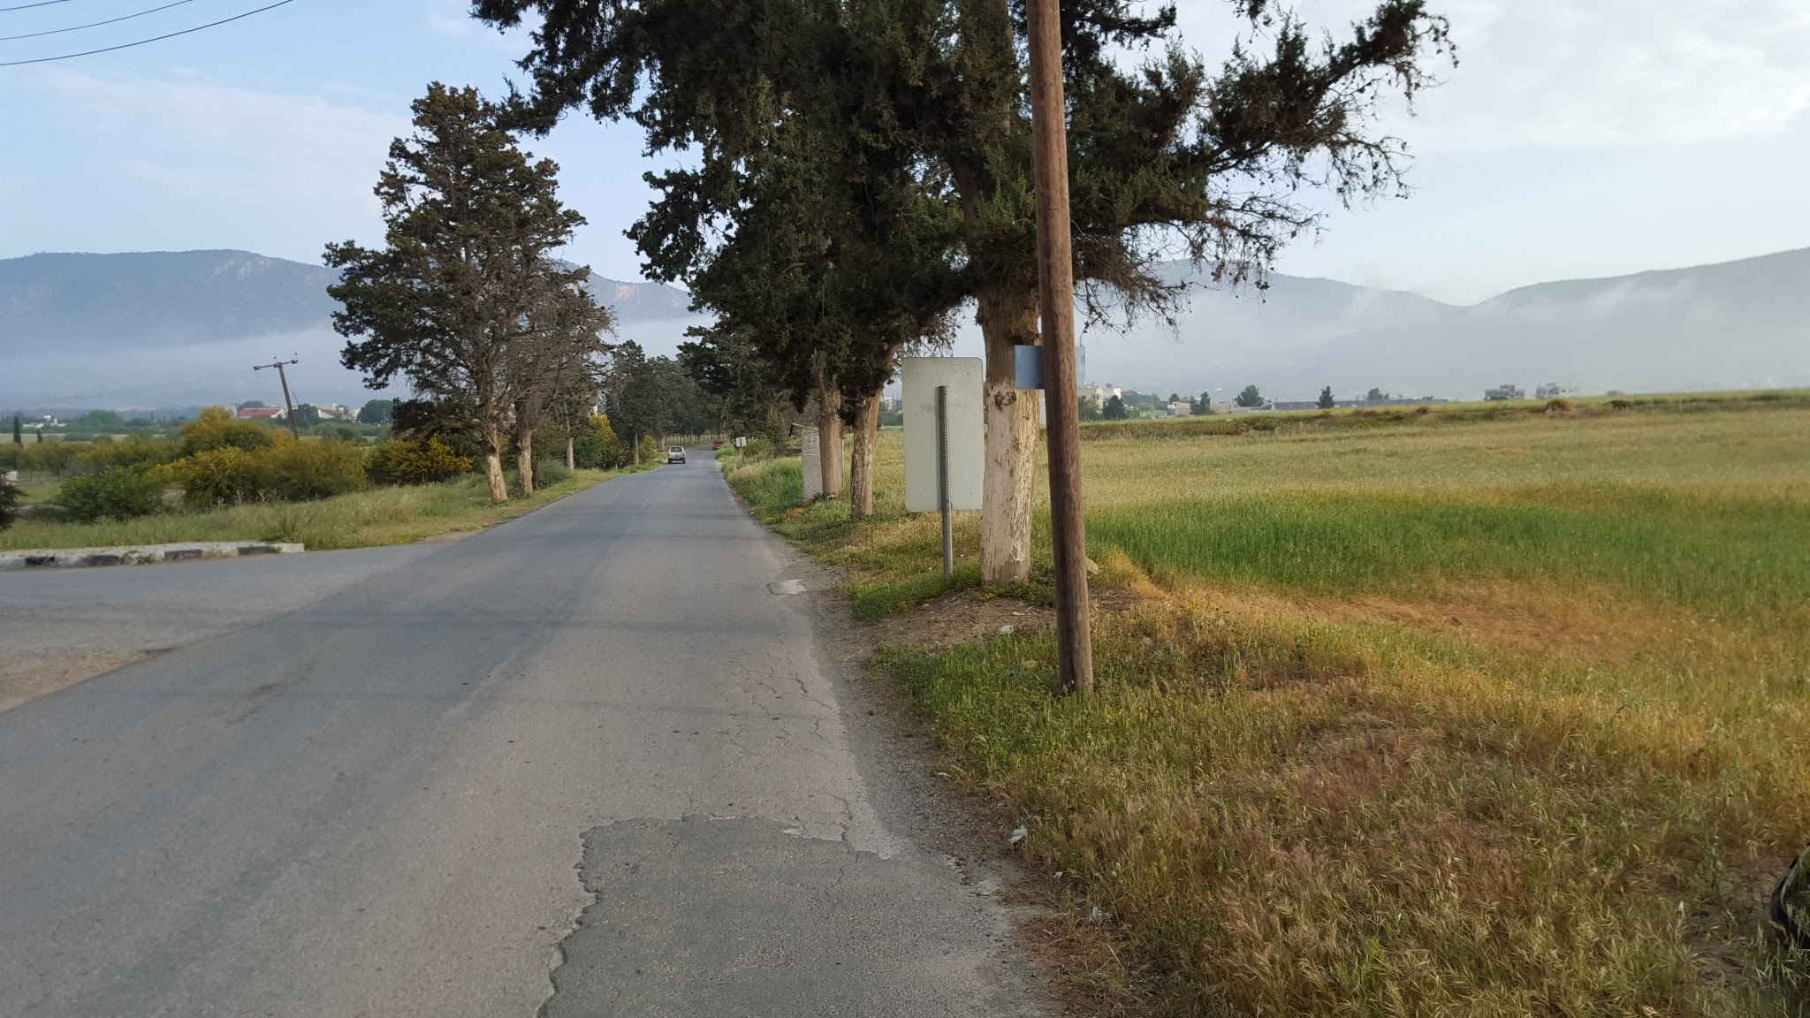

Slide 43
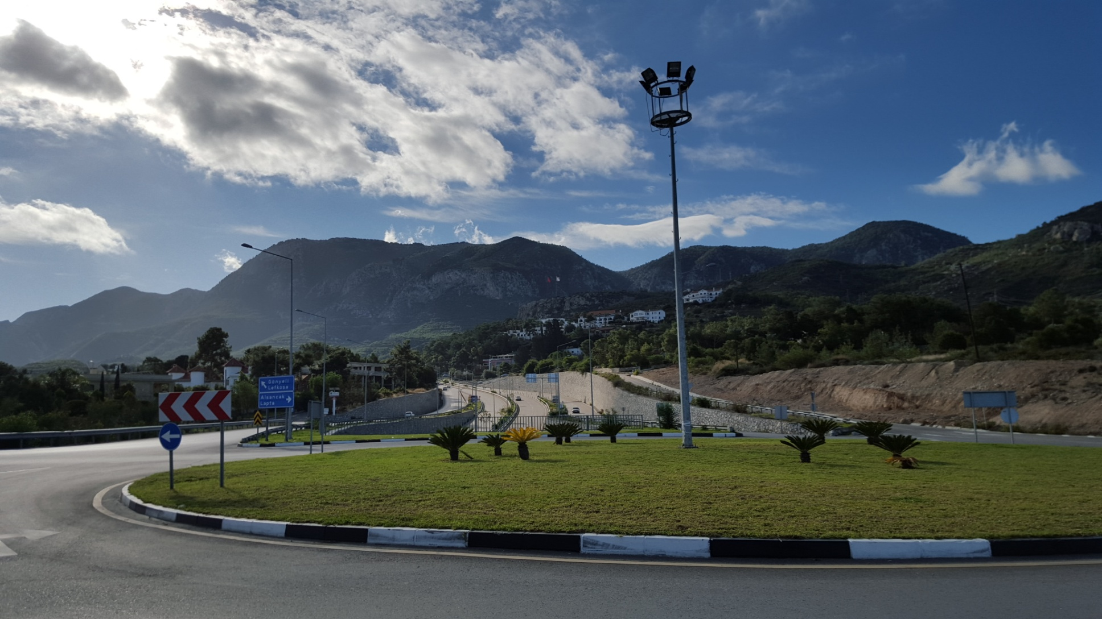

Slide 44
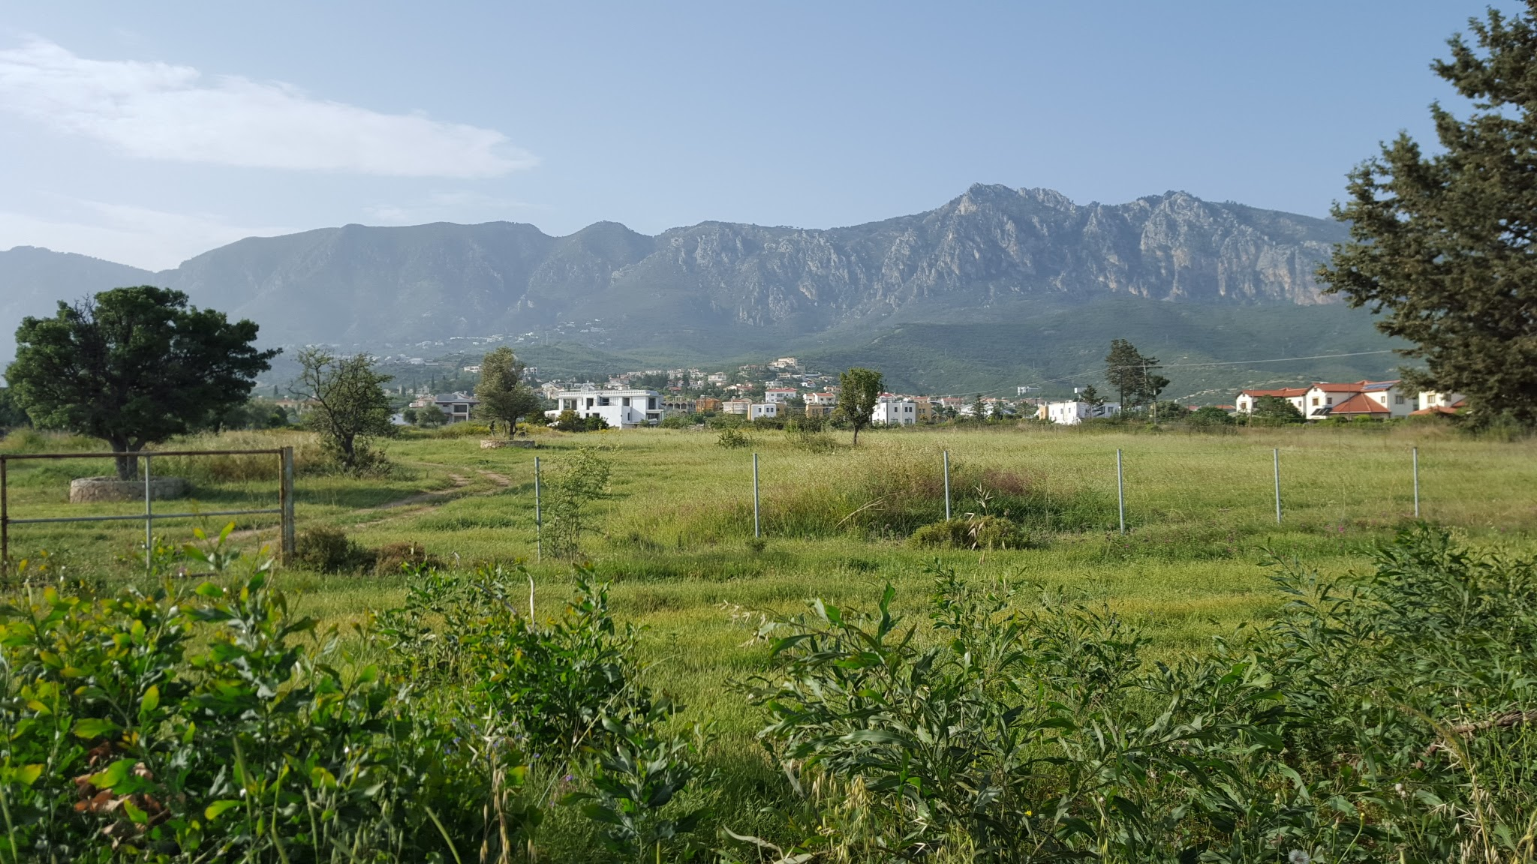

Slide 45
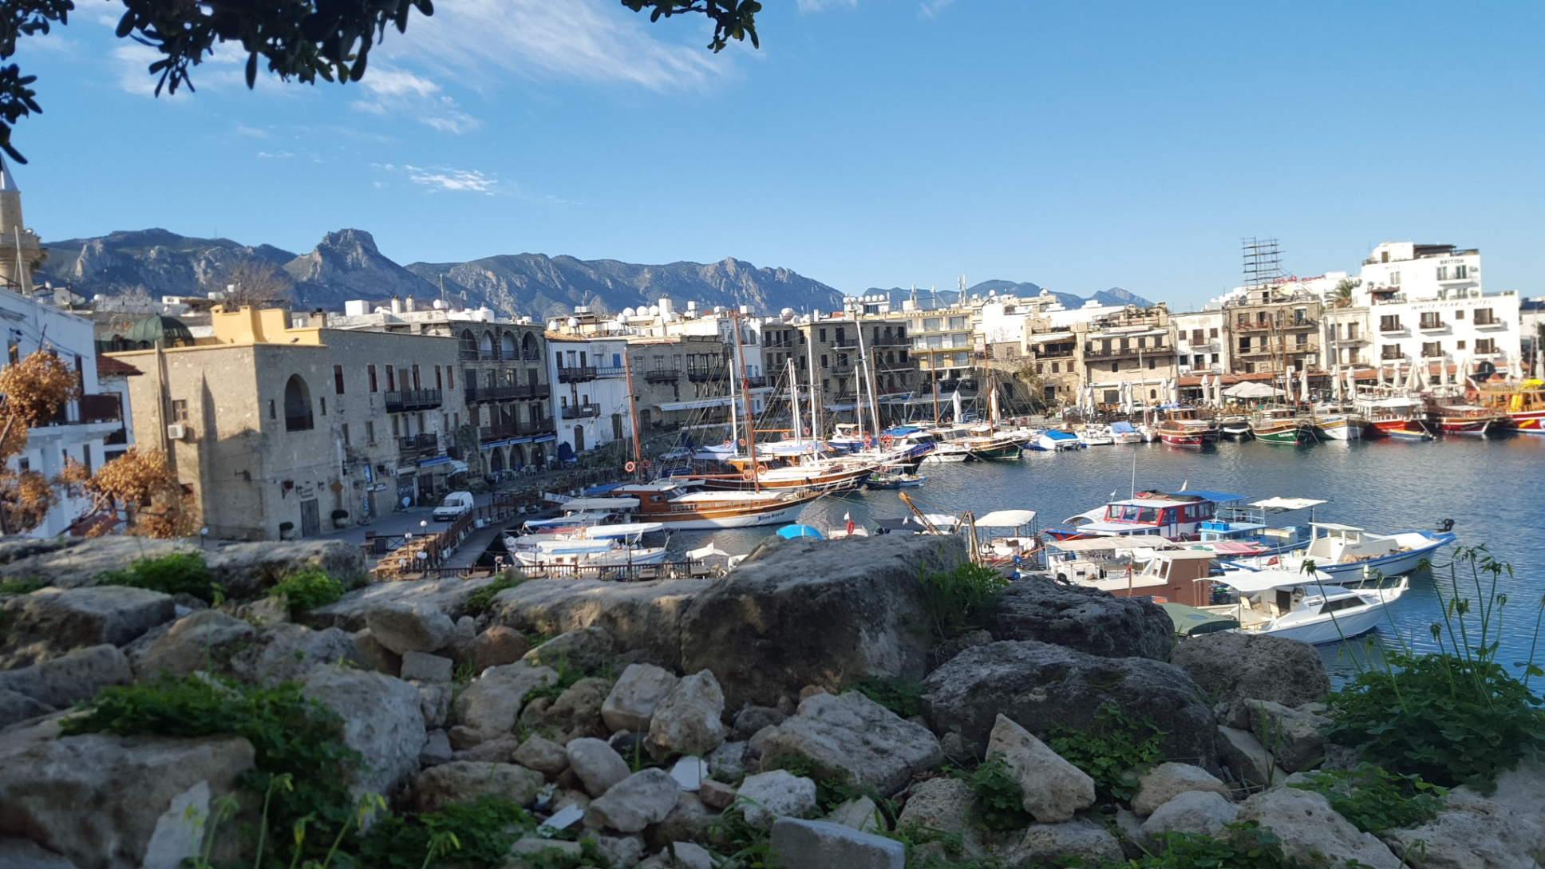

Slide 46
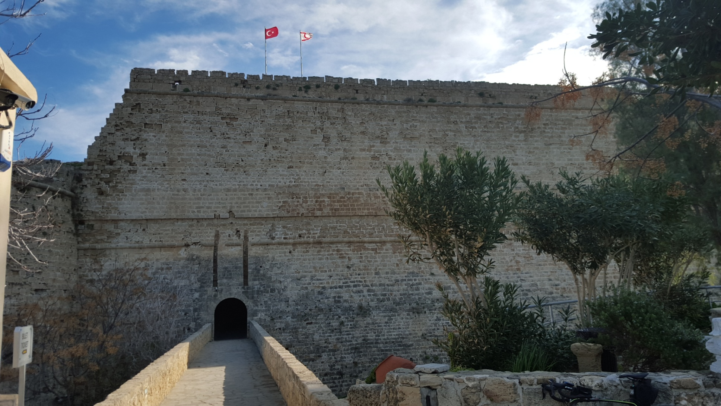

Slide 48
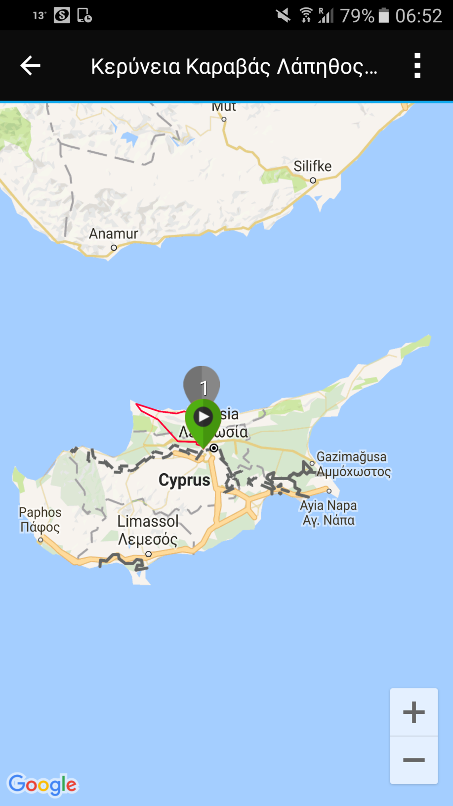

Slide 49
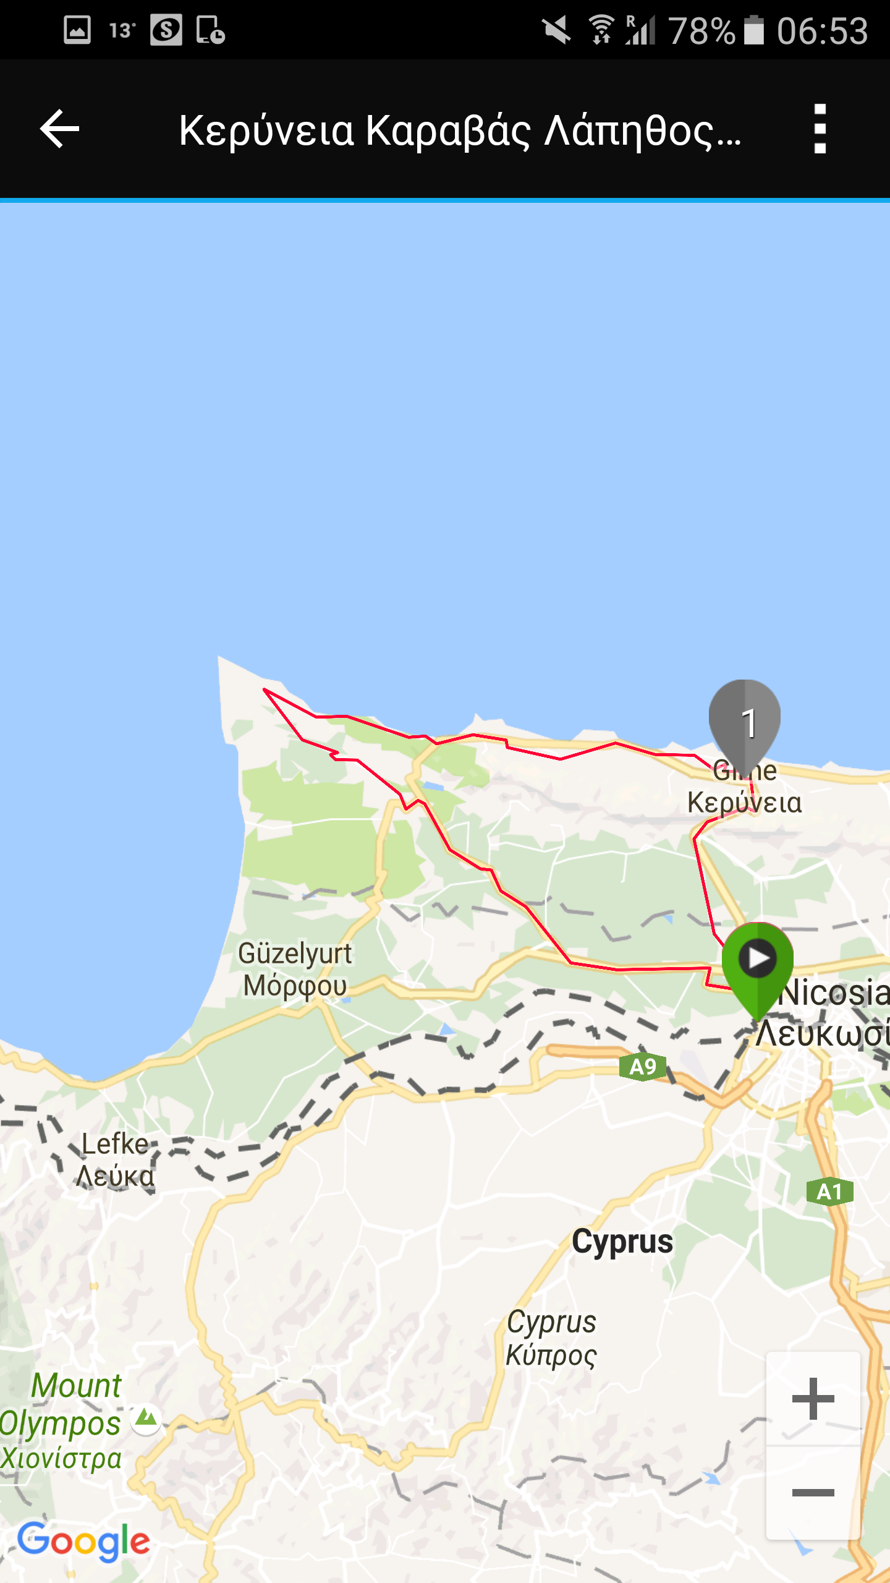

Slide 50
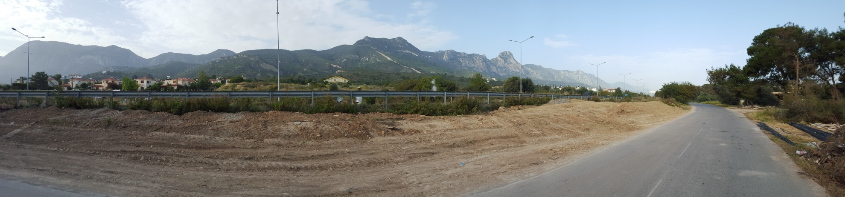

Slide 51
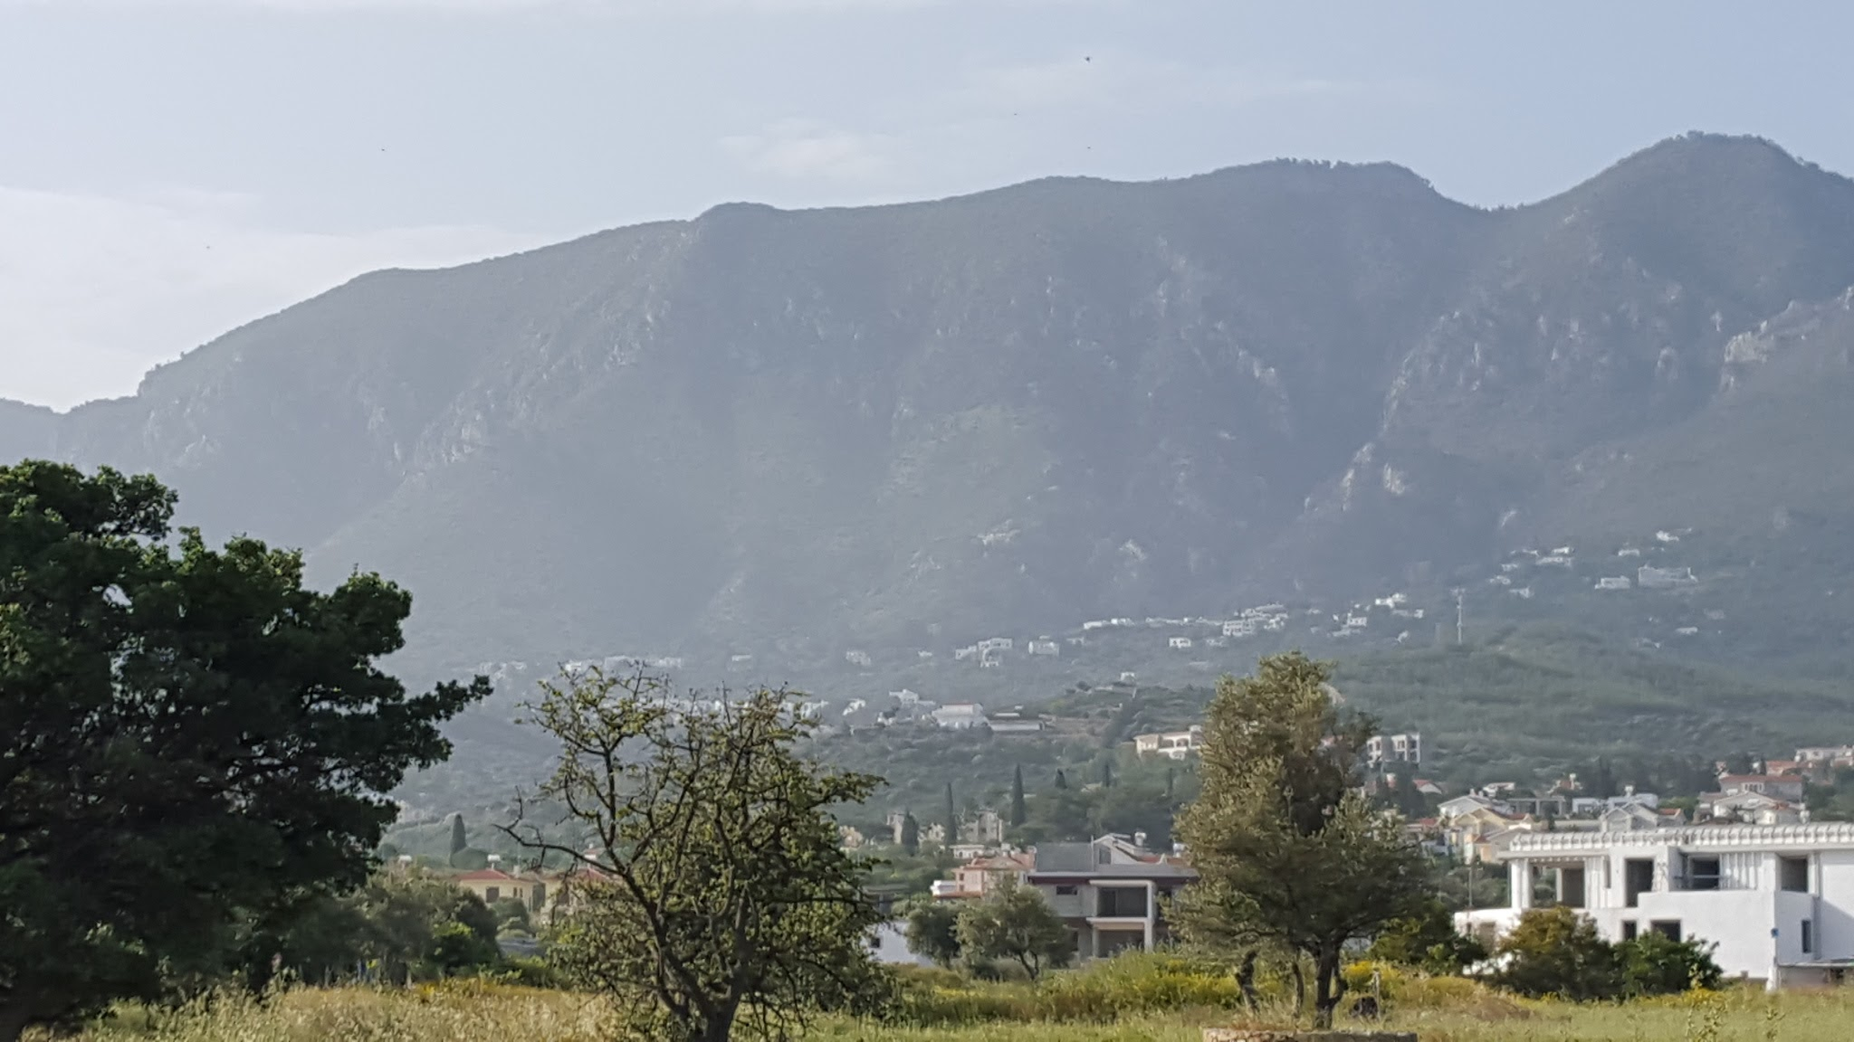

Slide 52
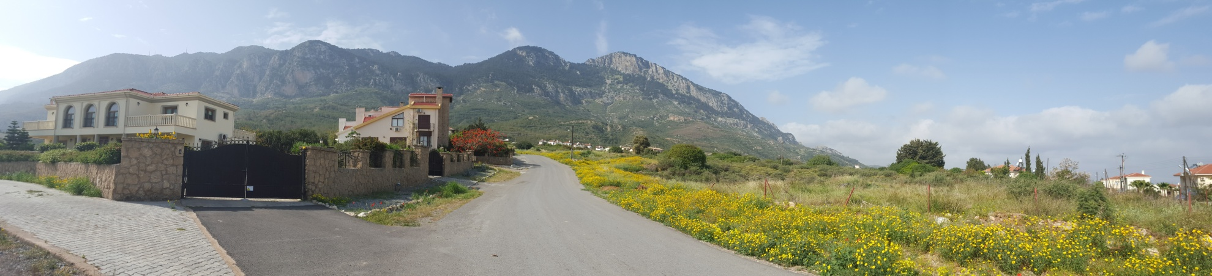

Slide 53
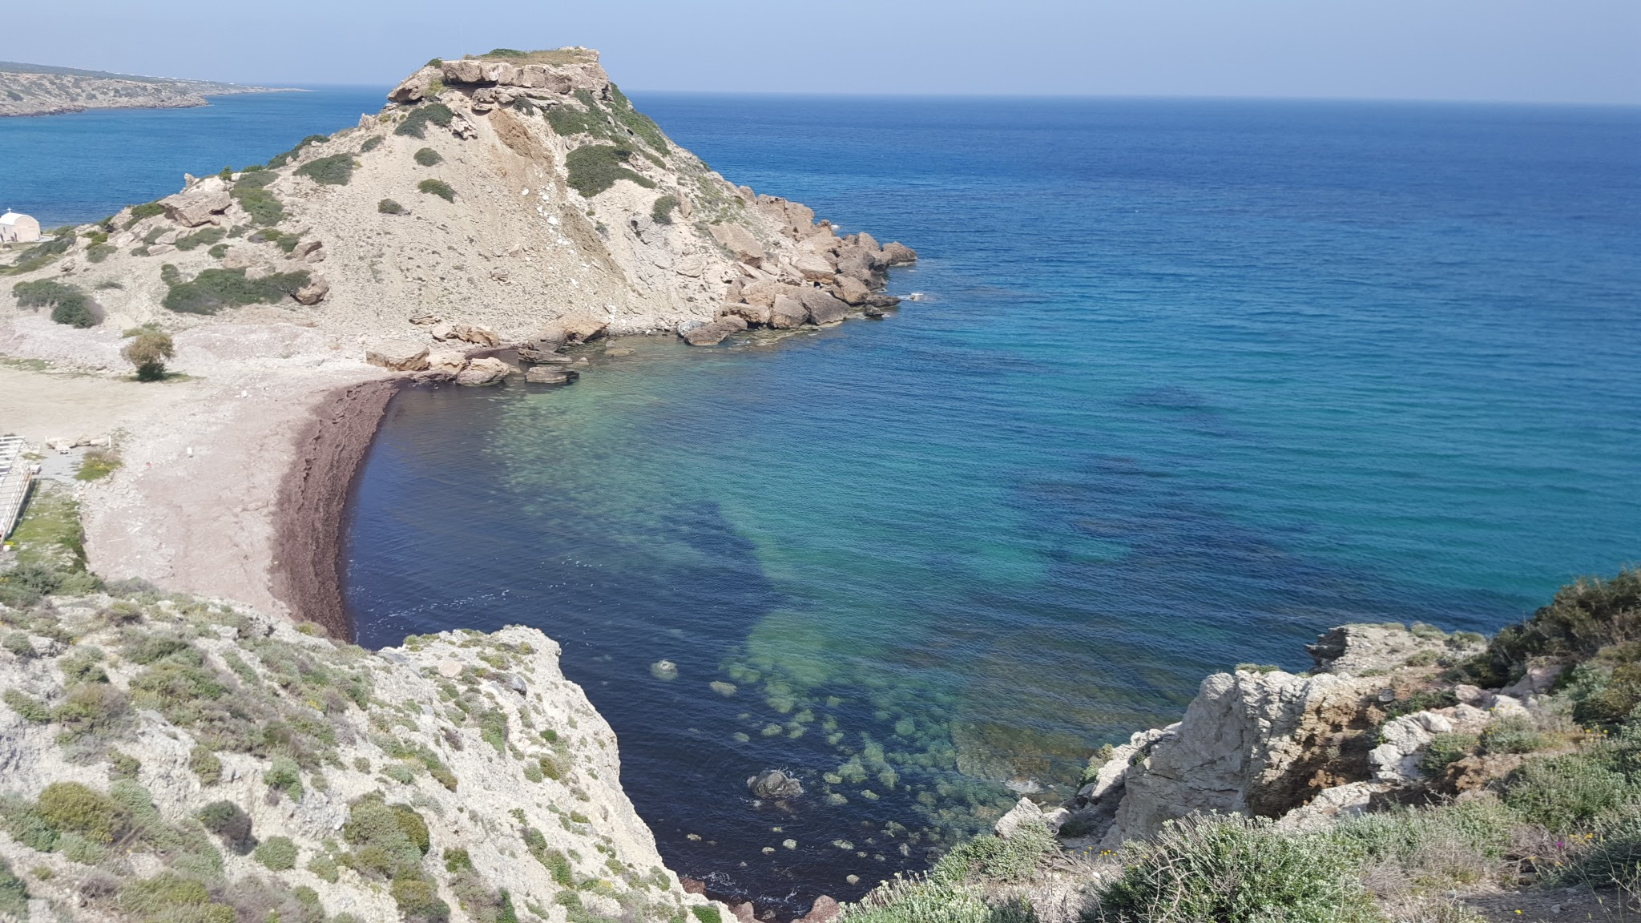

Slide 54
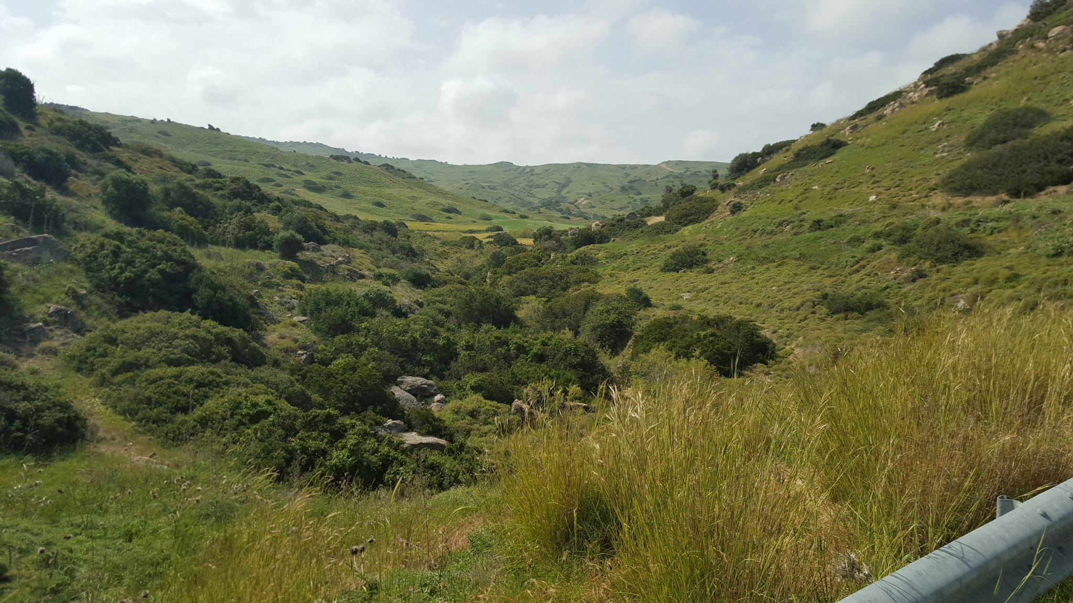

Slide 55
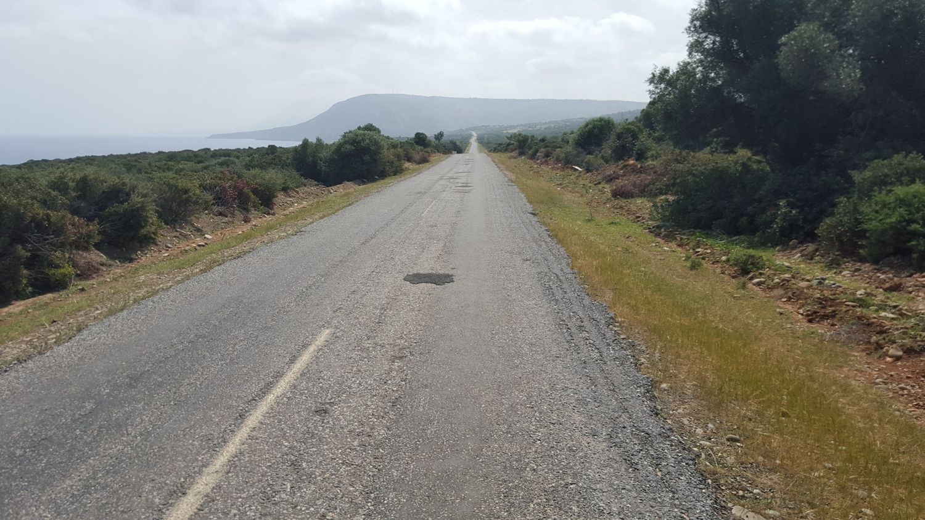

Slide 56
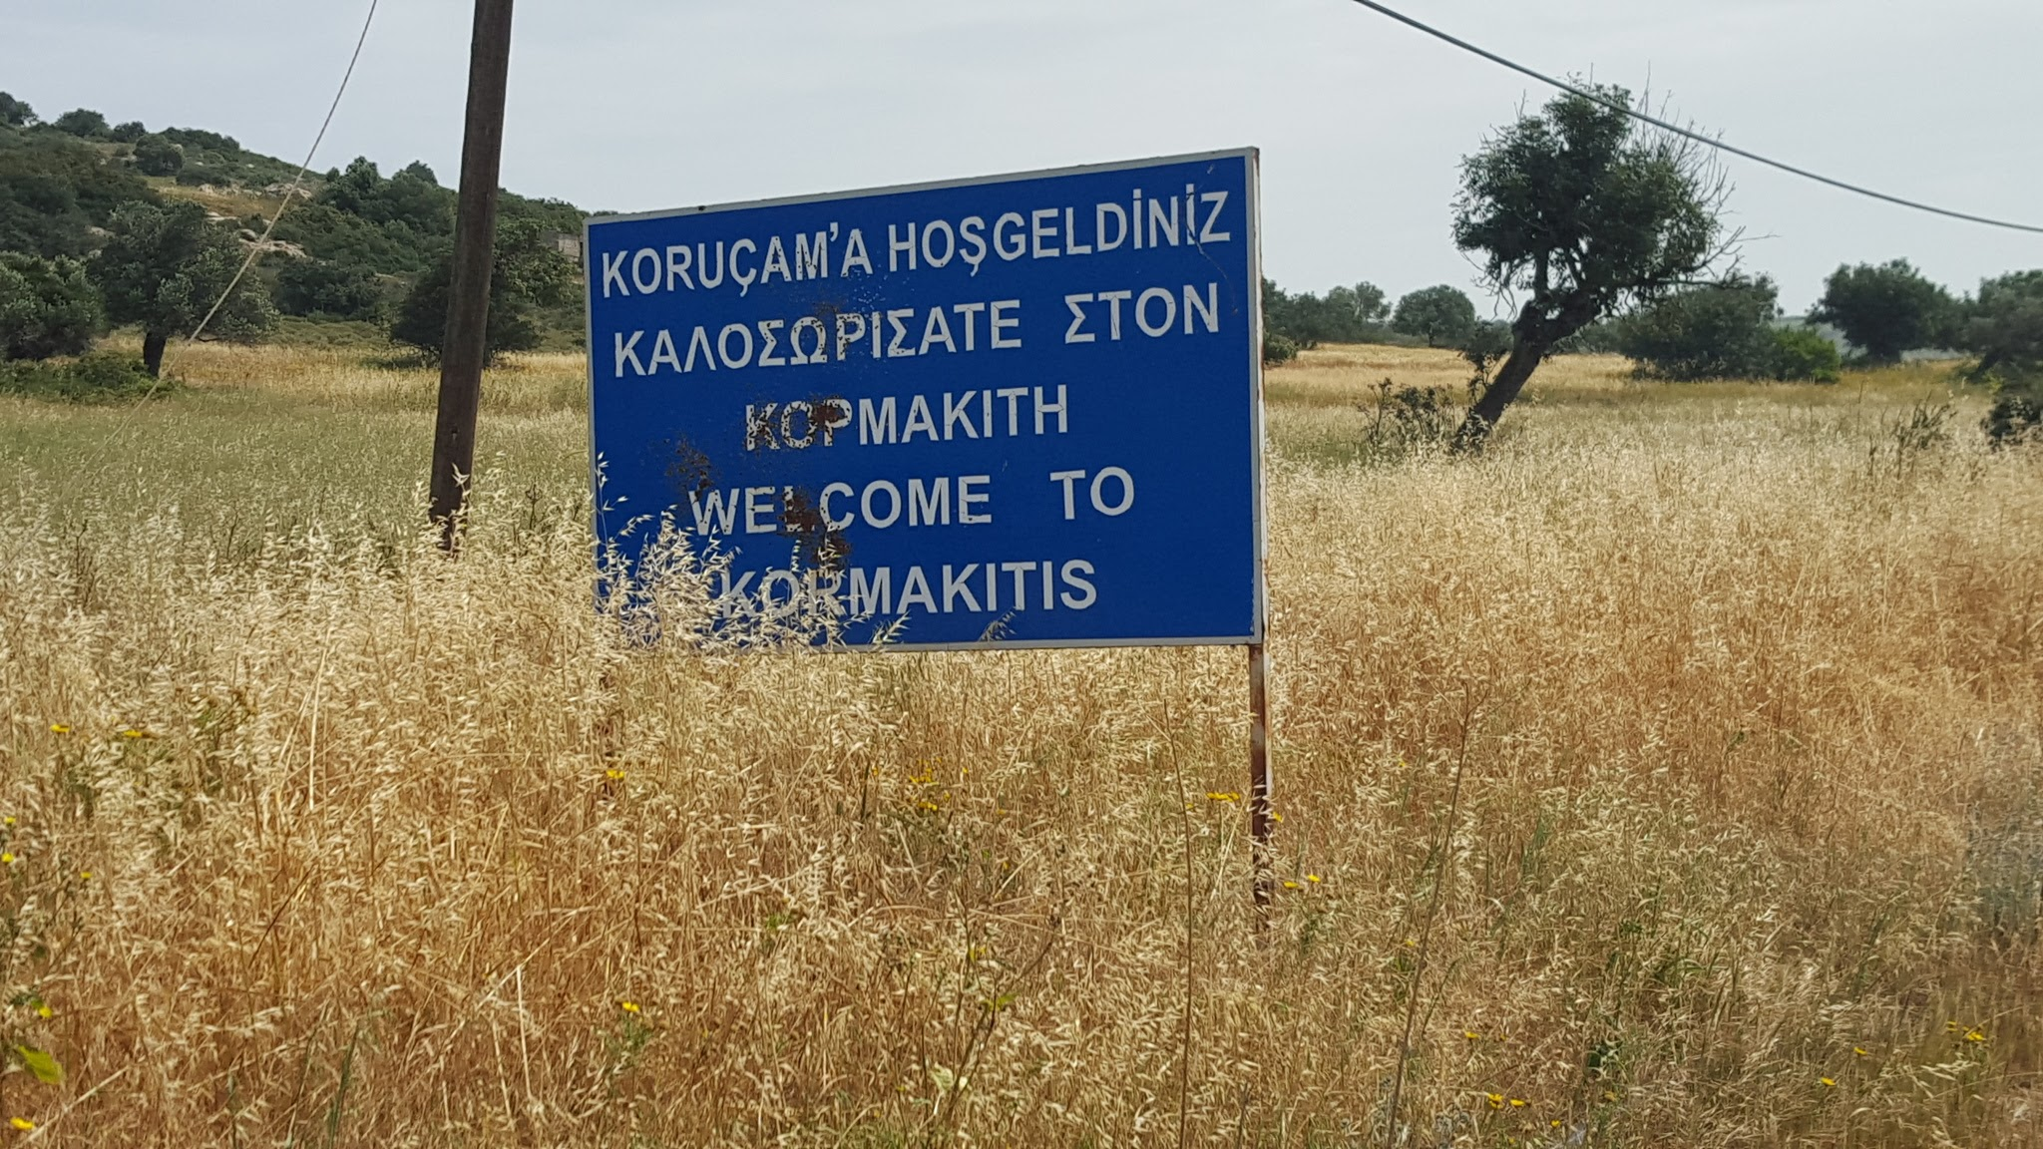

Slide 57
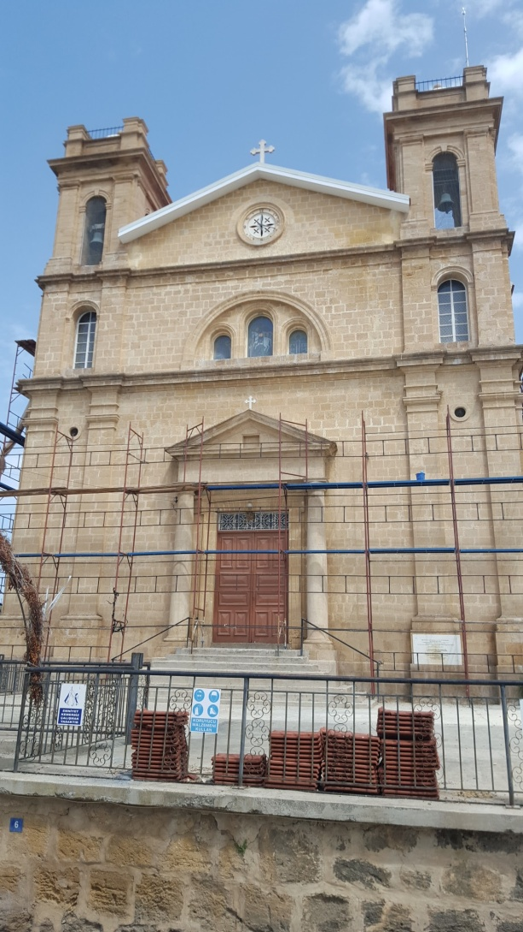

Slide 58
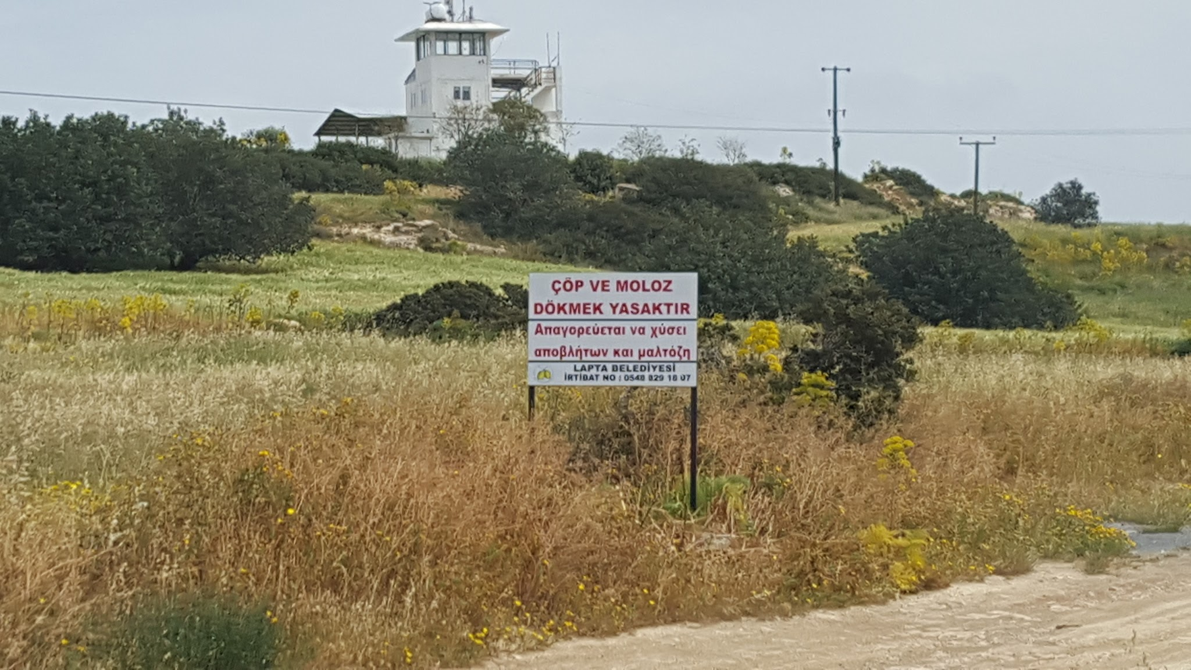

Slide 59
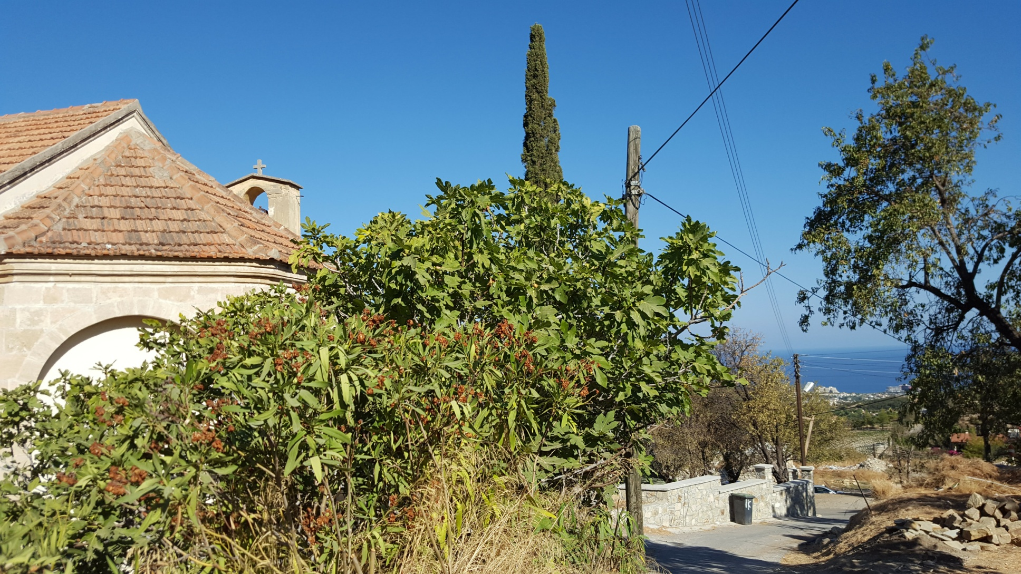

Slide 60
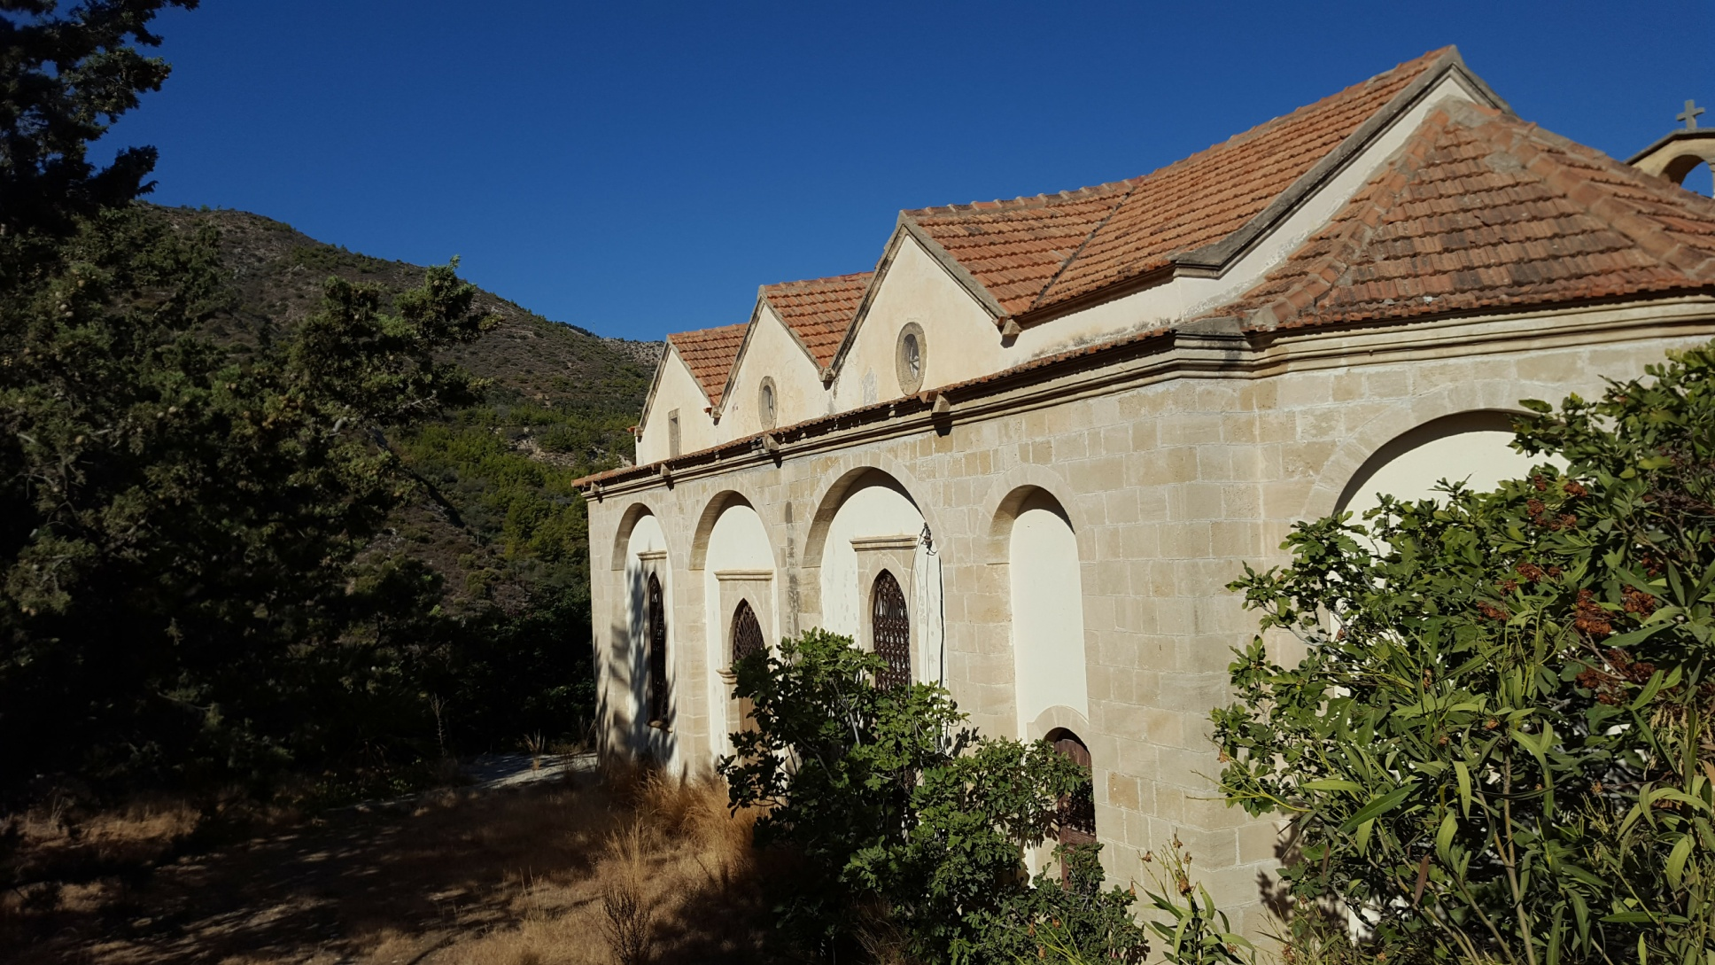

Slide 62
Dangerous without a telephone

Slide 63
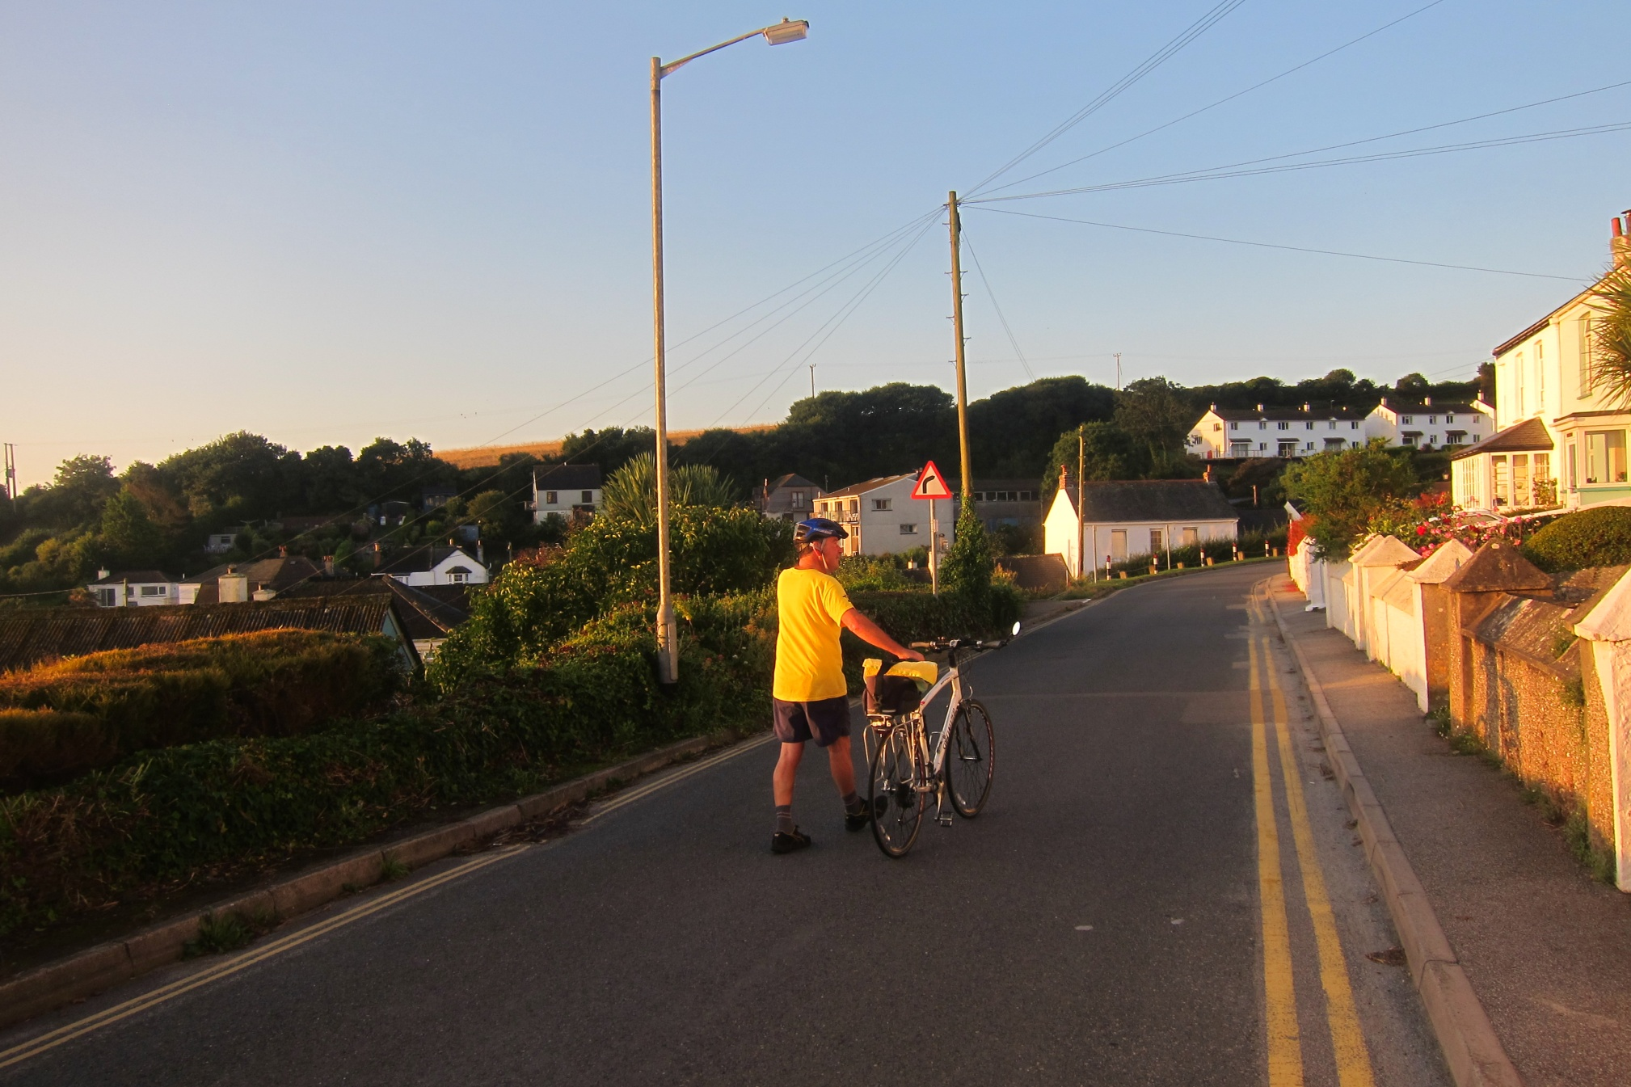

Slide 64
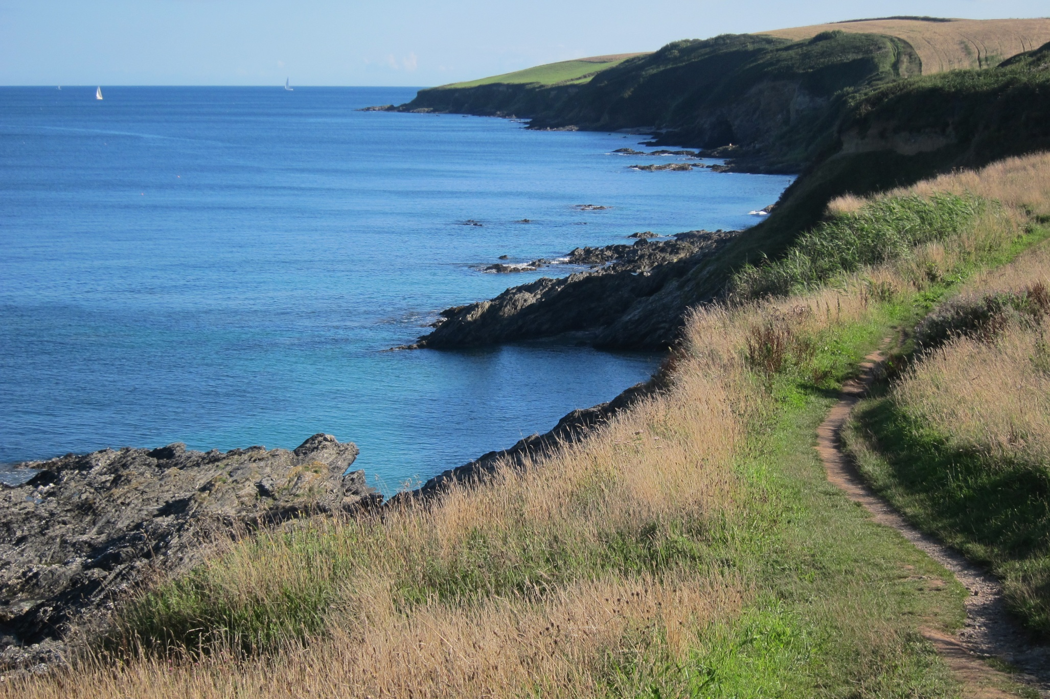

Slide 65
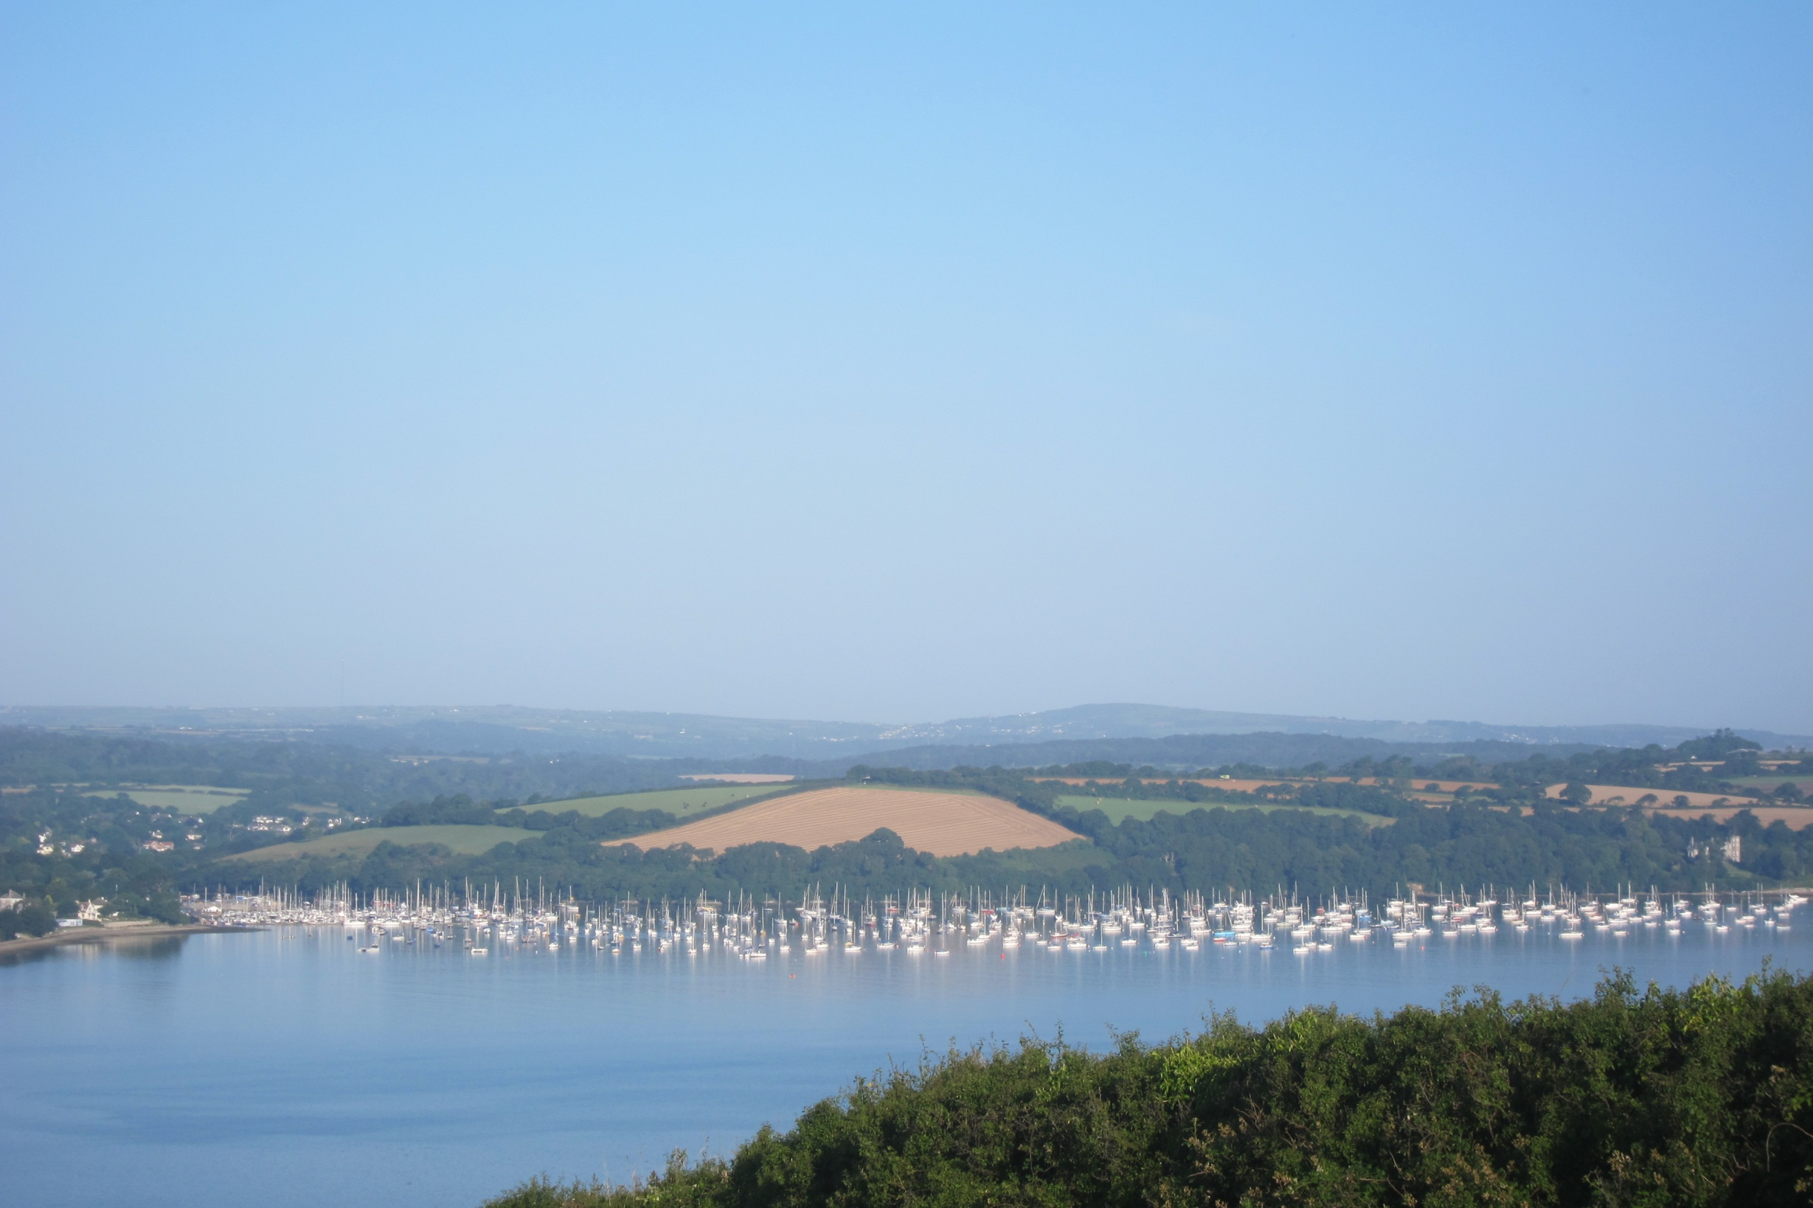

Slide 66
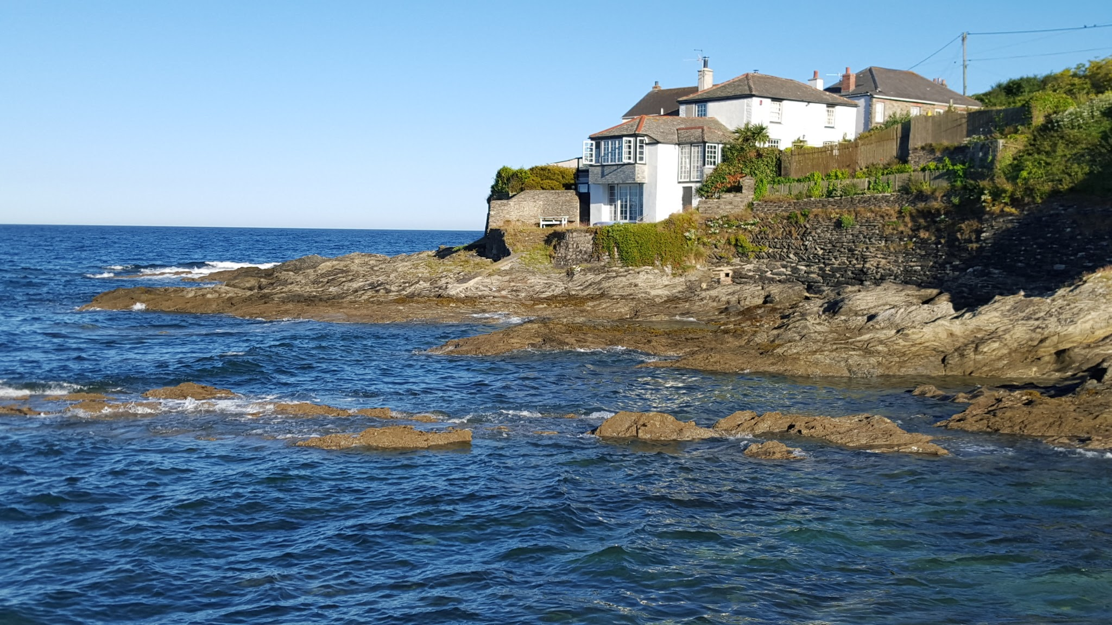

Slide 67
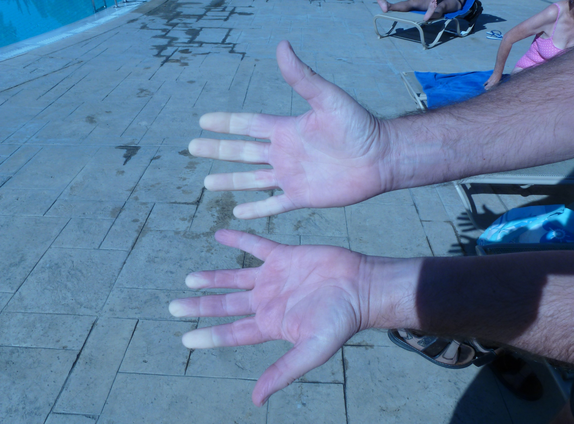

Slide 68
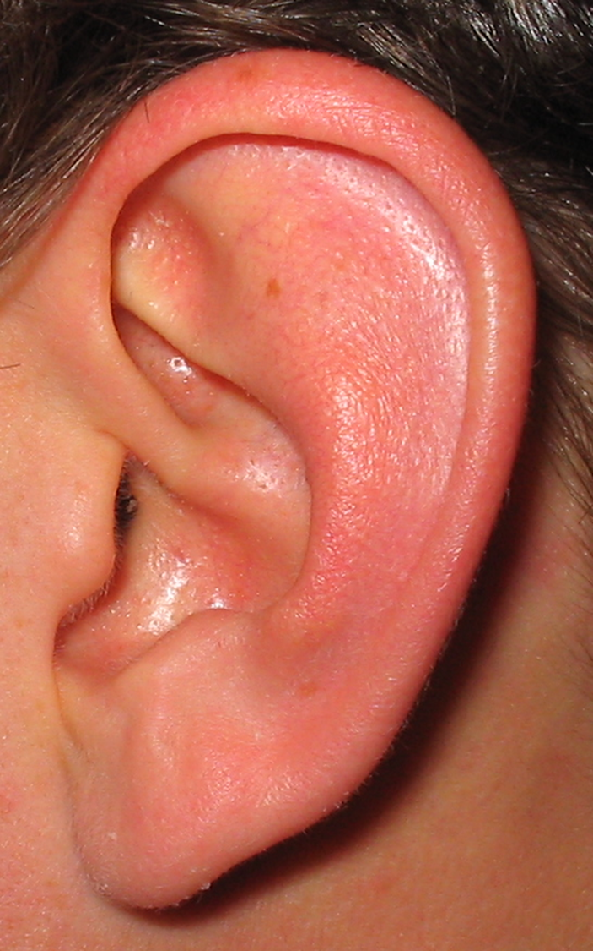

Slide 69
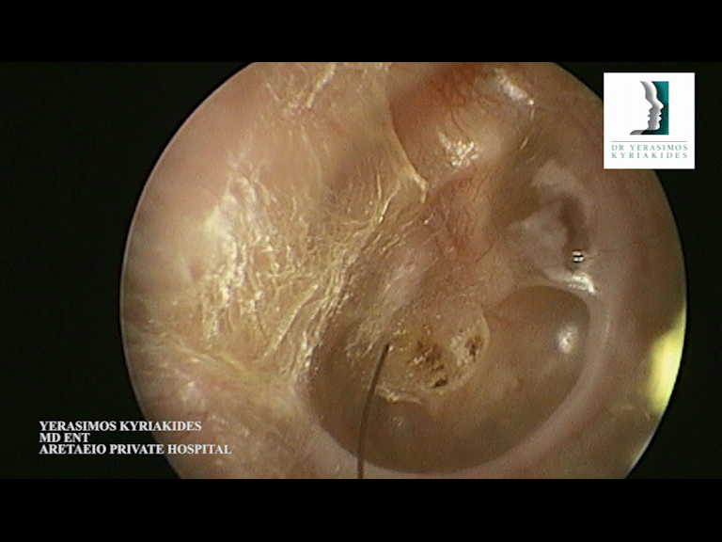

Slide 70
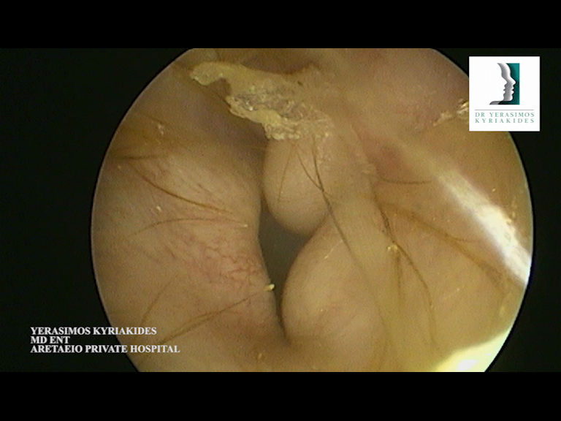

Slide 71
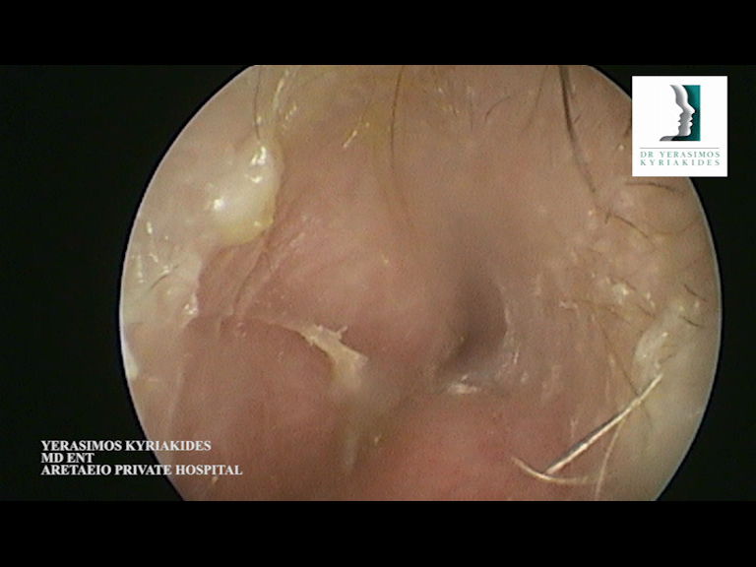

Slide 72
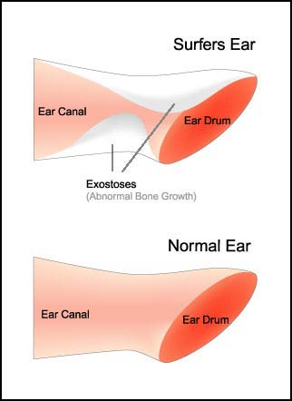

Slide 75
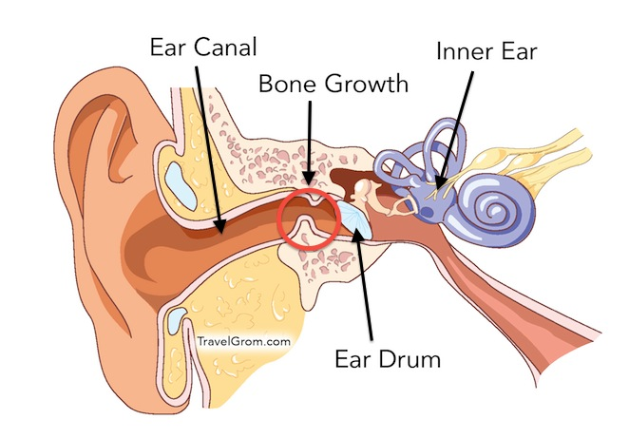

Slide 76
