Slide 1

Η περιφερική πολυνευροπάθεια στα Ρευματικά νοσήματα – διαγνωστική και θεραπευτική προσέγγιση
Ιωάννης Ζαγανάς
Νευρολόγος,
Επίκουρος Καθηγητής Νευρολογίας,
Τμήμα Ιατρικής Πανεπιστημίου Κρήτης

Slide 2
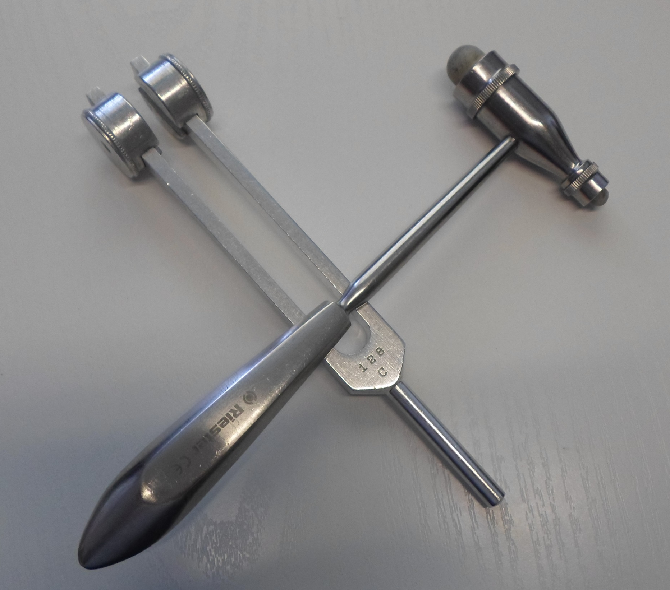
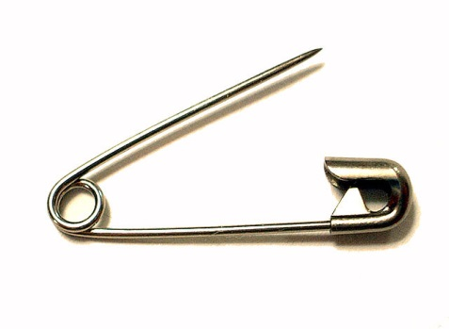


Slide 3
A 52-year-old woman with asymmetric sensory loss and paresthesias in both arms and legs and impaired dexterity
5 months earlier: hands and feet gradually began to feel as “wrapped tightly in bandages”
2.5 months earlier: difficulty with fine motor control, recognizing objects by feel in hands
1 month earlier: sensation of imbalance when closing her eyes, felt unstable while walking, numbness and tingling in hands and arms, intermittent shooting pain in the hands
The symptoms progressed proximally in the right arm and left leg and affected the left arm and right leg in a milder fashion, also increased in severity
Stiffness in her hands, worse in the morning
Chad et al, N Engl J Med, 2011

Slide 4
A 52-year-old woman with asymmetric sensory loss and paresthesias in both arms and legs and impaired dexterity
3 years earlier: episodes (for weeks) of numbness and tingling over the shoulders
On examination at that time:
  Patchy loss of sensation of pinprick in the arms that did not conform to a dermatomal pattern, loss of pinprick sensation on the back
  MRI of the spine with contrast: normal
No treatment was prescribed, and the symptoms resolved
Chad et al, N Engl J Med, 2011

Slide 5
A 52-year-old woman with asymmetric sensory loss and paresthesias in both arms and legs and impaired dexterity
Mild Raynaud's phenomenon for years, with no digital ulceration
Worked in an office
25-pack-year smoking, alcohol in moderation, no use of illicit drugs or exposure to metals, toxins, or large doses of vitamin supplements
Her brother and sister: ulcerative colitis, her sister: myasthenia gravis
Chad et al, N Engl J Med, 2011

Slide 6
A 52-year-old woman with asymmetric sensory loss and paresthesias in both arms and legs and impaired dexterity
Esophagogastroduodenoscopy: mild gastritis but otherwise normal
CXR and contrast-CT of abdomen and pelvis: normal
CBC, chemistry panel (including serum electrolytes), TSH, CRP: normal
ANA: positive (titer unknown)
Rheumatoid factor: 381 IU per milliliter (normal value, <30)
ESR: 65 mm per hour (normal rate, <20)
B₁₂: normal.
Borrelia burgdorferi antibodies: negative
Chad et al, N Engl J Med, 2011

Slide 7
A 52-year-old woman with asymmetric sensory loss and paresthesias in both arms and legs and impaired dexterity
Blood pressure 100/75 mm Hg, pulse 90 beats/minute while sitting (no orthostatic change)
Muscle tone and strength: normal
Successive hand tapping on a table and finger tapping of the index finger on the interphalangeal joint of the thumb: slightly slowed on the right side
Gait: normal; Romberg: swayed slightly; required support with tandem walking; able to walk on heels/toes
Sensory examination:
  Vibration: severely diminished in fingers and forearm on the right, and less severely diminished on the left, absent in the left great toe and right great toe, severely reduced at the left ankle and nearly normal at the right ankle
  Joint position: severely impaired at the interphalangeal joint of the right thumb, intact on the left
  Difficulty identifying coins with either hand when eyes closed
  Pinprick : diminished throughout the arms and legs but present on trunk
Chad et al, N Engl J Med, 2011

Slide 8
A 52-year-old woman with asymmetric sensory loss and paresthesias in both arms and legs and impaired dexterity
Summary:
  Diffuse, progressive sensory disorder for 5 months (arms >legs)
  Tightness, pins and needles (paresthesias), “shooting pains”: positive sensory symptoms (spontaneous discharges from sensory nerves)
  Loss of feeling in hands and feet, inability to recognize objects by feel, diminished dexterity, poor balance: negative sensory symptoms (loss of sensory-nerve function)
Chad et al, N Engl J Med, 2011

Slide 9

A 52-year-old woman with asymmetric sensory loss and paresthesias in both arms and legs and impaired dexterity
1) Where is the lesion?
2) What is the lesion?

Slide 10
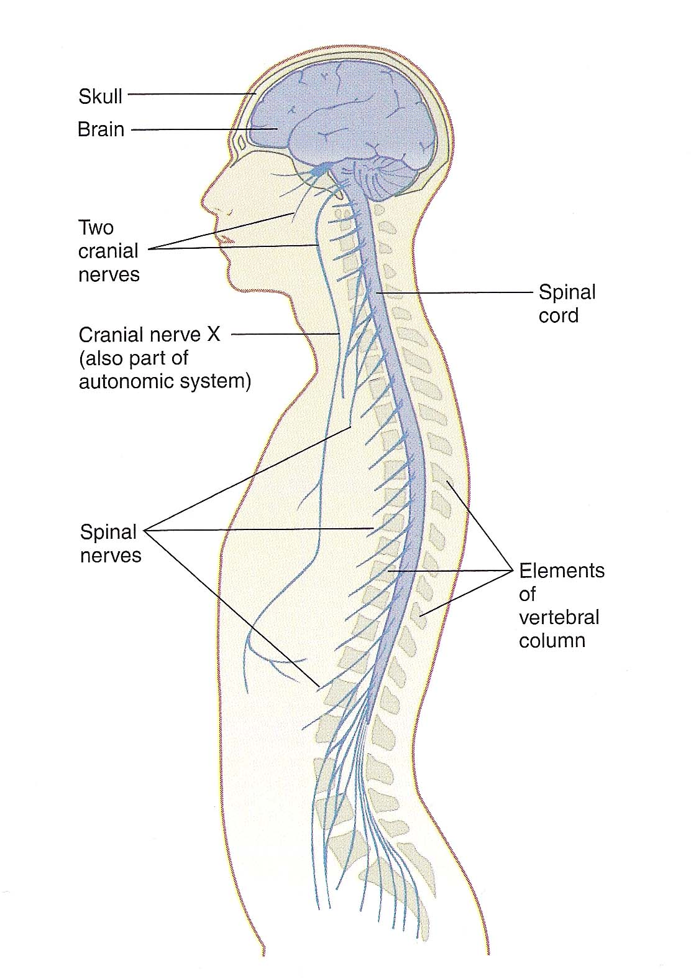
Subdivisions of the nervous system
Central NS (brain and spinal cord)
Peripheral NS (cranial and spinal nerves)

Slide 11
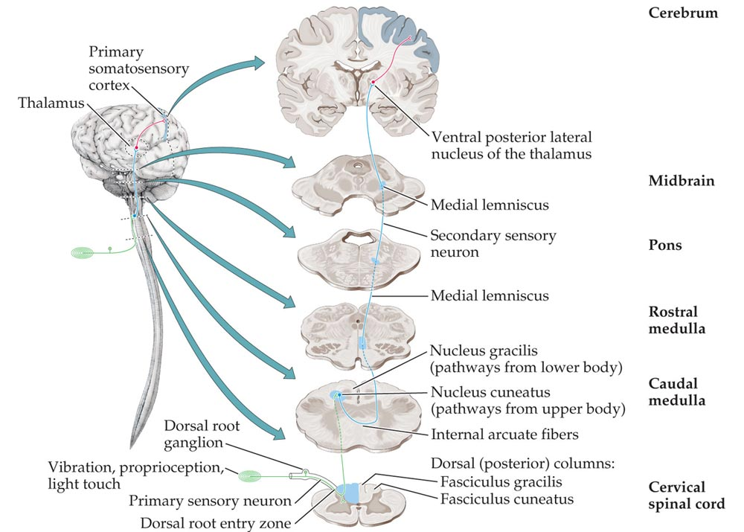
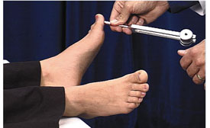
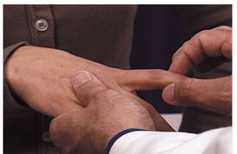
Posterior Column–Medial Lemniscal Pathway

Slide 12
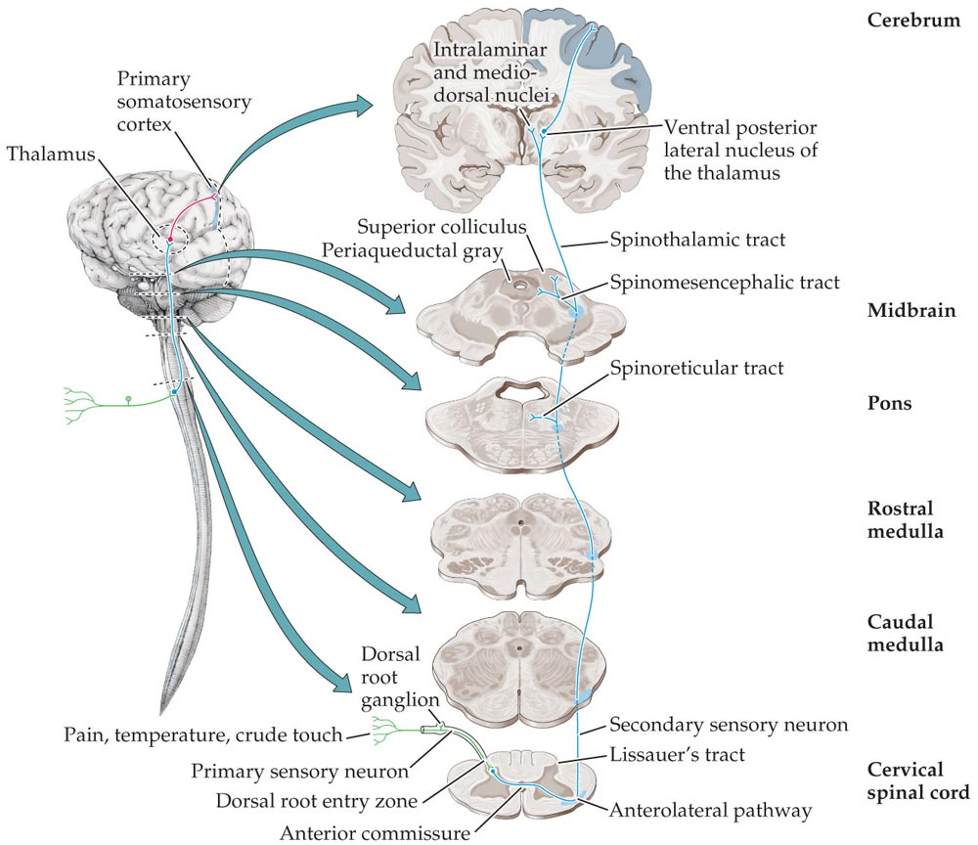
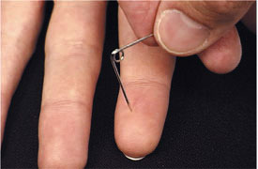
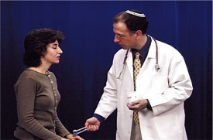
Anterolateral Pathways

Slide 13
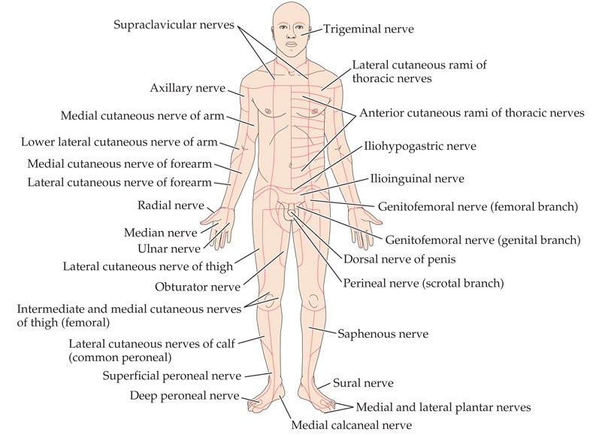
Regions of Sensory Innervation Supplied
by Cutaneous Nerve Branches
Notes:
Figure 9.5 Regions of Sensory Innervation Supplied by Cutaneous Nerve Branches (After Devinsky O, Feldmann E. 1988. Examination of the Cranial and Peripheral Nerves. Churchill Livingstone, New York.)

Slide 14
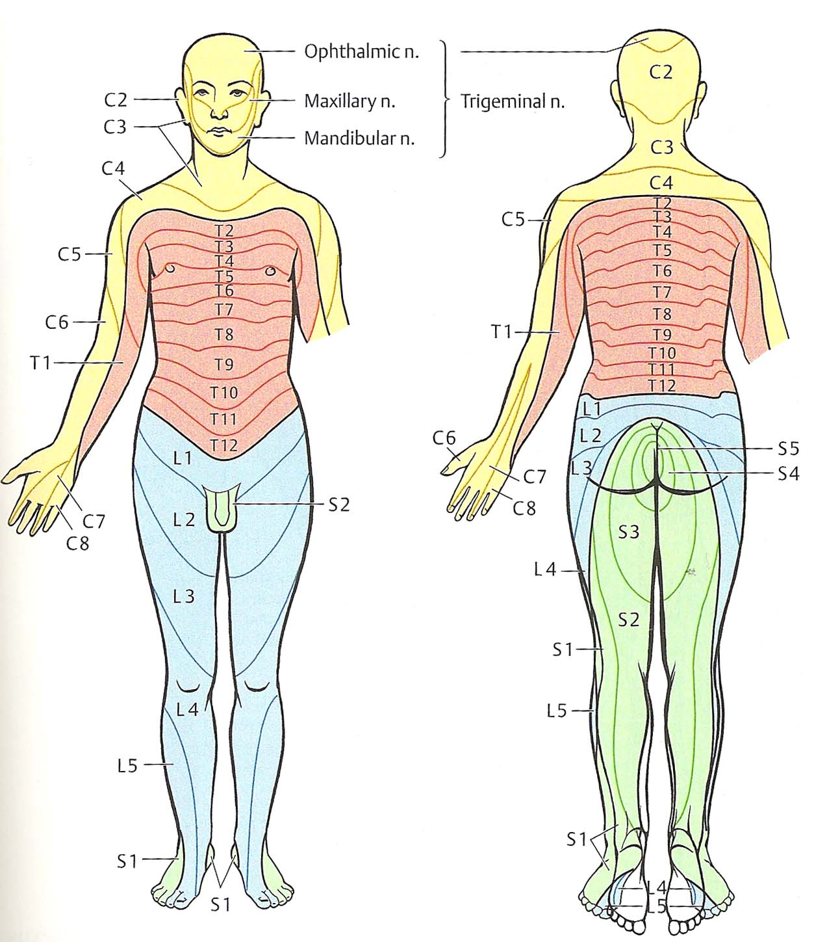
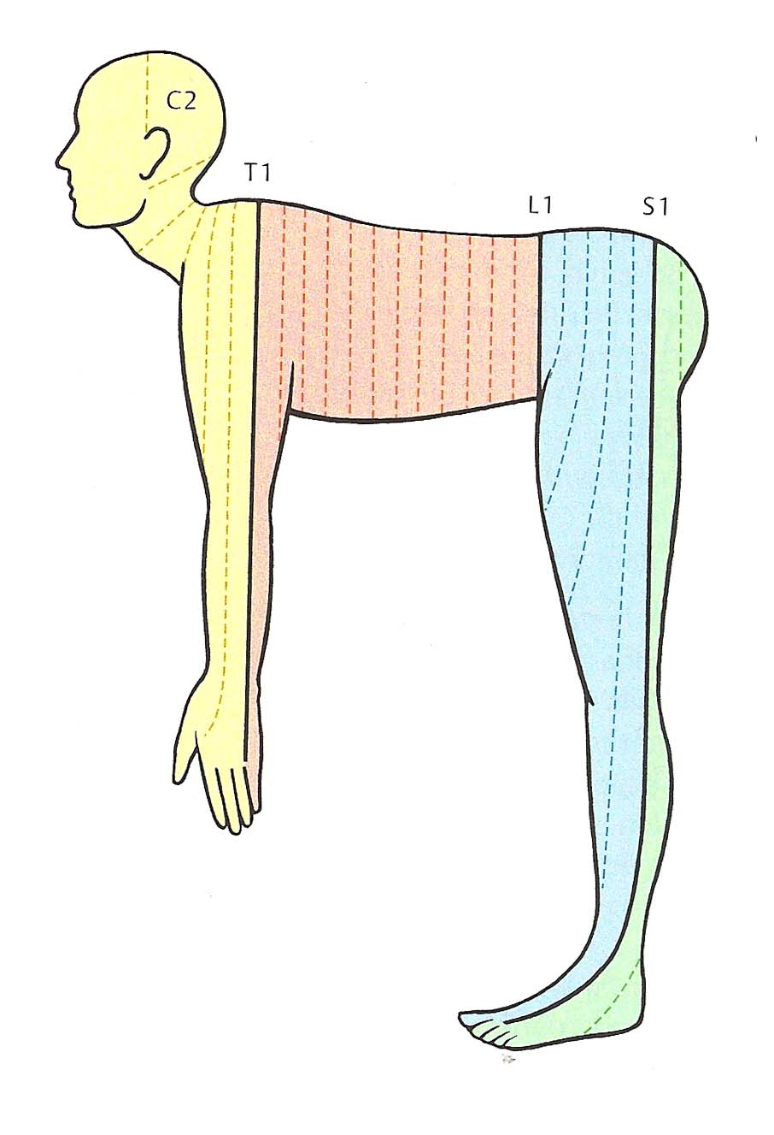
Dermatomes

Slide 15
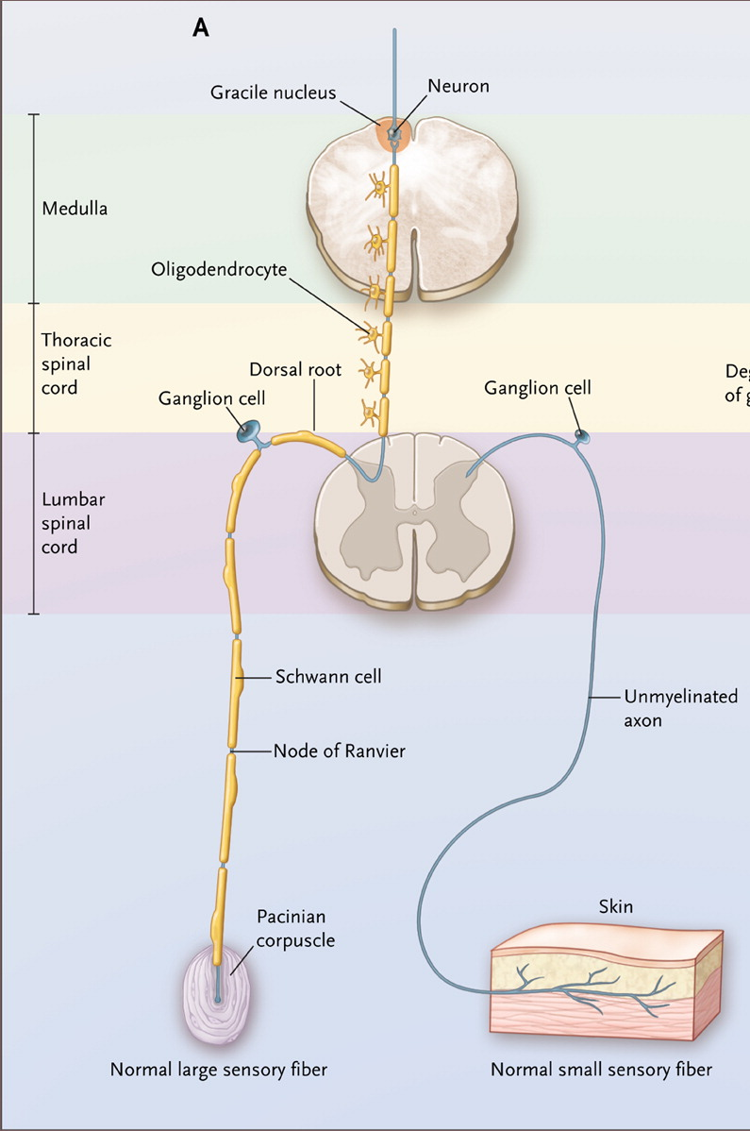
Chad DA et al. N Engl J Med 2011;364:1856-1865.
Cellular Organization of the Peripheral Nervous System
Notes:
Figure 1. Cellular Organization of the Peripheral Nervous System. There are two main types of sensory-nerve fibers (Panel A). The large sensory neuron in the dorsal-root ganglion projects to the periphery along a heavily myelinated fiber and innervates a pacinian corpuscle. The small sensory neuron in the dorsal-root ganglion projects to the periphery along either a thinly myelinated fiber or an unmyelinated fiber (as shown) and terminates as free endings in the skin. Both types of fibers were affected in this patient. Degeneration of a dorsal-root ganglion cell leads to degeneration of the axon and myelin of its peripheral connection to the pacinian corpuscle and of its central process en route to the gracile nucleus (Panel B). Adapted from Schaumburg et al.1

Slide 16
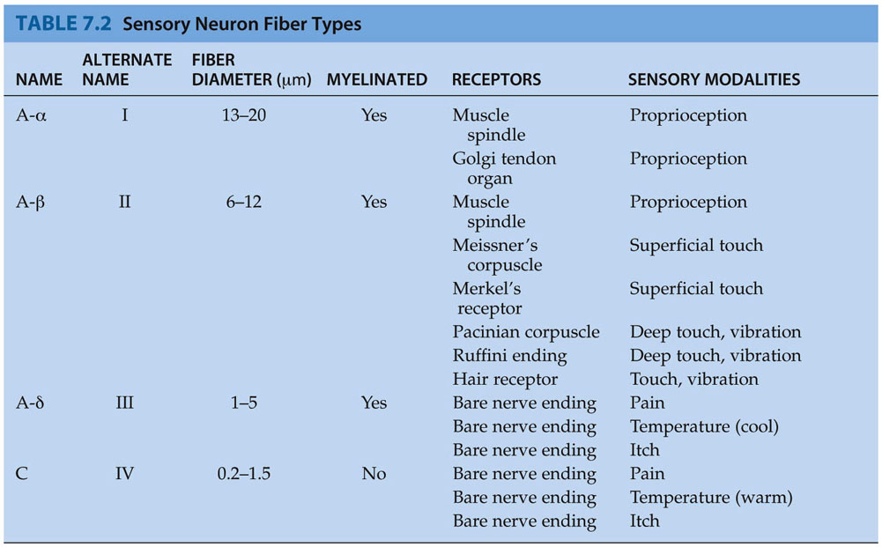
Sensory Neuron Fiber Types

Slide 17
A 52-year-old woman with asymmetric sensory loss and paresthesias in both arms and legs and impaired dexterity
Sensory loss from dysfunction of both large and small nerve fibers
Sensory deficits: bilateral and asymmetric (hands > feet, R>L)
Loss of tendon reflexes: asymmetric
Despite reported weakness, muscle atrophy and reduced strength were absent (subjective sense of weakness from impairment in proprioception)
No evidence of dysautonomia (e.g. orthostatic hypotension)
→neuropathy, not length-dependent
Chad et al, N Engl J Med, 2011

Slide 18
Electrophysiological testing

Slide 19
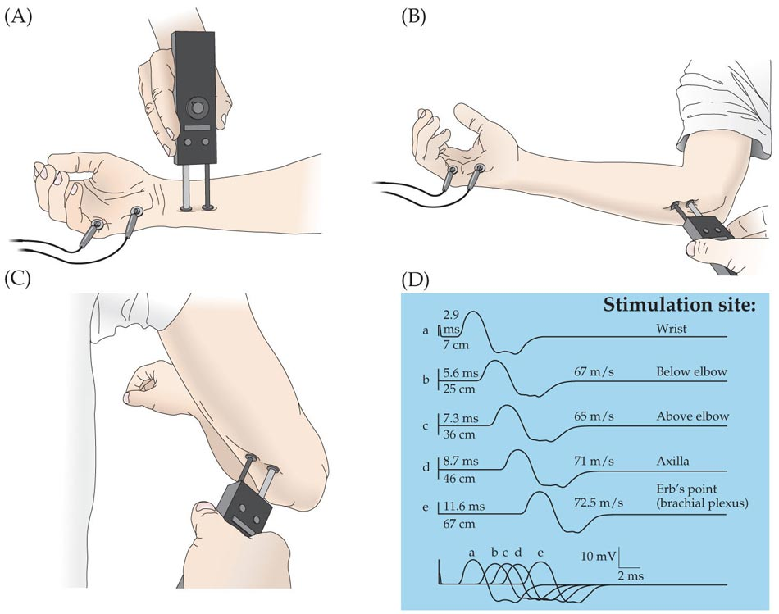
Nerve Conduction Study
(Ulnar Nerve, motor)
Notes:
Figure 9.9 Nerve Conduction Study The compound motor action potential (CMAP) of the ulnar nerve was recorded in this example from a normal subject at several stimulus locations. (A) Stimulation of the ulnar nerve at the wrist and recording of CMAP from the abductor digiti quinti in the hypothenar eminence. (B) Ulnar nerve stimulation just distal to the ulnar groove. (C) Ulnar nerve stimulation just proximal to the ulnar groove. (D) CMAP recordings for different stimulation sites. For each trace, the distance from the recording electrode (in centimeters) and the latency to CMAP onset (in milliseconds) are indicated to the left. Conduction velocities between adjacent stimulation sites (in meters per second) were calculated by dividing the distance between the two stimulation sites by the difference in motor latencies for the two sites. (After Rajesh KS, Thompson LL. 1989. The Electromyographer’s Handbook. 2nd Ed. Little, Brown, Boston.)

Slide 20
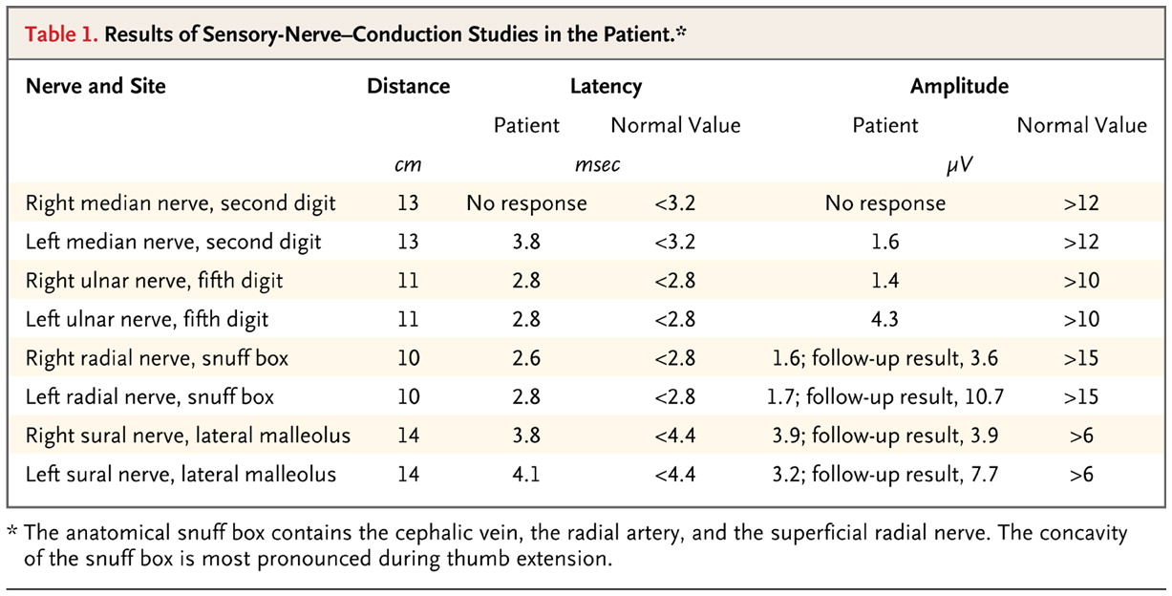
A 52-year-old woman with asymmetric sensory loss and paresthesias in both arms and legs and impaired dexterity
Chad et al, N Engl J Med, 2011
Notes:
The striking finding revealed by the nerve-conduction studies was the marked attenuation of the sensory responses (TABLE 1Results of Sensory-Nerve–Conduction Studies in the Patient.). Motor function was spared: median, ulnar, peroneal, and tibial motor-conduction studies, including F-wave responses, were uniformly normal. Moreover, the needle examination of selected upper- and lower-limb muscles was normal. There was no evidence of acquired demyelination that might have supported the Lewis–Sumner syndrome and no compelling evidence of multiple mononeuropathies that would have suggested a vasculitic neuropathic process. The sensory deficits were notable for a non–length-dependent pattern, which is consistent with the physical-examination findings: the sensory amplitudes of the upper extremities (median, ulnar, and radial nerves) were as diminished as or more so than those of the lower extremities (sural nerves). By contrast, in a length-dependent polyneuropathy, one would expect sural-nerve responses to be affected to a greater extent than median-, ulnar-, or radial-nerve sensory responses. Therefore, these electrodiagnostic findings were consistent with a sensory neuronopathy.5

Slide 21
Neuroimaging studies

Slide 22
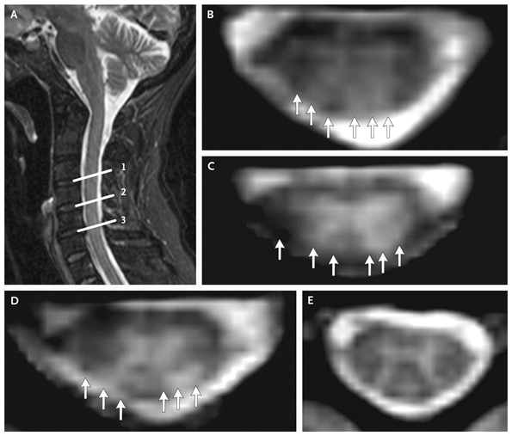
A 52-year-old woman with asymmetric sensory loss and paresthesias in both arms and legs and impaired dexterity
Chad et al, N Engl J Med, 2011
Notes:
Figure 2. Sagittal Short-Tau Inversion Recovery (STIR) and Axial T₂*-Weighted Images through the Parenchyma of the Cervical Spinal Cord. The STIR image (Panel A) shows patchy high-intensity signal abnormality involving the spinal cord, with a suggestion that the abnormal areas are primarily posterior in location. They extend from approximately C3 down to C6 level (lines at 1, 2, and 3 indicate levels corresponding to Panels B, C, and D, respectively). Axial T₂*-weighted images show patchy hyperintense signal abnormality involving the posterior columns (Panels B, C, and D; arrows). In comparison, a T₂*-weighted axial image from a normal spinal cord (Panel E) shows clear delineation of central gray matter, which is more hyperintense (light) than the surrounding white matter (dark).

Slide 23
A 52-year-old woman with asymmetric sensory loss and paresthesias in both arms and legs and impaired dexterity
Abnormal T₂ signal in spinal cord (especially posteriorly):
  Subacute combined degeneration
  Demyelinating conditions (multiple sclerosis)
  Transverse myelitis
  Tabes dorsalis
  Myelopathies associated with HIV
  Sarcoidosis
  Connective-tissue disorder
  Cord infarction
  Dorsal-root ganglionopathy with secondary involvement of the posterior columns
Chad et al, N Engl J Med, 2011

Slide 24
A 52-year-old woman with asymmetric sensory loss and paresthesias in both arms and legs and impaired dexterity
  Dorsal-root ganglionopathy with secondary involvement of the posterior columns
    Toxic neuronopathy (e.g. cisplatin or pyridoxine at mega levels)
    Paraneoplastic sensory neuronopathy (acute-days to subacute-months asymmetric onset, 90% small-cell lung carcinomas, in 80% of these anti-Hu positive)
    Neuronopathy associated with Sjögren's syndrome
Chad et al, N Engl J Med, 2011

Slide 25
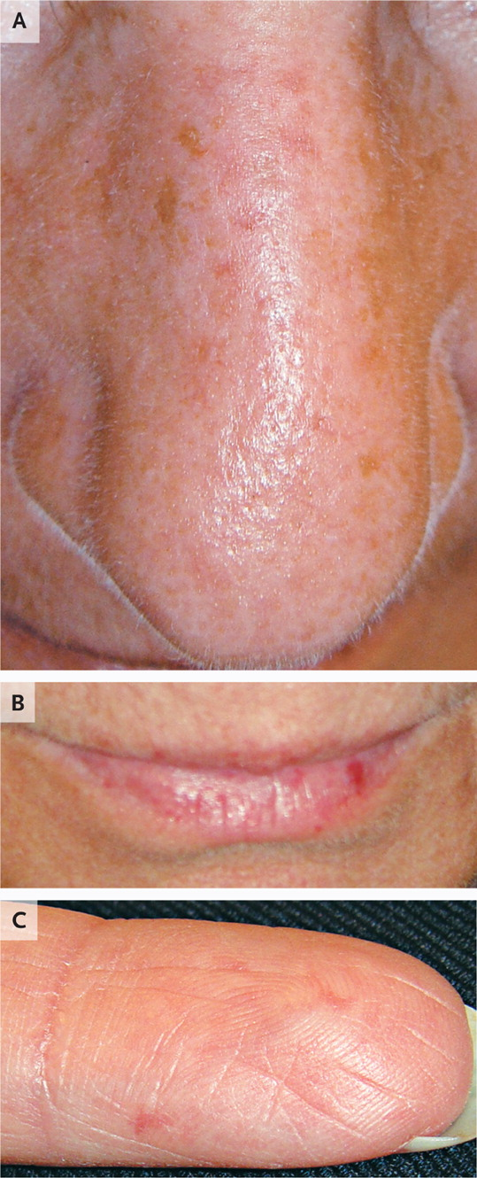
A 52-year-old woman with asymmetric sensory loss and paresthesias in both arms and legs and impaired dexterity
Telangiectasias (that blanched with pressure and refilled within seconds) over the nasal bridge (Panel A), on the lips (Panel B), and on the fingers (Panel C).
Chad et al, N Engl J Med, 2011

Slide 26
A 52-year-old woman with asymmetric sensory loss and paresthesias in both arms and legs and impaired dexterity
  Dorsal-root ganglionopathy
  Positive tests for ANA and rheumatoid factor, elevated ESR
  Raynaud's phenomenon: relatively mild
  No history of sicca symptoms, rash, or arthralgias
  Complete serologic evaluation:
    ANA assay (immunofluorescence on HEp-2 cells): classic speckled pattern
    Strongly positive anti-Ro antibodies (57.30 optical-density [OD] units; reference value, <19.99) (Sjögren's syndrome but also occurs in systemic lupus erythematosus, inflammatory muscle disease, systemic sclerosis, and overlapping connective-tissue diseases)
  Rheumatologic diagnosis: overlap syndrome, with features of Sjögren's syndrome and limited systemic sclerosis
Chad et al, N Engl J Med, 2011

Slide 27
A 52-year-old woman with asymmetric sensory loss and paresthesias in both arms and legs and impaired dexterity
  Treatment approach: halt damage to the dorsal-root ganglia as quickly as possible
    6-month course of prednisone beginning at 60 mg per day, oral cyclophosphamide (100 mg per day) for 6 months, rituximab (1000 mg intravenously in two doses, 15 days apart), and pneumocystis prophylaxis
    Anti-Ro antibody titer became negative (0.71 OD units)
    Follow-up electrodiagnostic studies 1 year after: slight increase in the amplitude of the left radial and left sural responses
    Pain: little response to gabapentin, good response to pregabalin but with unacceptable side effects, currently nortriptyline and lamotrigine, with hydrocodone for breakthrough pain
Chad et al, N Engl J Med, 2011

Slide 28
A 27-Year-Old Woman with Pain and Swelling of the Legs
5 months earlier: swelling of her ankles and lower legs (varied in severity from day to day, not affected by position)
6 weeks later: awakened by burning and stinging pain on the dorsal aspect of left foot
The paresthesia improved with naproxen
2 weeks later: pain recurred and involved both feet, with increased swelling of ankles and legs; a rash developed over her feet and toes and a 10-day course of dicloxacillin for presumed cellulitis was given
2 weeks later: spironolactone was prescribed and swelling of legs and ankles improved
However, the pain persisted, even after administration of NSAIDs, elevation, and icing, interfered with sleep
3 months later: referred to neurology
Vallat J et al. N Engl J Med 2007;356:1252-1259.

Slide 29
A 27-Year-Old Woman with Pain and Swelling of the Legs
Depression and hypothyroidism diagnosed 4-5 years earlier
Mild iron-deficiency anemia
Medications: levothyroxine, fluoxetine, iron supplement, ibuprofen, spironolactone, and tramadol
She did not abuse alcohol or drugs
No family history of neurologic disease
Vallat J et al. N Engl J Med 2007;356:1252-1259.

Slide 30
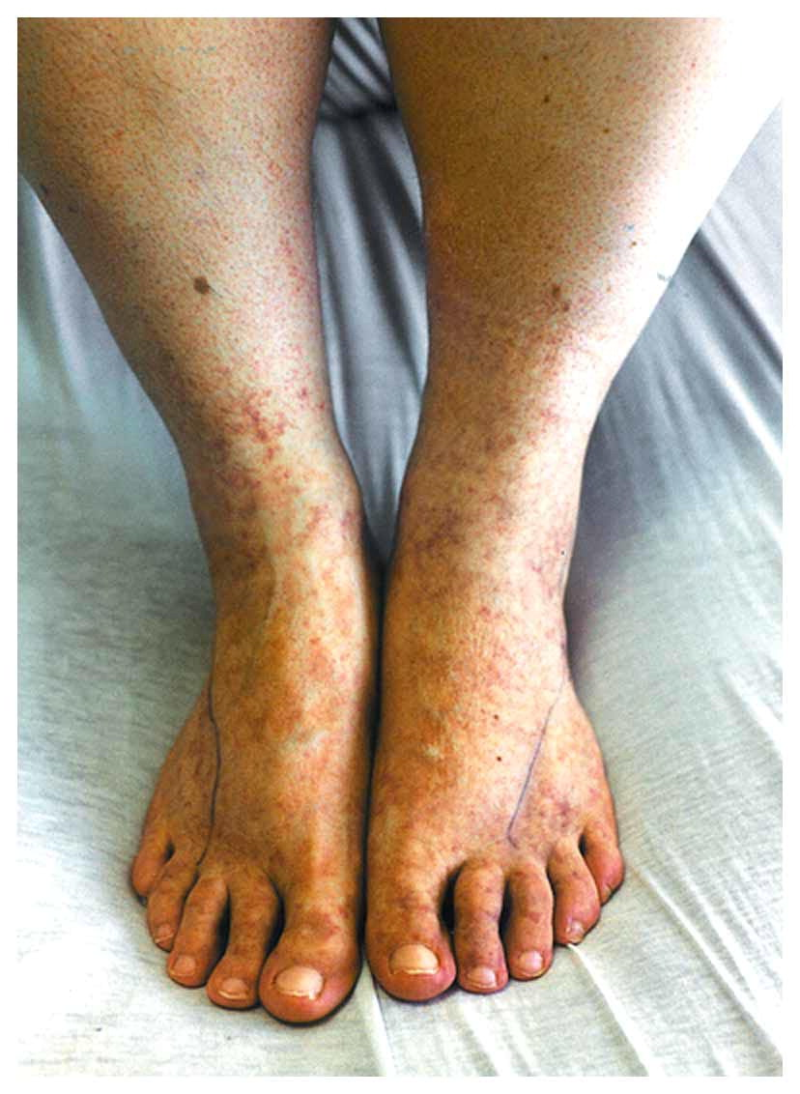
A 27-Year-Old Woman with Pain and Swelling of the Legs
Weight 159.1 kg, height 173 cm
Tense edema of the ankles and legs.
Skin over the lateral aspects of feet: dry and scaling with a diffuse purpuric rash and a few petechiae on the anterior legs and dorsal aspects of the feet (L>R)
Pain on light touch over the lateral aspects of both feet
Motor strength, deep-tendon reflexes and plantar responses: normal in both arms and legs
Reduced sensation to pinprick and vibration in the fourth and fifth toes bilaterally, worse on the left
Romberg test negative, tandem gait normal
Vallat J et al. N Engl J Med 2007;356:1252-1259.
Notes:
Figure 1. Photograph of the Patient's Lower Legs. There is a purpuric rash over the anterior surfaces of the ankles and the dorsal aspects of the feet, with a few petechiae; the changes are more marked on the left foot than on the right. (Photograph courtesy of Peter Siao, M.D.)
Weight 159.1 kg, height 173 cm
Tense edema of the ankles and legs.
Skin over the lateral aspects of the feet was dry and scaling with a diffuse purpuric rash and a few petechiae on the anterior legs and dorsal aspects of the feet (L>R)
Pain on light touch over the lateral aspects of both feet
Motor strength, deep-tendon reflexes and plantar responses: normal in both arms and legs
Reduced sensation to pinprick and vibration in the fourth and fifth toes bilaterally, worse on the left
Romberg test was negative, and tandem gait was normal

Slide 31
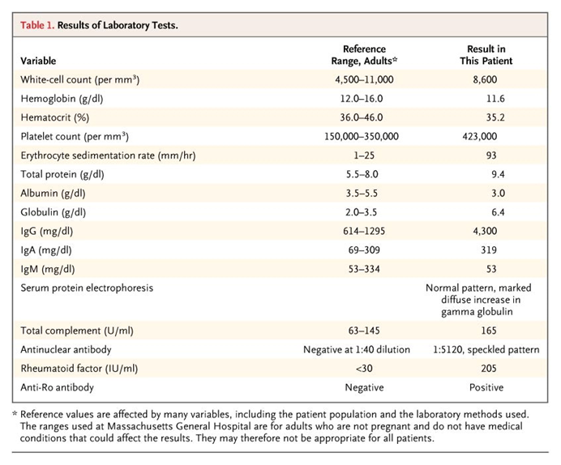
A 27-Year-Old Woman with Pain and Swelling of the Legs
Normal levels of blood glucose after an overnight fast, TSH, B₁₂, folate, and ACE.
Tests negative for ANCA; RPR; rapid plasma reagin; cryoprotein; serum immunofixation; Lyme antibody; hepatitis B and C antibody; HIV antibody; anti–double-stranded DNA, anti-La, anti-Smith, anti-RNP, and anti–Scl-70 antibodies; and anticardiolipin antibodies.
Vallat J et al. N Engl J Med 2007;356:1252-1259.

Slide 32
A 27-Year-Old Woman with Pain and Swelling of the Legs
Electrophysiological studies:
  Absent bilateral sural and superficial peroneal sensory potentials
  Median and ulnar sensory-nerve action potentials: normal in the left arm
  Motor-conduction studies in the arms and legs: normal
  Needle electromyogram: no abnormality in the gastrocnemius, tibialis anterior, or paraspinal muscles, fibrillations and positive sharp waves in the flexor hallucis brevis bilaterally (evidence for a length-dependent symmetric axonal polyneuropathy affecting both motor and sensory fibers)
Vallat J et al. N Engl J Med 2007;356:1252-1259.

Slide 33
A 27-Year-Old Woman with Pain and Swelling of the Legs
In Summary:
  Peripheral neuropathy, with acute onset, associated swelling of ankles and legs, cutaneous lesions
  Signs asymmetrical at onset and located in the lower legs in the distribution of the sural and superficial peroneal nerves bilaterally (sensation to pinprick and vibration reduced in the fourth and fifth toes bilaterally)
  No ataxia and present deep-tendon reflexes: ganglionopathy (neuronopathy) ruled out
  → sensorimotor multiple mononeuropathy (mononeuropathy multiplex) affecting large and small myelinated fibers
Vallat J et al. N Engl J Med 2007;356:1252-1259.

Slide 34
A 27-Year-Old Woman with Pain and Swelling of the Legs
Predominantly sensory multiple mononeuropathy
  Sarcoidosis
  Malignant tumors
  Infections (retroviruses, leprosy, hepatitis, Lyme disease)
  Vasculitic neuropathy (infarctions of the nerve fascicles → multifocal acute axonal lesions as a result of multiple small-vessel occlusions due to inflammation, and in some cases, fibrinoid necrosis within the walls of the vasa nervorum)
Vallat J et al. N Engl J Med 2007;356:1252-1259.

Slide 35
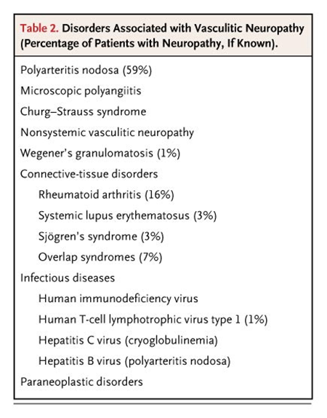
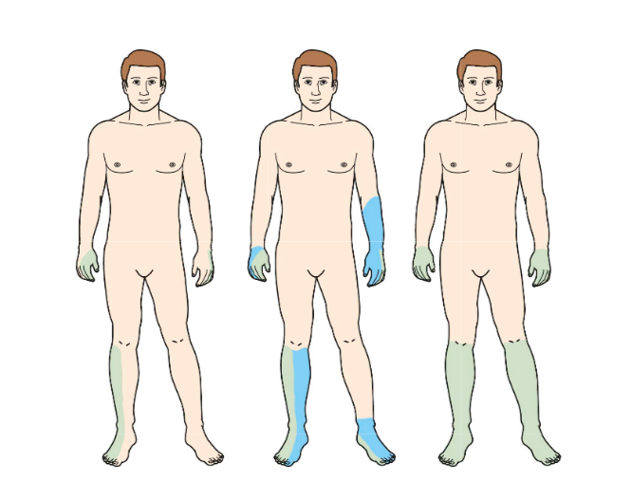
A 27-Year-Old Woman with Pain and Swelling of the Legs
Vallat J et al. N Engl J Med 2007;356:1252-1259.

Slide 36
A 27-Year-Old Woman with Pain and Swelling of the Legs
Biopsy of the left sural nerve to confirm the presence of axonal lesions induced by vasculitis
Salivary-gland biopsy to rule out Sjögren's syndrome (→mild periductal lymphoplasmacytic infiltrate that did not meet the criteria)
Vallat J et al. N Engl J Med 2007;356:1252-1259.

Slide 37
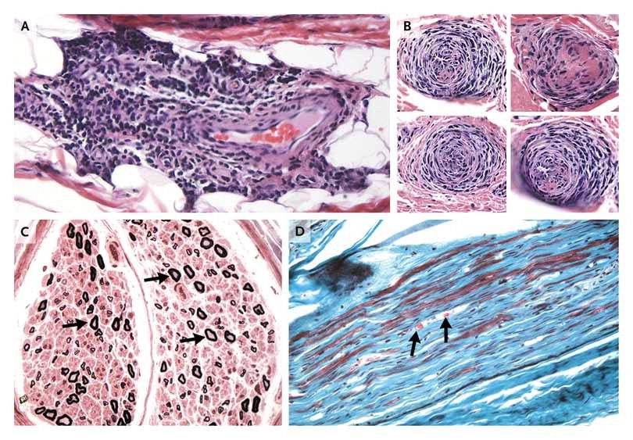

Vallat J et al. N Engl J Med 2007;356:1252-1259.
A 27-Year-Old Woman with Pain and Swelling of the Legs
Biopsy Specimen of the Sural Nerve
Notes:
Figure 2. Biopsy Specimen of the Sural Nerve. A lymphoplasmacytic infiltrate surrounds a small vein in the epineurium of the nerve (Panel A, hematoxylin and eosin). Step sections through a small epineurial artery (Panel B, hematoxylin and eosin) reveal focal involvement by the inflammatory process and smooth-muscle hypertrophy. An Epon-embedded cross section of the sural nerve (Panel C) that was 1 μm thick (toluidine blue) shows a markedly smaller number of myelinated fibers than normal (arrows). A trichrome-stained, paraffin-embedded longitudinal section (Panel D) shows a reduced number of myelinated fibers (red), an increased amount of endoneurial collagen (green), and the presence of myelin ovoids (arrows), indicating Wallerian degeneration.

Slide 38
A 27-Year-Old Woman with Pain and Swelling of the Legs
Axonal neuropathy due to lymphoplasmacytic small-vessel vasculitis, associated with connective-tissue disease with features of Sjögren's syndrome
Prednisone to 60 mg a day, for about 6 weeks, then gradually tapered and stopped over the period of 1 year
6 years after the diagnosis: increasing symptoms of dry eyes and dry mouth, recurrent edema of the lower legs (→ hydroxychloroquine), no evidence of neuropathy
Vallat J et al. N Engl J Med 2007;356:1252-1259.

Slide 39
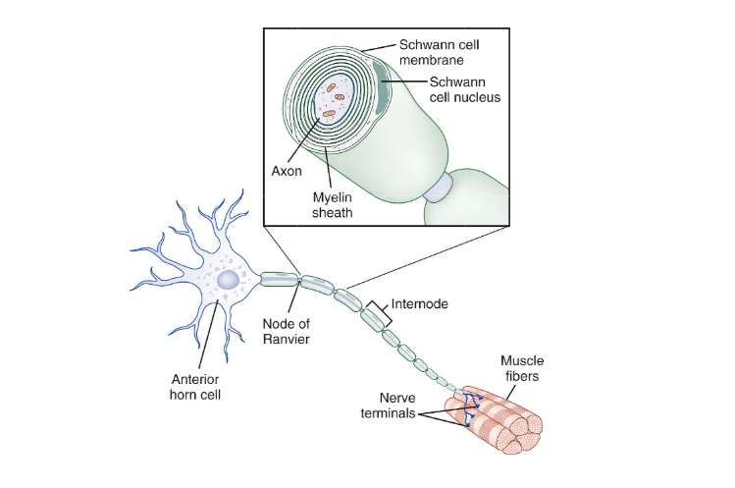

Slide 40
Pathological processes affecting peripheral nerves
Wallerian degeneration due to axon interruption
Axonal degeneration (axonopathy)
Neuronal degeneration (neuronopathy)
Segmental demyelination (myelinopathy)

Slide 41
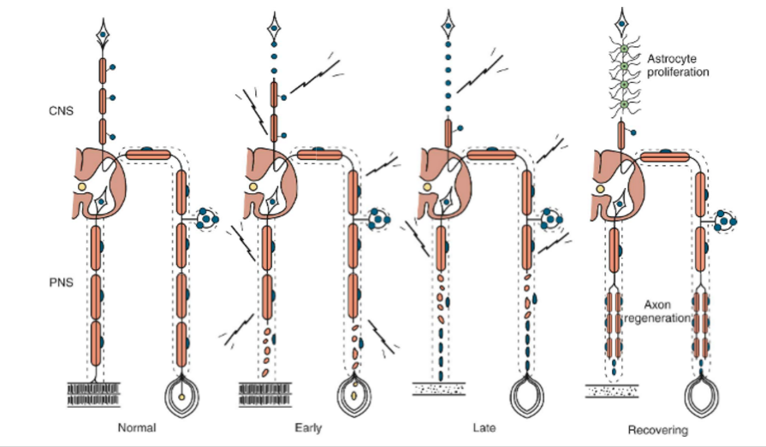
2. Axonal degeneration

Slide 42
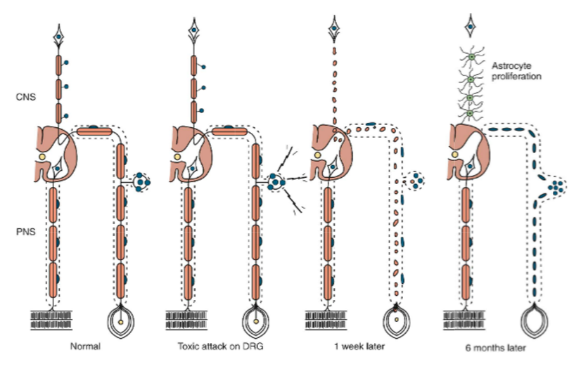
3. Sensory neuronopathy

Slide 43
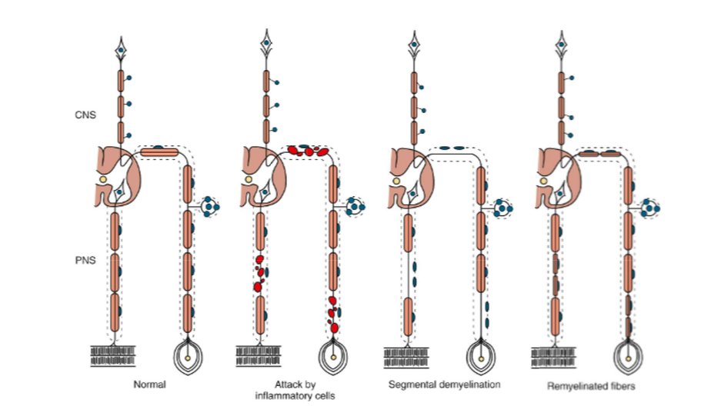
4. Segmental demyelination

Slide 44
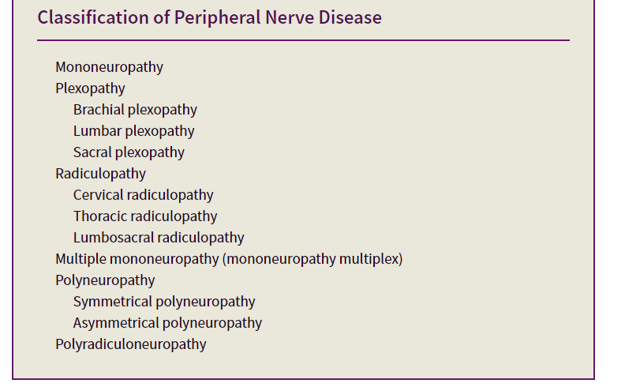

Slide 45
Connective tissue diseases and peripheral neuropathies
Vasculitic neuropathy
Distal axonal polyneuropathy
Compression neuropathy
Sensory neuronopathy
Trigeminal sensory neuropathy
Acute or chronic demyelinating polyneuropathy
Plexopathy

Slide 46
Rheumatoid arthritis
Peripheral neuropathy in 1% to 10%, although EDX evidence may be found in up to 57% (Agarwal et al, 2008)
(1) compression neuropathies (e.g. carpal tunel), often found with early disease and caused by periarticular inflammation and fibrosis
(2) Chronic distal symmetrical sensory polyneuropathy, possibly related to occlusive vasculopathy (dysesthesias, paresthesias, and loss of sensation in a patchy stocking-glove distribution)
(3) mononeuropathy or multiple mononeuropathies (vasculitis)
(4) Severe fulminating sensorimotor polyneuropathy (vasculitis)
(5) Neuropathies caused by treatments

Slide 47
Rheumatoid arthritis
Compression neuropathies: treatment includes splints, local corticosteroids, or surgical decompression
Chronic symmetrical, predominantly sensory polyneuropathy: prognosis is generally good, no specific treatment is recommended

Slide 48
Rheumatoid arthritis
Systemic vasculitis: severe chronic rheumatoid arthritis with poor prognosis (severe joint deformities, rheumatoid nodules, and cutaneous vasculitic lesions)
Rheumatoid vasculitis: frequently cause of vasculitic neuropathy (rheumatoid arthritis is a common disorder, affecting 2% to 5% of the general population)
Acute mononeuropathy, multiple mononeuropathies, distal symmetrical sensorimotor polyneuropathy
Treatment: high-dose prednisone and cyclophosphamide

Slide 49
Systemic Lupus Erythematosus
Peripheral neuropathy in 6% to 21% of patients
  Symmetrical subacute or chronic axonal polyneuropathy with predominant sensory symptoms most common
  Mononeuropathies, brachial plexopathy, and GBS or CIDP occasionally
  Sural nerve biopsy: perivascular inflammatory cell infiltration, only occasionally definite vasculitis
Polyneuropathy associated with SLE resulting in significant disability: immunosuppressive treatment (proven vasculitis: plasmapheresis, prednisone, and cyclophosphamide)

Slide 50
Sjögren Syndrome
Peripheral nerve involvement occurs in 10% to 32% (up to 62%) of patients with primary Sjögren syndrome, has a strong predilection for women and may precede and overshadow the sicca symptoms, being the major presenting complaint
Presentations:
  Distal symmetrical sensory neuropathy with mixed large- and small-fiber deficits (most common)
  Sensorimotor neuropathy
  Small-fiber neuropathy
  Polyradiculoneuropathy
  Multiple mononeuropathies
  Painful dorsal root ganglionopathy
  Trigeminal sensory neuropathy
  Sensory ataxic neuronopathy
  Autonomic neuropathy

Slide 51
Sjögren Syndrome
Reduced or absent SNAPs and normal or only mildly abnormal motor conduction studies
Sensory ganglionopathy: high-intensity lesions of the posterior columns on T2-weighted MRI of the cervical cord
Sural nerve biopsy: nonspecific perivascular lymphocytic infiltrates together with diffuse decrease in myelinated fibers
Vasculitis: rarely, in patients with multiple mononeuropathies

Slide 52
Sjögren Syndrome
Treatment recommendations: small retrospective uncontrolled series or individual case reports
Most report improvement with corticosteroids, either alone or in combination with immunosuppressants, neutralizing antibodies to TNF-α, or IVIG

Slide 53
Conclusions
Peripheral neuropathy a common occurrence in connective tissue disorders
Can precede the systemic manifestations of rheumatic disease
High degree of clinical suspicion and clinical and other testing can provide the diagnosis
Timely treatment essential for favorable long term prognosis

Slide 54
Ευχαριστώ για την προσοχή σας

