Slide 1



Update κλινικών μελετών
Δημήτριος A. Βασιλόπουλος
Κοινό Πρόγραμμα Ρευματολογίας
Mονάδα Κλινικής Ανοσολογίας-Ρευματολογίας
B’ Παθολογική Κλινική και Ομώνυμο Εργαστήριο
Ιατρική Σχολή ΕΚΠΑ
Ιπποκράτειο ΓΝΑ

Slide 2

OUTLINE
ΣΥΓΚΡΟΥΣΗ ΣΥΜΦΕΡΟΝΤΩΝ
Unrestricted Grants (μέσω EΛKE)
Pfizer
Advisor/lecturer (μέσω ΕΛΚΕ)
  Pfizer

Slide 3
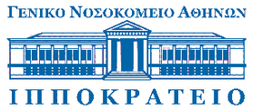
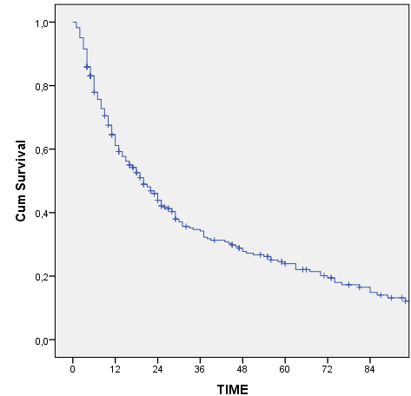
OUTLINE
Γιατί χρειαζόμαστε άλλο ένα θεραπευτικό παράγοντα στην ΡΑ??
Επιβίωση anti-TNF παραγόντων (ΡΑ)
n=284
Lazarini A.
Unpublished data
n 284 161 101 71 53 39 29 18

Slide 4
OUTLINE
TOFACITINIB
tofacitinib
Key Cytokines in the pathogenesis of RA
Cytokines | JAKs
IL-7 | JAK1/JAK3
IL-15 | JAK1/JAK3
IL-21 | JAK1/JAK3
IL-6 | JAK1/JAK2/Tyk2
IFNα and IFNβ | JAK1/Tyk2
IL-10 | JAK1/Tyk2
IL-12 | JAK2/Tyk2
IL-23 | JAK2/Tyk2
IL-1 IL-17 IL-18 TGF-β TNF | Jak independent
Cytokine
γc
Cytokine
receptor
JAK3
JAK1
Intracellular
JAK=Janus kinase.
Shuai K, Liu B. Nat Rev Immunol. 2003;3(11):900-911; Flanagan ME et al, J Med Chem 2010; 53:8468-8484
Tofacitinib is not approved in the EU.
Tofacitinib 5mg is approved in more than 45 countries around the world for the treatment of moderate to severe rheumatoid arthritis (RA).
Tofacitinib 5 mg and 10 mg is approved in Switzerland and Russia.

Slide 5
TOFACITINIB: Update κλινικών μελετών
OUTLINE
DMARD-IR
MTX-IR
TNFi-IR
MTX-naive
Study (N) | ORAL Solo¹ (N=610) | ORAL Sync² (N=792) |  | ORAL Scan³ (N=797) | ORAL Standard⁴ (N=717) |  | ORAL Step⁵ (N=399) |  | ORAL Start⁶ (N=952)
Duration | 6 months | 12 months |  | 24 months | 12 months |  | 6 months |  | 24 months
Background treatment | None | Non-biologic DMARDs |  | MTX | MTX |  | MTX |  | None
Feature | Monotherapy | Background DMARDs |  | X-ray | Active control (adalimumab) |  | TNFi failure |  | mTSS scores with monotherapy
1. Fleischmann R et al. N Engl J Med 2012;367:495–507.
2. Kremer J et al. Ann Intern Med 2013;159:253–261.
3. van der Heijde D et al. Arth Rheum 2013;65(3):559–570
4. van Vollenhoven R et al. NEJM 2012;367:508–519.
5. Burmester G et al. Lancet 2013;381:451–460.
6. Lee E et al. N Engl J Med 2014;370:2377-86.
Tofacitinib is not approved in the EU.
Tofacitinib 5mg is approved in more than 45 countries around the world for the treatment of moderate to severe rheumatoid arthritis (RA).
Tofacitinib 5 mg and 10 mg is approved in Switzerland and Russia.
DMARD, disease-modifying antirheumatic drug;
IR,,inadequate responder; mTSS, modified total Sharp score;
MTX, methotrexate; TNFi, tumour necrosis factor inhibitor.

Slide 6
OUTLINE
MTX-naive

Slide 7
OUTLINE
Tofacitinib: MTX-naive
ORAL-START
Tofacitinib 5 mg BID (monotherapy)
MTX-naïve N=958†
2:2:1 randomisation
Tofacitinib 10 mg BID (monotherapy)
MTX 10 mg q wk initially; 5 mg increase q 4 wks
up to 20 mg q wk*
Baseline
Month 12
Month 24
study end
Co-primary efficacy endpoints
Mean change in van der Heijde mTSS (months 0 → 6)
ACR70 (month 6)
BID, twice-daily; DMARD, disease-modifying antirheumatic drug;
mTSS, modified Total Sharp Score; MTX, methotrexate.

Slide 8
OUTLINE
MTX-naïve: TOF vs. MTX
ORAL-START
ACR70

Slide 9
OUTLINE
MTX-naïve: TOF vs. MTX
ORAL-START
Prostate Ca n=1
Burkitt’s Lymphoma n=1
Colon Ca n=1
NHL n=1
CLL n=1
Gastric Ca n=1
NHL n=1
Heart failure n=1
Sudden cardiac death n=1
Colon Ca n=1
Lee E et al. N Engl J Med 2014

Slide 10
OUTLINE
MTX-naïve: TOF vs. MTX: PROs
HAQDI
BP, Bodily Pain; GH, General Health; MH, Mental Health; PF, Physical Functioning; RE, Role Emotional; RP, Role Physical; SF, Social Functioning; SF-36, Short Form-36; VT, Vitality.
Strand V et al, RMD Open 2016

Slide 11
OUTLINE
MTX or DMARD -IR

Slide 12
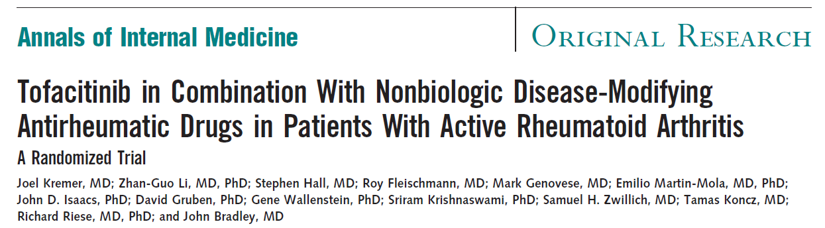
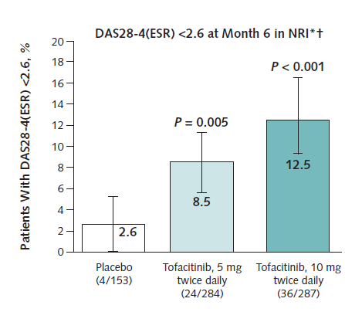
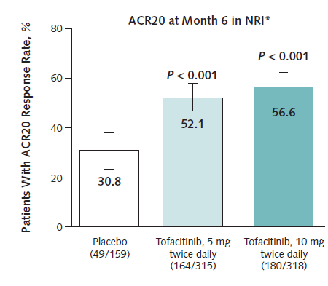
OUTLINE
MTX-IR: TOF+MTX vs. MTX:
Aποτελεσματικότητα – ασφάλεια
ORAL-Sync
Key features
Mean duration (yrs) | 8.1-10.2
DAS28 | 6.1-6.4
HAQ | 1.2-1.4
RF/anti-CCP | 67-74%
Ευκαιριακές λοιμώξεις (n=4)
- Disseminated herpes zoster (n=1)
Cryptococcal pneumonia (n=1)
Pulmonary TB (n=2)

Slide 13
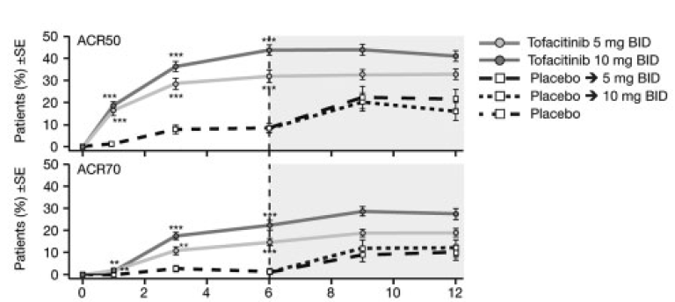
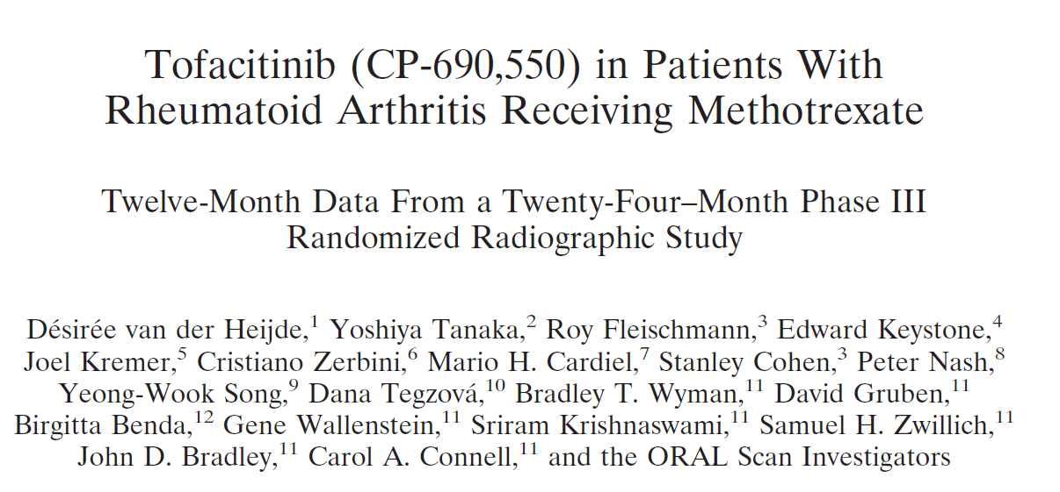
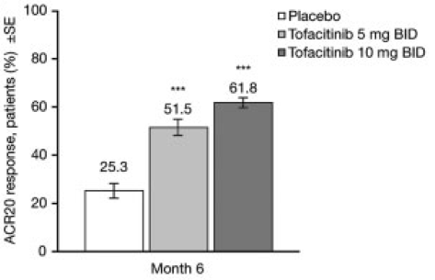
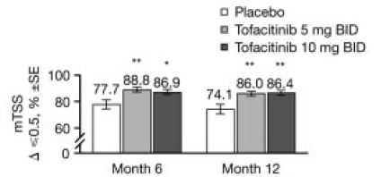
OUTLINE
MTX-IR: TOF+MTX vs. MTX: Aποτελεσματικότητα
ORAL-Scan
Non-progressors
van der Heijde D et al. Arth Rheum 2013;65(3):559–570

Slide 14
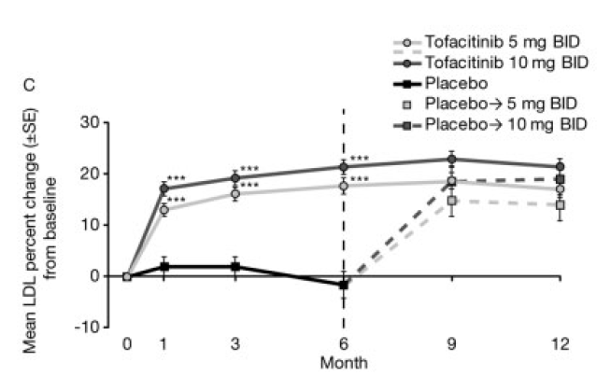
OUTLINE
MTX-IR: TOF+MTX vs. MTX: Ασφάλεια
ORAL-Scan
 | MTX | TOF (5 mg BID) + MTX | TOF (10 mg BID) + MTX
Σοβαρές λοιμώξεις (/100 pt-yrs) | 3.68 | 4.17 | 2.32
Ευκαιριακές λοιμώξεις (n= 7)
Pneumocystis jiroveci pneumonia (n=1)
Cytomegalovirus sialadenitis (n=1)
Cytomegalovirus viremia (n=1)
- Lymph node tuberculosis (n=1)
- Esophageal candidiasis (n=3)

Slide 15
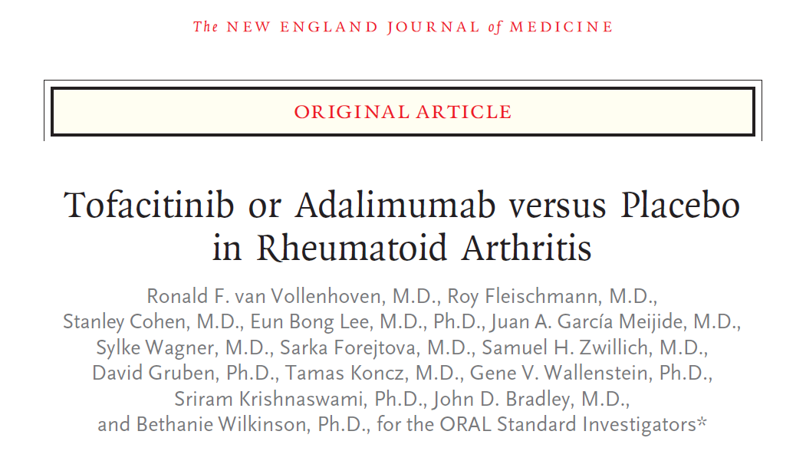
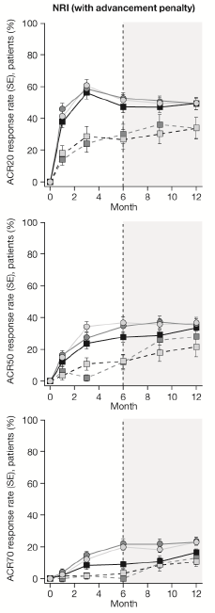
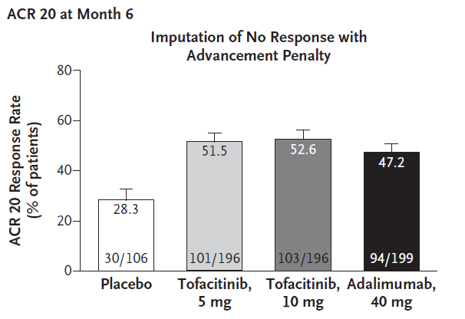
OUTLINE
DMARD-IR: TOF+MTX vs. ADA + MTX vs. MTX:
Aποτελεσματικότητα - ασφάλεια
ORAL-Standard
ACR20
ACR50
ACR70
Key features
Mean duration (yrs) | 6.9-9
DAS28 | 6.3-6.6
HAQ | 1.4-1.5
RF/anti-CCP | 61-76%
 | Tofacitinib | ADA
LDL (0-12 mo) | +10-21% | +1.4%
HDL (0-12 mo) | +8-16% | +8%
Σοβαρές λοιμώξεις | 3.4-4%* | 1.5%
Θάνατοι | 1 | 1
* Pulmonary TB (n=2)
van Vollenhoven R et al. NEJM 2012

Slide 16
OUTLINE
Anti-TNF-IR

Slide 17
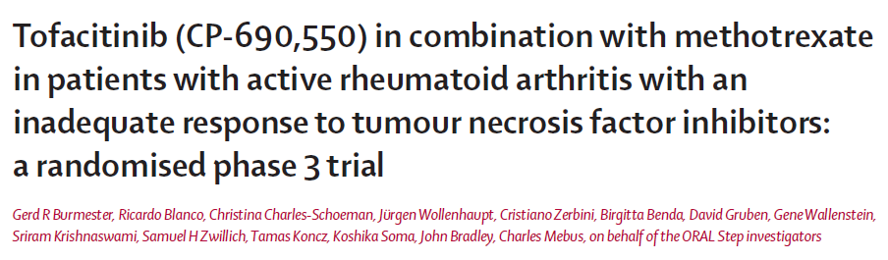
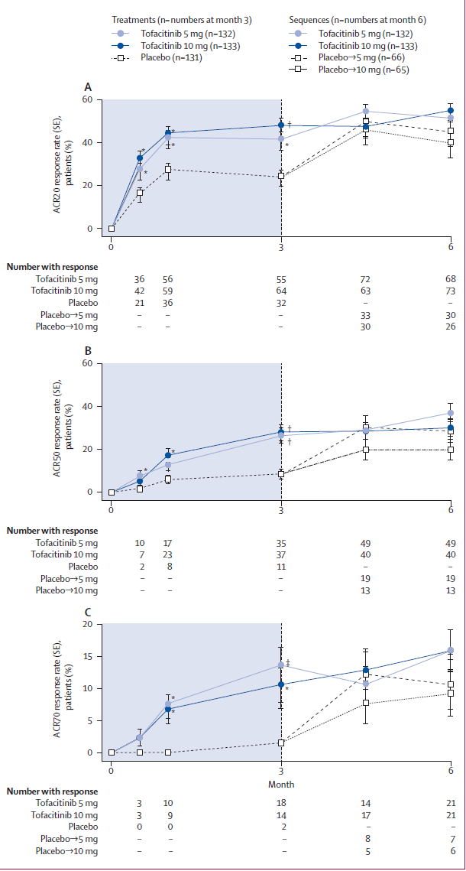
OUTLINE
Anti-TNF-IR: TOF+MTX vs. MTX:
Aποτελεσματικότητα - ασφάλεια
ORAL-STEP
Key features
Mean duration (yrs) | 11.3-13
DAS28 | 6.4-6.5
HAQ | 1.5-1.6
RF/anti-CCP | 66-76%
Χωρίς ιδιαίτερες παρενέργειες

Slide 18
OUTLINE
Τofacitinib: Aποτελεσματικότητα
ACR 20
Tofacitinib 5 mg BID
Tofacitinib 10 mg BID
Tofacitinib 5 mg BID mono
Tofacitinib 10 mg BID mono
Placebo + MTX
Placebo
Adalimumab
MTX
MTX-naive
DMARD-IR
Anti-TNF-IR
71-76% 52-66% 42-48%
***
***
***
***
***
***
***
***
***
***
**
***
*
N=
371
395
186
N=
120
241
242
N=
157
311
309
N=
106
196
196
199
N=
Start (6M)
Solo (3M)
Scan (6M)
Sync (6M)
Standard (6M)
131
132
133
Step (3M)
Lee E et al. 2014 Fleischmann R et al. van der Heijde D et al. Kremer J et al. van Vollenhoven R et al. Burmester G et al.
N Engl J Med N Engl J Med 2012 Arth Rheum 2013 Ann Intern Med 2013 NEJM 2012 Lancet 2013
*p≤0.05; **p<0.001; ***p<0.0001 vs placebo (unadjusted)

Slide 19
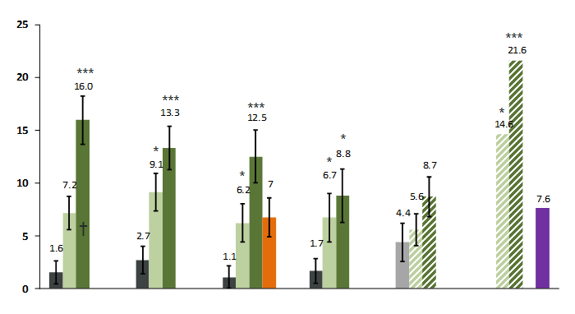
OUTLINE
Τofacitinib: Aποτελεσματικότητα
DAS28 < 2.6
Tofacitinib 5 mg BID
Tofacitinib 10 mg BID
Tofacitinib 5 mg BID mono
Tofacitinib 10 mg BID mono
Placebo + MTX
Placebo
Adalimumab
MTX
MTX-naive
DMARD-IR
Anti-TNF-IR
15-22% 6-16% 7-9%
Start (6M)
Solo (3M)
Scan (6M)
Sync (6M)
Standard (6M)
Step (3M)
Lee E et al. 2014 Fleischmann R et al. van der Heijde D et al. Kremer J et al. van Vollenhoven R et al. Burmester G et al.
N Engl J Med N Engl J Med 2012 Arth Rheum 2013 Ann Intern Med 2013 NEJM 2012 Lancet 2013
*p≤0.05; **p<0.001; ***p<0.0001 vs placebo (unadjusted)

Slide 20
OUTLINE
Τofacitinib: Aναστολή ακτινολογικών βλαβών
mTSS=0-448
MTX-IR
TOFA+MTX vs. MTX
van der Heijde D et al.
Arthr Rheum 2013
*p ≤ 0.05; **p ≤ 0.001; and ***p < 0.0001 vs PBO or MTX.
MTX-Naive
TOFA vs. MTX
Lee E et al.
N Engl J Med 2014
Landewé RBM et al, Arthr Res & Ther 2016
Notes:
Fig. 4 Change from baseline in mTSS according to baseline mTSS-defined tertiles for ORAL Scan and ORAL Start. *p ≤ 0.05; **p ≤ 0.001; and ***p <
0.0001 vs PBO or MTX. In post hoc analyses, presented values are descriptive. Data presented in Fig. 3 as a Forest plot are presented here as bar
graphs, showing that moving from a lower to a higher tertile category indicates an increase in treatment effect. BID twice daily, LS least squares,
mTSS van der Heijde modified total Sharp score, MTX methotrexate, PBO placebo, SE standard error

Slide 21
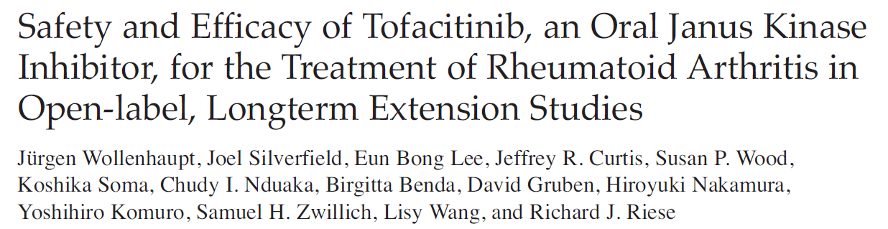
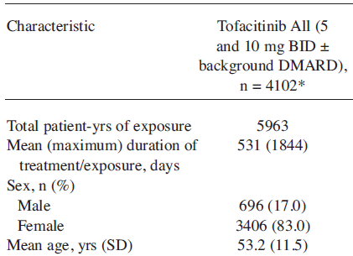
OUTLINE
Τofacitinib: Ασφάλεια
Phase II (6-24 wks) Phase III (6-24 months)
1 Open-label 6 RCTs
8 RCTs
Open label LTE (up to 60 months)
n=4.102 (5.963 pt-yrs)
Discontinuations = 21%
D/C (adverse events) = 11%
Deaths 31 (0.5/100 pt-yrs)
Malignancies 12 (0.3/100 pt-yrs)
Cardiovascular events 16 (0.3/100 pt-yrs)
csDMARDs 67%
CS 54%

Slide 22
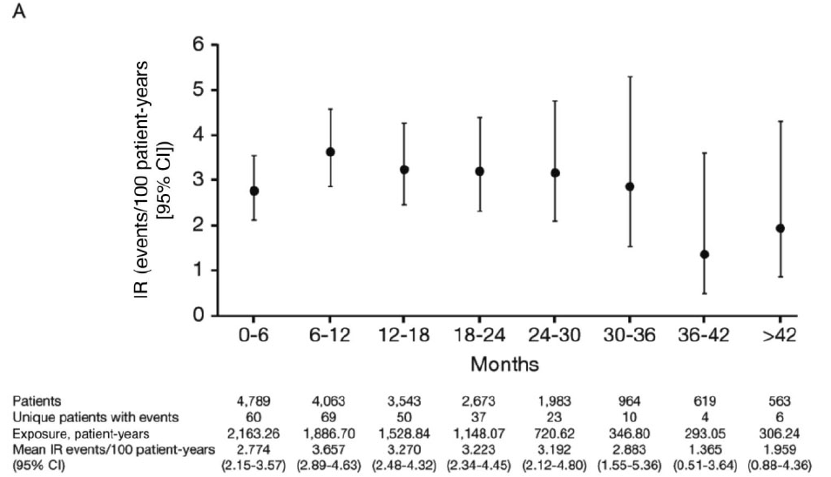
OUTLINE
Τofacitinib: Σοβαρές λοιμώξεις
n=4789
8460 pt-yrs
Cohen S et al, Arthritis Rheumatol 2014

Slide 23
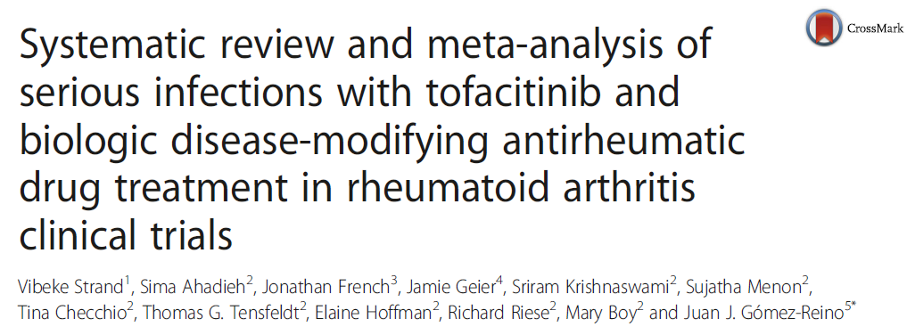
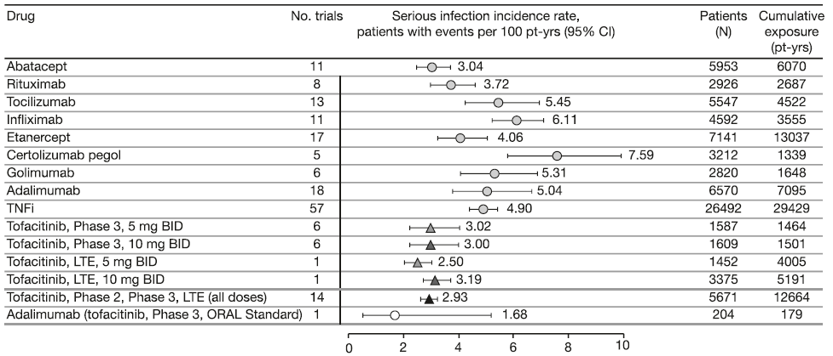
OUTLINE
Τofacitinib: Σοβαρές λοιμώξεις
bDMARDs = 3 - 4.9
Strand V et al, Arthr Res & Ther 2015
Notes:
Fig. 2 Incidence rates for serious infections with biologic DMARDs and tofacitinib across RCTs* and LTE studies. The results displayed did not
include the continuity factor to account for zero incidence rates due to the low percentage of zero incidence rates for serious infections within
these trials (<10 %). Tofacitinib data as of April 2013. *Clinical trial data published between 1999 and 2013. BID twice daily, CI confidence interval,
DMARD disease-modifying antirheumatic drug, LTE long-term extension, pt-yrs patient-years, RCT randomized controlled trial, TNFi tumor necrosis
factor inhibitors

Slide 24
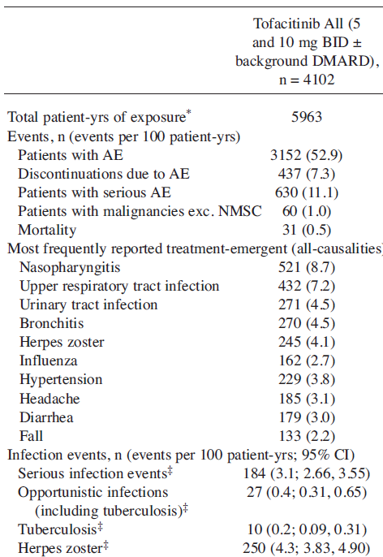
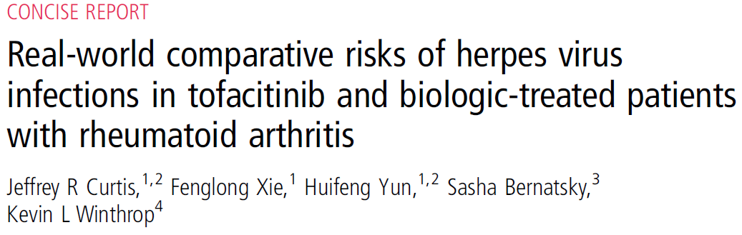
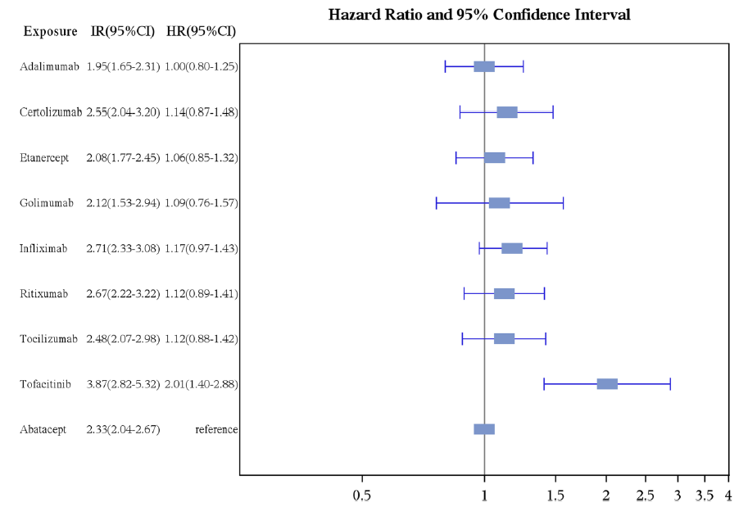
OUTLINE
Τofacitinib: TB – Herpes zoster
Anti-TNFs
ADA = 0.3/100 pt-yrs¹
¹Burmester GR et al, Ann Rheum Dis 2016
(ADA, n=15.152 – 24.810 pt-yrs)

Slide 25
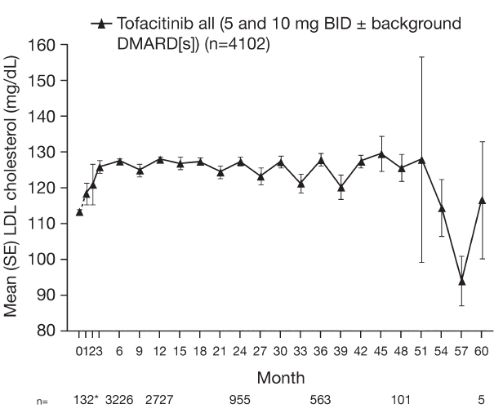
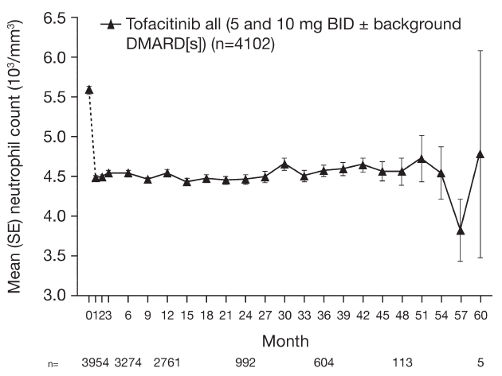
OUTLINE
Τofacitinib: LDL – Ουδετεροπενία
LDL
~ + 15 mg/dL
WBCs
1500-200 0 3.9%
<1500 0.7%
ALT > 2x ULN 8.8%
ALT > 3x ULN 3.3%

Slide 26
OUTLINE
Τofacitinib: Συμπεράσματα
To Tofacitinib αποτελεί ένα νέο από του στόματος, μικρό μόριο, με διαφορετικό τρόπο δράσης
Μακροχρόνια δεδομένα αποτελεσματικότητας από μεγάλο αριθμό ασθενών (~4000, x 4-5 χρ.) δείχνουν:
- ΜΤΧ-naïve: TOFA > ΜΤΧ (μονοθεραπεία)
- DMARD-IR: TOFA+MTX > ΜΤΧ
TOFA+MTX = ADA + MTX
- Anti-TNF-IR: Aποτελεσματικότητα σε ένα σημαντικό αριθμό ασθενών (ACR50=~ 26%)
- Aναστολή ακτινολογικών βλαβών
Από πλευράς ασφάλειας:
  - παρόμοιος κίνδυνος σοβαρών λοιμώξεων με bDMARDs
  - ↑ κινδύνου για ερπητα ζωστήρα
  - ↑ LDL (αλλά και HDL), χωρίς ↑ καρδιαγγειακού κινδύνου
  - ↑ ALT και ↓ WBC σε μικρό αριθμό ασθενών (<5%)
  Tα ενθαρρυντικά αυτά αποτελέσματα αναμένεται να δοκιμασθούν στη κλινική πράξη μετά την έγκριση του φαρμάκου

