Slide 1
Case Presentation 2
Victor Hajiroussos October 2016

Slide 2
Male, age 55
May 2016
C/O Pain in the thoracic spine for 18 months.
Continuous pain worse at times
Tends to be worse in the office but also at night
Some morning stiffness
DQ Hyperlipidemia, mild diabetes
Medication : Crestor, Glucophage
FH Nil

Slide 3
O/E
Anxious individual
Spine good ROM all segments
Chest expansion 5 cm
Lab results : ESR 6, CRP <5 mg/l, HLAB27 neg
MRI

Slide 4
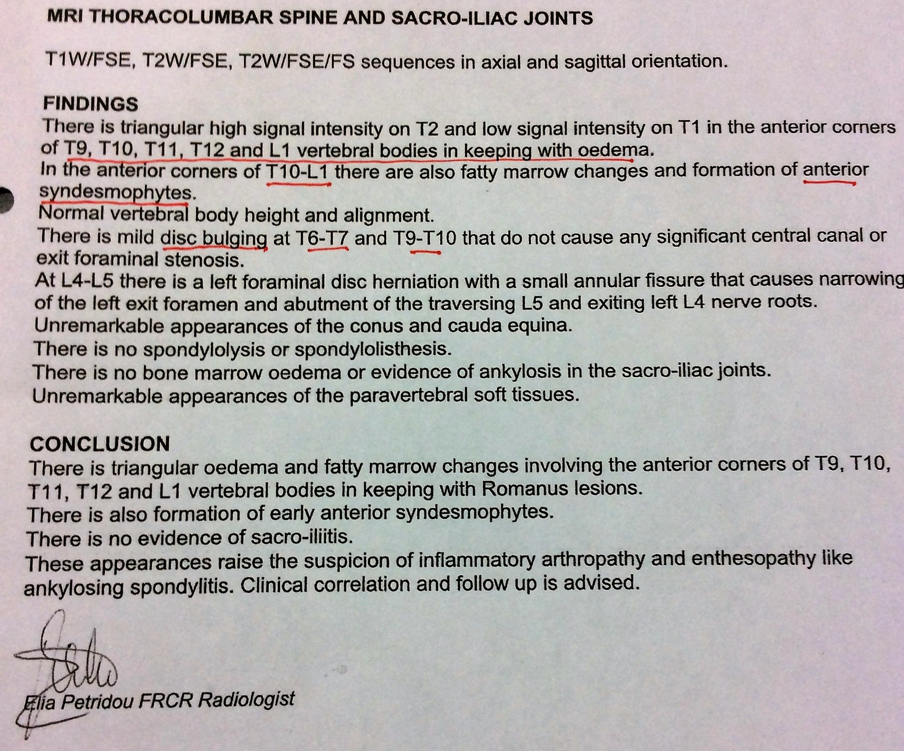

Slide 5
MRI
T1
T2/FS
T2

Slide 6
MRI
T2/FS
T1

Slide 7
Rx
Arcoxia, Indocid, Voltaren No benefit
Physiotherapy No benefit
Now on Tramadol
Repeat MRI but claustrophobic

Slide 8
Diagnosis?
SPA
Early degenerative spine disease [spondylosis]
Malignancy
Early DISH
Other Diagnosis
Don`t know

Slide 9
Bone marrow oedema
Term used to describe bone marrow hyperintensities of T2 MRI images 1998
It may be primary or secondary to many causes and the driving pathological process may not be the same in all conditions
Primary bone marrow syndrome; term used when there is no obvious cause

Slide 10
Bone marrow oedema classification
Primary
Transient osteoporosis [pregnancy] hip, knee, ankle,foot
Osteonecrosis of unknown aetiology hip,knee, ankle
Secondary
Trauma
Degenerative [OA]
Inflammatory: arthritis, enthesitis
Complex regional pain syndrome
Infections: osteomyelitis,septic arthritis
Ischaemia: sickle cell disease, polycythaemia
Neoplastic: primary, metastatic,benign [osteoid osteoma]
Iatrogenic: medicatios [steroids, calcineurin inhibitors]
Metabolic: chronic kidney disease

Slide 11
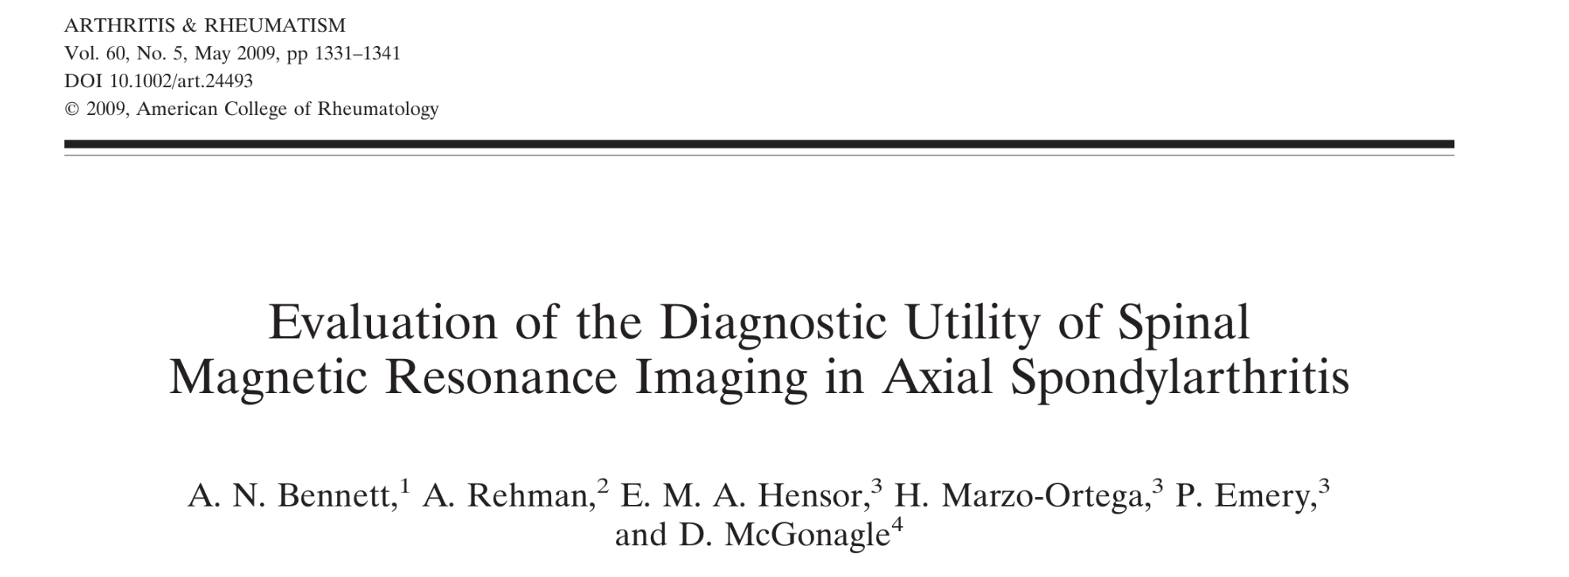
Objective: To compare MRI patterns in active SPA, degenerative arthritis and malignancy
Results/conclusion: MRI is of high diagnostic utility in axial SPA with severe or multiple Romanus lesions especially in younger patients, and posterior element lesions are highly specific for SPA
MRI lesions characteristic of SPA were found frequently in patients with degenerative discs of the spine and in patients with malignancy
No comparable control group

Slide 12
THANK YOU

Slide 13
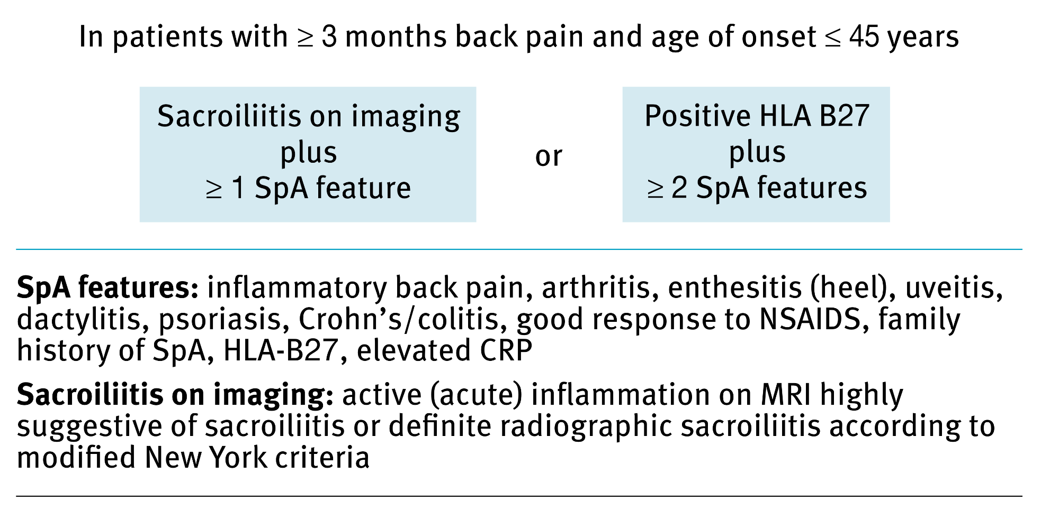
ASAS (2009) CLASSIFICATION CRITERIA FOR AXIAL SPONDYLOARTHRITIS

