Slide 1
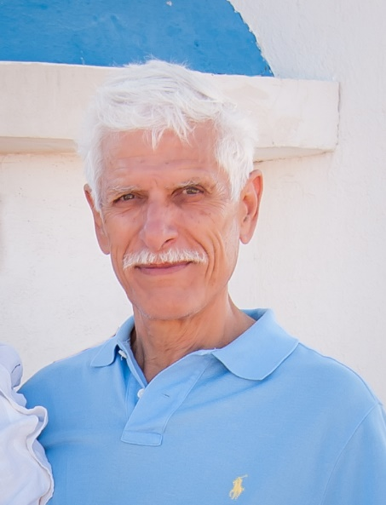

Slide 2
Case presentations: AXIAL SPONDYLOARTHRITIS
Cyprus-Crete Rheumatology Seminar
Victor Hajiroussos
October 2016

Slide 3
Male, age 65
August 2016
Pain and stiffness in the cervical and thoracolumbar spine for long time
Symptoms started ?10 years ago may be longer
Also pain in his R shoulder with restriction of movement
DQs
No night pain, little morning stiffness, otherwise ok
PMH
Prostatitis 20 years ago
Back pain started in the lower thoracic/upper lumbar area.
No recall of pain during youth; may be started in his forties
FH
First cousin with AS
Referred by his GP as a case of AS

Slide 4
ON EXAMINATION / lab results
Cervical spine very restricted ROM
Chest expansion 2.5cm
Lumbar spine very restricted ROM
Peripheral joints normal except for the R shoulder
ESR 16,
CRP 4.1 mg/l
HLAB27 neg

Slide 5
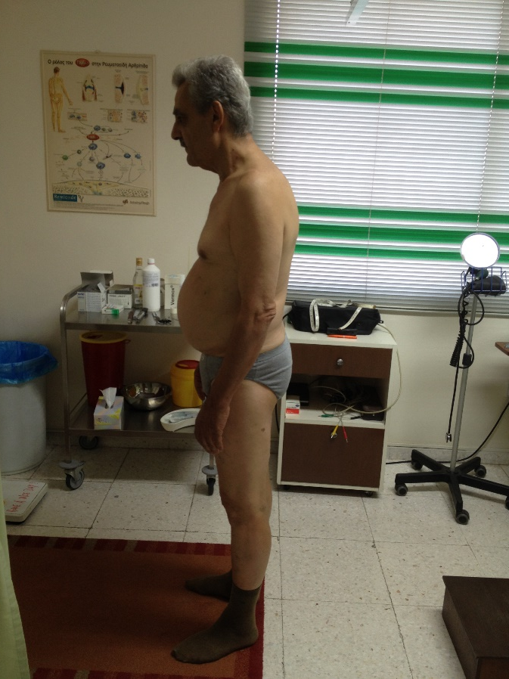
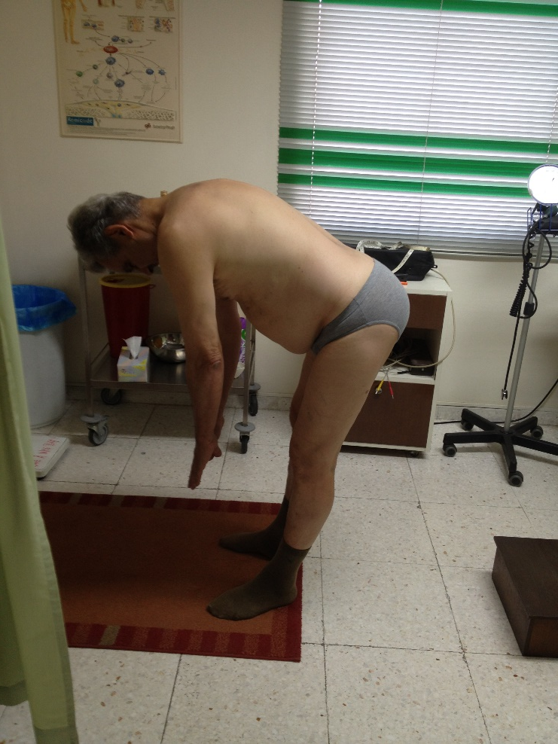
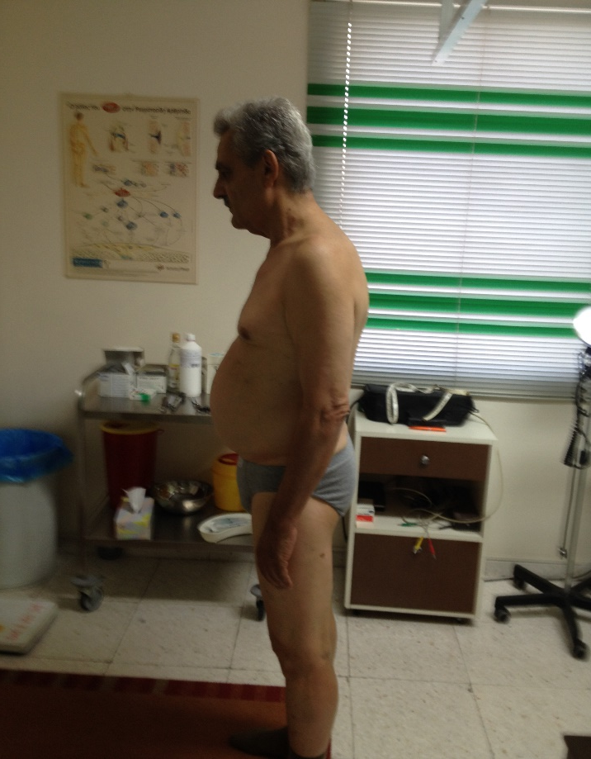
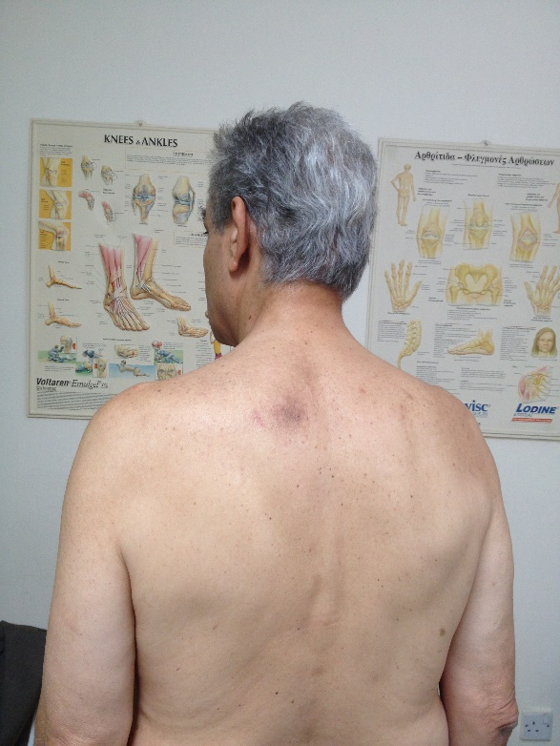
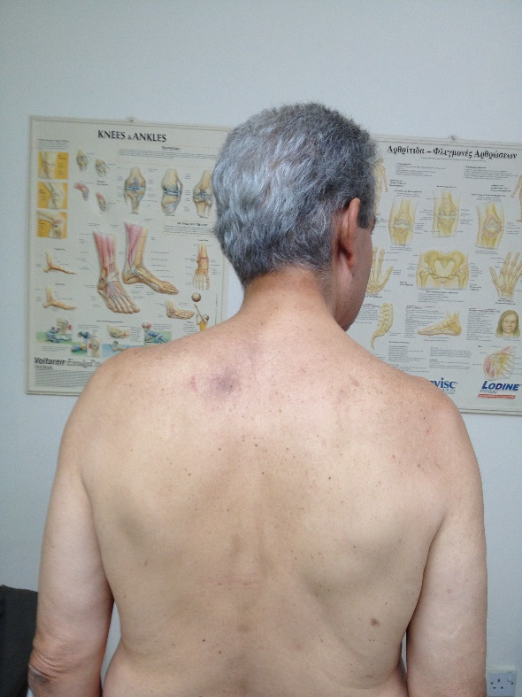

Slide 6
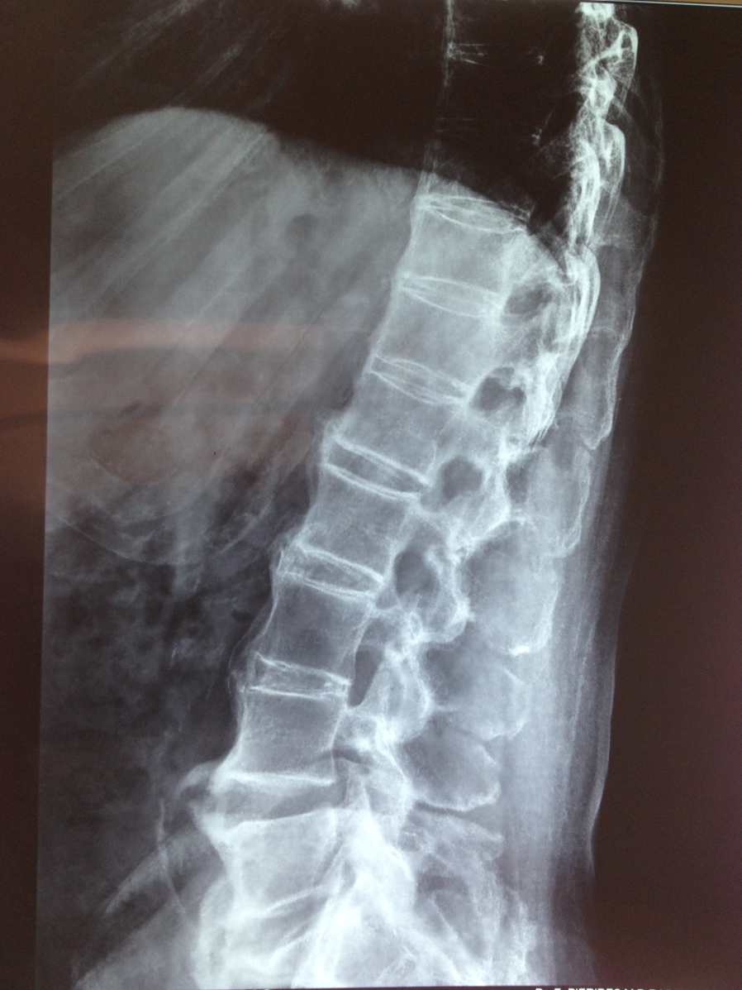
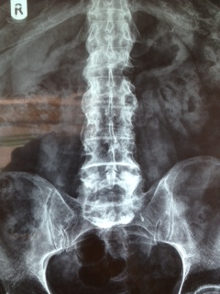
X-rays

Slide 7
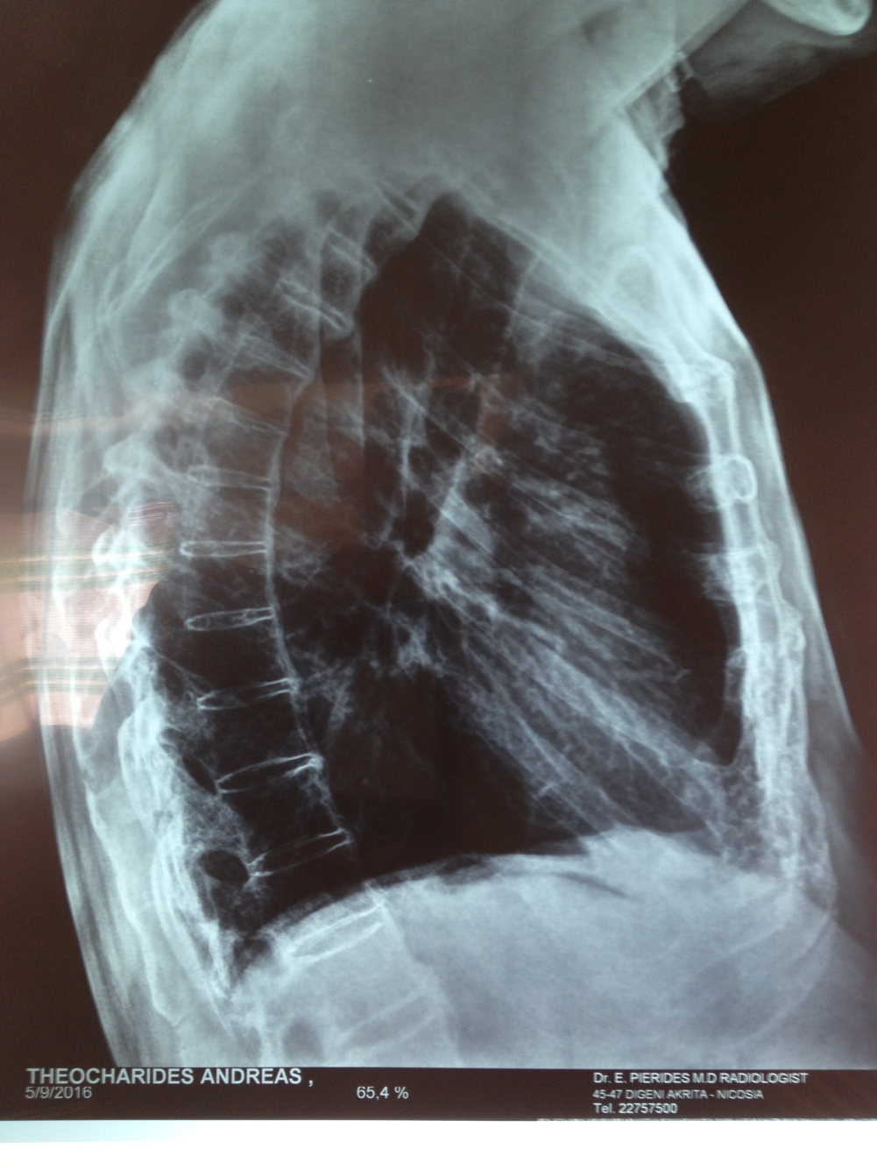
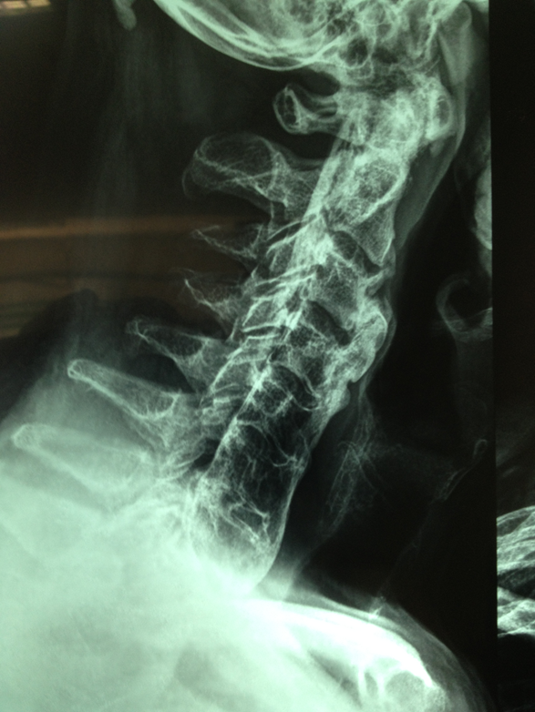
X-rays

Slide 8
Diagnosis ?
Ankylosing Spondylitis
Diffuse Idiopathic Skeletal Hyperostosis
AS and DISH

Slide 9
Dish Diffuse Idiopathic Skeletal Hyperostosis
Condition characterised by calcification and ossification of soft tissues mainly ligaments and entheses
Forestier called it Senile Ankylosing Hyperostosis –
Other name Spondylitis Ossificans Ligamentosa
Axial skeleton involved particularly in the thoracic spine and less often peripheral joints (reason for giving name DISH)

Slide 10
Dish Diffuse Idiopathic Skeletal Hyperostosis
DISH is not a degenerative condition but it shares many features of the degenerative disease of the spine [spondylosis deformans]

Slide 11
Dish Diffuse Idiopathic Skeletal Hyperostosis

Slide 12
Dish Diffuse Idiopathic Skeletal Hyperostosis
It presents after the age of 50 and in autopsy studies the frequency was found to be
28% [ average age of death was 68 years]
Male to female ratio 2 : 1
Clinically : most patients have symptoms [some argue this]
Stiffness, pain, restricted ROM in the spine and sites of enthesopathy
Degree of symptoms depends on the stage of the disease

Slide 13
Dish Diffuse Idiopathic Skeletal Hyperostosis
Complications: dysphagia, aspiration pneumonitis, unstable spinal fractures,
postsurgical heterotropic ossification, difficult intubation, difficult endoscopy,
myelopathy
Aetiology: advanced age, obesity, inflammation [speculation]

Slide 14
Dish Diffuse Idiopathic Skeletal Hyperostosis
Radiographic abnormalities [MRI and CT rarely required]:
Thoracic spine: always involved usually starts between 7th and 11th vertebrae
Calcification/ossification along the anterolateral parts of the vertebrae and continues across the intervertebral disc space.
Deposited bone of variable thickness [ 1 to 20 mm]
Right lateral aspect of vertebral column more heavily involved

Slide 15
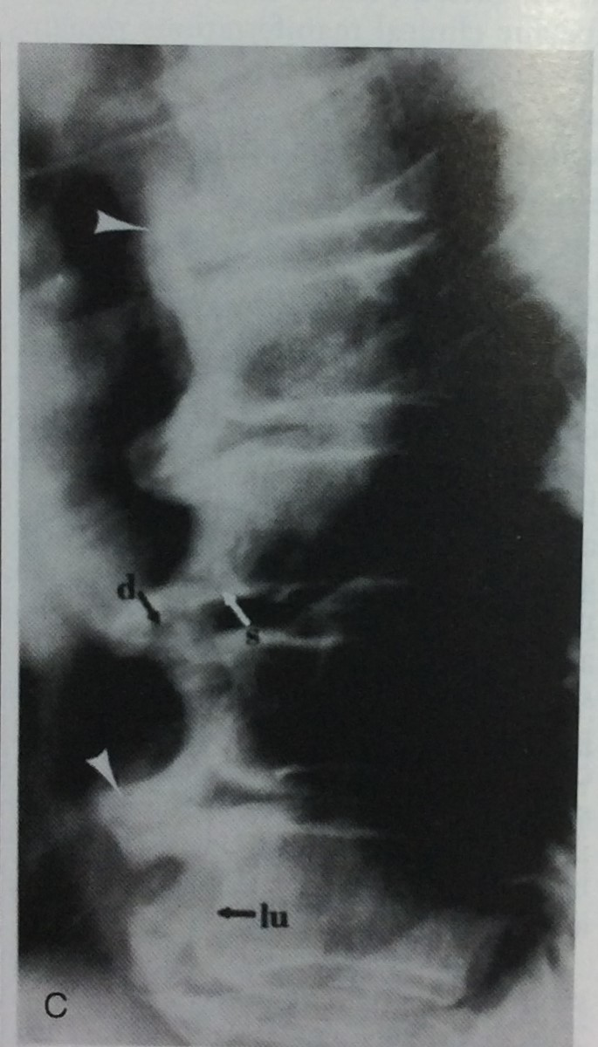
Dish Diffuse Idiopathic Skeletal Hyperostosis

Slide 16
Dish Diffuse Idiopathic Skeletal Hyperostosis
Cervical spine: involved in 68 to 78%
Abnormalities commoner in the lower cervical spine 4th to 7th
Posterior vertebral abnormalities frequent with hyperostosis, osteophytosis and sometimes posterior longitudinal ligament ossification causing myelopathy.

Slide 17
Dish Diffuse Idiopathic Skeletal Hyperostosis

Slide 18
Dish Diffuse Idiopathic Skeletal Hyperostosis
Lumbar spine: 68 to 90%
Commonest and heavier involvement between L1 and L3
Disc space may be normal or mildly/moderately diminished
Apophyseal joint narrowing and sclerosis not infrequent but not ankylosed

Slide 19
Dish Diffuse Idiopathic Skeletal Hyperostosis

Slide 20
Dish Diffuse Idiopathic Skeletal Hyperostosis
Extraspinal abnormalities:
Ossification of entheses and along ligaments and tendons around the pelvis, greater and lesser trochanters, calcaneous, olecranon, patella etc
Paraarticular osteophytes at the SI joints, hip joints, symphysis pubis, ankles, midtarsal joints etc

Slide 21
Dish Diffuse Idiopathic Skeletal Hyperostosis

Slide 22
Dish Diffuse Idiopathic Skeletal Hyperostosis

Slide 23
Dish Diffuse Idiopathic Skeletal Hyperostosis

Slide 24
Dish Diffuse Idiopathic Skeletal Hyperostosis

Slide 25
dtujgj

Slide 26
Objective: to compare natural course of new bone formation in AS and DISH
Methods: compare lateral radiographs of cervical and lumbar spine of patients with
AS and DISH over a period of at least 6 years
Results: AS patients had more new bone formation initially
Syndesmophytes [<45 degrees] commoner in AS
Spondylophytes [>45 degrees] commoner in DISH
Progression of abnormal bone formation over time was the same in the two disease
Discussion: The nature of the different mechanisms of bone formation needs
further study

Slide 28
Objective: Evaluation of the natural progression of bridging osteophyte formation
in DISH on CT
Methods: Whole spine was studied over a period of at least 3 years in DISH patients
Results: Slow progression of abnormal bone formation
Two bridging patterns were observed:
Osteophyte formation with calcification of the ALL [66%]
Osteophyte formation/fusion without ALL calcification [33%]
Both patterns were observed concomitantly in most patients
Discussion: No clear explanation for the two different patterns in terms of pathology

Slide 31
Discussion on the two studies
Imaging studies of DISH at the early stages are scarce
Prospective MRI imaging of DISH starting at the early stages may clarify
the mechanisms involved in ossifications of tissues

Slide 32
THANK YOU

