Slide 1
1st case
Dr Nedi Zannettou hadjichristofi
Physician rheumatologist
Apollonio private hospital
28.10.2016
4th creto-kypriako, Iraklion, Crete

Slide 2
2002
33 year old male, accountant
Divorced with one child age 9
Presented to a neurologist with double vision.
Diagnosed as Myasthenia Gravis
Symptoms resolved with Mestinon and cortisone
Screening for myasthenia was negative at the time

Slide 3
2007
Asymptomatic for 5 years
Relapse
Treated again as myasthenia and symptoms resolved

Slide 4
2014
Glaucoma
Family history of severe glaucoma
Treated with eye drops
Pressure from 30, stabilized to 16 –on chronic Rx

Slide 5
May 2016
3rd episode of ‘stuck’ eye on the right
Painful
2nd MRI, CSF, full work up
Referred for rheumatology evaluation

Slide 6
June 2016 1st visit
47 years old
Painful eye movements
Right eye was ‘catching’ and movement was painful
Severe headache, one week duration, fronto-temporal, and retro-orbital, worse on the right
Bloody nasal secretions for 3 years
No constitutional symptoms

Slide 7
MRI
2002:
MRI Brain-normal. Discrete mucosal thickening of the right maxillary sinus.
2016:
MRI brain, MRI orbits, MR Angiography of intracerebral vessels: enhancement of the right paracavernous area, most probably inflammatory.
Excess CSF spaces of the optic nerve sheaths.

Slide 8
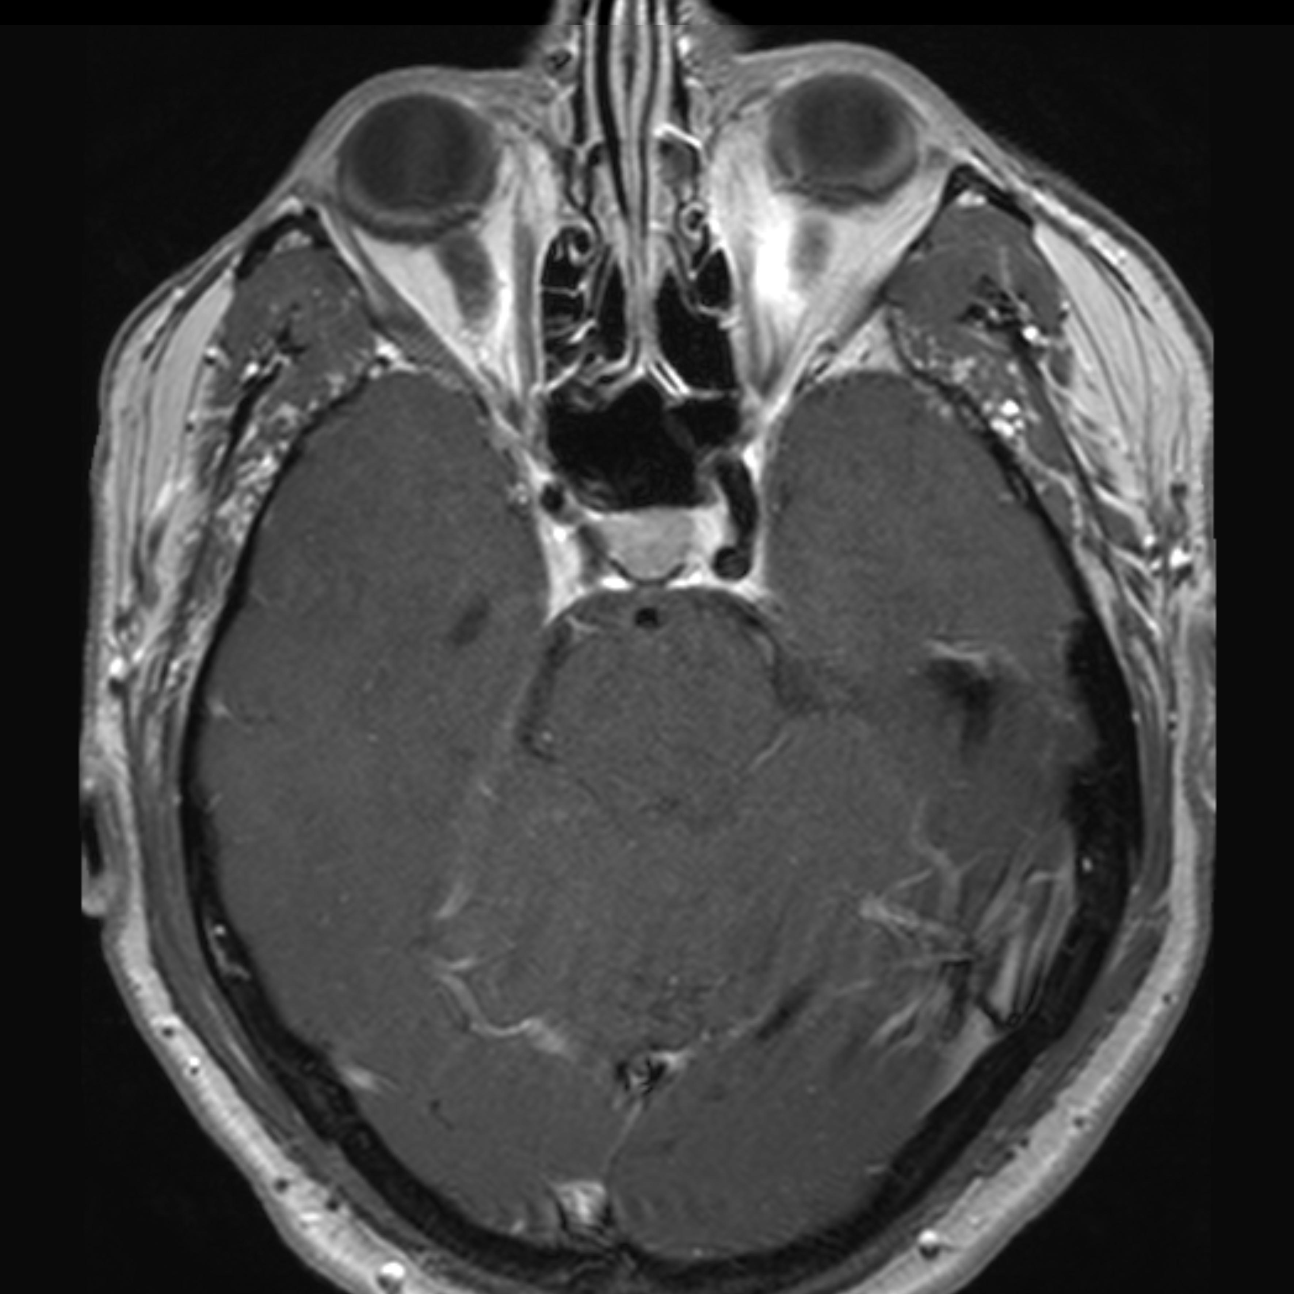
Axial large l T1 Gd001
T1 axial fat suppression

Slide 9
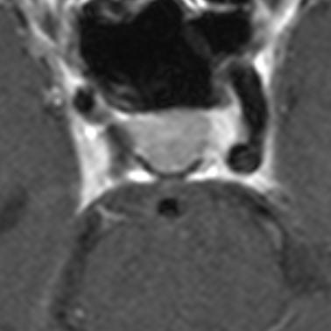
Axial T1 Gd001
Thickening of the Dura
Enhancement of the right paracavernous region

Slide 10
Coronal T1 Gd001
Cavernous Sinus
Enhanced Carotid Artery

Slide 11
Investigations
FBC, ESR, CRP, TSH,T4, LFT’s, Urea, Electrolytes, Creatinine and urine microscopy were normal
CSF
ANA, RF- negative
ANCA: PR3- normal x3
MPO>100 IU/ml; 70.8 IU/ml; > 30 IU/ml
CSF, CXR, ENT-dry mucosa, no lesions found

Slide 12
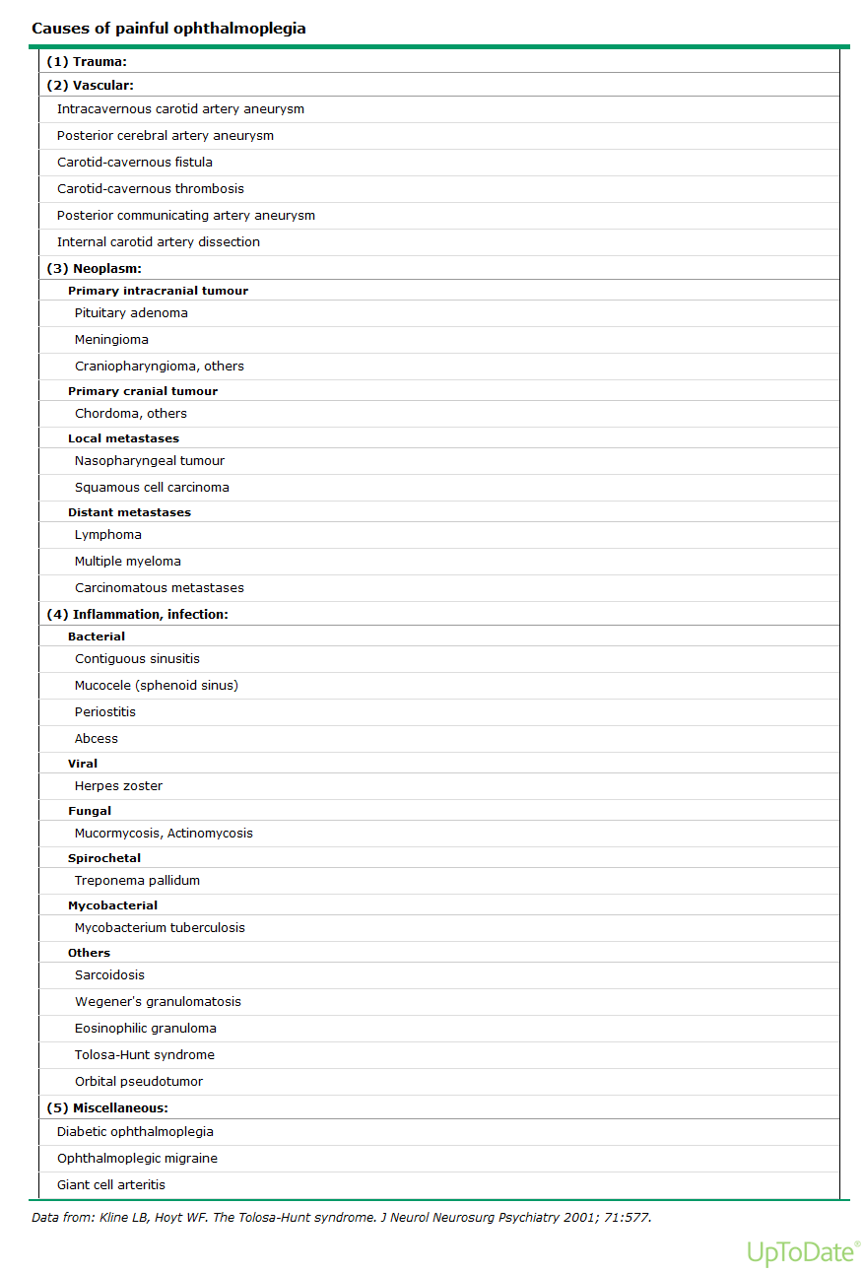

Slide 13
Dolosa- Hunt Syndrome (1954)
Rare 1:1.000.000 per year
Painful ophthalmoplegia due to idiopathic,
granulomatous inflammation of the cavernous sinus
Episodic orbital pain associated with paralysis of one or more of the III, IV, VI cranial nerves, resolves spontaneously, tends to relapse and remit, excellent response to cortisone

Slide 14
Wegener’s
‘Non severe’ ANCA associated vasculitis?
Limited form of Wegener’s?
Association of two autoimmune conditions?

Slide 15
Treatment
Glaucoma and steroids - patient very reluctant
Cytotoxics - benign course of disease last 14 years
Methotrexate & low dose cortisone
Follow up – repeat MRI

Slide 16
2nd Case

Slide 17
46 year old male
Diagnosed with Behcets in 2009. Symptoms since 2006
Recurrent painful mouth ulcers
No genital ulcers
Arthritis- ankles
Acneiform rash: Papulo-vesicular, pustular eruptions
HLA B51 positive

Slide 18
Problem
Renal Impairment with proteinuria
One episode of superficial thrombosis in the leg
Recurrent episodes of epidydymitis following physical exercise and sexual activity
Diagnosed with bilateral varicocele right more than left, causing epididymitis

Slide 19
Excellent response to steroids
Responding well to Azathioprine
Should he be operated for his varicocele?

Slide 20
Thank You

