Slide 1

Ανοσολογική ανοχή και αυτοανοσία
Verginis Panos
Laboratory of Cellular Immunology and Immune Regulation
Department of Immunology and Transplantation
Biomedical Research Foundation, Academy of Athens
pverginis@bioacademy.gr

Slide 2
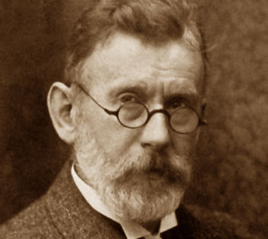
Autoimmunity is……
Horror autotoxicus: the horror of self-toxicity
A term coined by the German immunologist Paul Ehrlich (1854-1915) to describe the body’s innate aversion to immunological self-destruction
Autoimmunity is the failure of an organism in recognizing its own constituent parts as non self, which allows an immune response against its own cells and tissues. Any disease that results from such aberrant immune response is termed autoimmune disease.

Slide 3
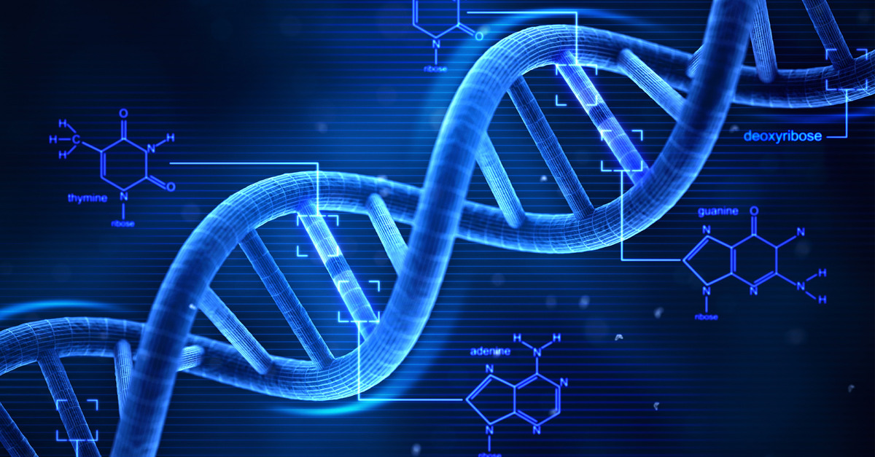
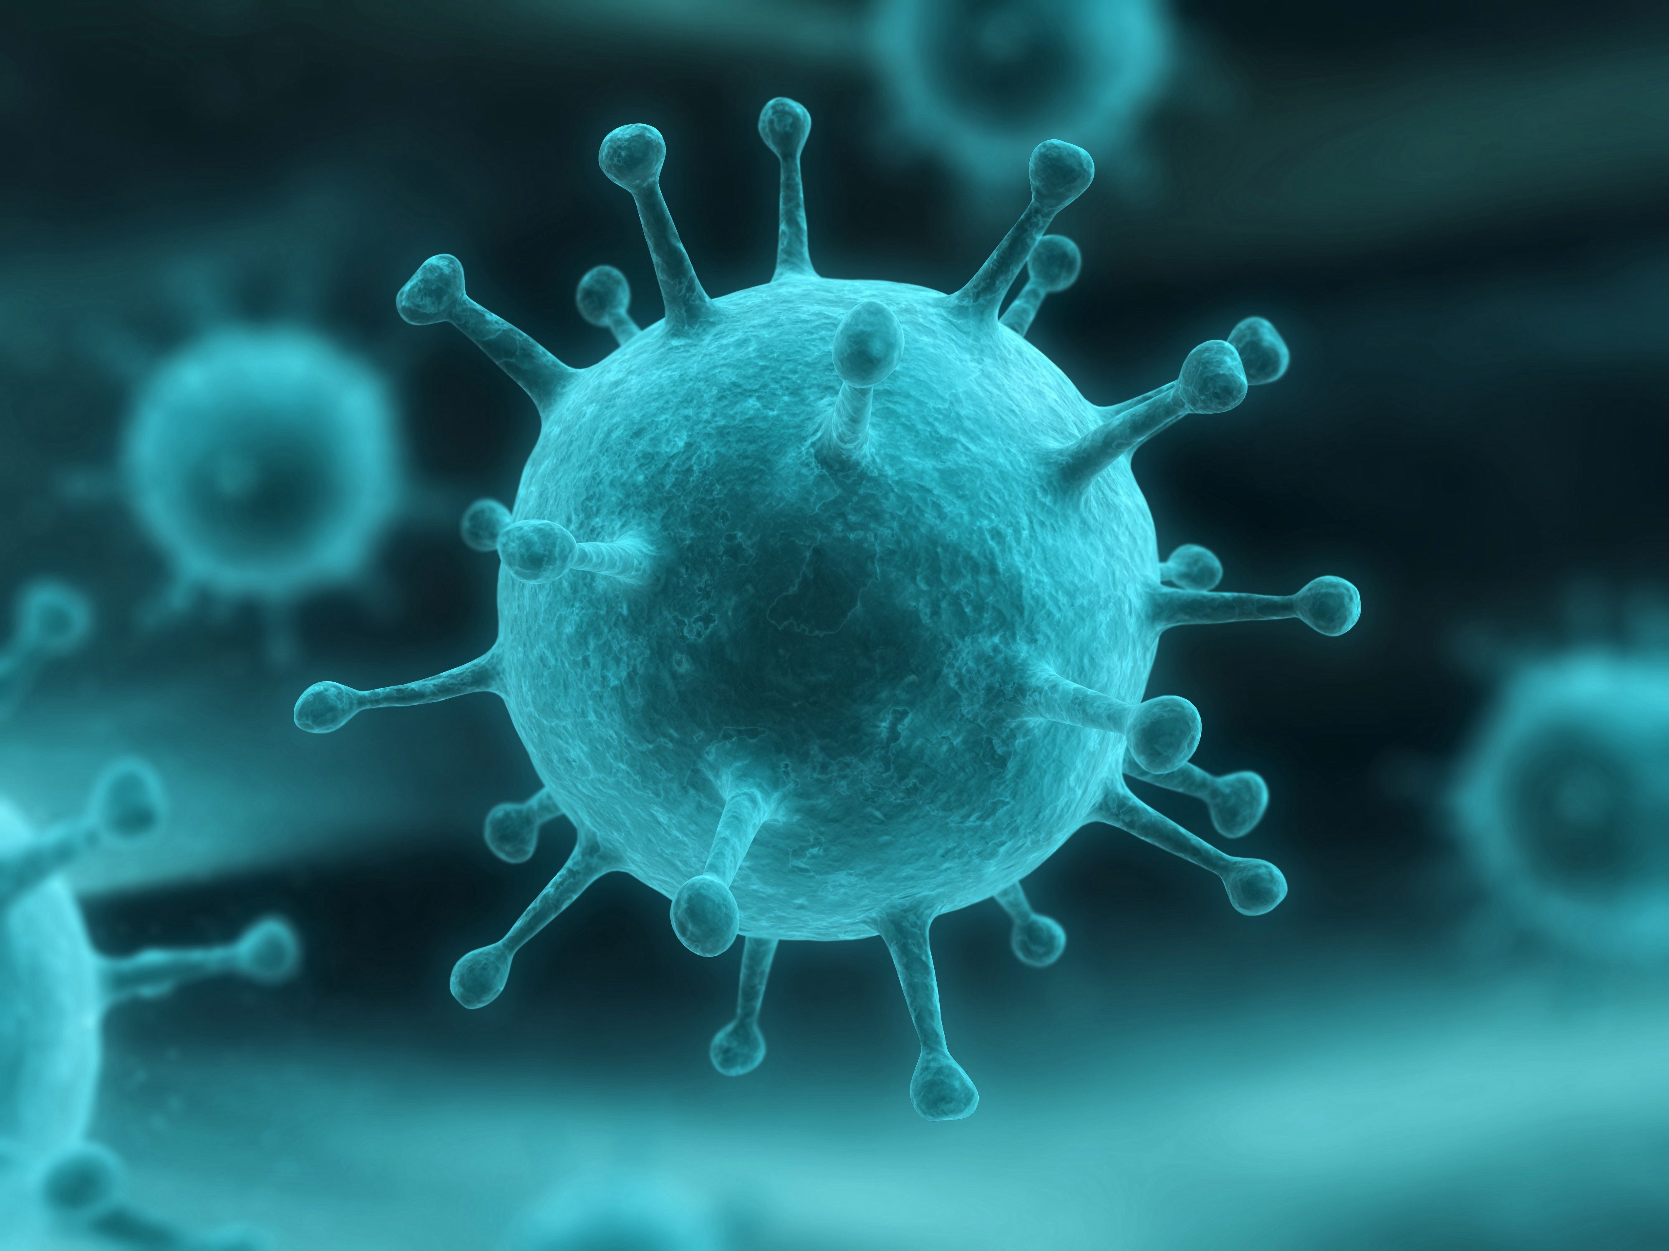
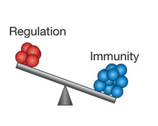
Autoimmune diseases are multifactorial
Environment
Genes
Autoimmune
diseases
Immune regulation

Slide 4
Genetic basis of autoimmunity
Multiple genes are associated with autoimmunity
  Most human autoimmune diseases are multigenic
  Single gene defects reveal pathways of self-tolerance and why it fails (e.g. AIRE, Fas, Foxp3, many others) but are not involved in most, common autoimmune diseases
Genes include HLA, many others
  Each gene individually makes a small contribution
  Little predictive value

Slide 5
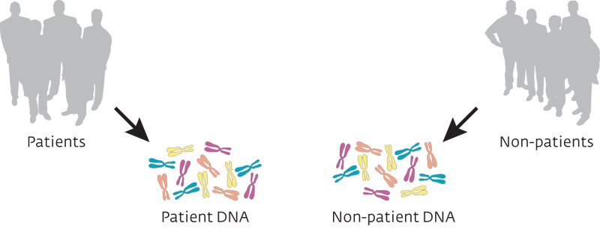
Mapping Human Disease Variants with GWAS
Autoimmune
Patients
Non-Patients
Autoimmune
DNA
Non-Patient
DNA

Slide 6
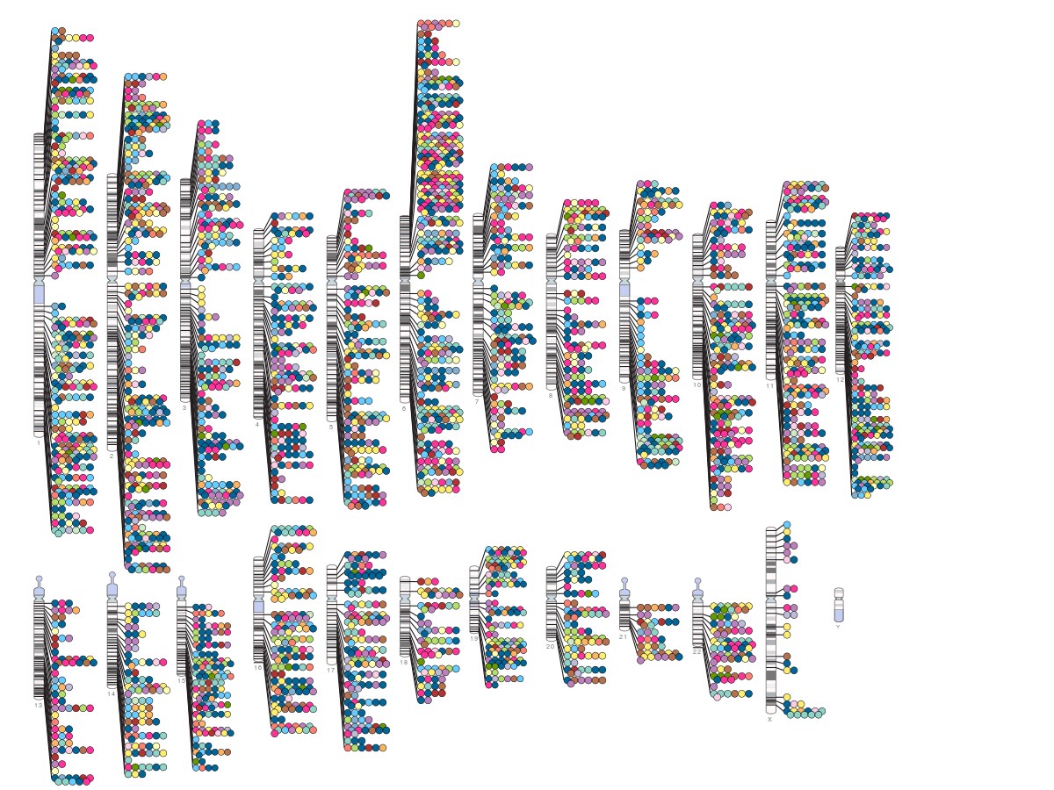
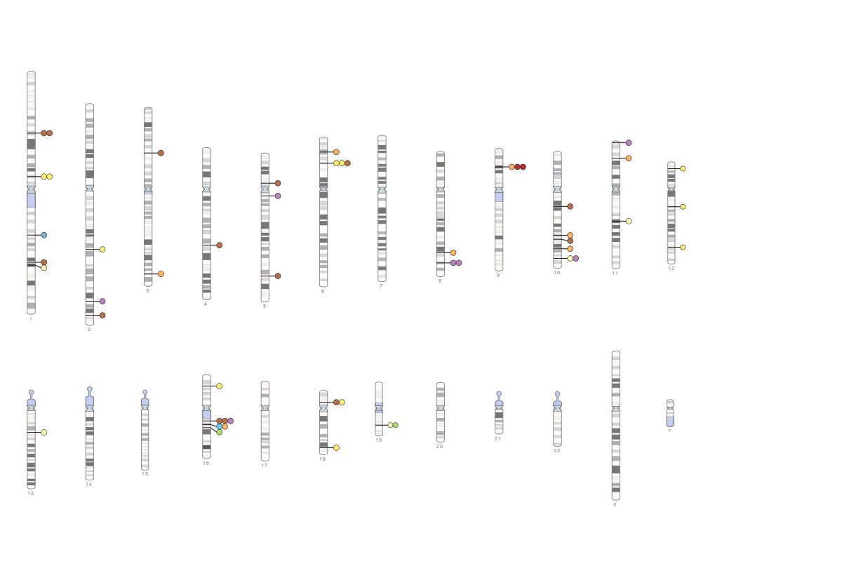
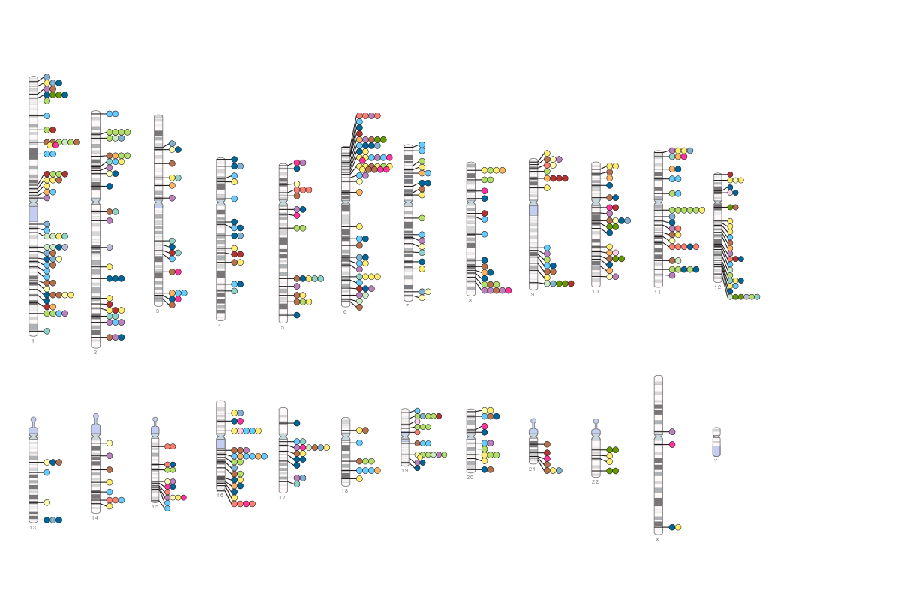
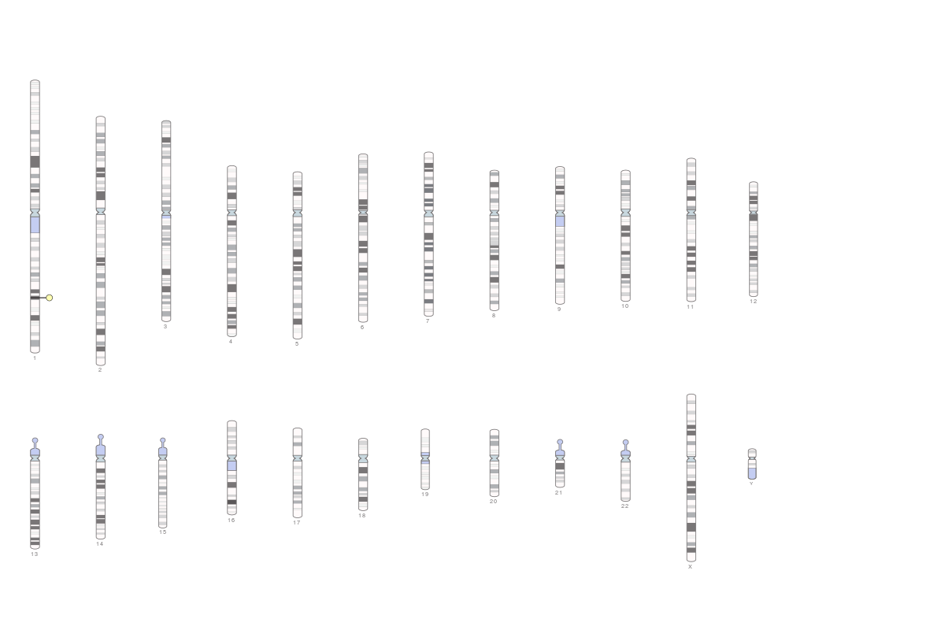
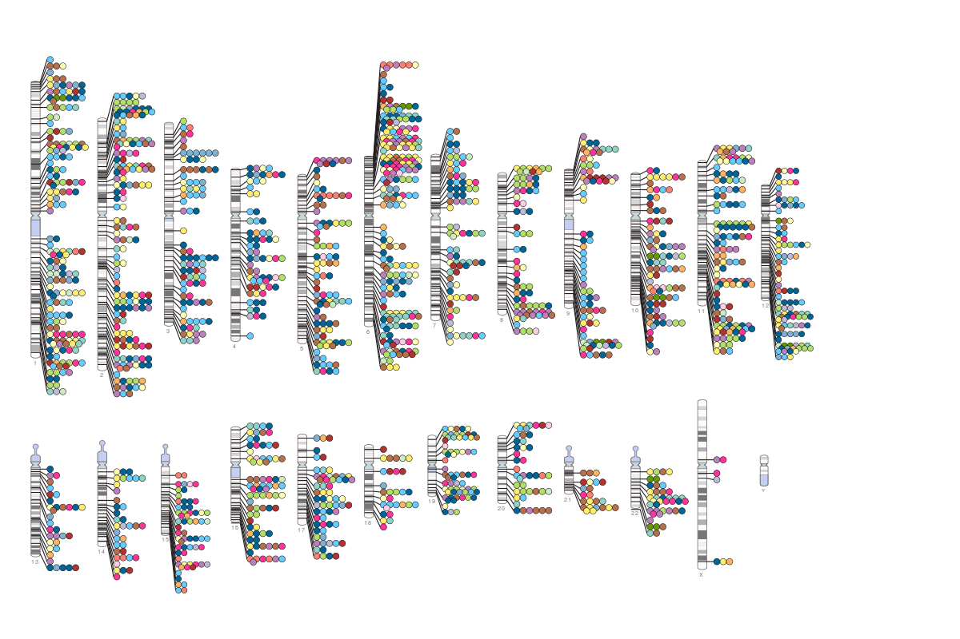
GWAS Era
2005
2011
2007
2014
2009

Slide 7
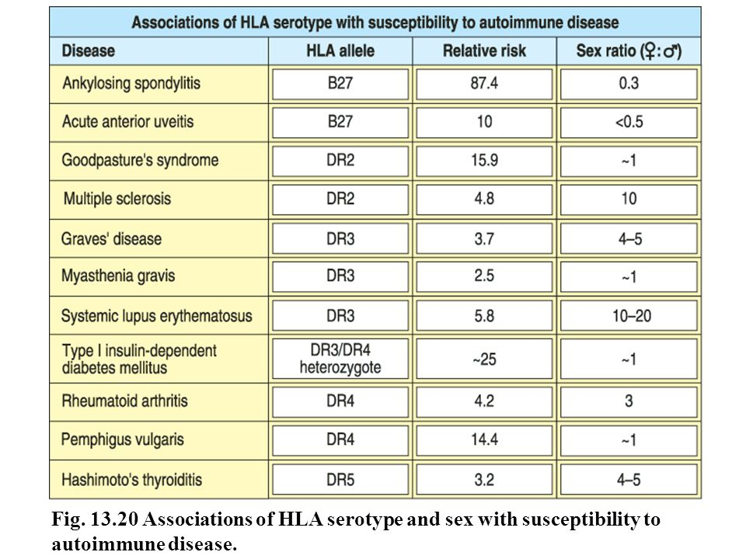

Slide 8
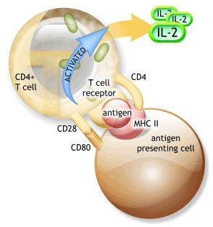
2 signals are required for the efficient activation of lymphocytes

Slide 9
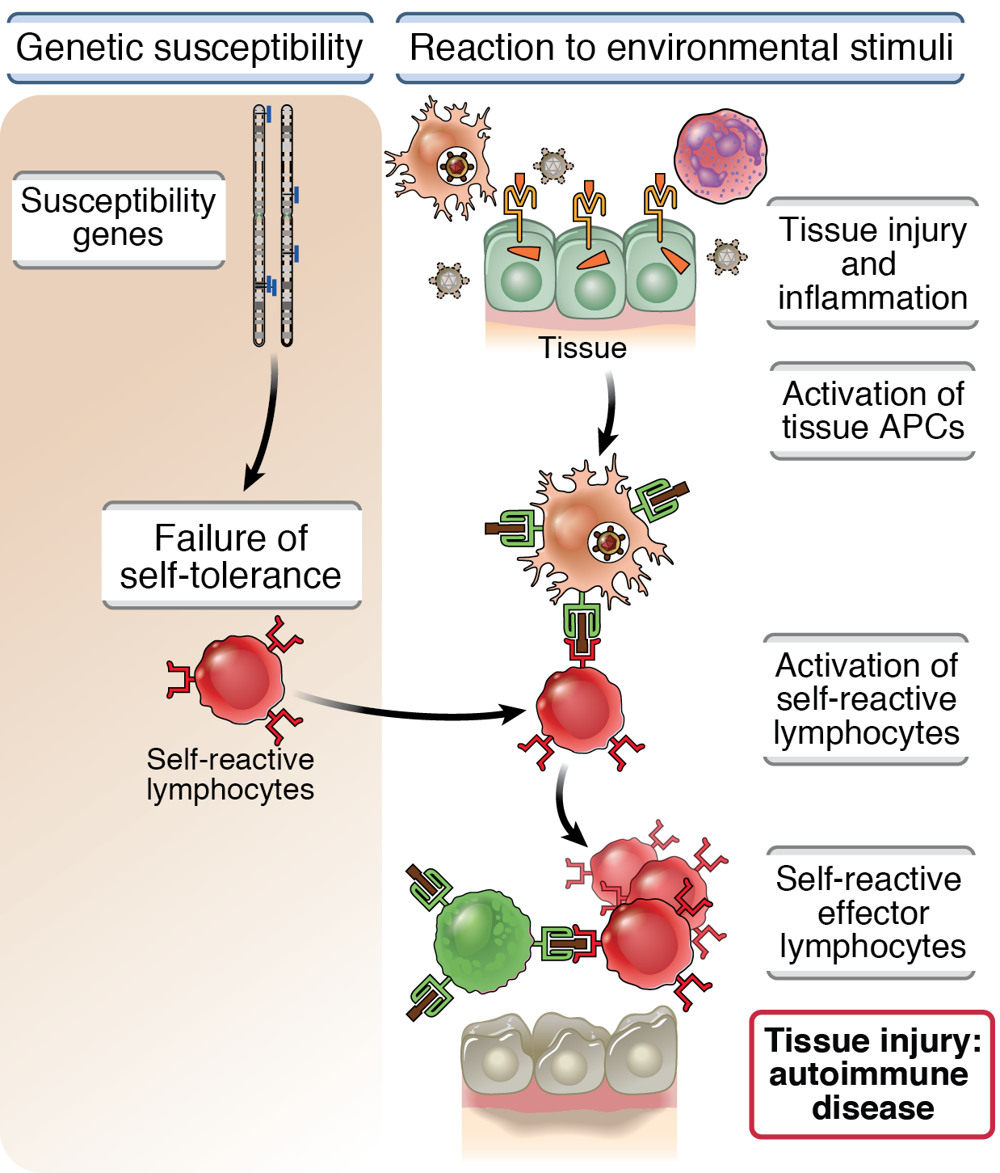
Pathogenesis of autoimmunity

Slide 10
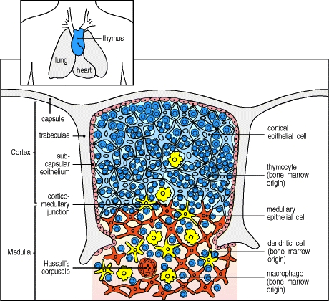
Central tolerance is achieved by the deletion of autoreactive thymocytes through negative selection in thymus
The affinity of the T-cell receptor (TCR) for self-peptide–MHC ligands is the crucial parameter that drives developmental outcome in the thymus

Slide 11
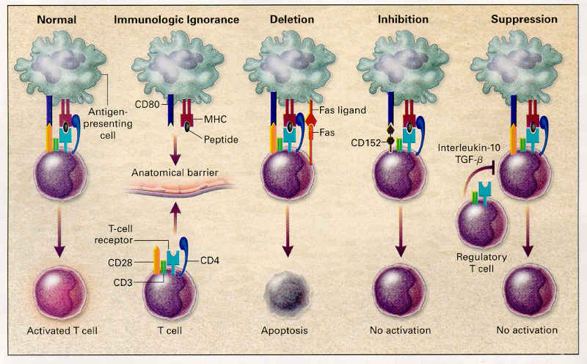
Peripheral mechanisms of tolerance operate to maintain
immune homeostasis

Slide 12
Immunologic ignorance (the sequestration of self-antigens by autoreactive clones)
Immunologically Privileged sites: Brain, Anterior chamber of eye, Testis and Uterus
Tissue grafts placed in these sites do not elicit an immune response – no rejection
Mechanisms of immunologic ignorance:
Lack of lymphatic drainage
Presence of physical barriers between blood and tissue
secretion of immunosuppressive factors

Slide 13
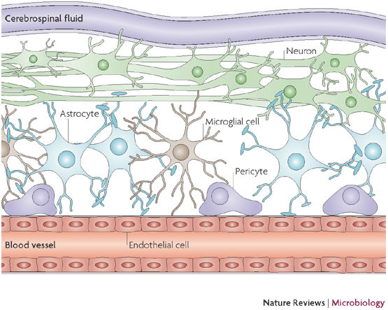
Blood brain barrier separates the circulating blood from brain

Slide 14
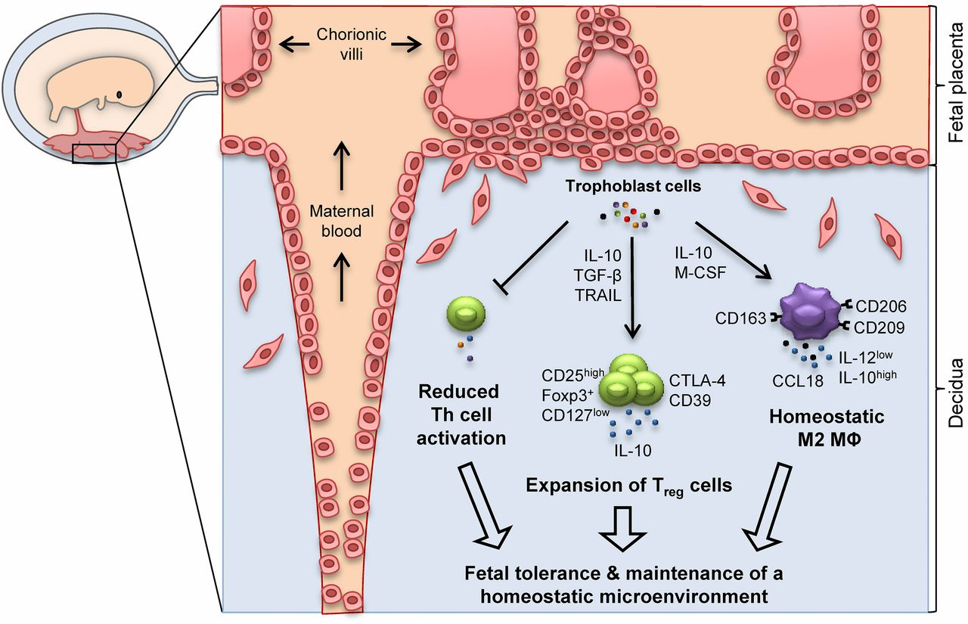
Fetal Tolerance

Slide 15
Clonal deletion (the physical loss of self-reactive clones)
T cell apoptosis ensures the proper removal of autoreactive T cells during thymic development as well as T cell homeostasis and the downregulation of immune responses against antigens in the periphery.
Apoptosis or antigen-induced cell death (AICD) is initiated upon by ligation of membrane-bound death receptors such as CD95/Fas, death receptors such as CD95L (FasL) or TNFR-related apoptosis-inducing ligand (TRAIL).

Slide 16
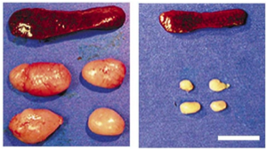
Fas-deficient mice spontaneously develop autoimmunity
The natural mutant lpr mouse (lymphoproliferative), which carries a mutation in the Fas gene and the FasL mutant gld mouse (generalized lymphoproliferative disorder), develop lymphadenopathy, splenomegaly and spontaneous autoimmunity
lpr
B6
autoimmune lymphoproliferative syndrome (ALPS) mutation in Fas gene

Slide 17
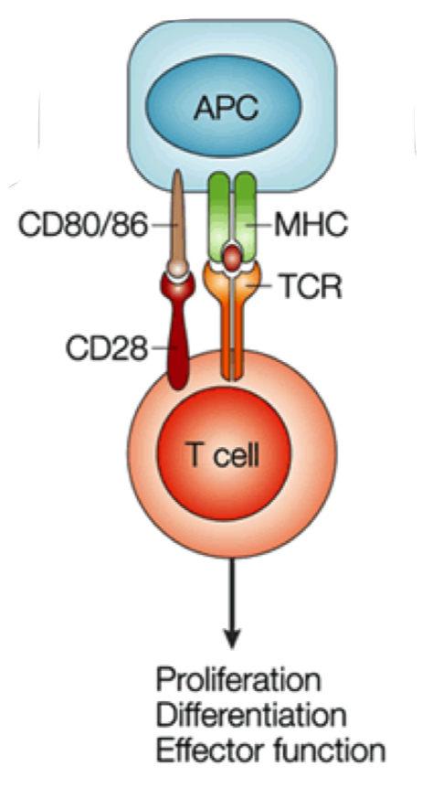
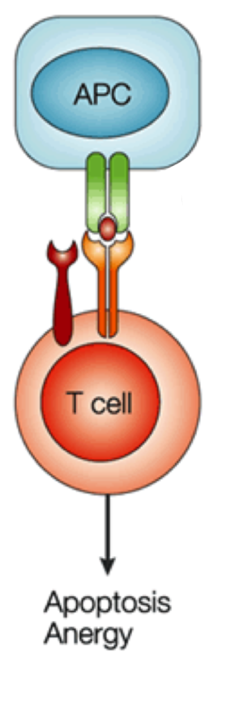
Full activation of T cells requires two signals

Slide 18
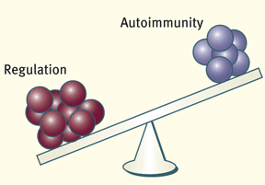
Immune regulation: the pivotal role of regulatory cell populations
Various regulatory cell populations:
Foxp3+ Tregs
IL-10-producing Tr1 cells
IL-10-producing Bregs

Slide 19
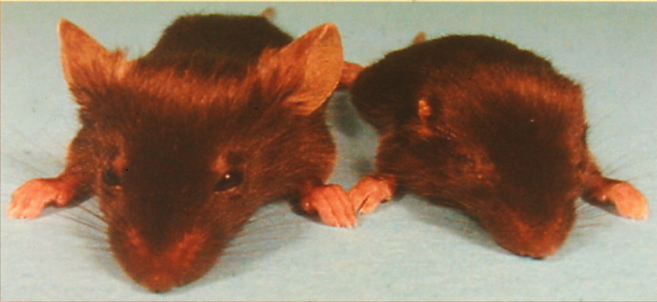
Scurfy Mouse (outside)
Wild type
Scurfy
X-linked recessive inheritance
Lethality at 21-25 days
Wasting syndrome
Exfoliative dermatitis

Slide 20
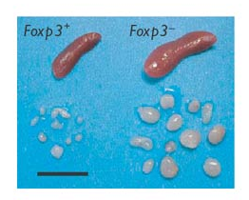
Spleen and lymph nodes at day 21 of age from littermate male Foxp3⁺ and Foxp3⁻ mice
Foxp3⁻ mice succumb to an aggressive lymphoproliferative autoimmune syndrome
Khattri et al. Nat Immunol. 2003 Apr;4(4):337-42

Slide 21
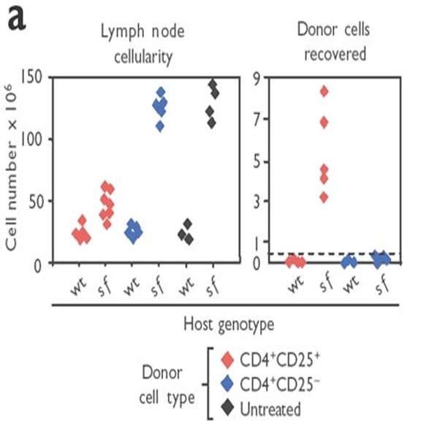
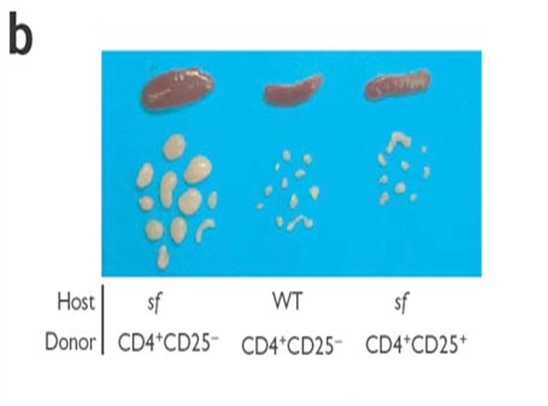
Adoptive transfer of CD4⁺CD25⁺ Tregs “rescue” scurfy mice from the autoimmune phenotype

Slide 22
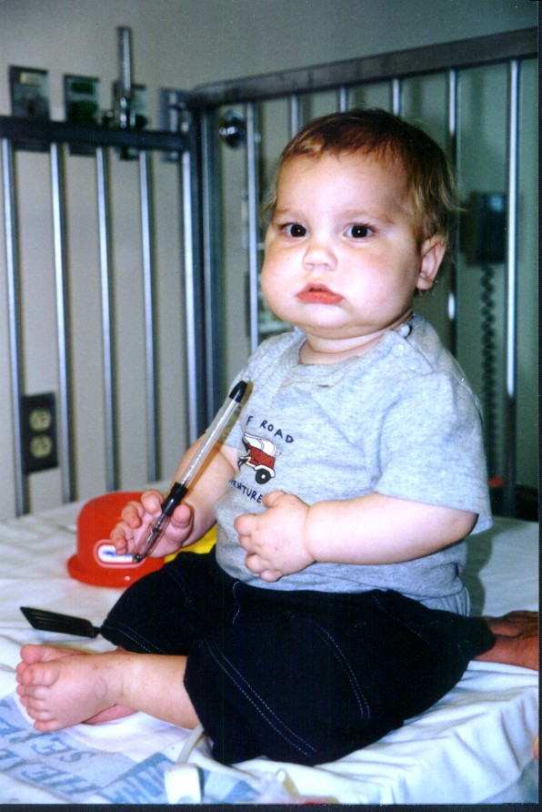
Immunedysregulation Polyendocrinopathy Enteropathy X-linked syndrome (IPEX)
Treg deficiency due to Foxp3 mutation
Neonatal onset diabetes mellitus
Hypothyroidism
Enteritis (diarrhea/villous atrophy)
Hemolytic anemia & thrombocytopenia.
Dermatitis
Dermatitis (eczema)
Death by 1-2 years of age

Slide 23
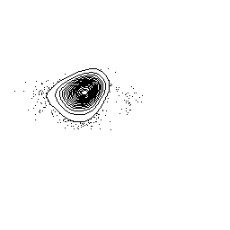
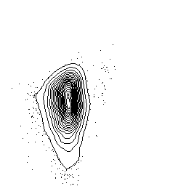
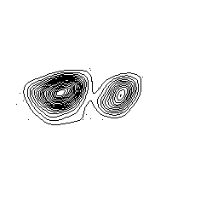
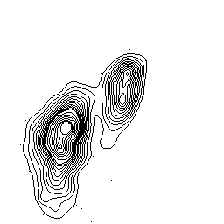
Treg cells are antigen specific
2000
1845
Gated on CD4⁺IAb-HY⁺ cells
1800
1600
0.72
0.68
1400
Quantity of Foxp3 mRNA
relative to β-Actin mRNA
♂ cell-immunized ♀
1200
1000
800
CD4
GITR
600
456
23.5
23.3
400
♂ cell-immunized
Peptide-infused ♀
200
0
5.15
Immunized
controls
Immunized
peptide-infused
Control
CD4⁺CD25⁺
Foxp3
Verginis et al. PNAS 2008; 105 (9) 3479–3484

Slide 24
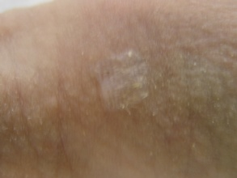
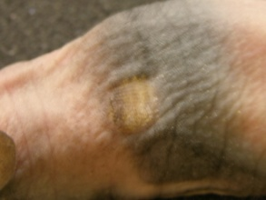
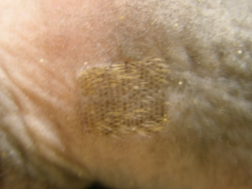
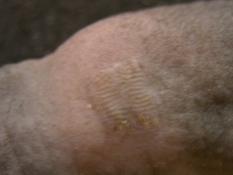
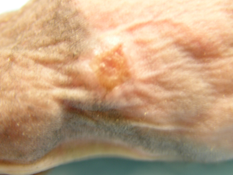
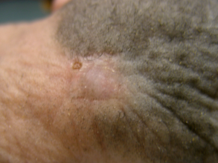
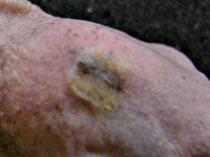
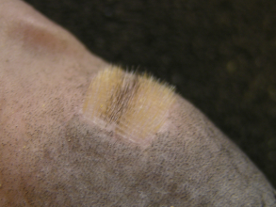
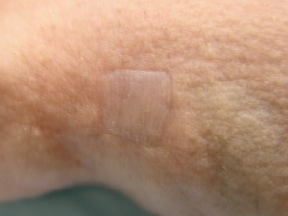
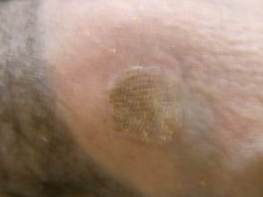
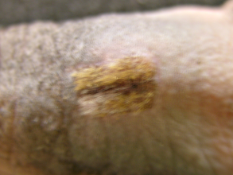
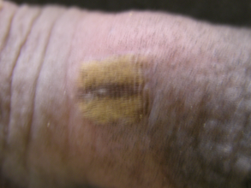
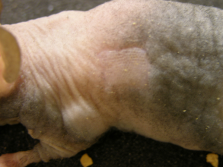
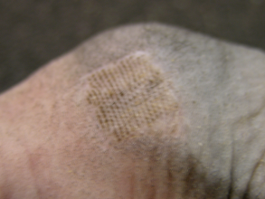
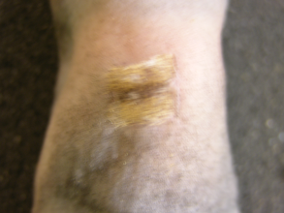
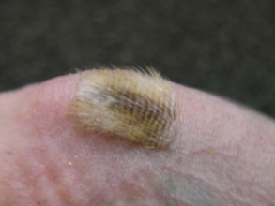
(CD25⁺CD4⁺) Δ TCRβ⁺ cells + - - +
from control B6 ♀
(CD25⁺CD4⁺) Δ TCRβ⁺ cells - + + -
from HY-infused B6 ♀
CD25⁺CD4⁺ cells from - - + +
HY-infused B6 ♀

Slide 25
Regulatory T cells in Autoimmune Diseases

Slide 26
Essential role of Foxp3⁺ Treg cells in maintenance of self-tolerance
Foxp3⁺CD25⁺CD4⁺ Treg cells play an indispensable role in the dominant mechanism of self-tolerance
An illustration of this is provided by the scurfy phenotype in mice
Hori S, et al., Science 2003
Khattri R, et al., Nat. Immunol. 2003
Fontenot JD, et al., Nat. Immunol. 2003

Slide 27
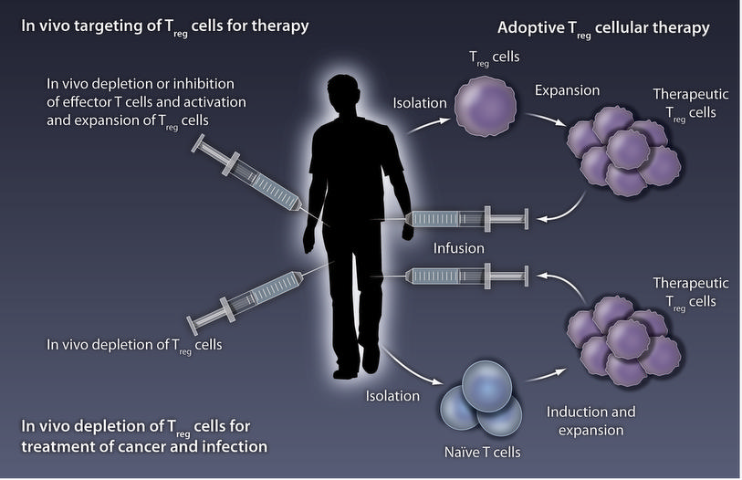
Treg cell immunotherapy

Slide 28
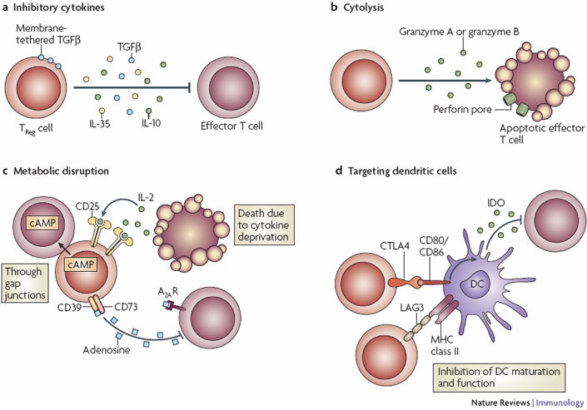
Basic mechanisms of Treg cell function

Slide 29
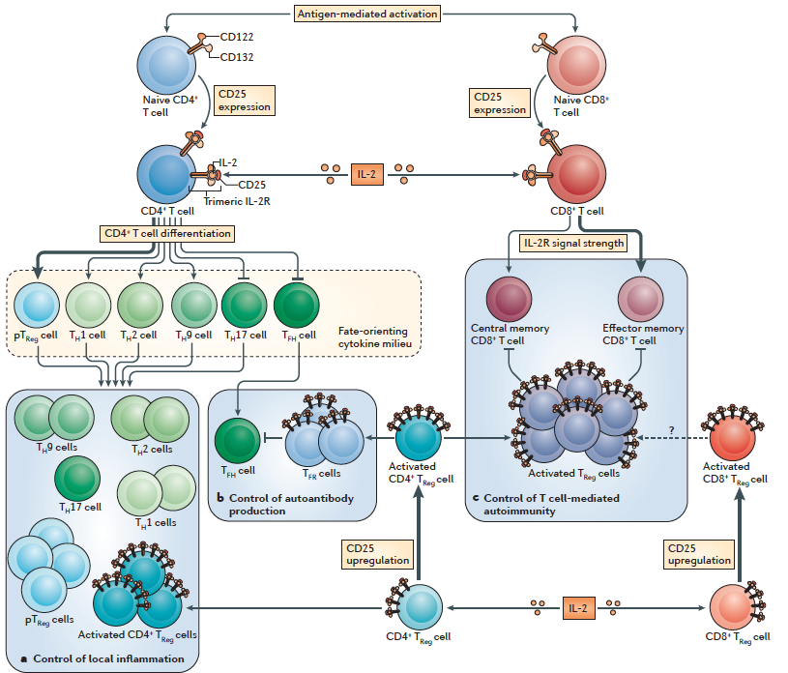
The promise of low-dose IL-2 therapy in autoimmune and inflammatory diseases
Klatzmann and Abbas Nature reviews Immunology 2015

Slide 30
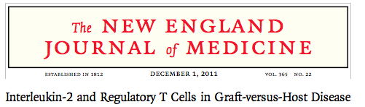


Slide 31




Slide 32

But …..Tregs infiltrate tumors and assist in tumor immune evasion

Slide 33


Slide 34

Other mechanisms that influence peripheral tolerance
Immunoregulatory molecules:
cytotoxic T-lymphocyte antigen 4 (CTLA-4)
programmed death-1 (PD-1)

Slide 35

Therapy of immune disorders: rational approaches target lymphocyte activation and subsequent inflammation

Slide 36
Examples from the literature

Slide 37



Slide 38

IFN-β treatment blocks Th1-induced EAE but exacerbates Th17-mediated EAE

Slide 39

Cytokine profile in RRMS patients

Slide 40



Slide 41


Slide 42









Foxp3⁺ Tregs inhibit the autophagolysosome formation in DCs
MOG₃₅₋₅₅/CFA
Foxp3
T cells
DC isolation
Rag1^{-/-}
LC3
Lamp-1
p62
merged
Foxp3⁻ T cells
Foxp3⁺ Tregs
***
Foxp3⁻ T cells
LC3 puncta/cell
***
p62 puncta/cell
Foxp3⁺ T regs

Slide 43




Down-modulation of DC autophagy compromises auto-antigen presentation
and EAE induction
autophagy KO DCs
MOG₃₅₋₅₅/IFA
2D2
T cells
EAE
Induction
Atg16l1^{flox/flox} DCs
Rag1^{-/-}
Atg16l1^{ΔCd11c} DCs
Atg16l1^{fl/fl} DCs
Atg16l1^{ΔCd11c} DCs
Mean Clinical score
Max. severity of EAE
(clinical score)
**
**
**
*
*
*
*
***
days post immunization

Slide 44










Foxp3⁺ Tregs inhibit autophagy in DCs in a CTLA4-dependent manner
LC3
Lamp-1
p62
merged
control
control
Foxp3⁺ Tregs
anti-CTLA4
Foxp3⁺ Tregs/anti-CTLA4
LC3 puncta/cell
Foxp3⁺ Tregs
anti-CTLA4
p62 puncta/cell
Foxp3⁺ Tregs/
anti-CTLA4

Slide 45


CTLA4-deficient Foxp3⁺ Tregs did not inhibit autophagy on DCs
Rosa26^{CreERTwt/wt}Ctla4^{fl/fl}
LC3/Lamp-1/p62/dapi
LC3 puncta/cell
wt
iKO
p62 puncta/cell
Rosa26^{Cre/ERT2+}Ctla4^{fl/fl}
5uM

Slide 46











CTLA4-Ig (Abatacept) diminishes autophagy in human DCs and
promotes FoxO1 nuclear exclusion
LC3/p62
***
IgG
CTLA4-Ig
anti-TNFα
Abatacept
IgG
CTLA4-Ig
LC3 puncta/cell
Ly294002 - +
p-mTOR
Lc3b relative
expression
total mTOR
***
p-p85
total p85
CTLA4-Ig
p-Akt
p62 puncta/cell
total Akt
IgG
CTLA4-Ig
Relative intensity
nuclear FoxO1

Slide 47


Regulatory T cells restrain autophagy in dendritic cells to ameliorate autoimmunity in a CTLA4-dependent fashion
Foxp3⁺ Treg
CTLA4
CD80/CD86
P
P
PI3K
FoXO1
P
AKT
LC3B
MHCII
Dendritic Cell
TCR
CD4⁺ T cell

