Slide 1
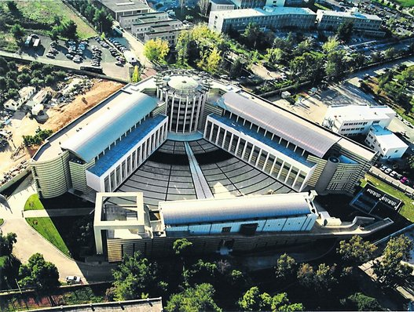
T Cell Effector Function and Cytokine Biology
Georgina Xanthou, PhD
Cellular Immunology Laboratory
Center for Basic Research,
Biomedical Research Foundation
of the Academy of Athens

Slide 2
Adaptive Immunity
Recognizes non self & self antigens (in pathological cases)
Responds to a foreign invader
Distinguishes between invaders (potential pathogen)
Recognition of a non-self presence causes:
Humoral responses – based upon the presence of antibodies
Cellular responses – based upon the activity of T lymphocytes
Works on the basis of:
Specificity
Diversity
Memory

Slide 3
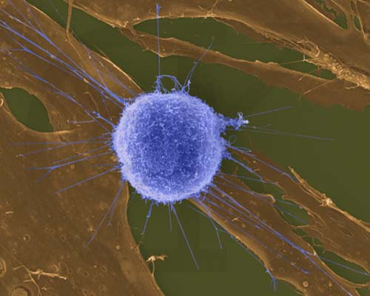
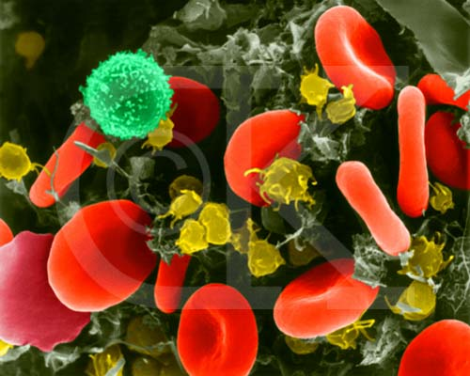
T cell-mediated immunity
There are only a few lymphocytes with antigen receptors for any particular epitope.
In the lymph nodes, an antigen is exposed to a steady stream of lymphocytes until a match with the TCR is made.
This binding of a mature lymphocyte to an antigen initiates events that activate the lymphocyte.
Clusters of Differentiation (CD): An internationally-recognized systematic nomenclature for cell surface molecules used to discriminate between hematopoietic cells

Slide 4
T lymphocytes
all T cells express CD3
αβ⁺ TCR, about 90% in blood
γδ⁺ TCR, about
10% in blood
~²/₃
express CD4-
Th helpers
~¹/₃
express CD8-
Cytotoxic, CTLs
CD4⁺ Th cells: produce cytokines that enhance humoral and CTL-mediated immunity and non-specific innate mechanisms of defense.

Slide 5
A typical CD4⁺ T helper type of immune response #1
Antigen presented by
APC to a CD4⁺ T cell
Activation
Clonal Expansion of CD4⁺ T cells
CD4⁺ Th cells
Cytokine production
Expansion requires
Specific Antigen
Cytokines eg IL-2

Slide 6
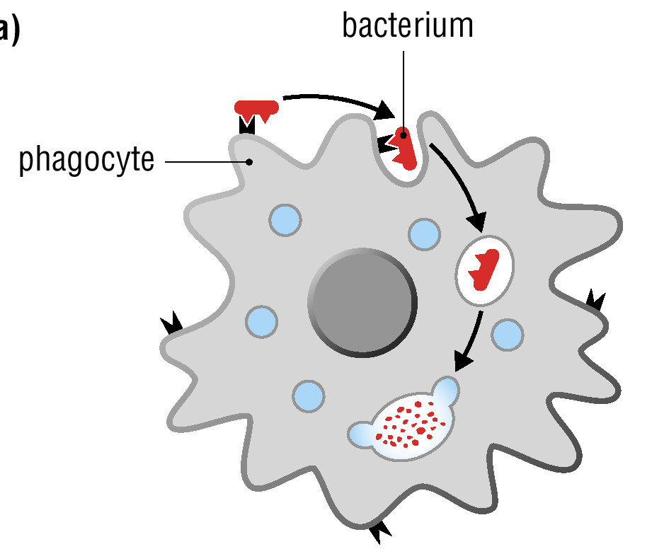
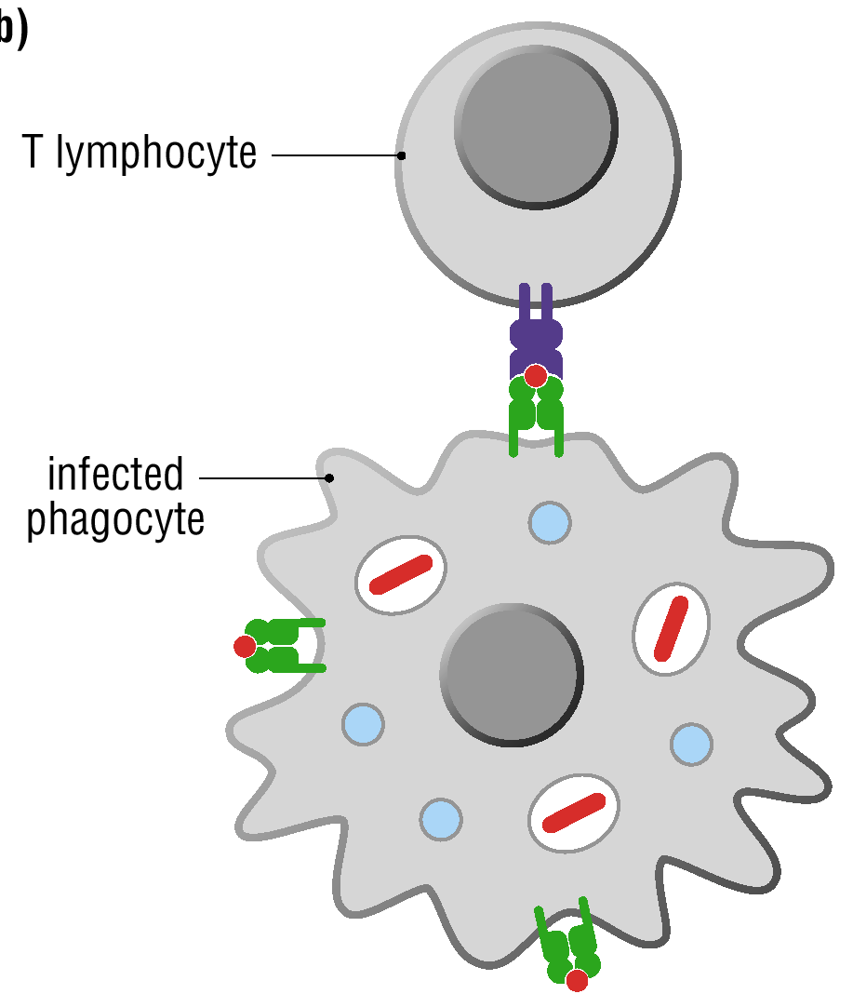
A typical CD4⁺ T helper type immune response #2
Microbe evades
Killing
helper
cytokines

Slide 7
A typical CD4⁺ T helper type immune response #3
Antigen presented by
APC to a CD8⁺ T cell
Clonal Expansion
Activation
Kill infected cells
CD8⁺ T cell
Cytokine
(eg IL-2)
CD4⁺ Th cells
Provide help (cytokines) for target cell killing

Slide 8
T lymphocytes

Slide 9
CD8⁺ Cytotoxic T Cells (CTLs)
CTLs are the effector cells in cell-mediated adaptive responses
Defense against intracellular pathogens, including bacteria and viruses
CTLs recognize fragments of foreign proteins produced by infected cells and possess an accessory protein that binds to class I MHC molecules
Activated CTLs secrete proteins that disrupt the membranes of target cells and trigger apoptosis.

Slide 10
CD8⁺ Cytotoxic T Cell responses
Cytotoxic T cell
Accessory protein
Antigen receptor
Class I MHC molecule
Infected cell
Antigen fragment
1
Notes:
Figure 43.17 The killing action of cytotoxic T cells on an infected host cell.

Slide 11
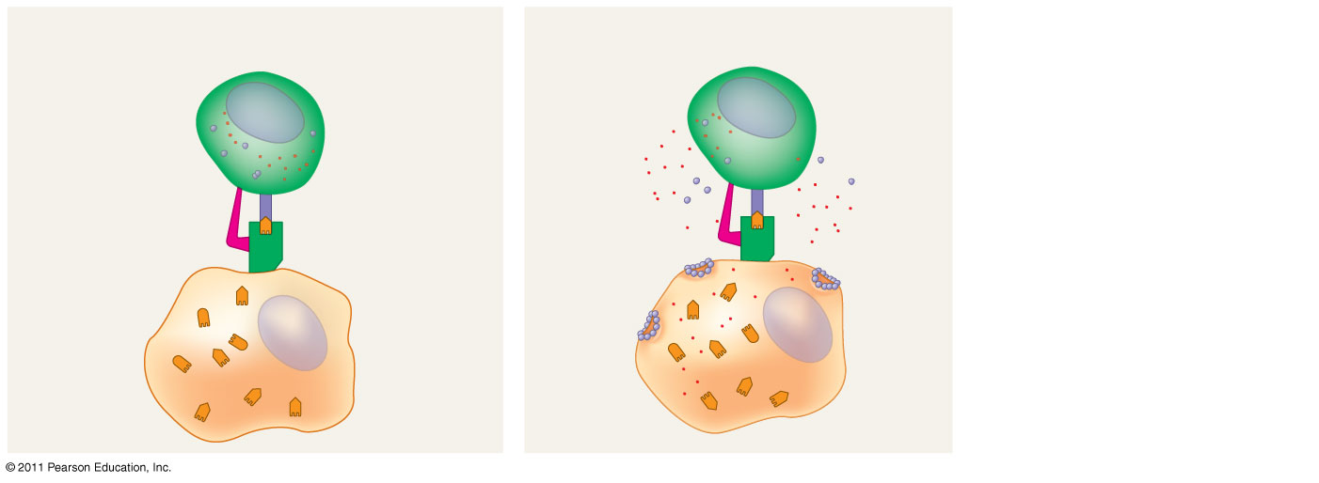
CD8⁺ Cytotoxic T Cell responses
Cytotoxic T cell
Accessory protein
Antigen receptor
Class I MHC molecule
Perforin
Gran- zymes
Pore
Infected cell
Antigen fragment
1
2
Notes:
Figure 43.17 The killing action of cytotoxic T cells on an infected host cell.

Slide 12
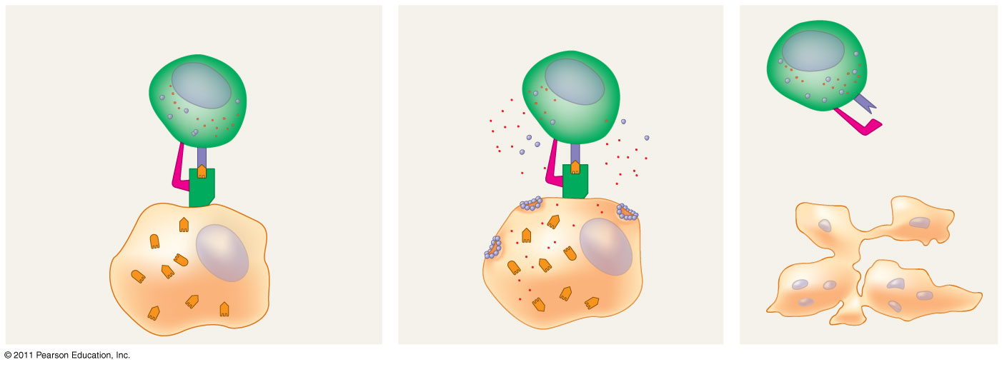
CD8⁺ Cytotoxic T Cell responses
Cytotoxic T cell
Released cytotoxic T cell
Accessory protein
Antigen receptor
Dying infected cell
Class I MHC molecule
Perforin
Gran- zymes
Pore
Infected cell
Antigen fragment
1
2
3
Notes:
Figure 43.17 The killing action of cytotoxic T cells on an infected host cell.

Slide 13
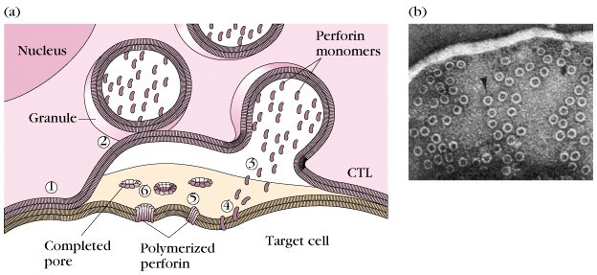
CTL mediated target cell killing

Slide 14
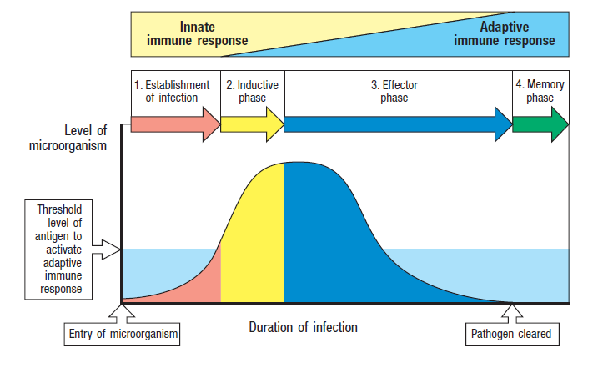
Adaptive immune responses are essential for the clearance of acute infections.

Slide 15
Immunological Memory:
Immunological memory is responsible for long-term protections against diseases, due to either a prior infection or vaccination.
The first exposure to a specific antigen represents the primary immune response.
During this time, selected B and T cells give rise to their effector forms.
In the secondary immune response, memory cells facilitate a faster, more efficient response.

Slide 16
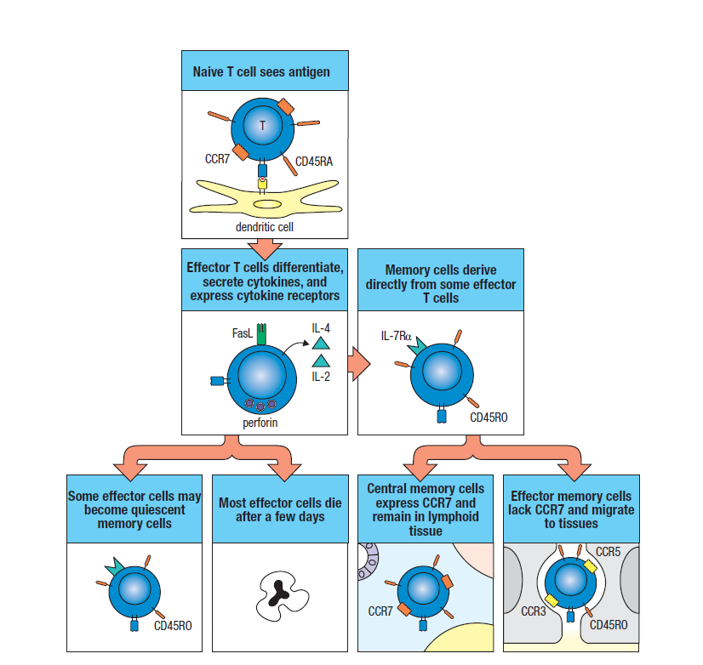
T cell memory responses
Once activated, a T cell undergoes multiple cell divisions.
T cell proliferation is called clonal selection.
short-lived activated effector cells act immediately against the antigen.
long-lived memory cells give rise to effector cells upon encounter with the same antigen

Slide 17
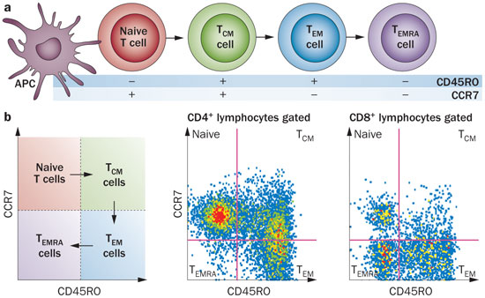
T cell naive, effector and memory cells express distinct CD antigens.

Slide 18
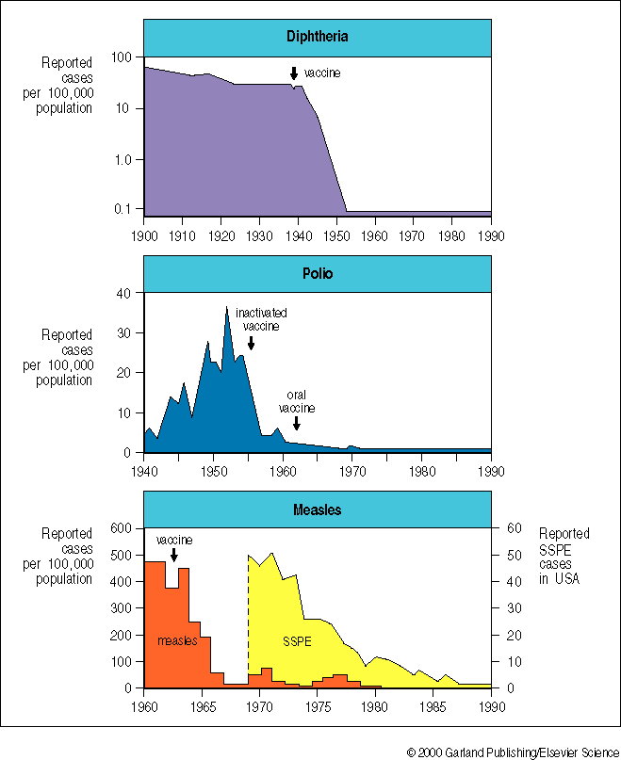
Artificially Acquired Active Immunity: vaccination
The vaccine might include live attenuated (non-pathogenic) organisms, portions of the organism, toxins, subunits of antigenic portions of the organism.
Antibodies that are received through vaccines play no role in the antibody production process.
They can be used to cure a person suffering from a disease.

Slide 19
Available vaccines for infectious diseases in humans

Slide 20
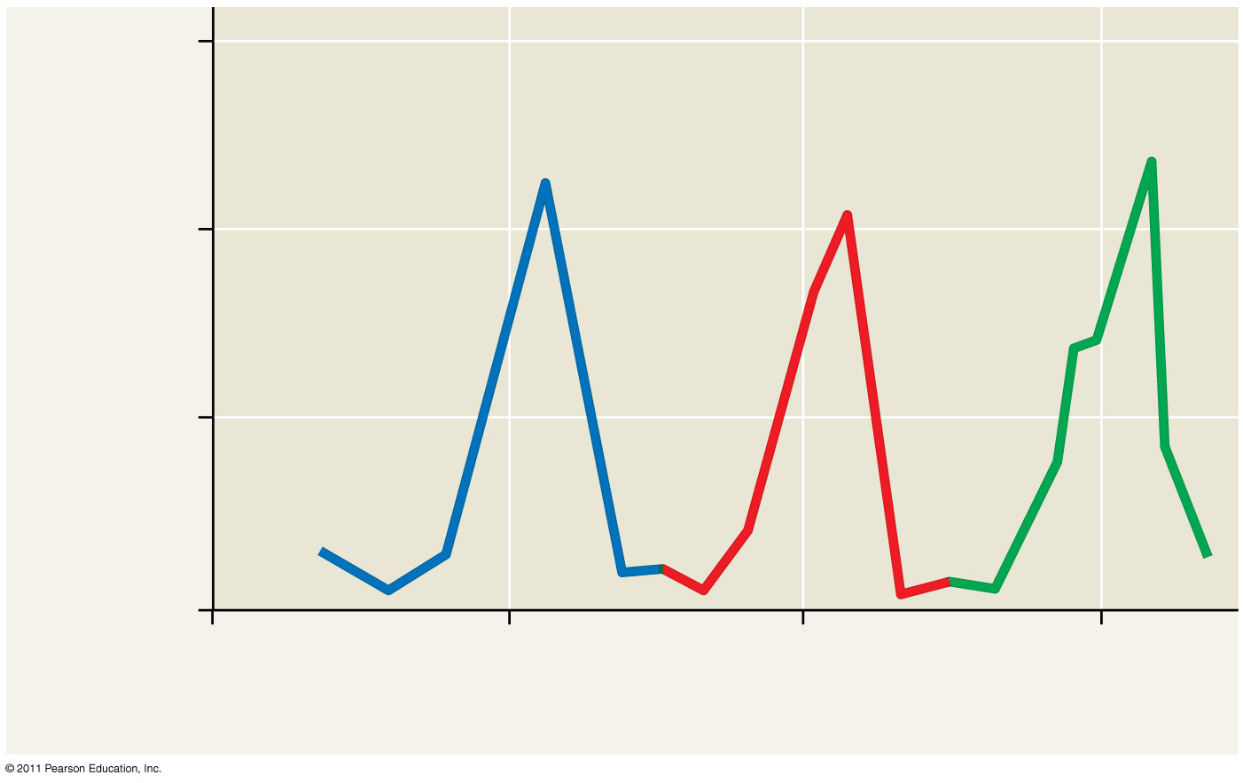
Evolutionary Adaptations of Pathogens That Underlie Immune System Avoidance
Through antigenic variation, pathogens change epitope expression and prevent recognition.
The human influenza virus mutates rapidly, and new flu vaccines must be made each year.
Human viruses occasionally exchange genes with the viruses of domesticated animals.
This poses a danger as human immune systems are unable to recognize the new viral strain.
1.5
Antibodies to variant 1 appear
Antibodies to variant 2 appear
Antibodies to variant 3 appear
1.0
Millions of parasites per mL of blood
Variant 1
Variant 2
Variant 3
0.5
0
25
26
27
28
Weeks after infection

Slide 21
Th cell differentiation and effector function
in protective immunity

Slide 22
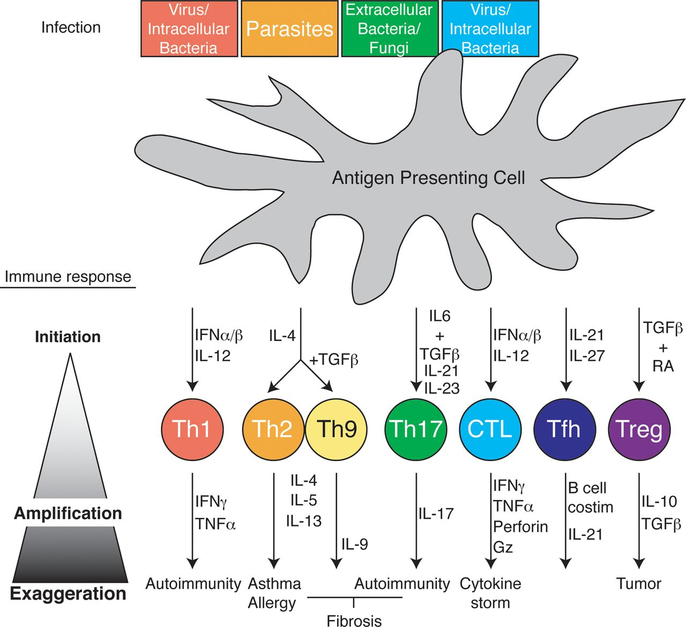
Th cell differentiation

Slide 23
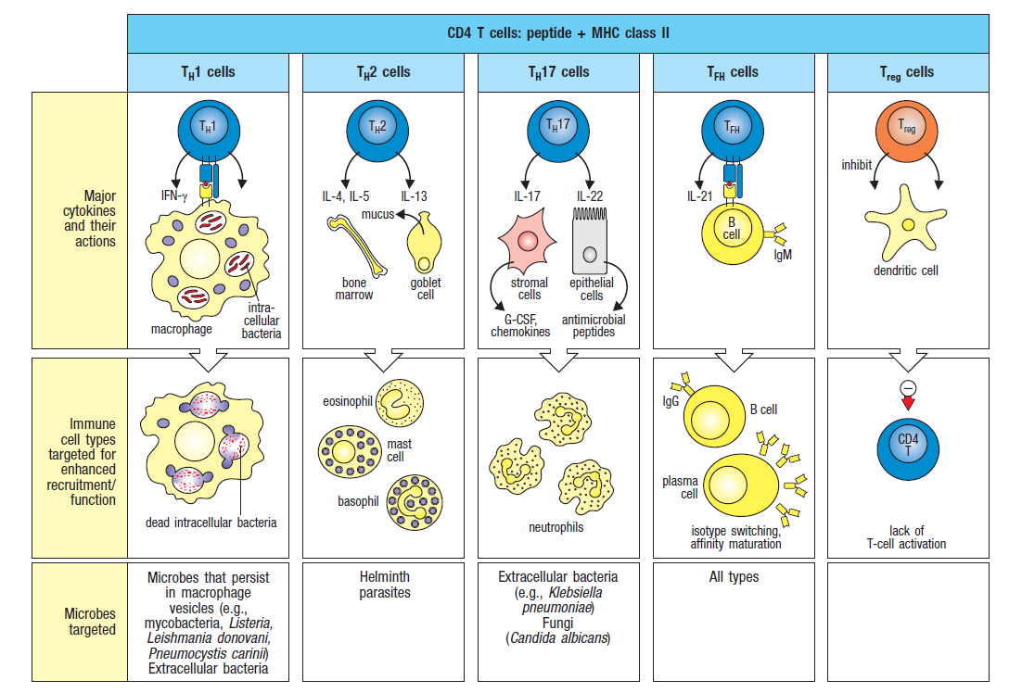
T cell effector responses provide protective immunity through innate immune cell activation.

Slide 24
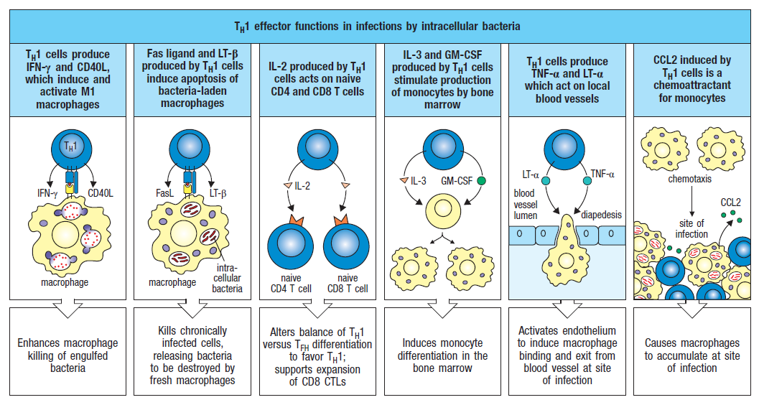
Th1 effector functions are essential for protective immunity against intracellular pathogens.

Slide 25
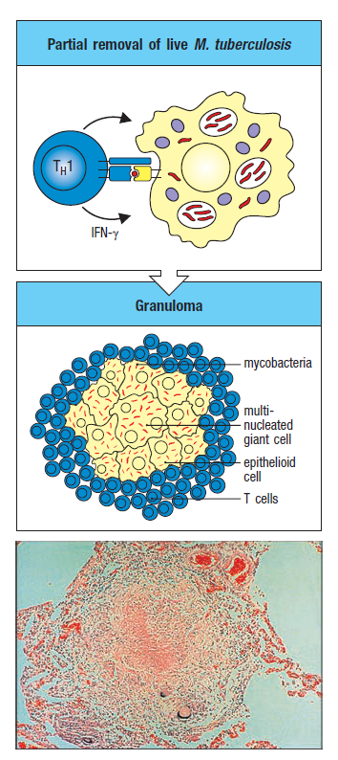
Ineffective Th1 cell responses cannot eliminate pathogens: the case of granulomas
A localized inflammatory response that consists of infected macrophages surrounded by CD4⁺ T cells.
Mycobacteria persist in the core.
Granulomas also form in patients with sarcoidosis by inapparent mycobacterial infection.

Slide 26
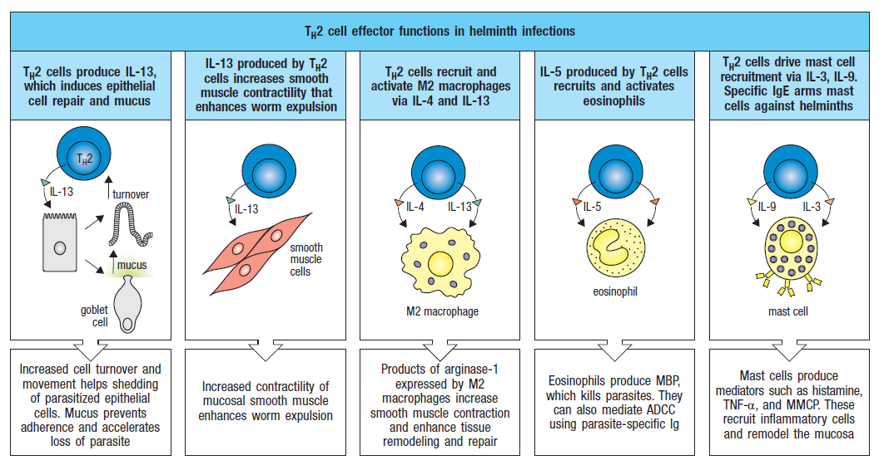
Th2 effector functions are essential for protection against parasites and helminth infections.

Slide 27
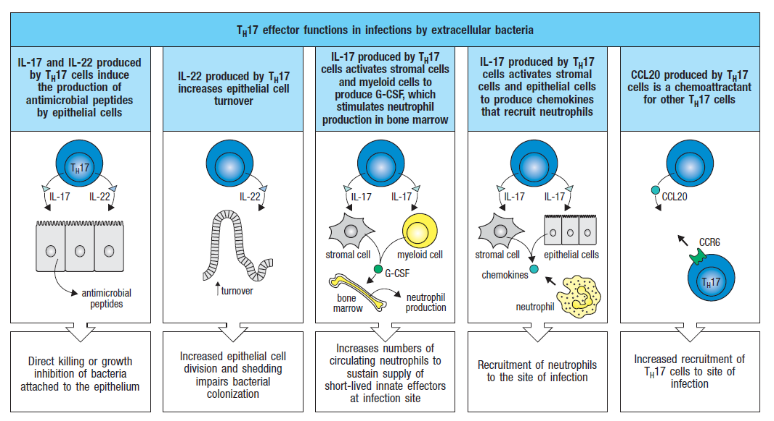
Th17 effector functions are essential for protective immunity against extracellular pathogens.

Slide 28
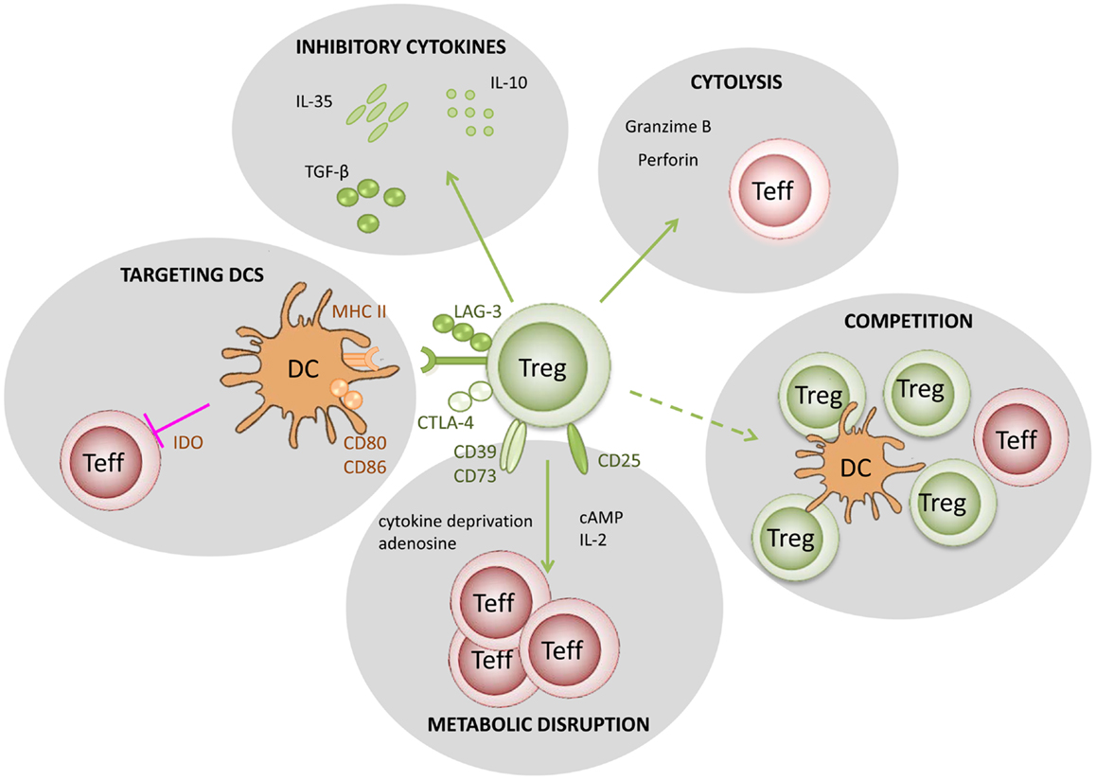
T regulatory cells: maintenance of immune homeostasis

Slide 29
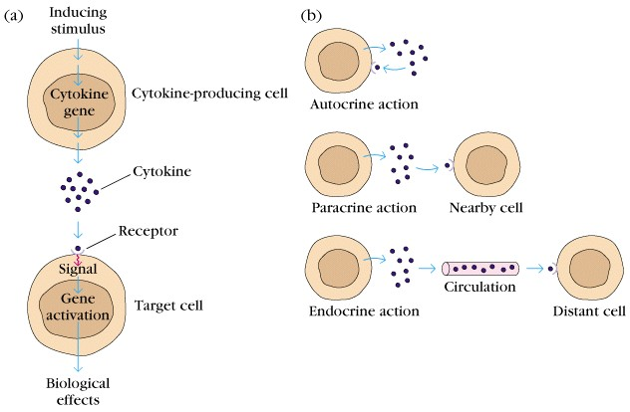
Cytokines
small secreted proteins, produced in response to pathogens
growth, differentiation and activation of leukocytes
cell-to-cell communication
‘messengers’ of the immune system
short-lived, biological effects at low concentrations

Slide 30
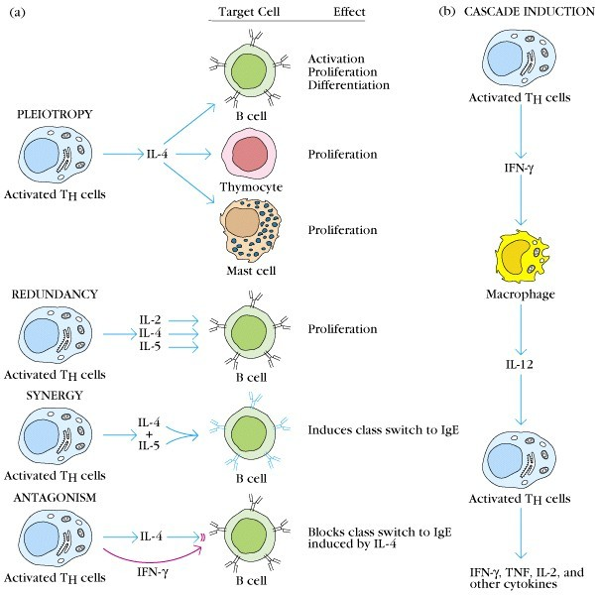
Cytokine properties
a given cytokine that has different biological effects on different cells is ‘pleiotropic’
cytokines that mediate similar functions are ‘redundant’
cytokine ‘synergism’ occurs when the combined effect is more than additive
‘antagonism’ occurs when one cytokine inhibits the effects of another

Slide 31
Major cytokines involved in T cell responses
IL-1β, TNF-α, IL-6, proinflammatory and cytotoxic role
IL-2, Th proliferation, NK proliferation and activation
IL-4, B cell Ig class switching, Th proliferation and differentiation
IL-5, eosinophil proliferation and differentiation
IL-10, TGF-β, immunosupression, inhibit effector cell proliferation
IFN-α/β, IFN-γ, anti-viral immunity, macrophage/DC activation, B cell Ig class switching
IL-12, directs adaptive immunity, activates NK cells

Slide 32
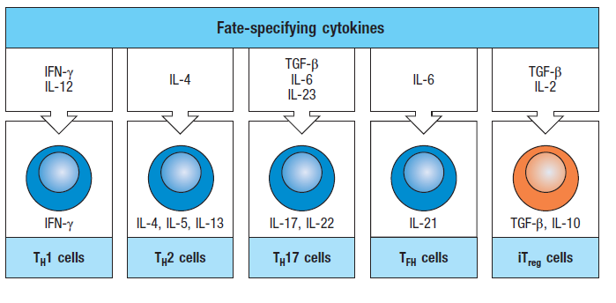
The cytokine milieu dictates the development of distinct Th effector subsets.
APCs produce distinct cytokines depending on the pathogen they encounter.
IFN-γ and IL-12 induce Th1 differentiation, IL-4 drives Th2 cells and IL-6, IL-23 and TGF-β induce Th17 cell differentiation.
In the absence of pathogens, cytokines such as TGF-β and IL-2 guide Treg development.

Slide 33
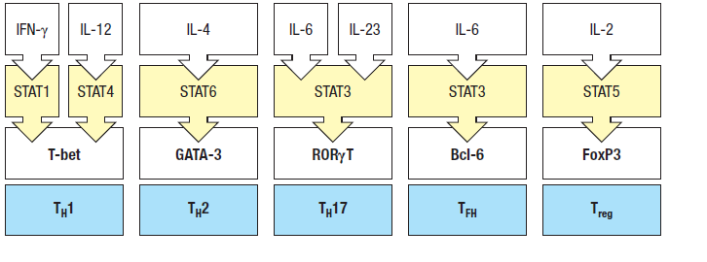
Cytokines signal through the STAT family of transcription factors
to initiate Th cell differentiation.
STATs are activated downstream of cytokine receptor signalling and induce key Th cell programming transcription factors, such as T-bet (Th1), GATA-3 (Th2), RORγT (Th17), BCL6 (Tfh) and Foxp3 (Treg).

Slide 34
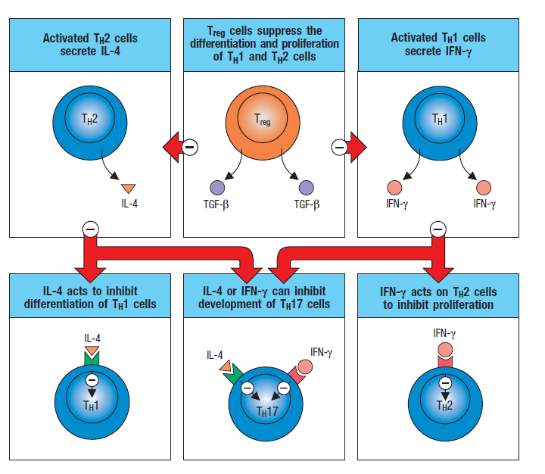
Th cell subsets produce cytokines that regulate the activity and development of other CD4⁺ cells.
Th cells express IL-10 at later time points during the immune response which inhibits IL-12, IL-4 and IL-23 release by APCs and inhibits Th1, Th2 and Th17 responses.

Slide 35
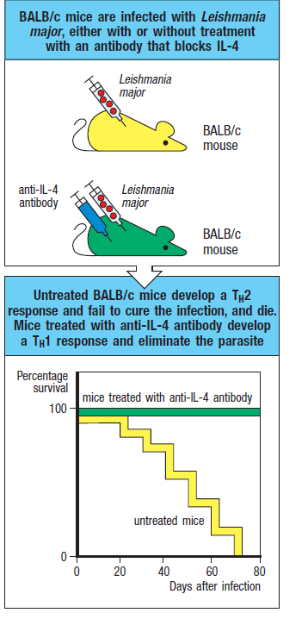
Th effector cell development is manipulated by cytokines present during priming.
BALB/c mice are susceptible to infection by the intracellular parasite Leishmania major infection because they generate a Th2-skewed immune response.
Blocking IL-4 early during infection inhibits diversion to Th2 responses and augments Th1 responses and IFN-γ release.
IFN-γ activates macrophages that provide protection against the parasite.

Slide 36
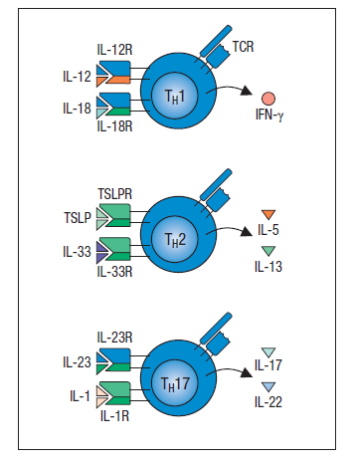
Th effector cells can be activated independent of antigen recognition.
Unique Th effector function:
Th effectors are stimulated through Th1, Th2 and Th17 cell-associated cytokines to produce other effector cytokines independent of TCR signalling.

Slide 37
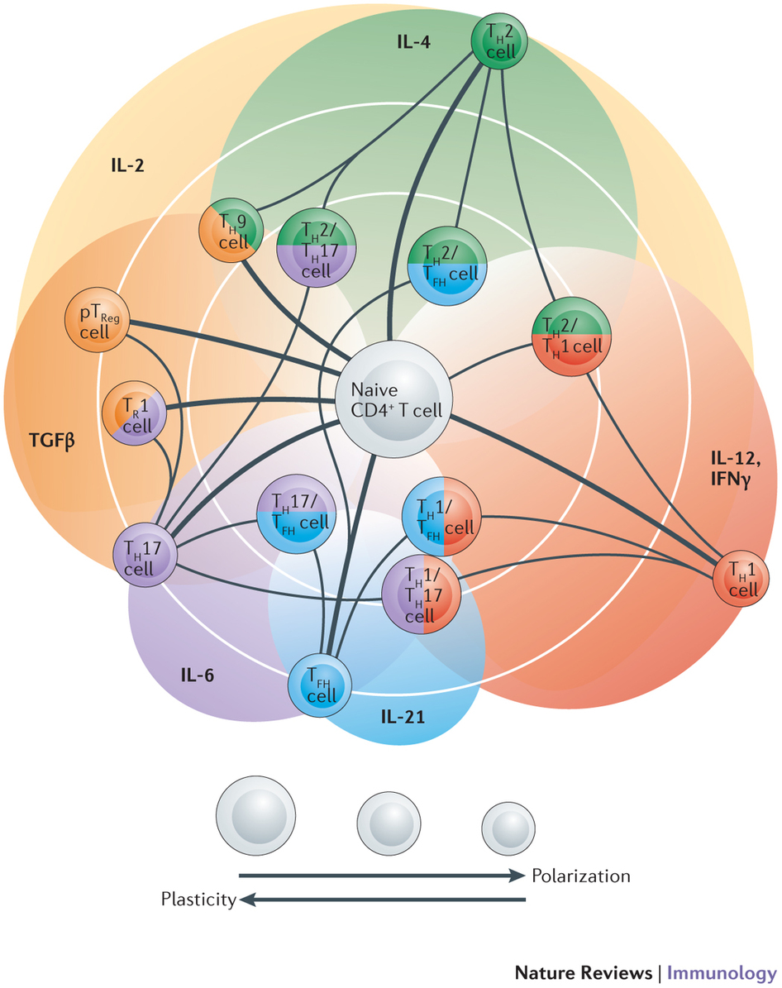
Th cell plasticity: an emerging concept

Slide 38
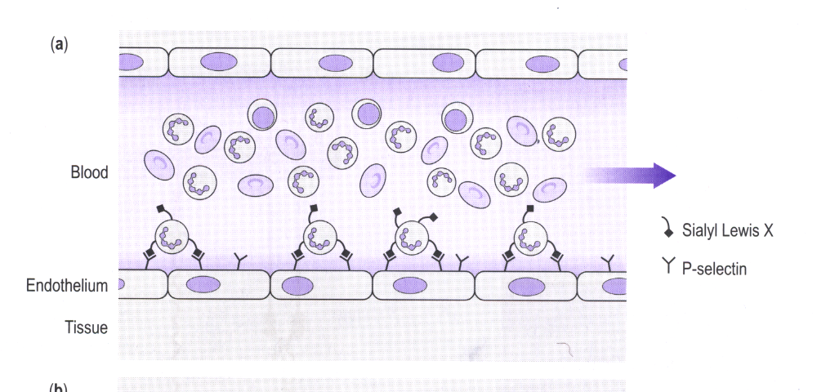
1. MARGINATION, NEUTROPHIL “ROLLING”
blood
Sialyl
Lewis X
endothelium
selectin
tissue

Slide 39
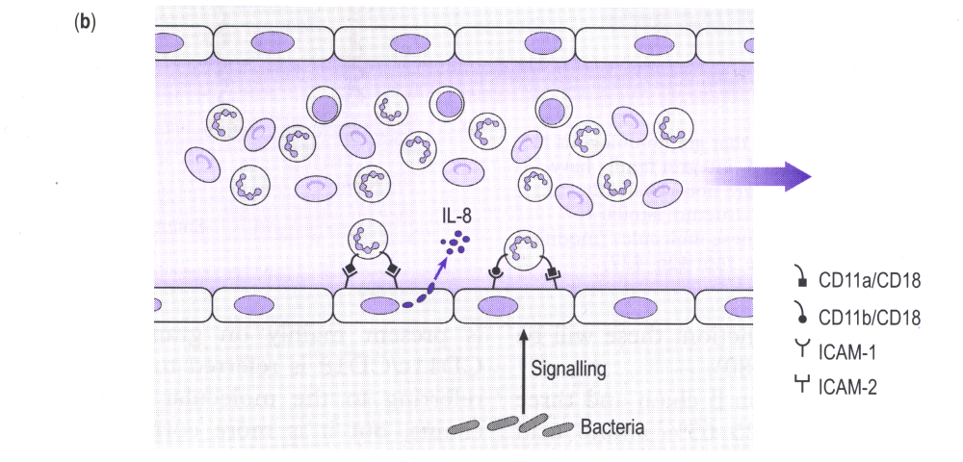
2. ACTIVATING SIGNALS, INCREASED ADHESION

Slide 40
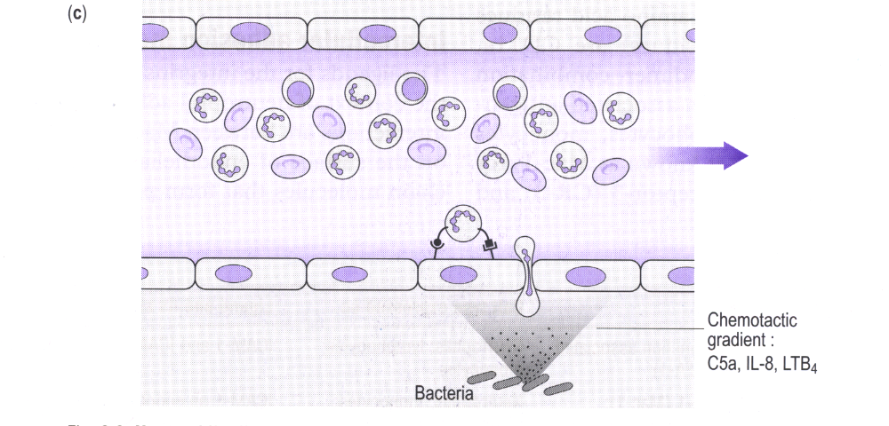
3. MOVEMENT INTO TISSUES
“DIAPEDESIS”
chemotactic
gradient: signal
of infection or
tissue damage

Slide 41
Chemokines: chemoattractant cytokines
50 human chemokines and 20 receptors are known
4 subfamilies: CXC, CC, lymphotactin (XC) and fractalkine (CX₃C)
attract leukocytes via 7-transmembrane G-protein-coupled receptors
intracellular signalling is conducted by a system of second messengers
Major function of chemokines is: chemotaxis
induction of cell migration to sites of infection
cytoskeletal actin-mediated rearrangements
leading to shape change of leukocytes and formation of lamellipodia
leukocyte speed: 7-7.5μm/min
intracellular Ca⁺² increases and signalling

Slide 42
Chemokines are multifunctional cytokines
HIV
P. vivax
CCR5
CXCR4
vCCR
CD4
DARC
DARC
HHV8
HIV
Myeloid Progenitors
Endothelial Cells
Erythrocyte
CD4
Leukocyte
Host Cell
Proliferation
Myelopoiesis
Angiogenesis
Malaria
HIV Infection
Chemokine
Clearance
Inflammation

Slide 43
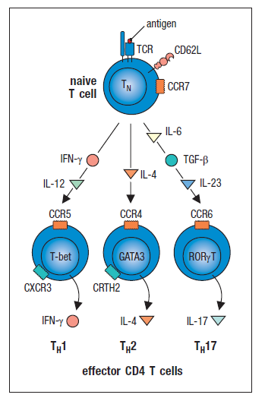
During Th effector cell differentiation chemokine receptor expression is altered.
Effector Th cell subsets lose CCR7 and express chemokine receptors guided by cytokine and chemokine signals.
CXCR3 & CCR5 characterize Th1 cells.
CRTH2 & CCR4 characterize Th2 cells.
CCR6 & CCR9 characterize Th17 cells.

Slide 44
Th cell differentiation and effector function
in human immune diseases

Slide 45
Disruptions in immune system function can elicit or exacerbate disease.
If the delicate balance of the immune system is disrupted, effects range from minor to sometimes fatal.
Exaggerated, adaptive responses towards self or innocuous environmental antigens can lead to allergies, asthma and autoimmunity.
Some pathogens and/or tumor cells have evolved mechanisms to diminish the effectiveness of host immune responses leading to chronic infections and cancer.

Slide 46
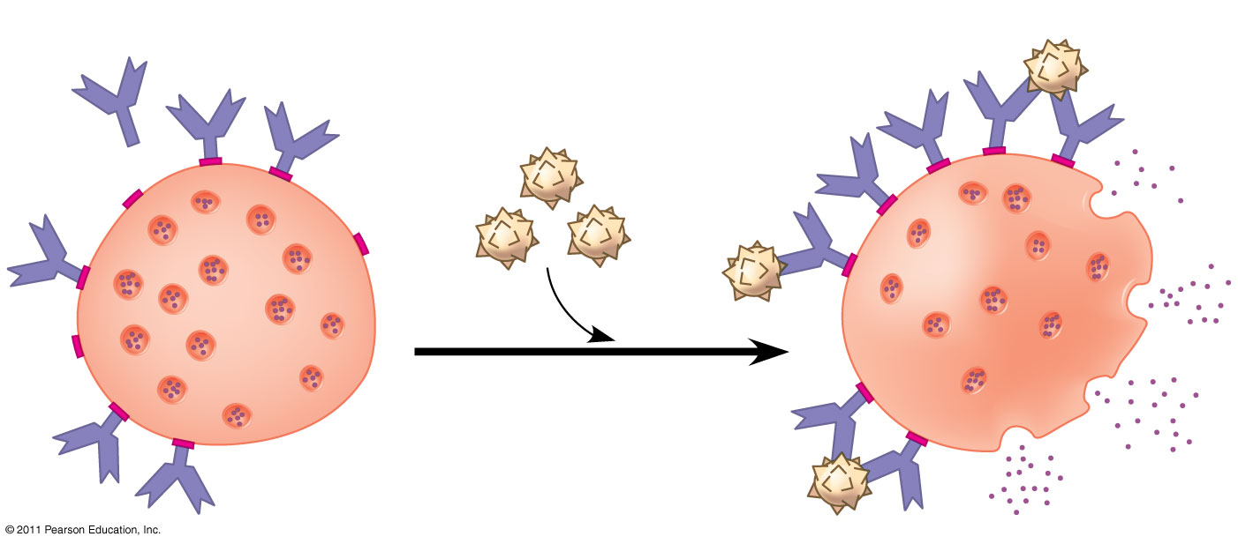
Allergic diseases
In localized allergies such as hay fever, IgE is produced after first exposure to an allergen binding to receptors on mast cells.
The next time the allergen enters the body, it binds to mast cell–associated IgE molecules.
Mast cells release histamine that cause vascular changes leading to typical allergy symptoms.
An acute allergic response can lead to anaphylactic shock within seconds of allergen exposure.
Histamine
IgE
Allergen
Granule
Mast cell

Slide 47
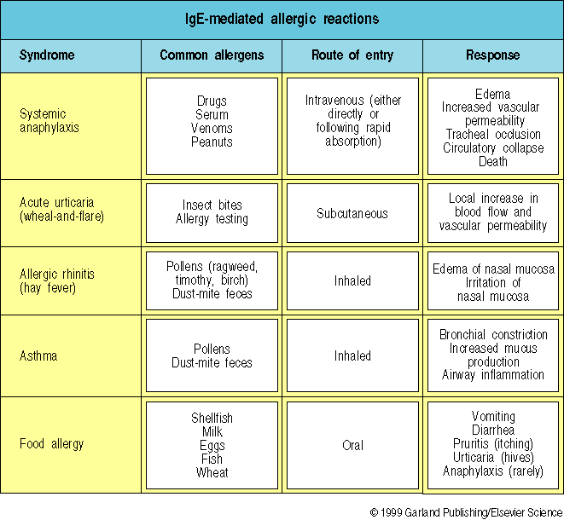
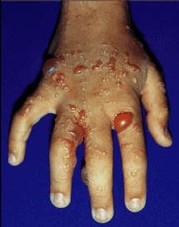
Asthma & Allergy

Slide 48
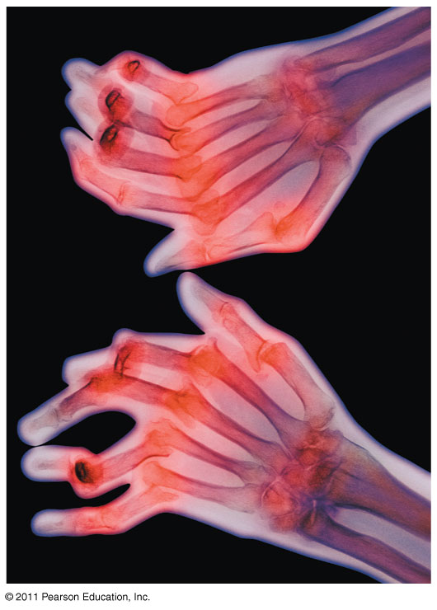
Origin of Self-Tolerance-autoimmune diseases
Antigen receptors are generated by random rearrangement of DNA.
Lymphocytes are tested for self-reactivity.
B and T cells with receptors specific for self antigens are destroyed by apoptosis, or programmed cell death or rendered non-functional.
In autoimmune diseases, self-tolerance is broken and the immune system attacks antigens in the body.
Examples: systemic lupus erythematosus, rheumatoid arthritis, insulin-dependent diabetes mellitus, and multiple sclerosis.

Slide 49
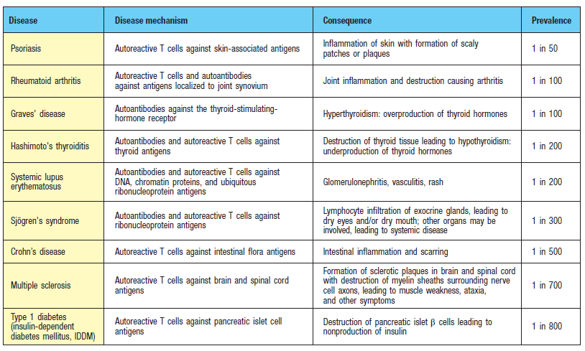
Autoreactive T cells and autoantibody-secreting B cells mediate excessive inflammation and tissue damage in the target organ.

Slide 50
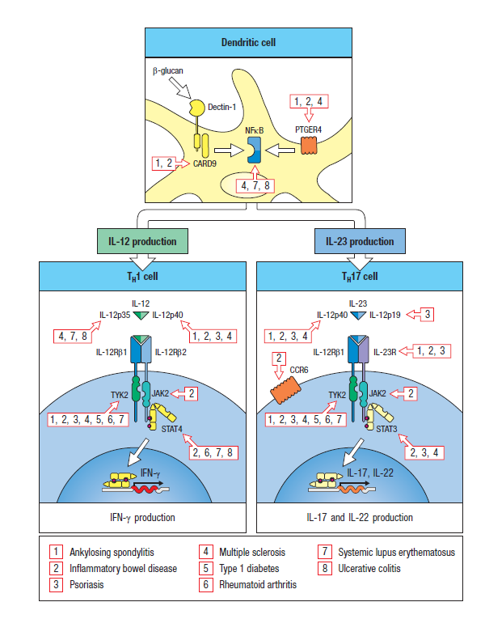
Th1 and Th17 pathway components are associated with human autoimmune diseases.
GWAS studies reveal that components of the IL-12R and the IL-23R pathways map within genomic intervals associated with certain autoimmune diseases.

Slide 51
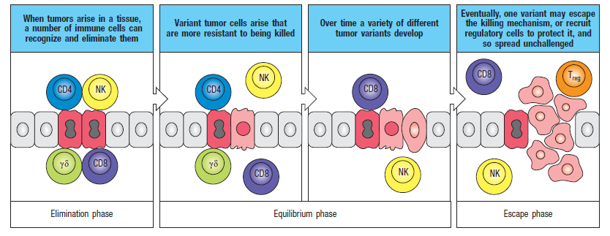
Cancer and Immunity
The frequency of certain cancers increases when adaptive immunity is impaired.
20% of all human cancers involve viruses.
The immune system can act as a defense against viruses that cause cancer and cancer cells that harbor viruses.
In 2006, a vaccine was released that acts against human papillomavirus (HPV), a virus associated with cervical cancer.

Slide 52
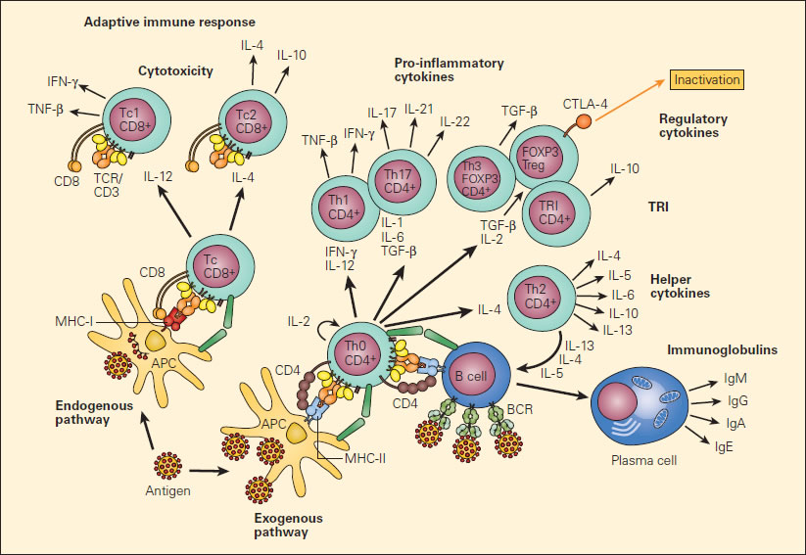
autoimmunity
cancer/infections
allergy
Selected readings:
Janeway’s, 9th edition, Kenneth Murphy & Casey Weaver
www.whfreeman.com/kuby

