Slide 1
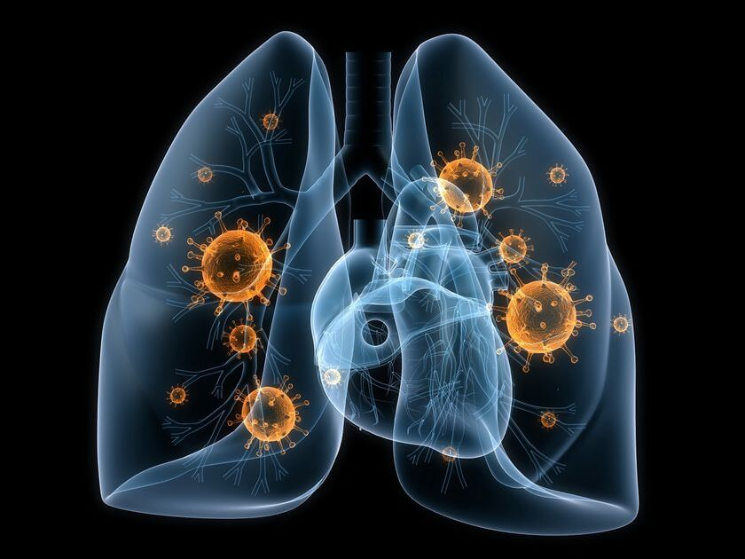
“Sensing the pathogens: Viruses, bacteria, intracellular pathogens”
Evangelos Andreakos
vandreakos@bioacademy.gr
Biomedical Research Foundation, Academy of Athens

Slide 2
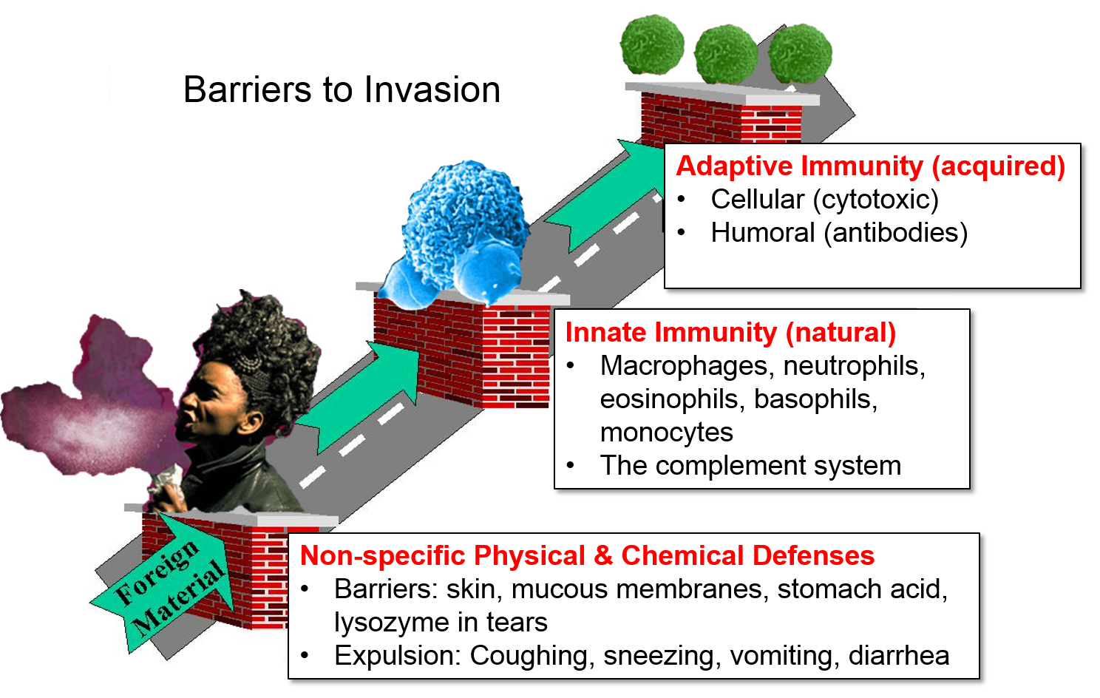
Barriers (defenses) to invasion

Slide 3

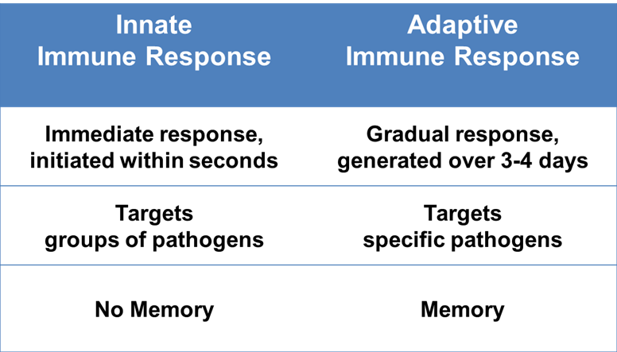
Innate vs Adaptive immunity

Slide 4
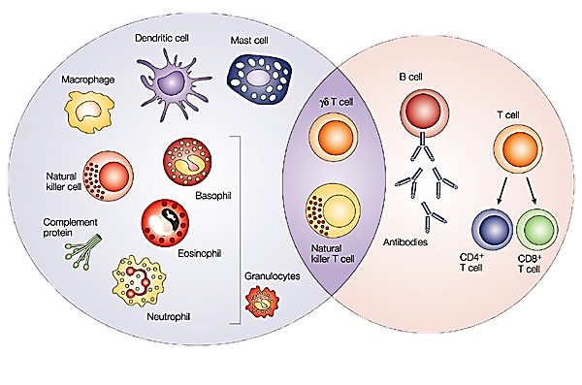
Cells of Innate and Adaptive Immunity
Innate Immunity (rapid response)
Adaptive Immunity (slow response)
Further reading:
Janeway's Immunobiology, 9th Edition, Garland Science
Kuby Immunology, Sixth Edition 7th/8th Edition

Slide 5
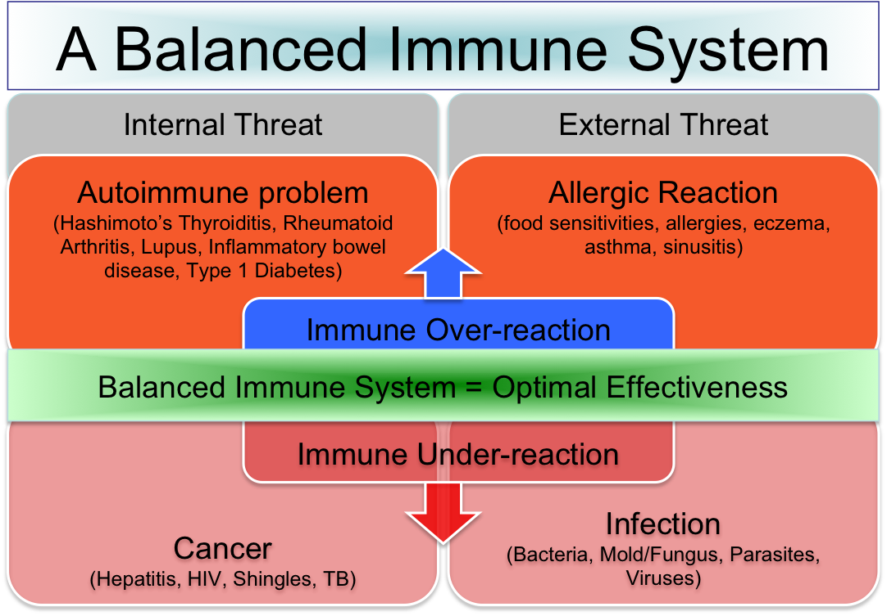
Innate immunity balances the immune system

Slide 6
Outline of presentation
Pattern recognition receptors
  -Toll-like receptors
  -NOD-like receptors and inflammasomes
  -RIG-I-like receptors
Pattern recognition receptors in health and disease
  -Susceptibility to infections
  -Acute and chronic inflammation
Type I and type III IFNs in antiviral defense

Slide 7
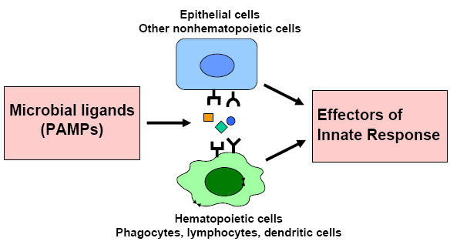
Pattern recognition by cells: Pattern Recognition Receptors (PRRs)

Slide 8
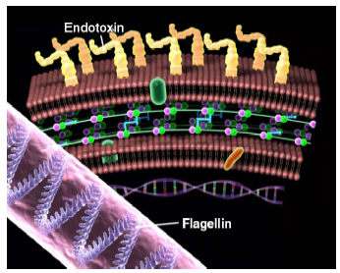
PPR Ligands: Gram –ve bacteria
• LPS
• Peptidoglycan
• Flagellin
• Bacterial (unmethylated) DNA

Slide 9
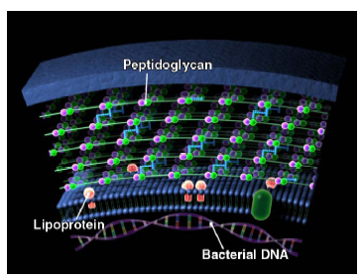
PRR Ligands: Gram +ve bacteria
• Lipoproteins
• Lipoteichoic acid
• Unmethylated DNA
• Peptidoglycan
(Gram+ and Gram-)

Slide 10
Toll-like Receptors
Named after the homologous Drosophila protein Toll
Toll initially identified in Drosophila for its role in dorsoventral polarity during embryogenesis.
Subsequently shown in Drosophila to control the potent antifungal response (Lemaitre et al. Cell. 1996).
TLR4 first identified in LPS hyporesponsive C3H/HeJ and C57BL/10ScCr mice as the elusive LPS receptor (Poltorak et al. Science 1998)
TLR2 subsequently identified as the receptor for the bacterial cell wall component peptidoglycan (Takeuchi et al. Immunity 1999; Underhill et al. PNAS 1999)
14 homologs of Toll termed as TLRs have been identified in mammals

Slide 11
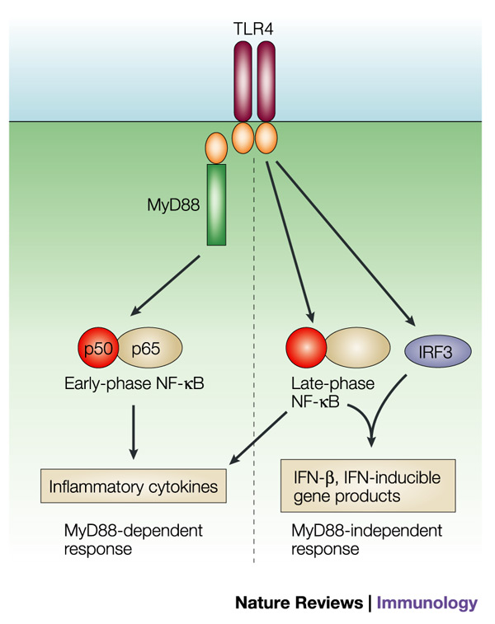
Toll-like receptor 4 recognizes bacterial LPS
LPS
Akira and Takeda 2004

Slide 12
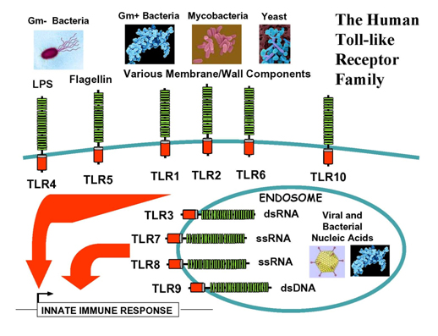
Localization of Toll-like receptors

Slide 13
Recognition of PAMPs according to phylogenetic tree

Slide 14
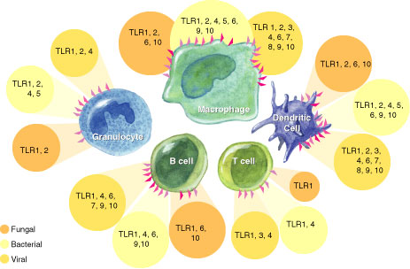
Expression of TLRs on immune cells

Slide 15
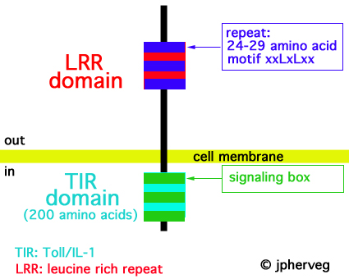
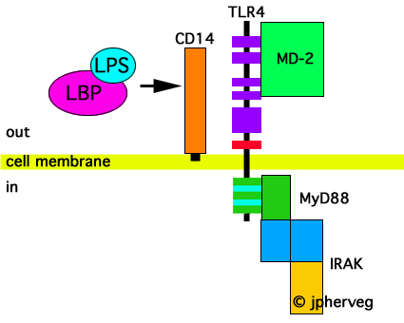
Structure of Toll-like Receptors

Slide 16
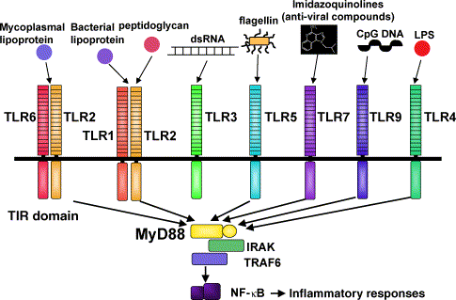
Toll-like receptors form homo/hetero dimers to activate downstream signalling

Slide 17
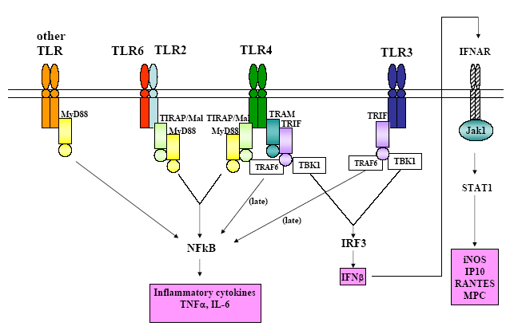
NEGATIVE REGULATION OF TLRs
Soluble Receptor forms (sTLR2, sTLR4)
Negative TLRs
SIGIRR
Myd88s isoform
Tollip
IRAKM
Dephosphatases Kinases
Other enzymes

Slide 18
Functional consequence of TLR activation:
A. Induction of innate immunity
Antibacterial responses
Macrophage/neutrophil activation
Antiviral respones

Slide 19
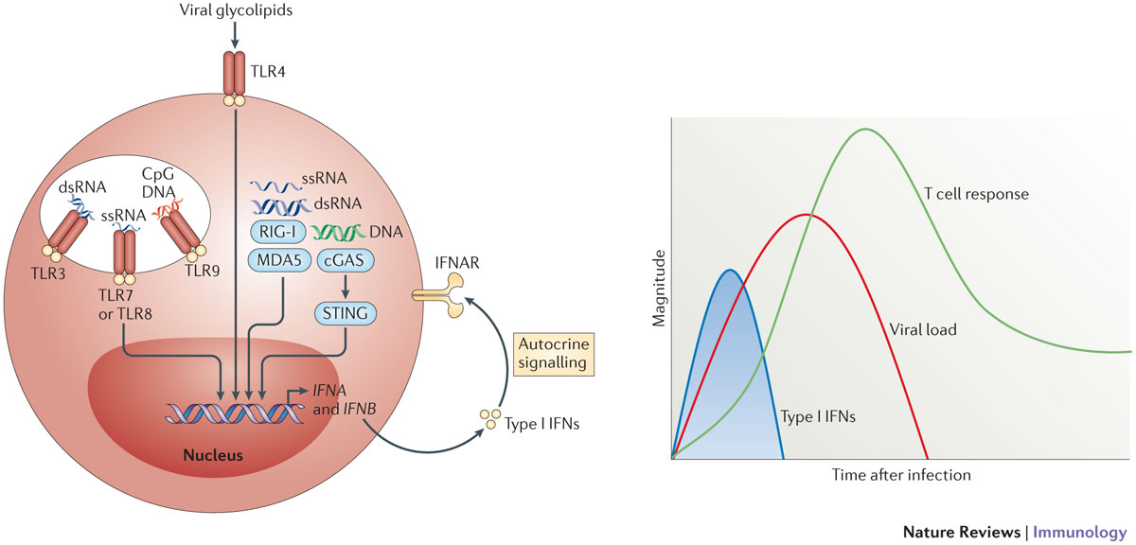
Key components of the innate immune defence:
Interferons
Epithelial cells
Macrophages
mDCs
pDCs
Notes:
19

Slide 20
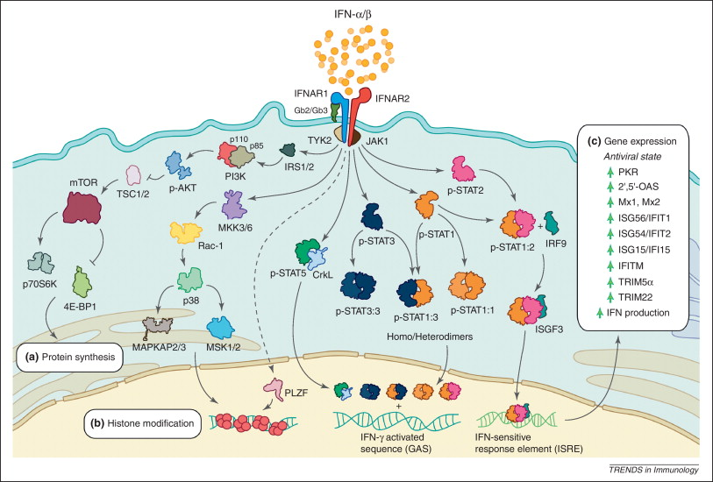
Interferons induce an antiviral state
Notes:
20

Slide 21
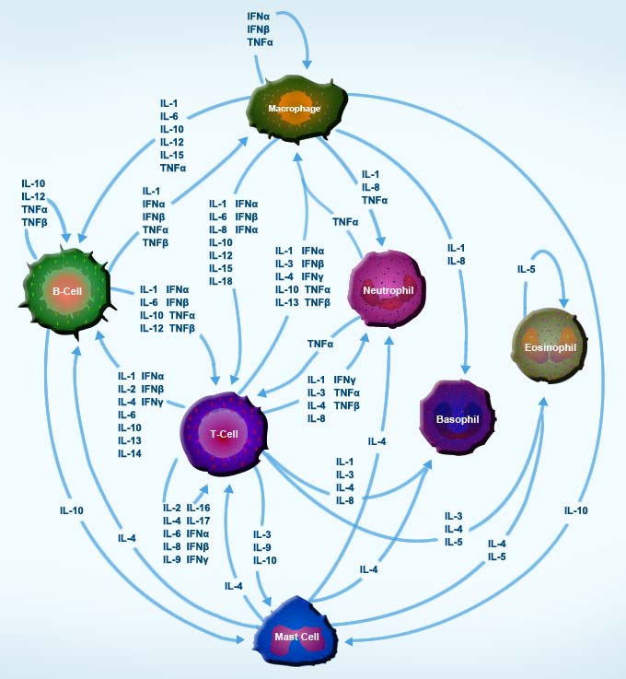
Key components of the innate immune defence:
Cytokines and chemokines

Slide 22
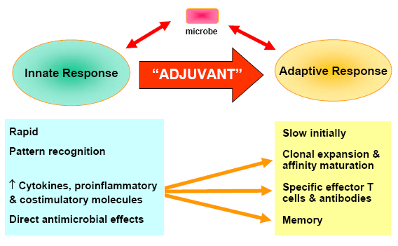
Functional consequence of TLR activation:
B. Instruction of adaptive immunity
TLR ligands

Slide 23
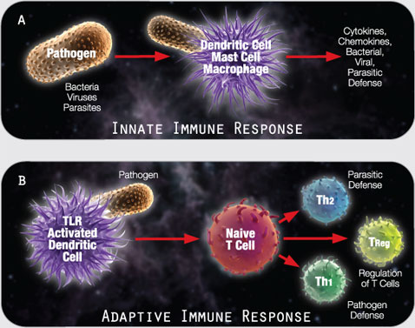

Slide 24
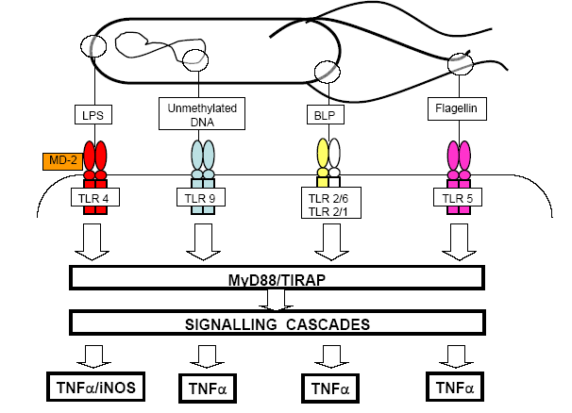
The pattern of TLRs engaged shapes immunity
Example: Salmonella typhimurium
Response A
Response B

Slide 25
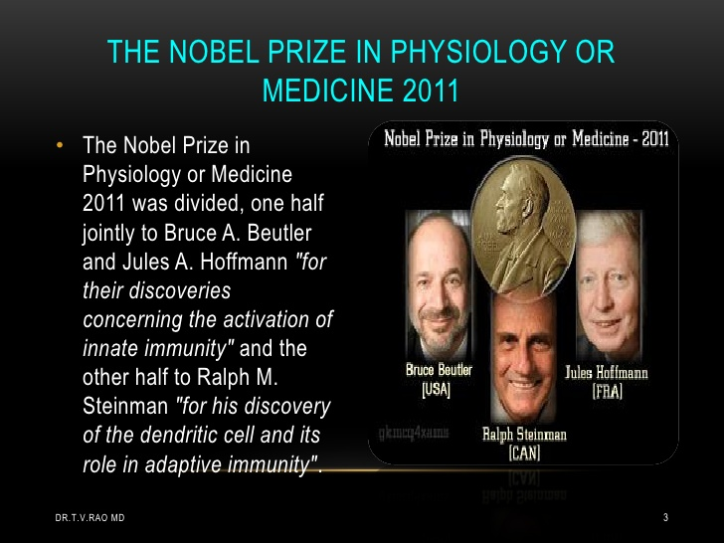

Slide 26
Pattern recognition receptors: Not just TLRs

Slide 27
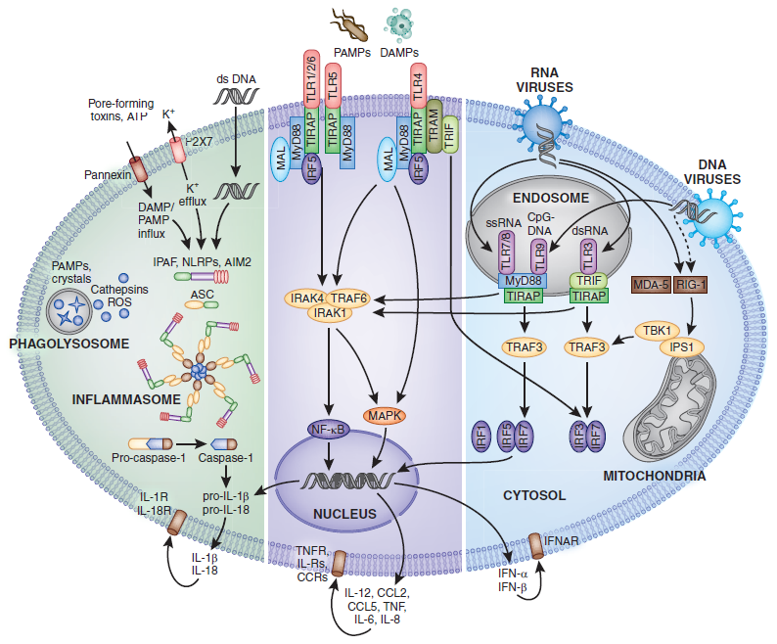
Pattern recognition depends on multiple systems acting together
TLR
RLR
Andres and Muruve JASN 2011

Slide 28
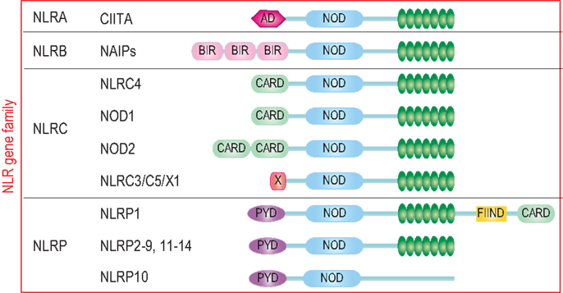
NOD-like receptors (NLRs)
LRR
NLR superfamily and domain structures
LRR: Leucine-rich repeat domain
NOD (NACHT): Nucleotide-binding oligomerization
CARD: Caspase activation and recruitment domain
PYD: Pyrin domain
BIR: Baculovirus inhibitor repeat

Slide 29
Nod-like receptors (NLRs)
NLRs and their components are expressed in cell and tissues that have role in immunity such as phagocytes
Epithelial cells - the Physical barrier
NAIP, NLRC4 (IPAF) – brain, spleen, lung, liver
Some like NLRP5, 8, 4, 7, 10, 11 have restricted expression – germ cells and preimplantation embryos
Regulation – TLR stimulation increases the expression of NLRs (NOD1, NOD2, NLRP3)

Slide 30
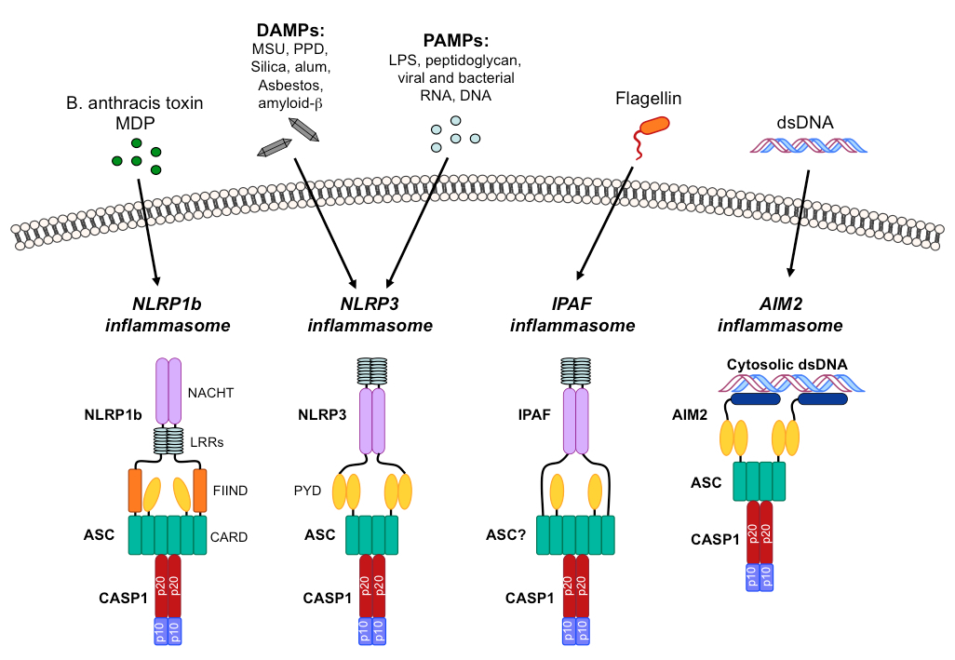
NOD-like receptors (NLRs) sense diverse insults

Slide 31
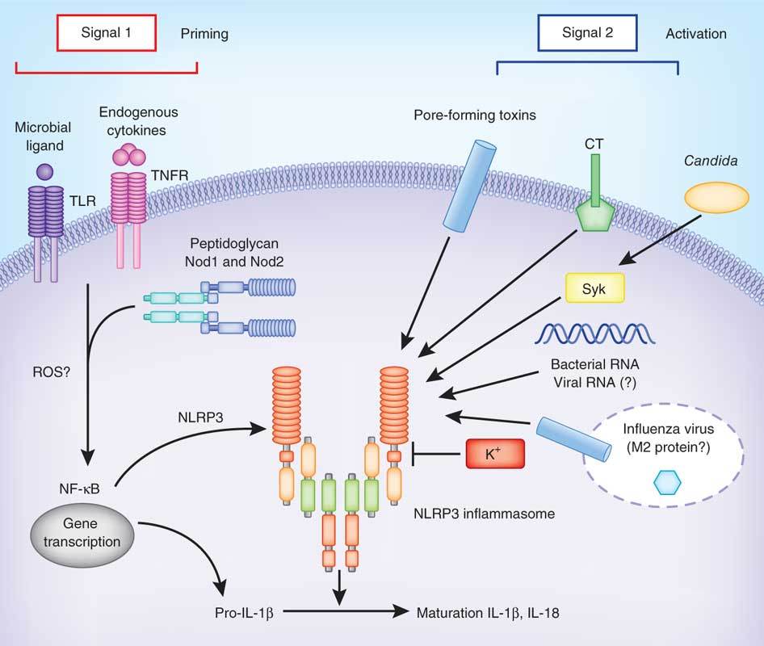
Activation of inflammasomes is dependent on two signals
Andres and Muruve JASN 2011

Slide 32
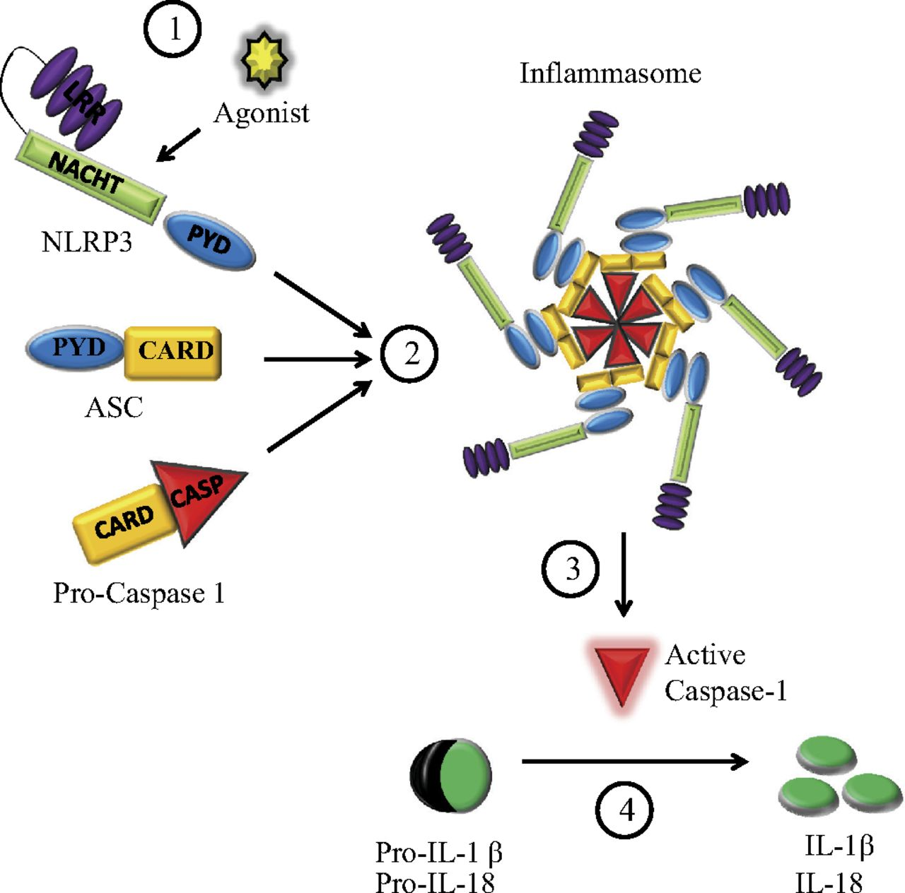
Inflammasomes assemble into large multiprotein complexes in a stepwise process
The exact composition depends on the activator (agonist) which initiates inflammasome assembly
NLRP3 recruits ASC and then pro-caspase-1 which gets cleaved and activated
Active caspase-1 cleaves in turn and activates IL-1β
In some inflammasomes pro-caspase-1 recruitment direct through their CARD domain

Slide 33
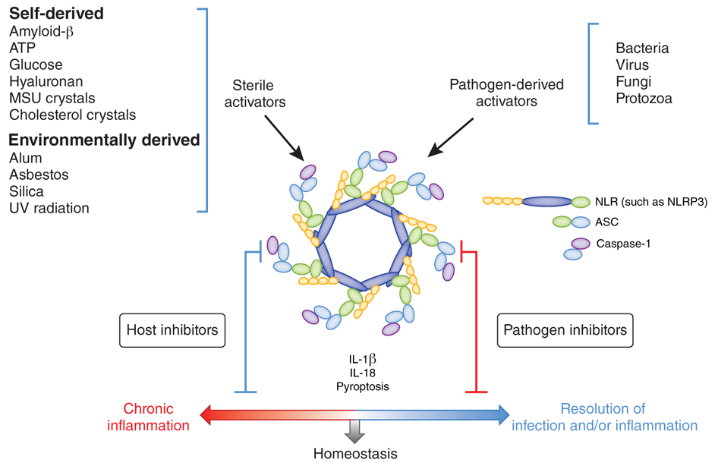
Inflammasome activity regulates homeostatic processes and inflammation during infection and tissue injury.
Jorge Henao-Mejia Nat Immunol 2012

Slide 34
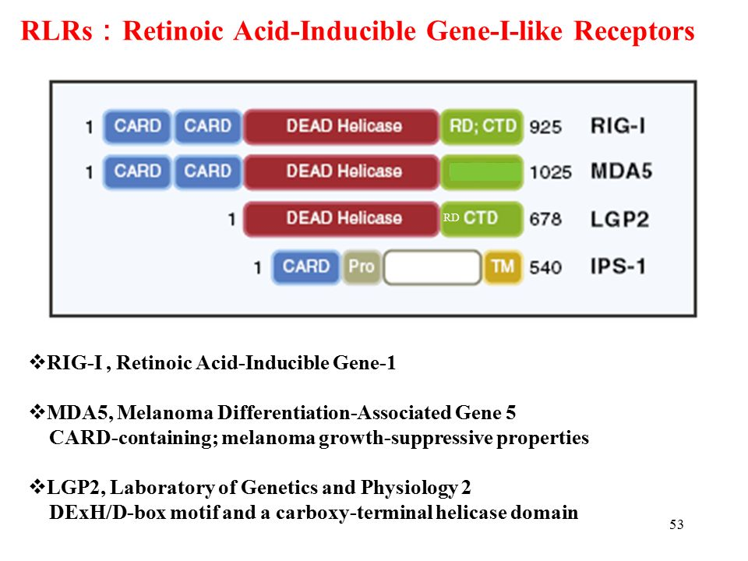
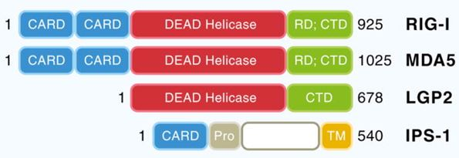
Retinoic acid-inducible gene I (RIG-I)-like receptors
MAVS

Slide 35
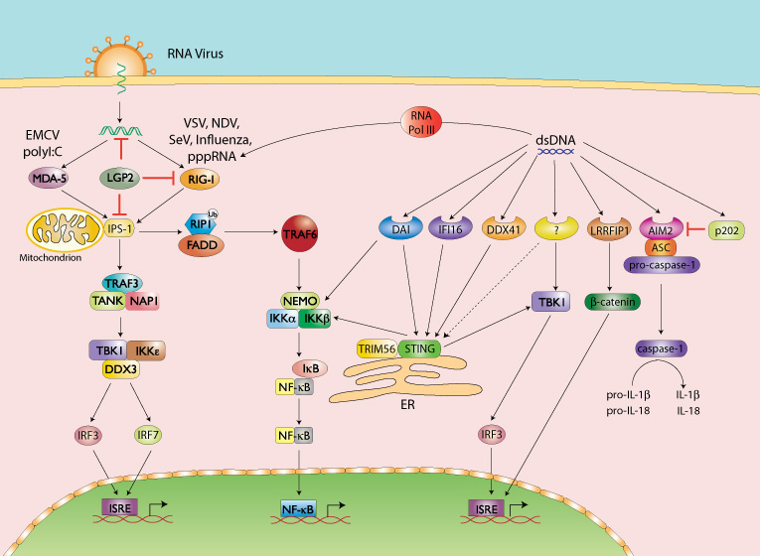
RIG-I like receptors
www.Invivogen.com

Slide 36
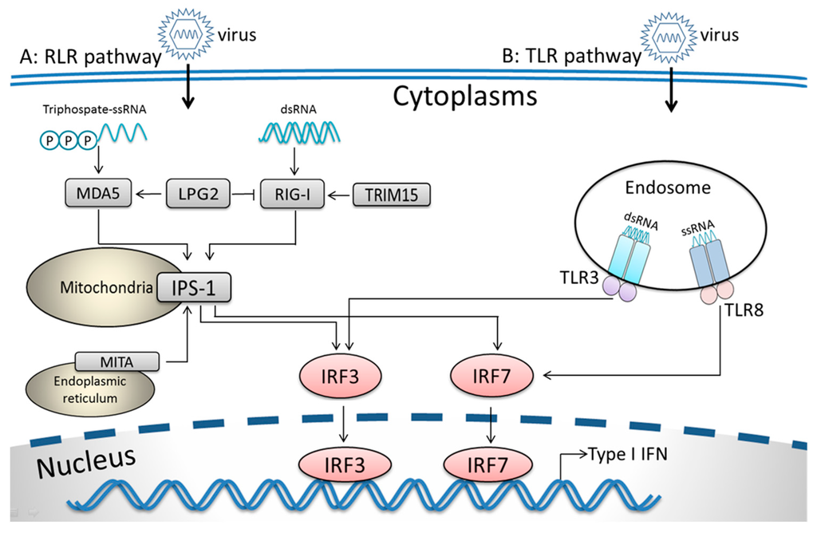
Cross-talk between RLR and TLR pathways in antiviral immunity
Xu et al. Viruses 2016

Slide 37
Pattern recognition receptors in health and disease

Slide 38
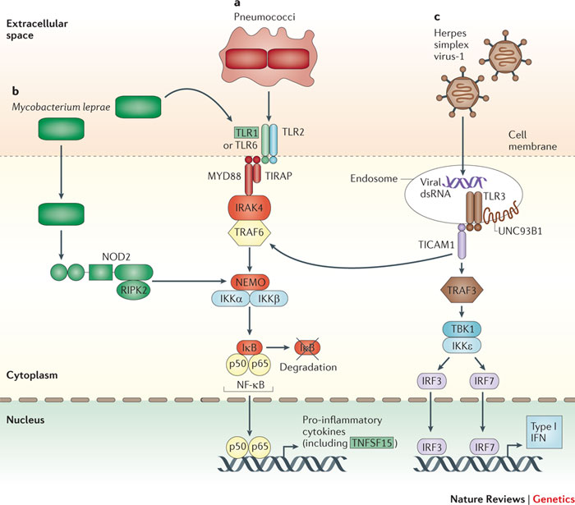
PRRs and disease: susceptibility to infections
Multiple examples of susceptibility demonstrated in animal models
Patients with defective TLR2 are more susceptible to Gram +ve infections and Mycobacterium leprae and Pneunococci
5% of people are heterozygous for a stop mutation in TLR5 are susceptible to Legionaire's disease
Mutations in the TLR3-TRIF pathway enhance susceptibility to herpes simplex virus encephalitis
Individuals with MyD88 or IRAK4 mutations suffer from recurrent bacterial infections
Chapman & Hill. Nature Reviews Genetics 2012

Slide 39
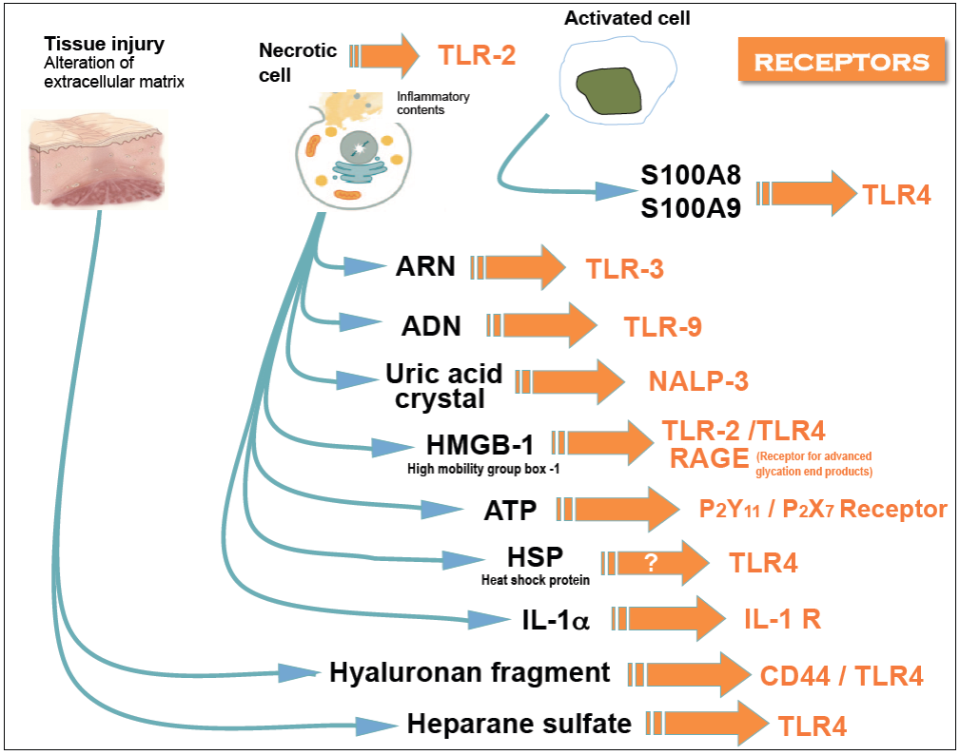
Damage-associated molecular patterns (DAMPs) and recognition by PRRs
Self
TLR3, TLR7
RNA
Self
DNA
Crystals
NLRP3
Cholesterol, uric acid
ECM
TLR4
(fragments)
OxLDL
TLR4

Slide 40
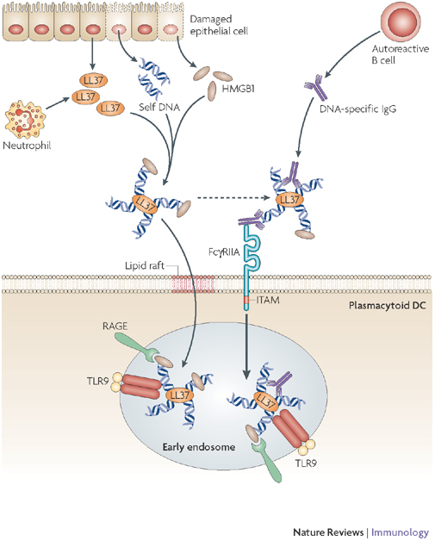
Self DNA or RNA, complexed with antimicrobial peptides or autoantibodies promotes autoimmunity

Slide 41
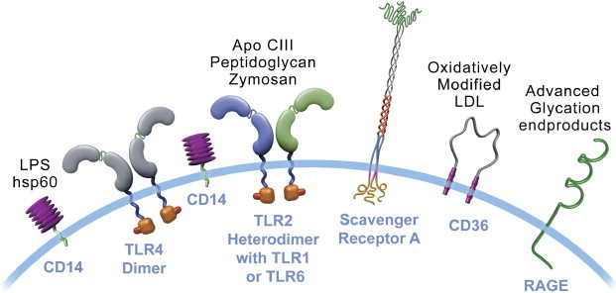
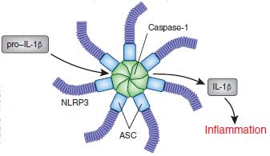
DAMPs promote inflammation in atherosclerotic plaques
ApoCIII
Oxidized lipids
Modified lipoproteins
Cell necrosis
OxLDL
ECM fragments
HSP60, HSP90
Cell necrosis
OxLDL
Oxidized lipids
AGE products
Cholesterol crystals
Inflammasome
Modified from AN Seneviratne et al. Clinica Chimica Acta 2012
Notes:
41

Slide 42
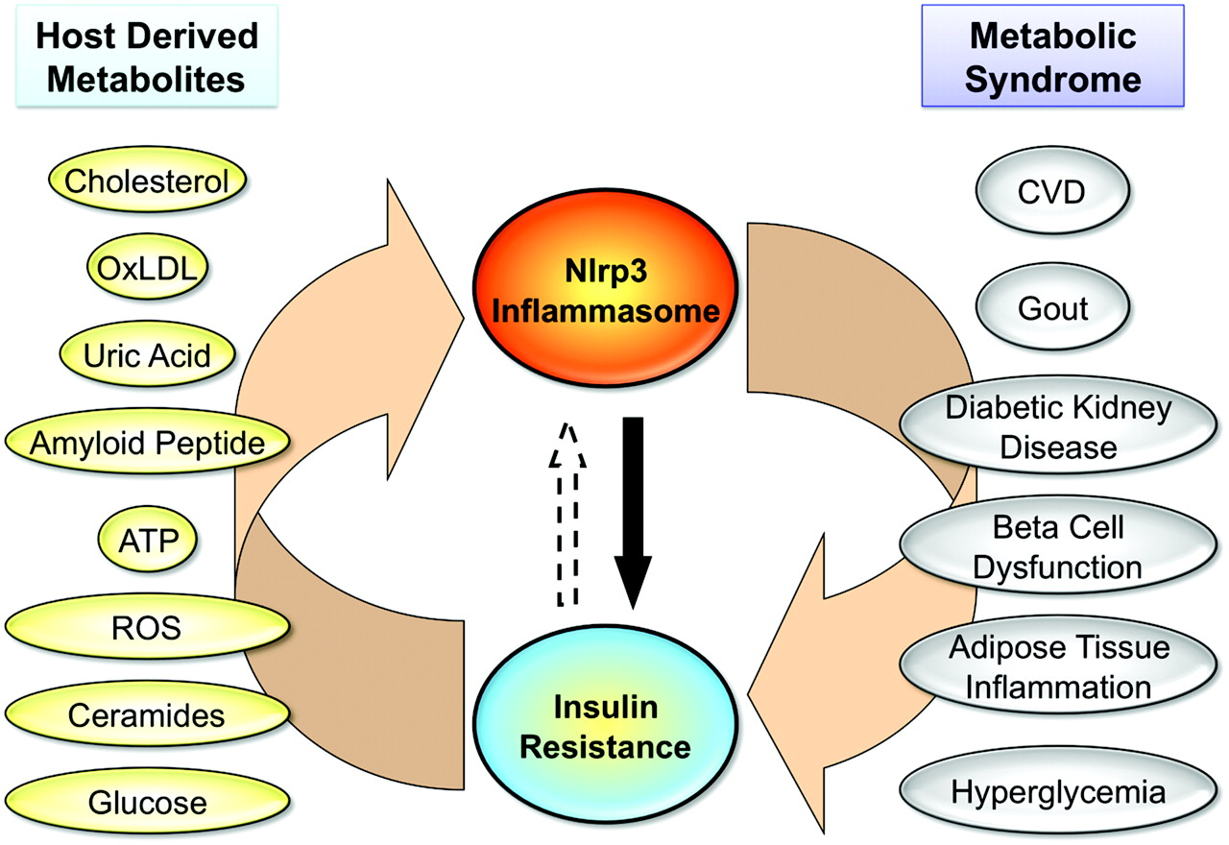
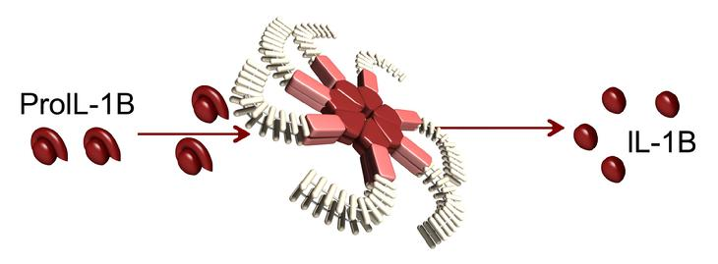
DAMPs promote metabolic disease
Circ Res

Slide 43
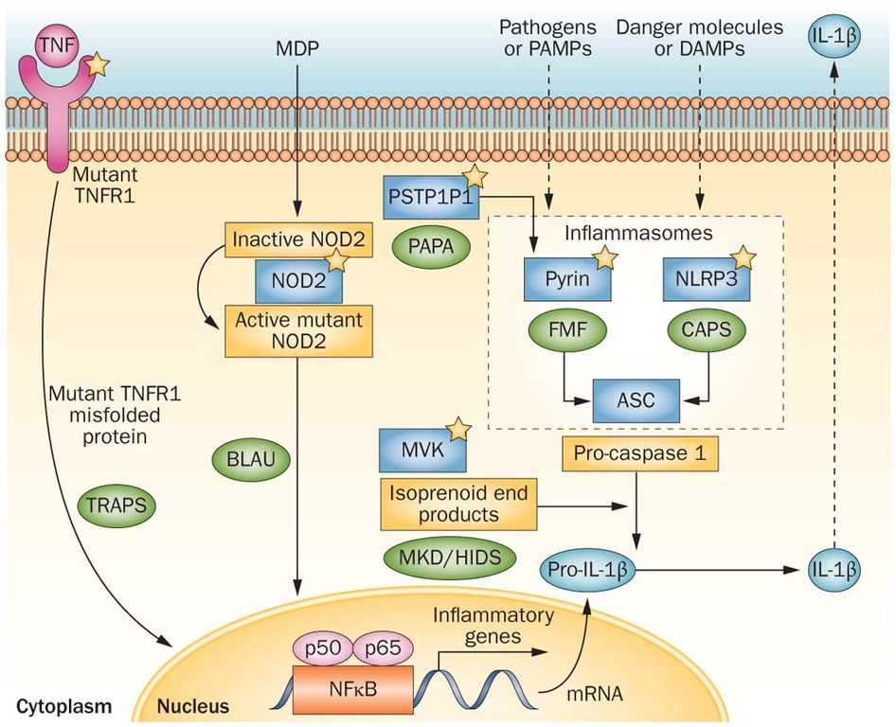
Overactivation/incoordination of PRR responses triggers auto-inflammatory diseases

Slide 44
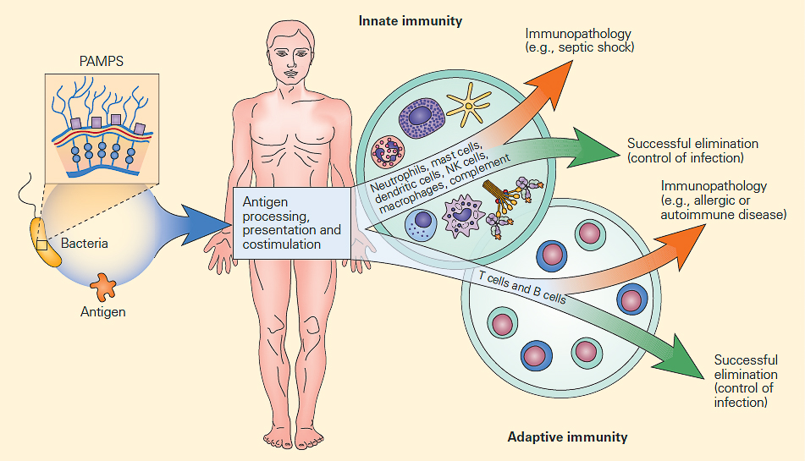
Innate immunity: Central to immune homeostasis

Slide 45
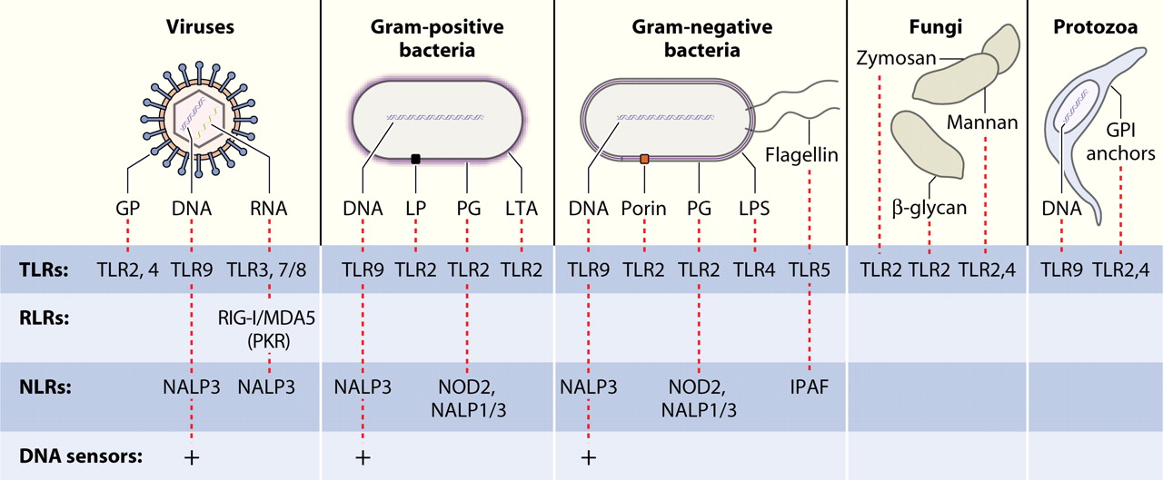
Take-home message
Innate immunity is essential for protecting the organism from infections, tissue injury and homeostatic disturbances
Pattern recognition takes place through TLRs, NLRs and RLRs which sense diverse structures
Innate immune responses are highly beneficial but when deregulated can lead to pathology and disease

Slide 46
Interferons

Slide 47
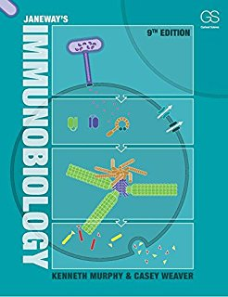
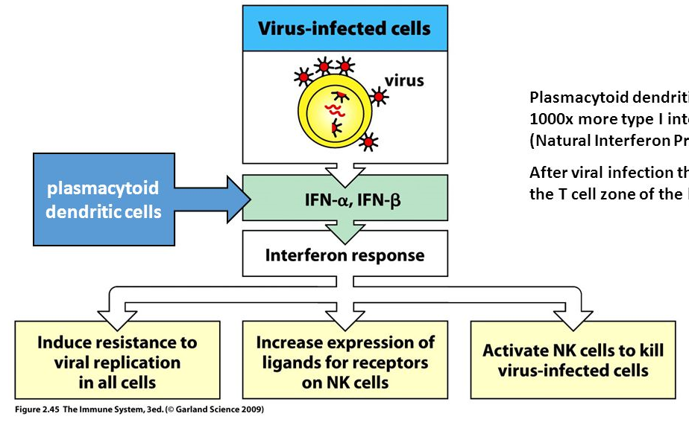
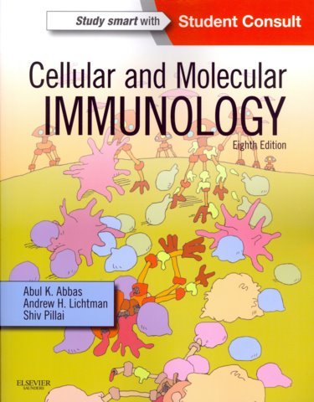
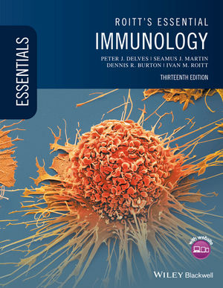
Textbooks: Type I IFNs constitute the predominant system of antiviral defense
IFN-stimulated genes (ISGs)
Induce antiviral state
(viral resistance)
Inhibit virus replication (all stages of lifecycle)
Deal with infectious viral load
(degrade vRNA etc)

Slide 48
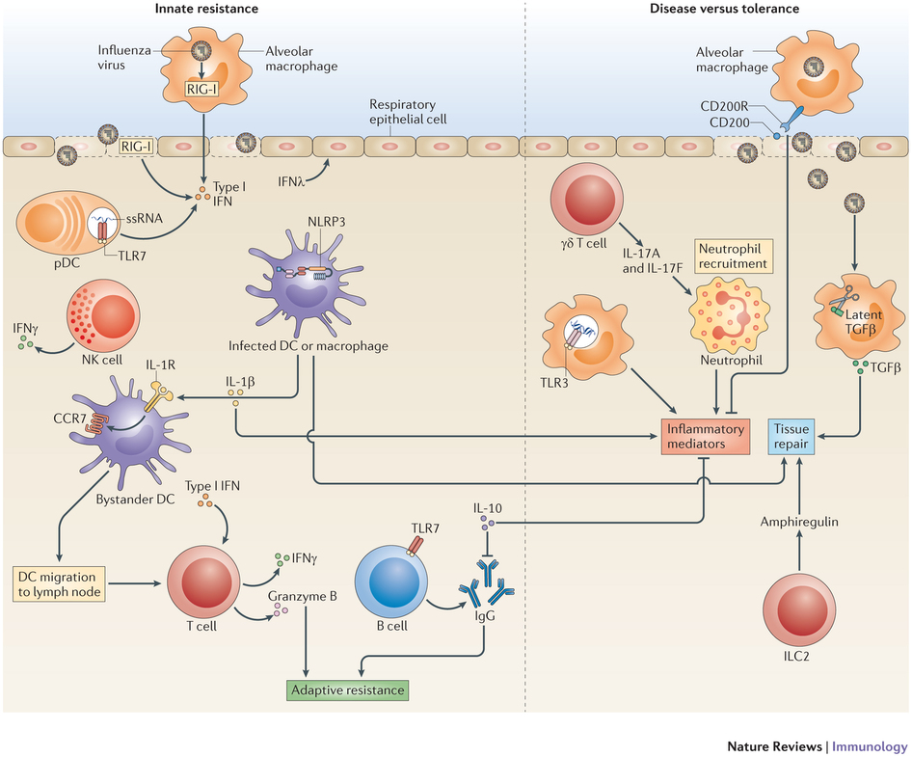
Current state-of-the-art: Type I IFNs are at the forefront of antiviral defense in the respiratory tract
IFNλ
Type I IFN
Iwasaki & Pillai Innate immunity to influenza virus infection. Nat Rev Immunol 2014

Slide 49
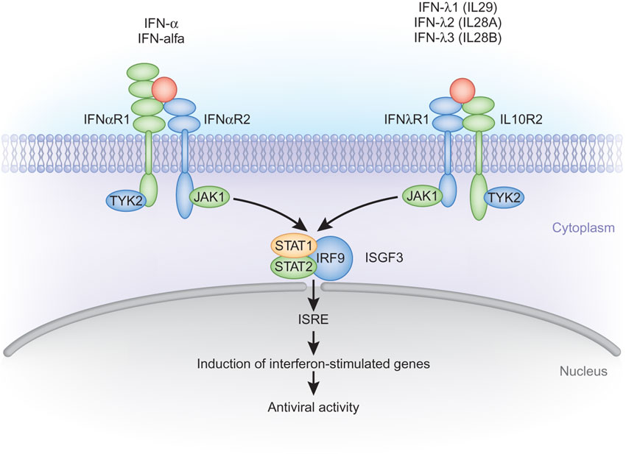
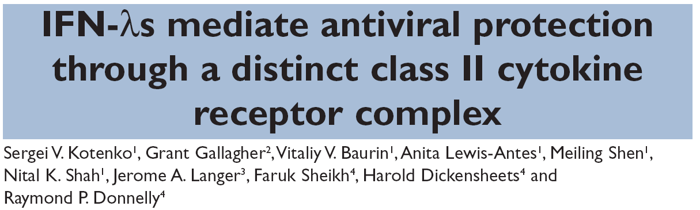
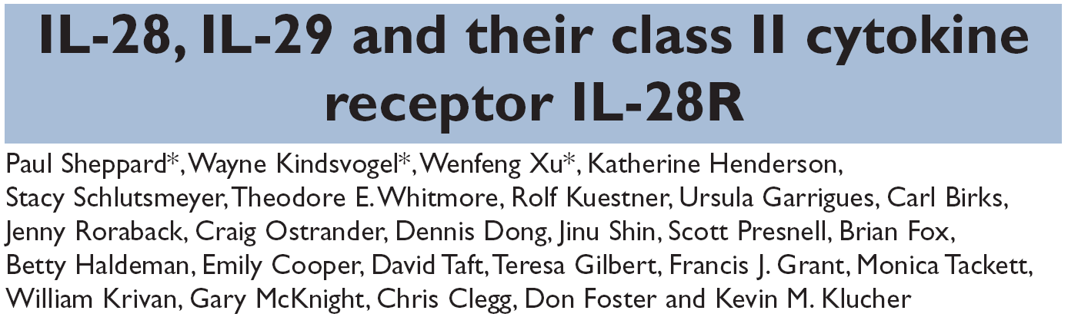
IFNλ/IL-28 cytokines signal through a heterodimeric receptor in a process reminiscent to that of type I IFNs
Nat Immunol. 2003 Jan;4(1):69-77
IFN-λ4
Nat Immunol. 2003 Jan;4(1):63-8
Antitumour
defence
Immune modulatory
Antitumour
defence
Immune modulatory
Antiviral defence
Adapted from Thomas R O'Brien Nat Genetics 2009

Slide 50

IFN signature (ISG induction)
PROTECTION
DAMAGE
Pro-inflammatory, neutrophil signature (TNF, IL1β, chemokines)

Slide 51







IFNλs are the first and most abundant IFNs produced in response to influenza virus infection
10 pfu : 0.1LD50 (sublethal dose)
100 pfu : LD50 (lethal dose)
Strain A/Puerto Rico/8/1934 H1N1 (PR8)
Body weight (%l)
Survival (%l)
WT
IFNλ
IFNα
IFNβ
BAL (pg/ml)
Days p.i.
Days p.i.
Days p.i.

Slide 52


IFNλs are essential for initial antiviral protection in the lung against sublethal (10 pfu) IAV Infection
WT
Ifnlr1^{-/-}
Ifnar1^{-/-}
Ifnlr1^{-/-}Ifnar1^{-/-}
Survival (%l)

Slide 53

IFNλs are required for preventing overactivation of the innate immune response during sublethal (10 pfu)

Slide 54
IFNλs are essential for initial antiviral protection against lethal (100 pfu) IAV infection but are spared later on

Slide 55

IFNλs are required for preventing overactivation of the innate immune response during lethal infection

Slide 56


Both type I and type III IFNs are required for preventing acute lung injury and death during lethal infection
Body weight (%l)
WT
Ifnlr1^{-/-}
Ifnar1^{-/-}
Ifnlr1^{-/-}Ifnar1^{-/-}
Days p.i.
Survival (%l)
Days p.i.

Slide 57


Ifnλ2^{Egfp}-reporter mice reveal that IFNλs are initially produced by airway epithelial cells
15μm
7.5μm

Slide 58


FACS sorting of lung cell populations

Slide 59






IFNλs are produced by epithelial cells and pro-inflammatory cytokines from neutrophils during early viral infection

Slide 60
Both type I and type III IFNs activate neutrophil antiviral functions

Slide 61

Only type I IFNs activate neutrophil pro-inflammatory responses

Slide 62
Summary
Viral infection
Low viral burden
High viral burden
IFNλ control
Escape from IFNλ control
IFNλ
IFNλ
IFNα/β
Limited
TNF
IL-1β
IL-6
CC
CXC
Inflammation
Host fitness
Host damage
Galani IE et al. Immunity 2017

Slide 63





Slide 64







Acknowledgements
Ioanna Galani
E. Eleminiadou
S. Tagkareli
V. Triantafyllia
K. Thanopoulou
O. Koltsida
TACIT
NILTHERA

