Slide 1
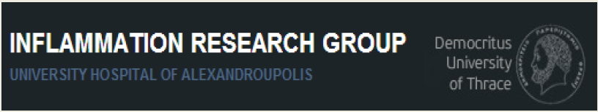
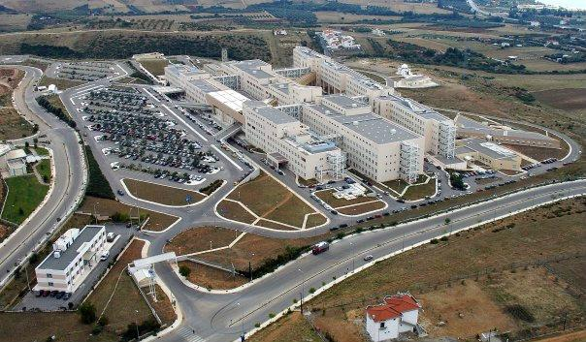
1ο Σχολείο Βασικής Ανοσολογίας για Κλινικούς, Ηράκλειο 06-08/10/2017
Ανοσοπαθογένεια συστηματικών νοσημάτων: Αυτοφλεγμονώδη νοσήματα
Autoinflammatory diseases:
old concepts, novel pathways
Α΄ Παθολογική Κλινική ΔΠΘ &
Εργαστήριο Μοριακής Αιματολογίας ΔΠΘ
Πανεπιστημιακό Νοσοκομείο Αλεξανδρούπολης
Παναγιώτης Σκένδρος
Επικ. Καθηγητής Παθολογίας
pskendro@med.duth.gr

Slide 2
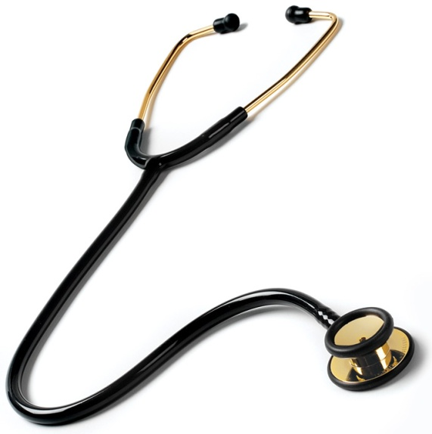
Ανοσοπαθογένεια
αυτοφλεγμονωδών διαταραχών;;
Σχέση με κλινική ιατρική;;

Slide 3
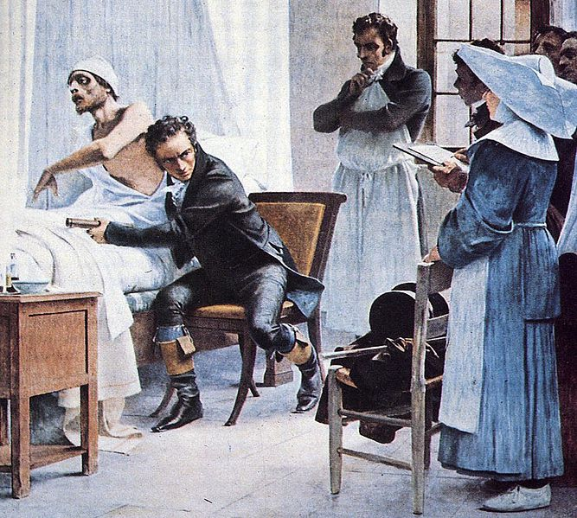
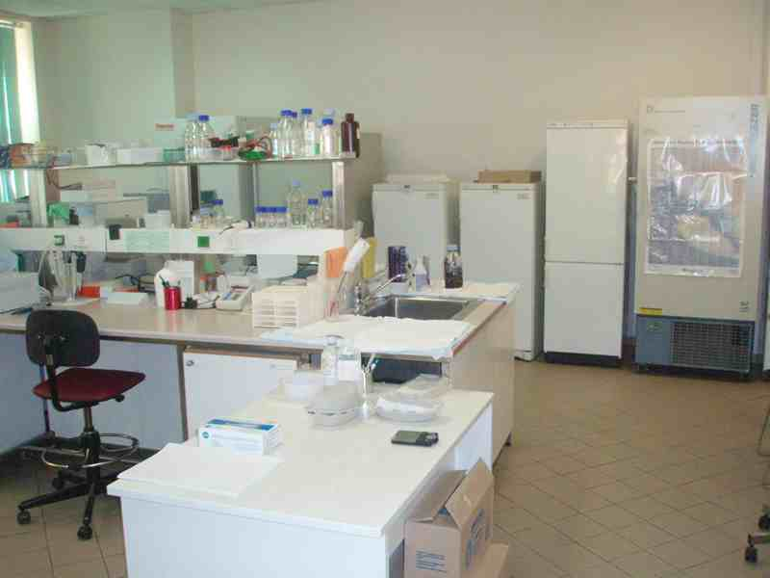
Μεταφραστική έρευνα στην Ιατρική
Εφαρμοσμένη ιατρική έρευνα
Translation Medicine Research
“from bench to bedside”
από τον κλινικό φαινότυπο στο εργαστήριο και πίσω στην κλινική εφαρμογή
Notes:
ανάπτυξη της μεταφραστικής έρευνας που συνδέει τα ερευνητικά δεδομένα με κλινικές πρακτικές

Slide 4

Από την μοριακή ανάλυση της νόσου, στην κλινική πράξη
ΒΙΟ-ΠΛΗΡΟΦΟΡΙΕΣ
ΚΛΙΝΙΚΗ ΙΑΤΡΙΚΗ
κυτταρομική
(cytomics)
γενομική
(genome)
πρωτεομική
(proteome)
System biology approach
Μέθοδοι βιολογίας συστημάτων

Slide 5
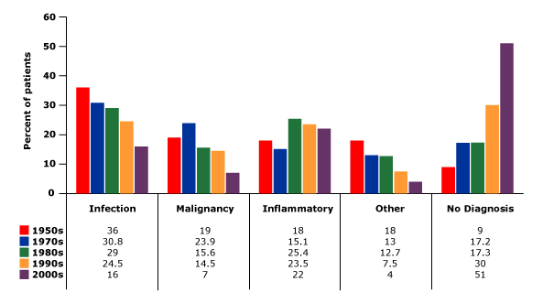
Percentage of patients with
fever of unknown origin (FUO)
Vanderschueren S, et al. Arch Intern Med 2003
Bleeker-Rovers CP, et al. Medicine (Baltimore) 2007
Horowitz HW. N Engl J Med 2013
Notes:
Infections and malignancies as a cause of FUO have been decreasing over time, while increased inflammatory diseases and undiagnosed fevers (Figure 1).
In conclusion, the proportions of patients with FUO that are eventually diagnosed with infection or malignancy have decreased in recent years, while the percentage of undiagnosed cases has increased significantly.

Slide 6


In developing countries infections remain the most common cause of FUO, while non-infectious inflammatory diseases (NIID) or no diagnosis cause FUO in the majority of patients in developed countries

Slide 7
Μη-λοιμώδεις φλεγμονώδεις νόσοι (NIID)
Αυτοάνοσα νοσήματα
Αυτοφλεγμονώδη νοσήματα

Slide 8
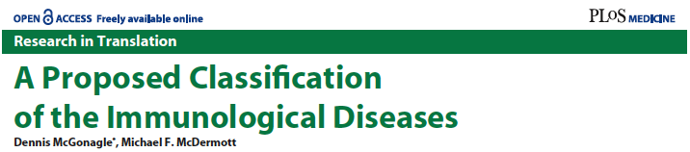
autoinflammation and autoimmunity are the two opposite poles of the same spectrum disorders that are characterized by immune response dysregulation and chronic inflammation
Notes:
The monogenic “autoinflammatory” diseases may be exclusively determined by local tissue-specific factors. For rare monogenic “autoimmune” conditions, the disease localisation appears to be determined predominantly by the adaptive immune response. The clinical heterogeneity within the immunological diseases, both among patients and between populations, may reflect the variable expression of autoinflammatory and autoimmune factors in disease causation. For example, in humans, there is considerable genetic and molecular evidence for uveitis falling into all of the disease categories, with the exception of the rare monogenic autoimmune diseases. There is also considerable overlap between polygenic autoinflammatory diseases and MHC class 1–associated diseases, but to simplify classification, these are split up into different categories. This figure does not include all immunologically recognised diseases because of their large number

Slide 9
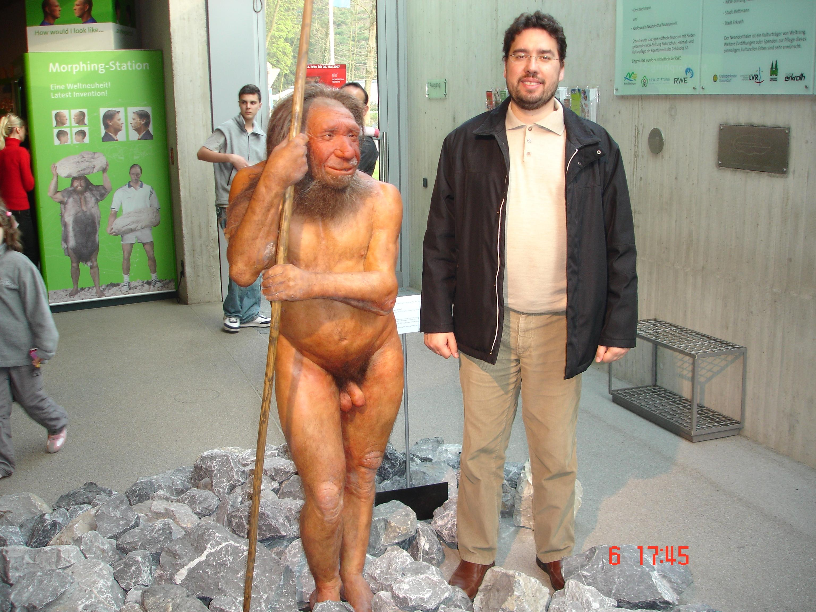
What remains remarkable conserved during evolution in humans???
Innate immune system (σύστημα εμφυτης/φυσικής ανοσίας)

Slide 10
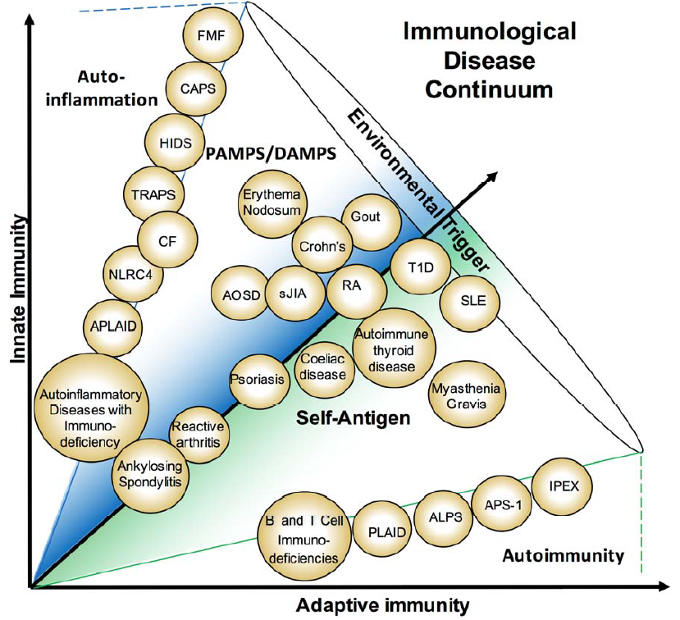
Peckham D, Scambler T, Savic S, McDermott MF. The burgeoning field of innate immune-mediated disease and autoinflammation. J Pathol. 2016

Slide 11
Γενικά χαρακτηριστικά των αυτοφλεγμονωδών νοσημάτων
Συστηματικά φλεγμονώδη νοσήματα (ουδετεροφιλία/CRP)
Διαταραχή φυσικής ανοσίας (DAMPs, ουδετερόφιλα, Μφ)
Απουσία ειδικών αυτοαντισωμάτων/αυτοαντιδραστικών Τ-κυττάρων
Απουσία ενεργού λοίμωξης ή νεοπλασίας
Σπάνια μονογονοδιακά σύνδρομα περιοδικού πυρετού (periodic fever syndromes) έως συχνότερες πολυγονιδιακές νόσοι ή σύνδρομα απροσδιόριστης αιτιολογίας

Slide 12
Κλινικές εκδηλώσεις αυτοφλεγμονής
Υποτροπές πυρετού/φλεγμονής (περιοδικότητα)
Έναρξη εκδηλώσεων συνήθως στην παιδική ηλικία
Συχνά η διάγνωση καθυστερεί ως την ενήλικη ζωή
Δερματικές εκδηλώσεις
Ορογονίτιδες
Εκδηλώσεις από τις αρθρώσεις*
Νευρολογικές εκδηλώσεις*
Αμυλοείδωση (AA)*
Τροποποίηση κλινικής εικόνας άλλων καταστάσεων (πχ αυτοάνοσων νοσημάτων)
*συνοδεύονται από χρόνιες βλάβες

Slide 13

Αυτοφλεγμονώδη νοσήματα σήμερα
IL-1β
IFNs-I

Slide 14
γενετικά νοσήματα αυτοφλεγμονής
in vivo πειράματα της φύσης
represent true experiments of nature
that continue to provide unique pathogenic insights
into the regulation of immune responses

Slide 15
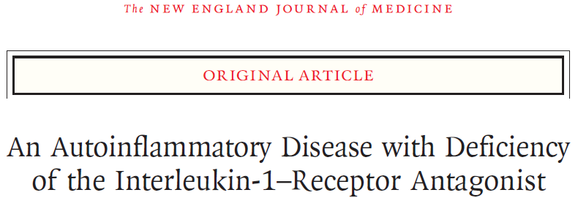
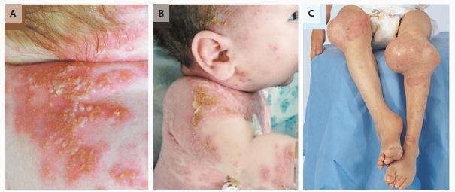
life-threatening systemic inflammation with skin and bone involvement
Aksentijevich I. et al (2009) . An autoinflammatory disease with deficiency of the interleukin-1-receptor antagonist. N Engl J Med

Slide 16
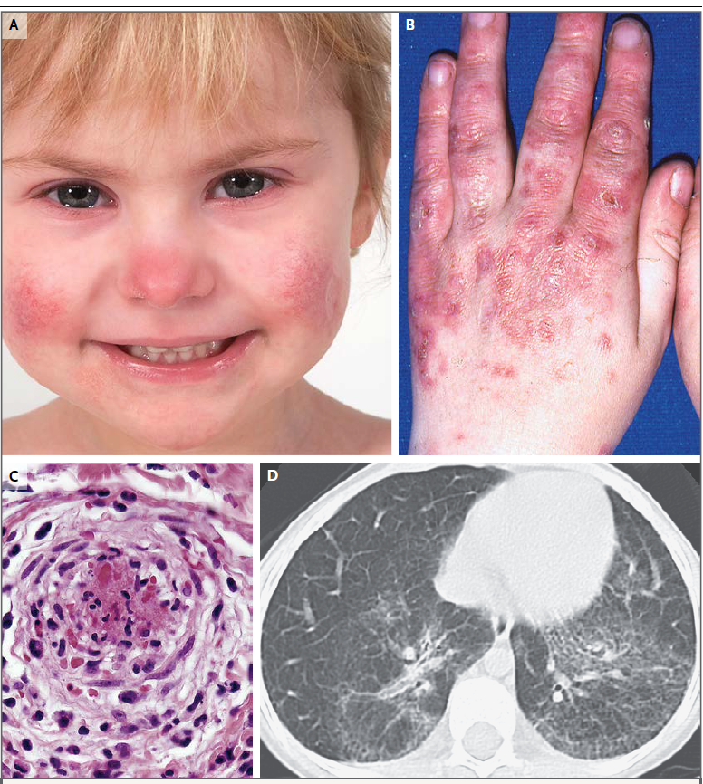
Stimulator of Interferon Genes (STING)–Associated Vasculopathy with Onset in Infancy
(SAVI)
Liu Y et al. N Engl J Med 2014
Notes:
Panel A shows the typical facial distribution of telangiectatic lesions on the nose and cheeks of Patient 1, who has SAVI.
Panel B shows violaceous, scaling, atrophic plaques on the hands of Patient 6. Panel C shows histologic features of vascular
inflammation in a skin-biopsy sample from a clinically involved area depicting a dense neutrophilic infiltrate with karyorrhexis
throughout the vessel wall (hematoxylin and eosin); fibrin deposits are seen in the lumen of a severely damaged
vessel. In Panel D, a high-resolution computed tomographic image of the lung of Patient 5 shows interstitial lung disease.

Slide 17
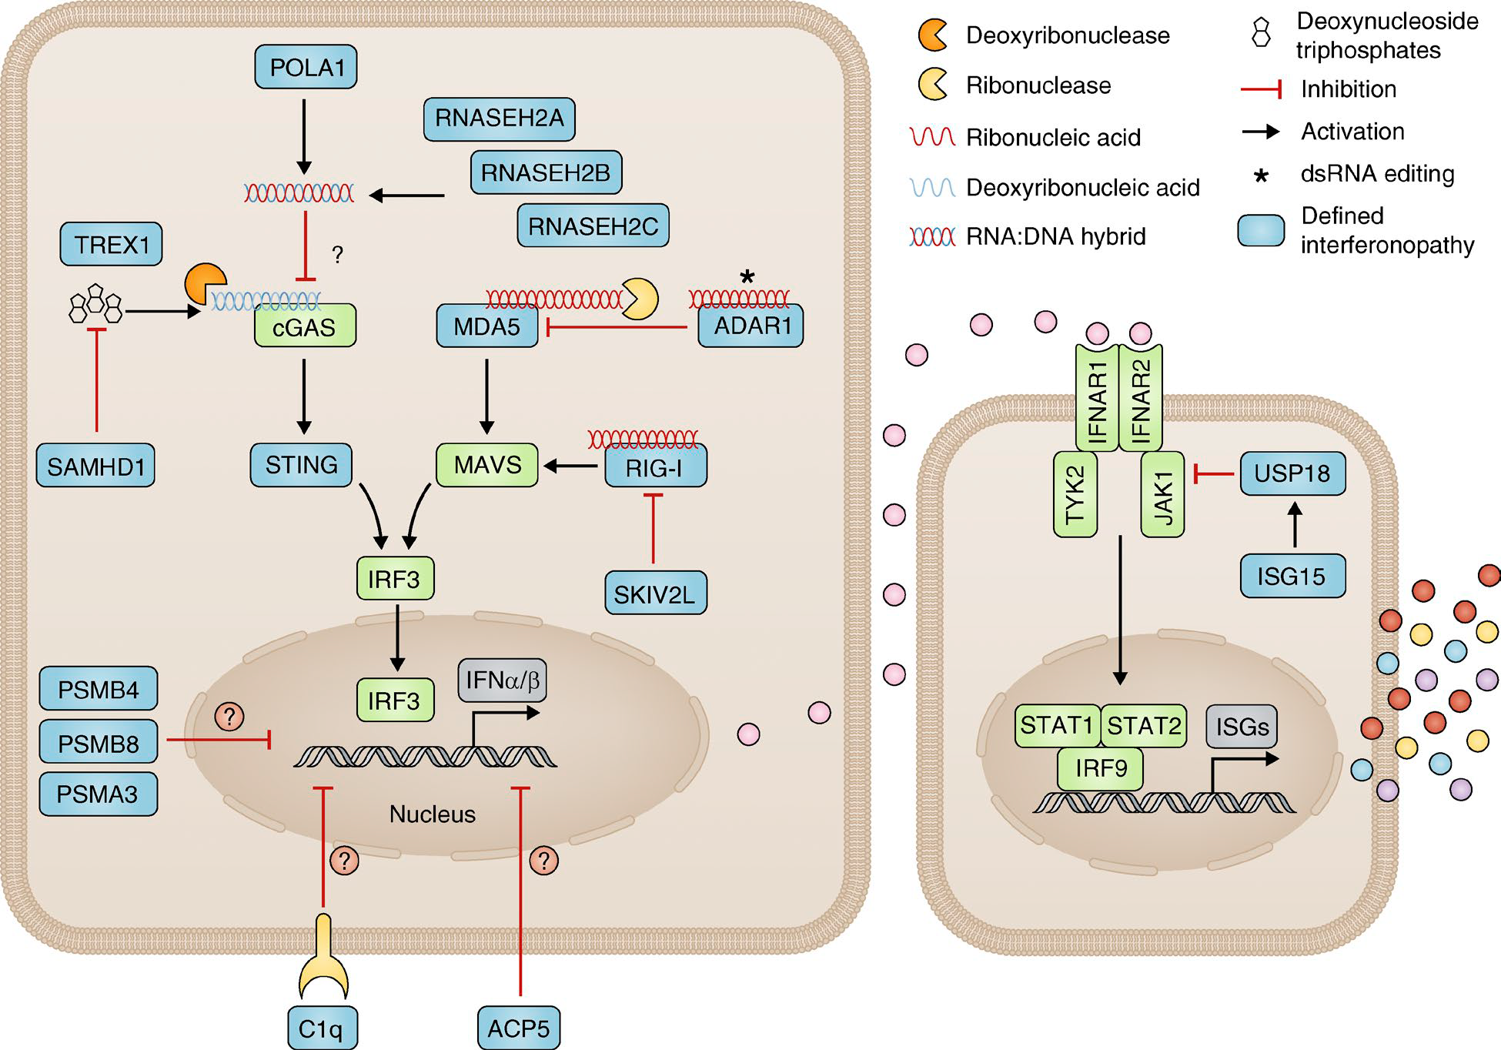
Type I interferonopathies
Rodero and Crow , JEM 2016
Notes:
Type I interferon signaling and type I interferonopathies as currently assigned. Diseases considered as monogenic interferonopathies
are represented by blue boxes. This schema alludes to at least seven possible cellular mechanisms resulting in sustained activation of interferon signaling
caused by the following: (1) loss-of-function mutations leading to increased cytosolic DNA (TREX1 [Stetson et al., 2008] and SAM HD1 [Behrendt et al.,
2013; Rehwinkel et al., 2013]) or RNA/DNA hybrid (RNA SEH2A, RNA SEH2B and RNA SEH2C, POLA1) sensing (Hiller et al., 2012; Mackenzie et al., 2016;
Starokadomskyy et al., 2016); (2) loss-of-function mutations leading to a defect in RNA editing and abnormal sensing of self–nucleic acid RNA species
in the cytosol (ADAR1 [Liddicoat et al., 2015; Pestal et al., 2015]); (3) gain-of-function mutations leading to constitutive activation of cytosolic interferon
signaling pathways/increased sensitivity to cytosolic nucleic acid ligands (MDA5 [Rice et al., 2014], RIG-I [Jang et al., 2015], and STI NG [Liu et al., 2014]);
(4) loss-of-function mutations leading to aberrant RNA signaling via MAVS caused by a disturbance of the unfolded protein response (SKIV2L [Eckard et
al., 2014]); (5) loss-of-function mutations in molecules responsible for limiting interferon receptor (IFN AR1/2) signaling leading to uncontrolled ISG production
(USP18 [Meuwissen et al., 2016] and ISG15 [Zhang et al., 2015]); (6) proteasomal dysfunction leading to increased interferon signaling through an
unknown mechanism (PSMA3, PSMB4, and PSMB8 [Brehm et al., 2015]; we do not include the so-far single-published mutations in PSMB9 and POMP); and
(7) loss-of-function mutations in TRAP/ACP5 (Briggs et al., 2011; Lausch et al., 2011) and C1q (Lood et al., 2009; Santer et al., 2010) where we consider the
mechanisms leading to type I interferon signaling are yet to be fully clarified (we do not include mutations in other molecules of the complement pathway
as a clear demonstration of enhanced interferon signaling has not been established).

Slide 18
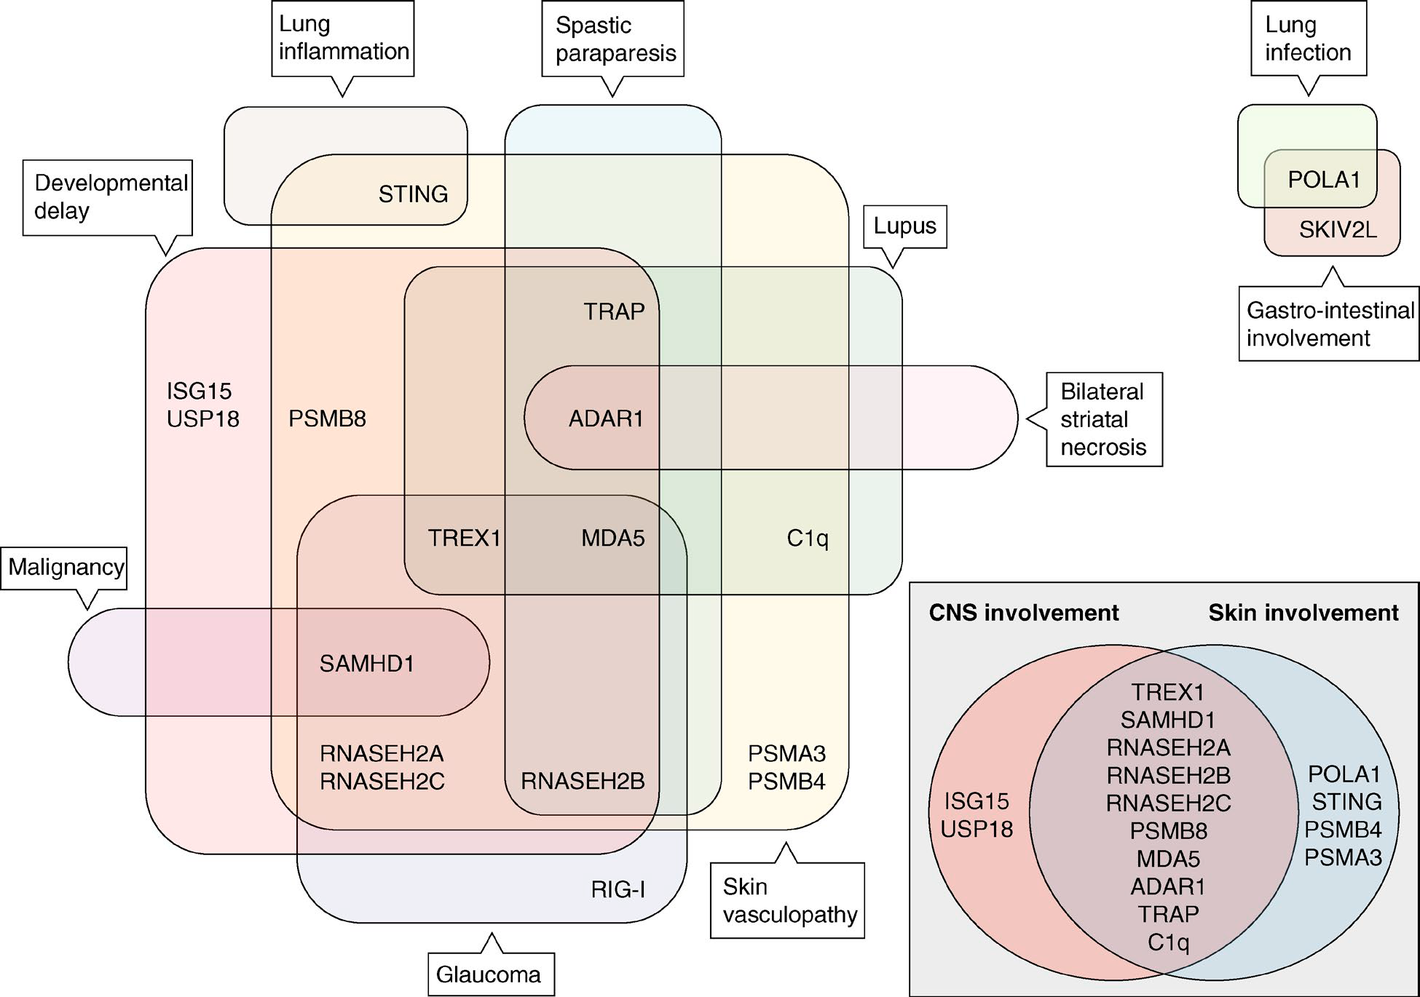
Specific and overlapping features of monogenic type I interferonopathies
Rodero and Crow , JEM 2016

Slide 19
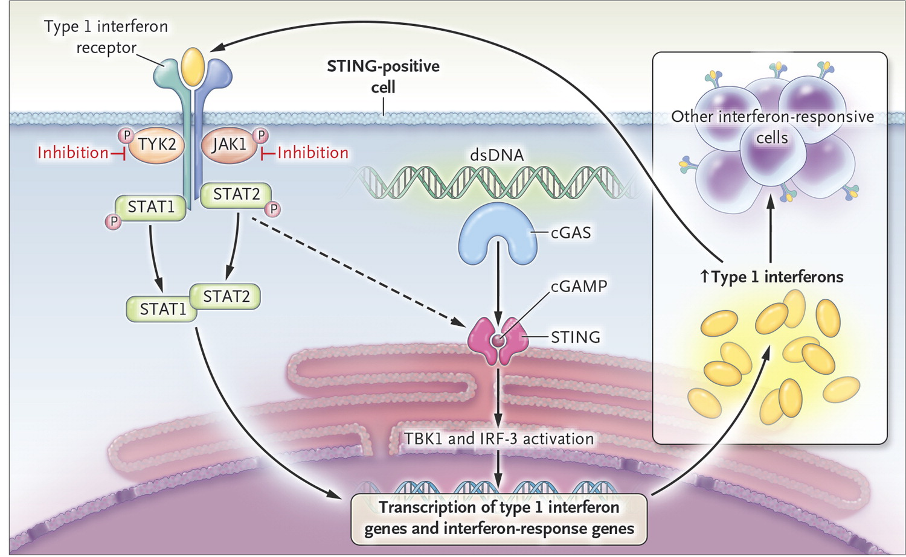
Liu Y et al. N Engl J Med 2014

Slide 20
IL-β-mediated autoinflammation
Importance of IL-1 as a master cytokine in inflammation ?

Slide 21

Hereditary Periodic Fever Syndromes (HPFs): Genetically Diverse But Clinically Similar Group of Conditions
Characterized by recurrent attacks of fever; rash; serositis; lymphadenopathy; and musculoskeletal involvement
In HPFs, genetic mutations lead to dysregulation of the innate immune system and to episodic manifestations of systemic inflammation
  Familial Mediterranean fever (FMF)
  Hyperimmunoglobulinemia D and periodic fever syndrome (HIDS)
  Tumor necrosis factor receptor–associated periodic syndrome (TRAPS)
  Cryopyrin-associated periodic syndromes (CAPS)
Notes:
Hereditary periodic fever (HPF) syndromes are a group of genetically diverse but clinically similar autoinflammatory diseases characterized by recurrent attacks of fever, rash, serositis, lymphadenopathy, and musculoskeletal involvement.
In HPFs, genetic mutations lead to dysregulation of the innate immune system and to episodic manifestations of systemic inflammation.
The 3 classic HPFs presenting with recurrent episodic fevers, nonspecific maculopapular rashes, and abdominal pain are
Familial Mediterranean fever (FMF)
Hyperimmunoglobulinemia D and periodic fever syndrome (HIDS)
Tumor necrosis factor receptor–associated periodic syndrome (TRAPS)
οικογενές κρυοεπαγόμενο αυτοφλεγμονώδες σύνδρομο (familial cold autoinflammatory syndrome, FCAS),
σύνδρομο Muckle–Wells (MWS)
χρόνιο βρεφικό νευρολογικό, δερματικό και αρθρικό σύνδρομο (chronic infantile neurologic cutaneous articular syndrome, CINCA/ Neonatal-Onset Multisystem Inflammatory Disease, NOMID)
Reference
De Jesus AA, Goldbach-Mansky R. Monogenic autoinflammatory diseases: concept and clinical manifestations. Clin Immunol. 2013;147:155-74.

Slide 22
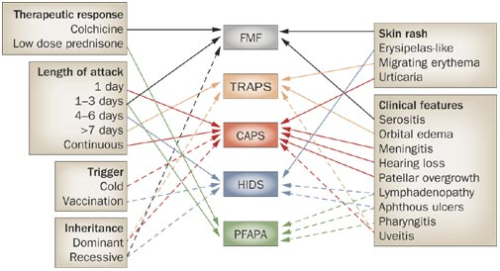

Diagnostic features and differential diagnosis of recurrent febrile syndromes
Hoffman HM and Simon A (2009) Recurrent febrile syndromes—what a rheumatologist needs to know Nat Rev Rheumatol
Notes:
First, exclude other, more common causes of fever and inflammation in the patient. When a recurrent febrile syndrome seems likely, check the clinical characteristics found in your patient on the right and left of the diagram and assign one point to each syndrome that is linked to these characteristics by an arrow (one characteristic could point to more than one syndrome). The final combined score of both panels assigns a rank of likelihood of the disorders, and helps in determining the correct subsequent diagnostic tests. This algorithm is not evidence-based, but is solely derived from expert opinion. Lines are dotted or solid for clarity only—both are worth one point. Abbreviations: CAPS, cryopyrin-associated periodic syndromes; FMF, familial Mediterranean fever; HIDS, hyper-IgD syndrome; PFAPA, periodic fever, adenitis, pharyngitis and aphthous stomatitis; TRAPS, TNF-receptor-associated periodic syndrome. Adapted with permission from Elsevier © Simon, A. et al. Familial Autoinflammatory Syndromes. In Kelley's Textbook of Rheumatology, 8th edn, Ch. 113 (Eds Firestein, G. S.et al.) 1863–1882 (Saunders, Philadelphia, 2008).⁵⁶
Periodic Fever, Aphthous stomatitis, Pharyngitis, Adenitis

Slide 23
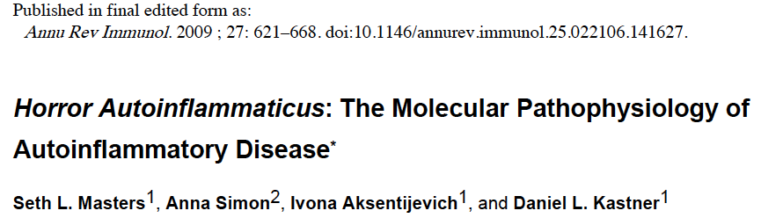

“Horror Autotoxicus”
Ehrlich, P. Studies in Immunity. London: Wiley; 1910.
Notes:
“Horror Autotoxicus”
Ehrlich, P. Studies in Immunity. London: Wiley; 1910.
Horror autotoxicus: Literally, the horror of self-toxicity. A term coined by the great German bacteriologist and immunologist Paul Ehrlich (1854-1915) to describe the body's innate aversion to immunological self-destruction. However, as we now know, the immune system can upon occasion attack itself and does so in the autoimmune disorders.

Slide 24
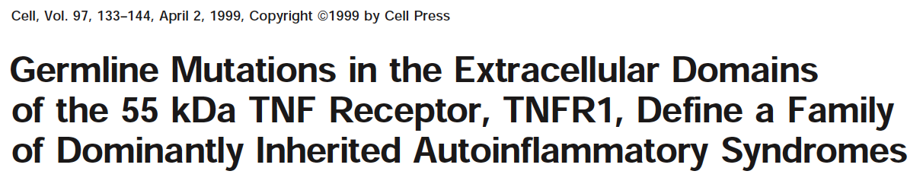
Περιοδικό σύνδρομο που σχετίζεται με τον υποδοχέα του TNFα
(TNF-receptor associated periodic syndrome, TRAPS)
Dan Kastner 1999: First proposition of term “autoinflammation”
Notes:
The term “autoinflammation” was first proposed by Dan Kastner, in 1999
a candidate gene approach in families with a rare autosomal dominant HPF termed familial Hibernian fever
FMF, HIDS υπολειπόμενα, Λοιπά περιοδικά αυτοφλεγμονώδη επικρατή

Slide 25

CAPS Σύνδρομα σχετιζόμενα με την κρυοπυρίνη (NLRP3)
Mutation of a new gene encoding a putative pyrin-like protein causes Familial Cold Autoinflammatory Syndrome and Muckle-Wells syndrome.
Hoffman HM et al. Nat Genet. 2001

Slide 26
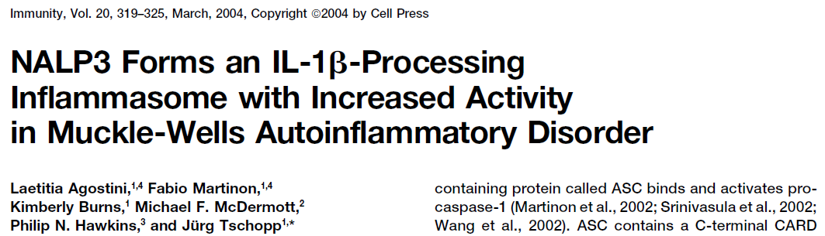

Slide 27

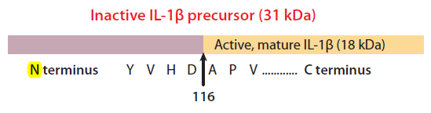
NLRP3 φλεγμονόσωμα
inflammasome
NOD-like receptor (NLR) family, pyrin domain–containing protein 3 (NLRP3)
maturation of pro-IL1-β to bioactive IL-1β
LRR
Inflammation
Alarm signal
NALP3 (cryopyrin)
ASC
Caspase-1
Notes:
Με εξαίρεση τον IL-1Ra, όλα τα άλλα μέλη της IL-1 οικογένειας στερούνται σηματοδοτικού τμήματος, παράγονται δηλαδή ως ενδοκυττάρια, ανενεργά, πρόδρομα μόρια (precursors) που χρειάζονται πρωτεϊνική διάσπαση, είτε από την κασπάση-1 του NLRP3 φλεγμονοσώματος, είτε από πρωτεάσες των ουδετεροφίλων, προκειμένου να σχηματισθούν οι ώριμες, βιοενεργά δραστικές κυτταροκίνες

Slide 28
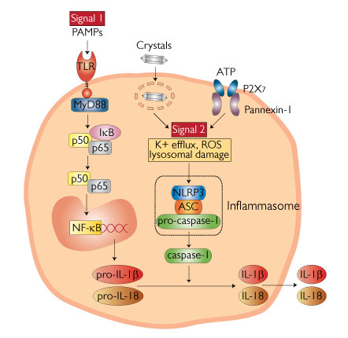
Δύο σήματα χρειάζονται για την παραγωγή της IL-1β
Notes:
Πρωτεολυτική διάσπαση
Η παραγωγή της IL-1β ρυθμίζεται από δύο ενδοκυττάρια μονοπάτια. Αρχικά, εξωκυττάρια σήματα κινδύνου μέσω των Toll-like υποδοχέων (TLRs), ή και η ίδια η IL-1β μέσω του υποδοχέα της (IL-1R), προκαλούν την ενεργοποίηση του μεταγραφικού παράγοντα NFκB που οδηγεί στην παραγωγή της προ-IL-1β, αλλά και της NLRP3 πρωτεΐνης, του βασικού δηλαδή συστατικού του φλεγμονοσώματος. Η προ-IL-1β στη συνέχεια με την πρωτεολυτική μετα-μεταγραφική τροποποίησή της από την κασπάση-1 του NLRP3 φλεγμονοσώματος μετατρέπεται σε ώριμη (ενεργή) IL-1β. Κατά ανάλογο τρόπο ενεργοποιείται και η IL-18 από την πρόδρομη μορφή της προ-IL-18

Slide 29
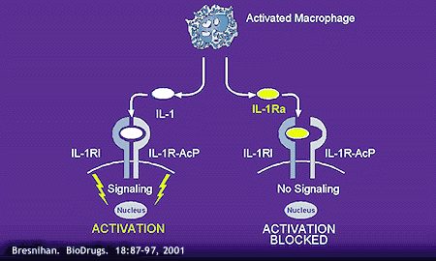
IL-1/IL-1R/IL-1Ra system

Slide 30
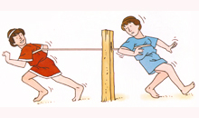

Παρέμβαση στην ισορροπία IL-1/IL-1Ra
IL-1β
IL-1Rα

Slide 31
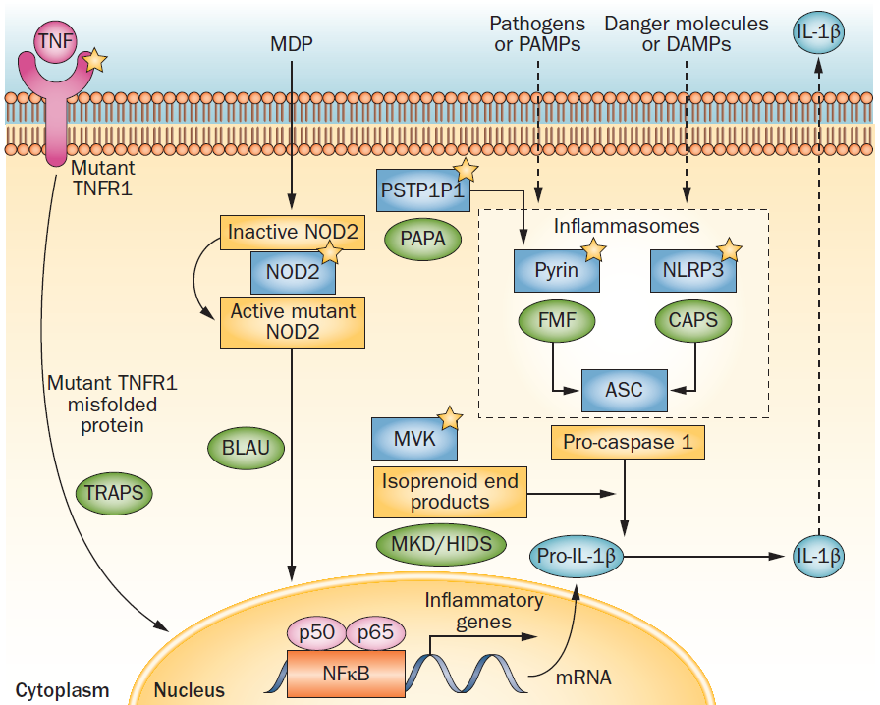
Ozen & Bilginer. Nat Rev Rheumatol. 2014
Notes:
Figure 1 | A schematic showing a simplified view of the pathogenesis of the main monogenic autoinflammatory syndromes. Mutated proteins are denoted by stars, and the terms in green circles denote the diseases with which they are associated. In TRAPS, mutant TNFR1 (misfolded protein) leads to an abnormal inflammatory response through NFκB activation. In Blau syndrome, mutant NOD2 that is activated after stimulation with MDP induces NFκB activation. In FMF, mutant pyrin is suggested to associate with the inflammasome adaptor protein ASC and increase IL‑1β processing. In CAPS, activated NLRP3 oligomerizes and interacts with the adaptor protein ASC and caspase 1 to form macromolecular complexes (inflammasomes) that process IL‑1β into its active form. In PAPA syndrome, PTSPIP1 has been implicated through its binding to pyrin. In MKD/HIDS, a shortage of nonsterol isoprenoid end products results in increased IL‑1β production. Abbreviations: CAPS, cryopyrin-associated periodic syndromes; DAMP, damage-associated molecular pattern; FMF, familial Mediterranean fever; MDP, muramyl dipeptide; MKD/HIDS, mevalonate kinase deficiency/hyperimmunoglobulin D syndrome; MVK, mevalonate kinase; NFκB, nuclear factor κB; NLRP, NOD, LRR and pyrin domain-containing protein; NOD2, nucleotide-binding oligomerization domain protein 2; PAMP, pathogen-associated molecular pattern; PAPA, pyogenic arthritis, pyoderma gangrenosum, and acne; PSTPIP1, proline-serine-threonine phosphatase interacting protein 1; TNFR1, TNF receptor 1; TRAPS, TNF receptor-associated periodic syndrome.

Slide 32
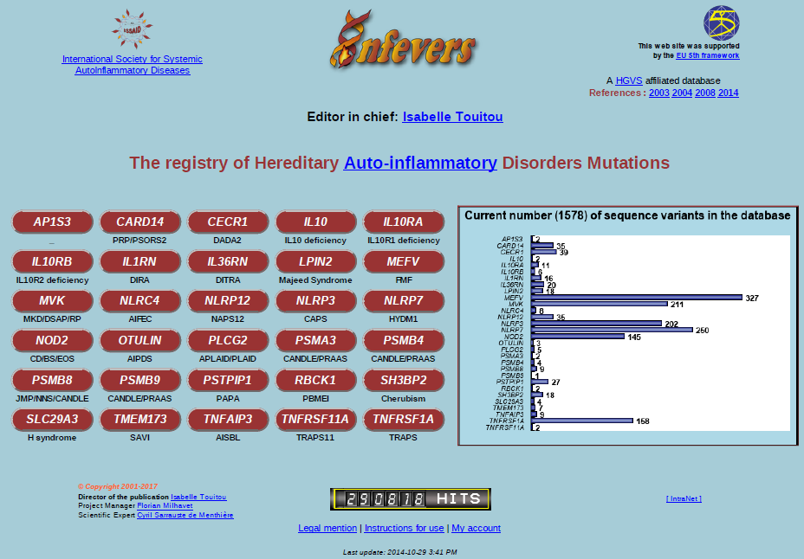

Slide 33
Γυναίκα 22 ετών, λευκό ατομικό/οικογενειακό αναμνηστικό
10 ημέρες αιχμές πυρετού καθημερινά έως 39ºC
Κυνάγχη
Τραχηλική λεμφαδενίτιδα, ηπατοσπληνομεγαλία
Αρθρίτιδα αγκώνα, γόνατος, ΠΔΚ, ΜΤΦ
Παροδικό εξάνθημα κηλιδοβλατιδώδες, μη κνησμώδες
WBC: 23.580 (94% PMNs), Ht: 28,7/Hb: 9,2, MCV: 85,4
CRP 35,74 (<1), PCT: 1,5 (<0,5)
κ/α αίματος/ούρων (-), αυτοαντισώματα (-), CT ΘΑΚΟ (-)
Αντιβιοτικά, μεθυλπρεδνιζολόνη 16 mg
????????

Slide 34
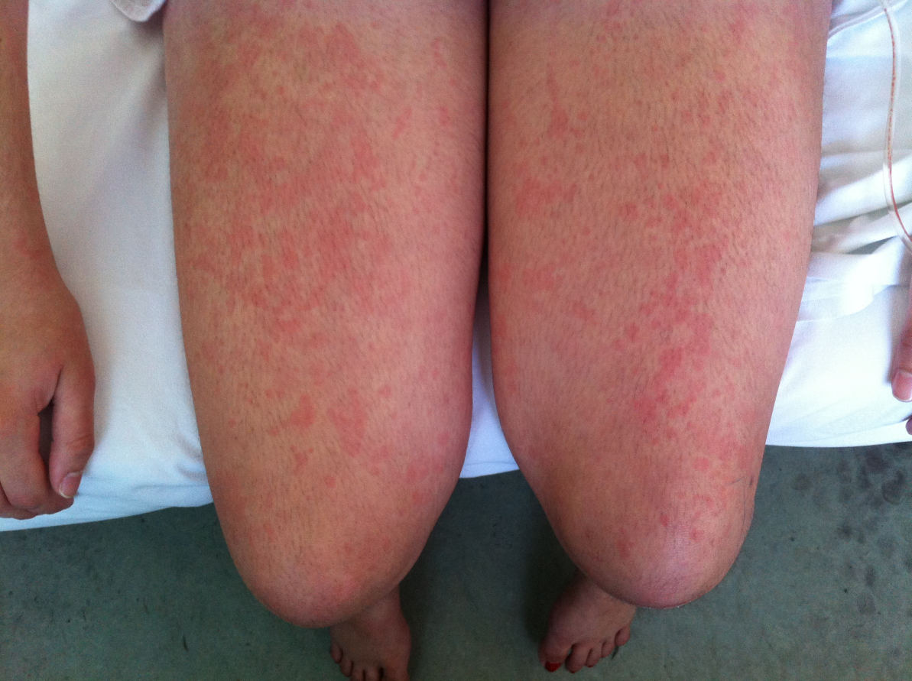
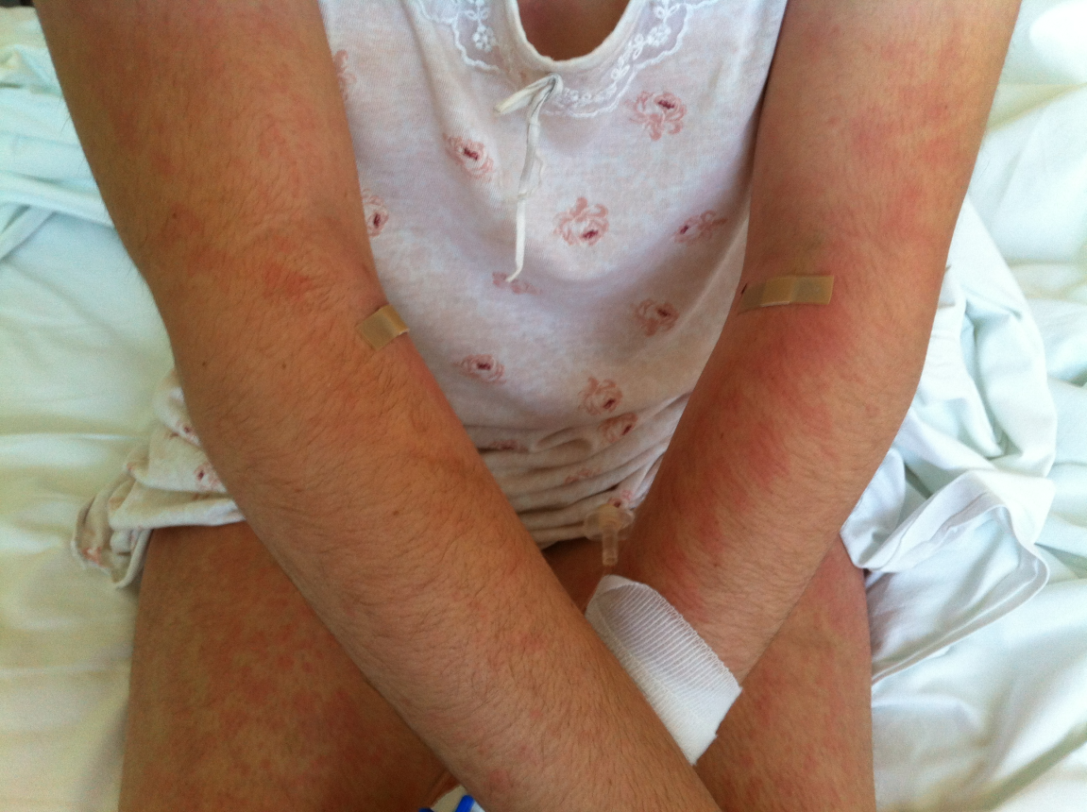

Slide 35
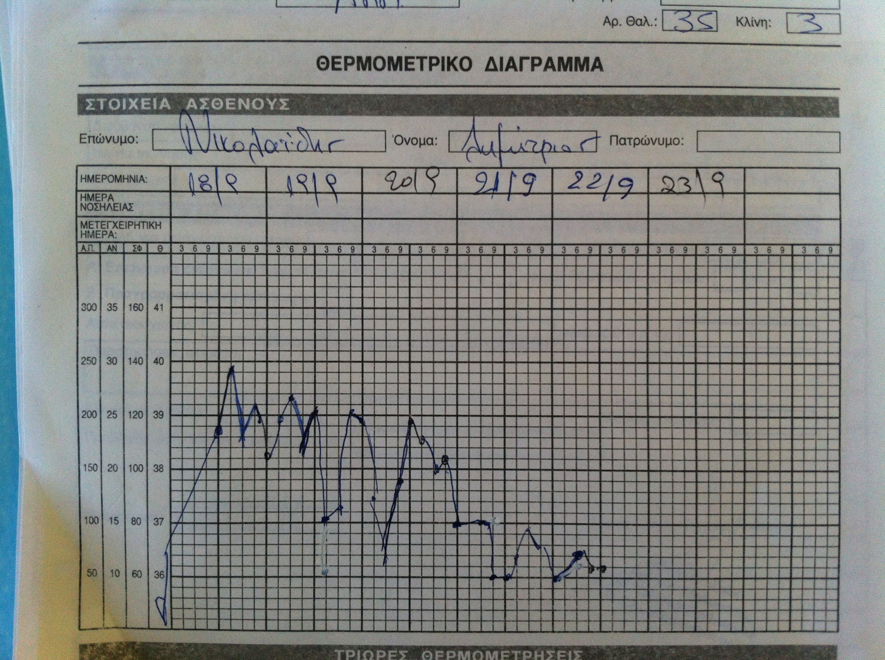
ΠΕΡΙΠΤΩΣΗ-3
Anakinra

Slide 36
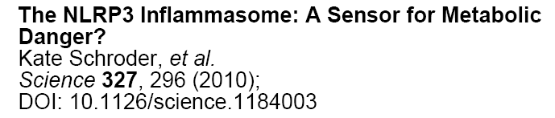
NLRP3 inflammasome contributes to the pathogenesis of T2DM and gout by functioning as a sensor for metabolic stress

Slide 37
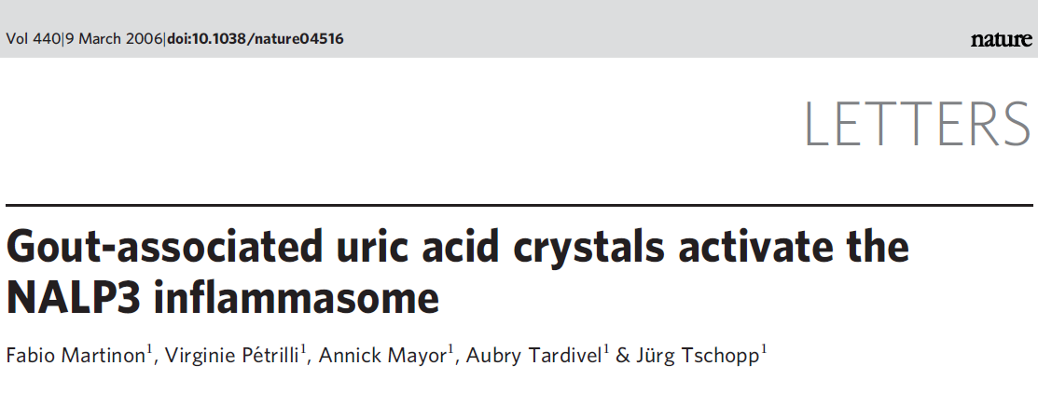
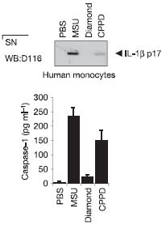
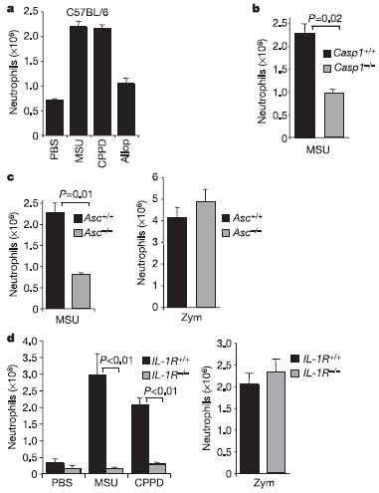

Slide 38
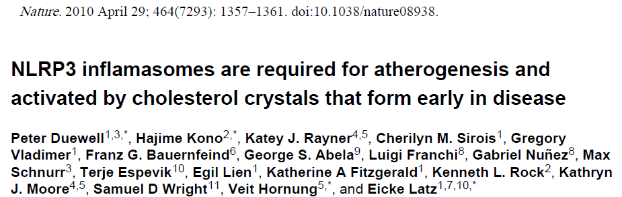
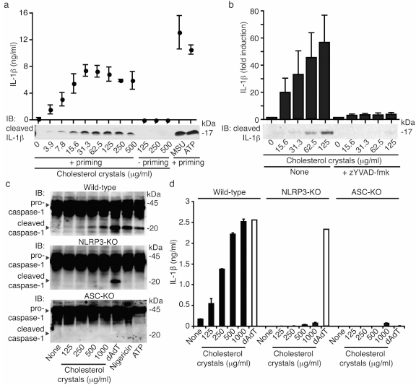
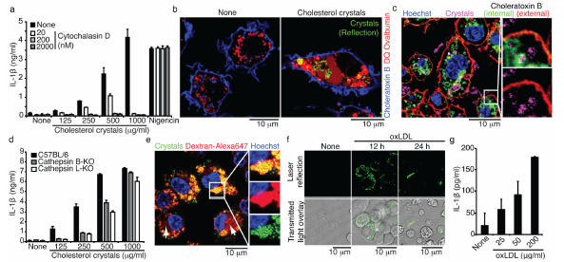
Notes:
Our results demonstrate that crystalline cholesterol acts as an endogenous danger signal and its deposition in arteries or elsewhere is an early cause rather than a late consequence of inflammation. These findings provide new insights into the pathogenesis of atherosclerosis and point to new potential molecular targets for the therapy of this disease.

Slide 39

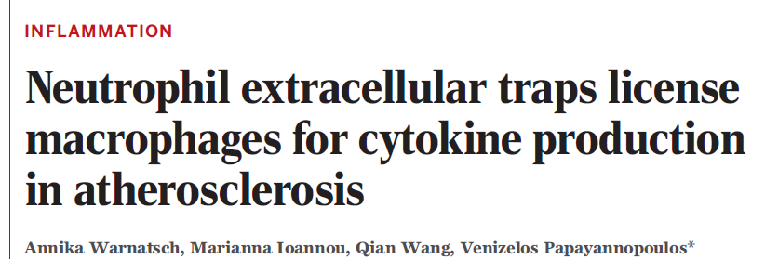
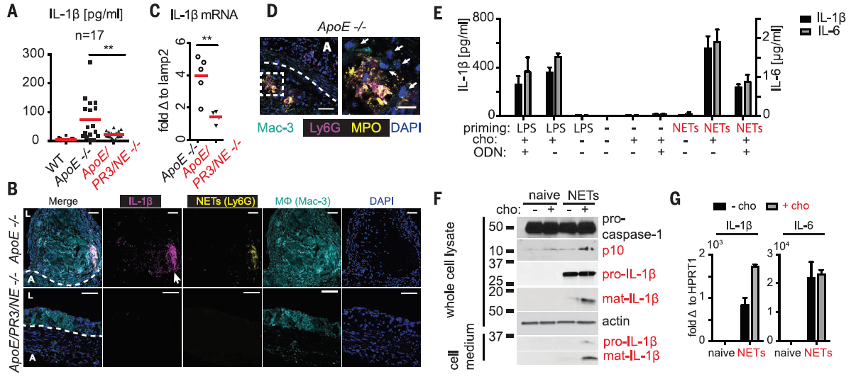

Slide 40
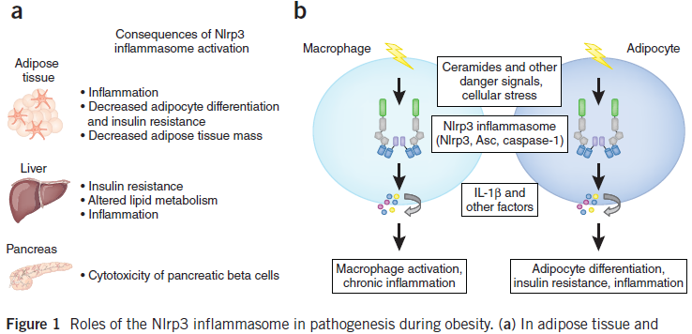
The NLRP3 inflammasome instigates obesity-induced inflammation and insulin resistance
Vandanmagsar et al Nature Medicine VOL 17 ; 2 | FEBRUARY, 2011

Slide 41
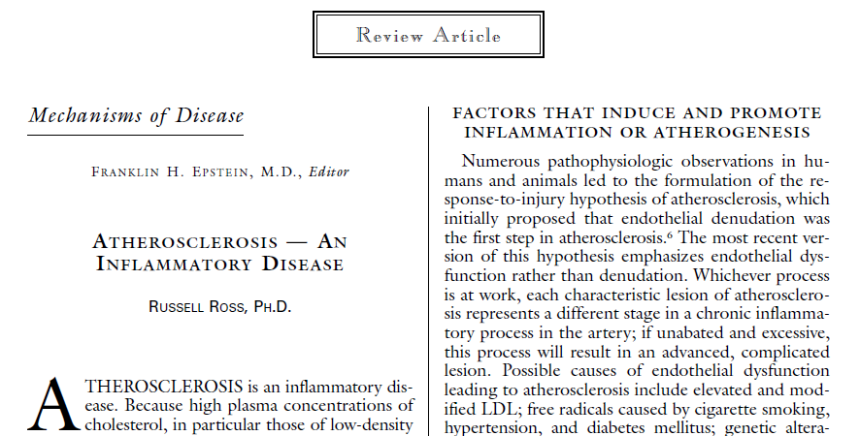
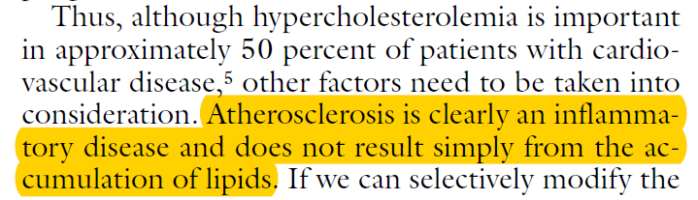
The New England Journal of Medicine 1999

Slide 42
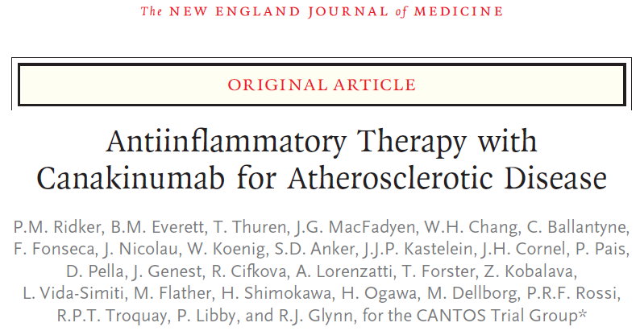
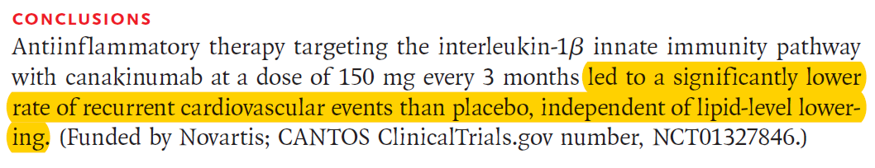
2017
10,061 patients
Previous myocardial infarction
CRP> 2m/dl
Notes:
The trial randomly assigned patients with a previous myocardial infarction and an elevated level of high-sensitivity C-reactive protein to
receive one of three doses of canakinumab or placebo, administered subcutaneously every 3 months

Slide 43
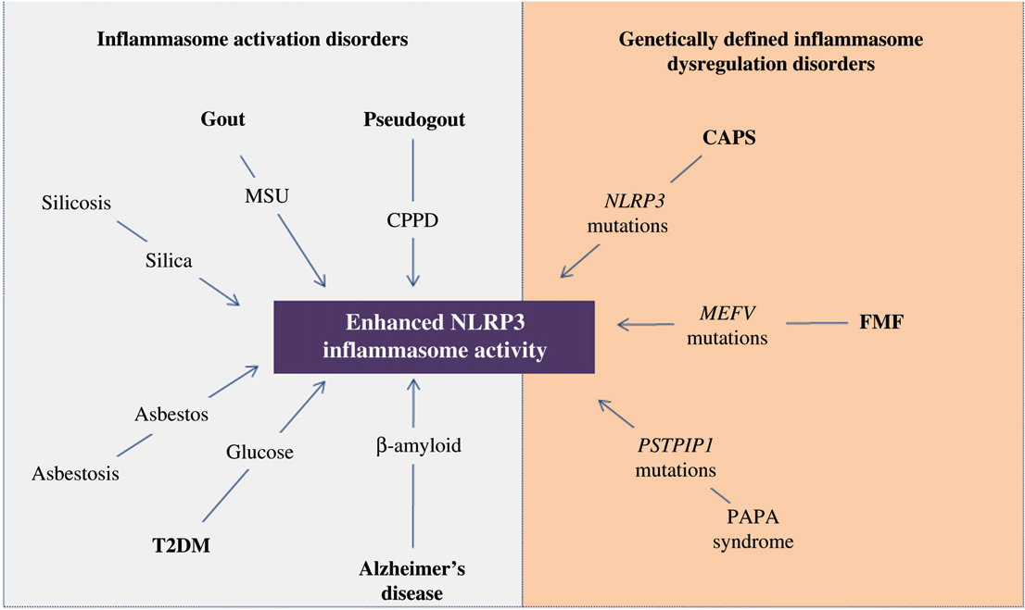
Disorders that are associated with dysregulation of NLRP3 inflammasome and increased production of IL-1β
Mitroulis I, Skendros P, Ritis K. Eur J Intern Med. 2010

Slide 44
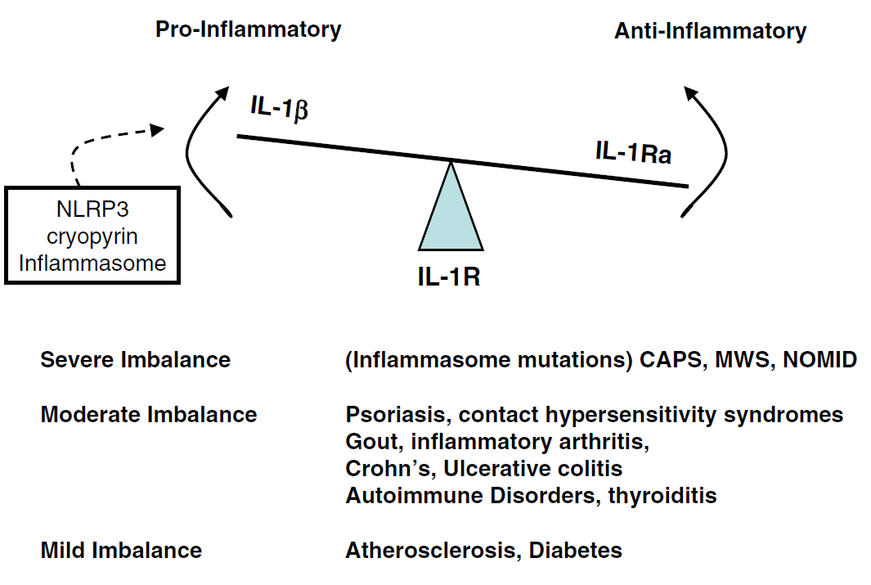
Balancing the IL-1β system and its contributions to human disease
C.A. Dinarello, J.W.M. van der Meer / Seminars in Immunology 25 (2013) 469– 484

Slide 45
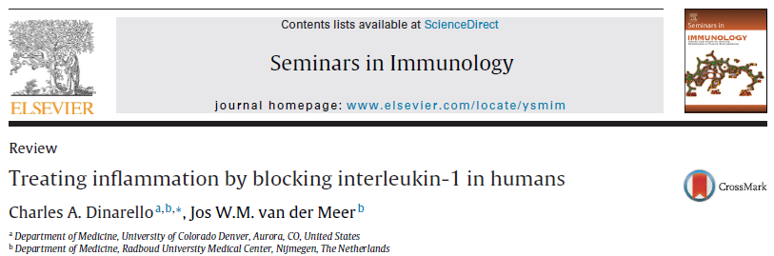
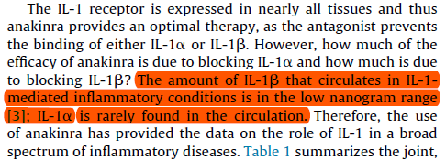
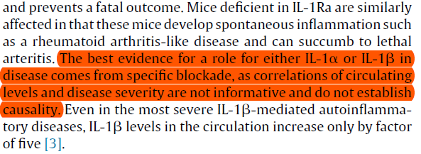

Slide 46
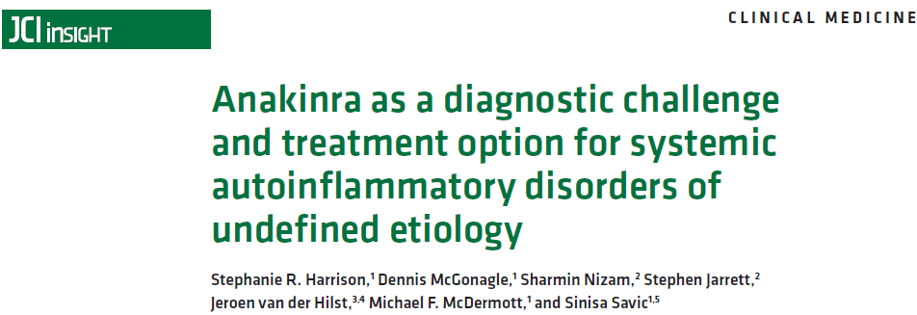
JCI Insight 2016

Slide 47
Γενικά χαρακτηριστικά των IL-1 διαμεσολαβούμενων
αυτοφλεγμονωδών νοσημάτων
Συστηματικά φλεγμονώδη νοσήματα / Ουδετεροφιλία
Διαταραχή του μηχανισμού φυσικής ανοσίας
Απουσία αυτοαντισωμάτων /αυτοαντιδραστικών Τ-κυττάρων
Απουσία ενεργού λοίμωξης
Σπάνια μονογονοδιακά σύνδρομα περιοδικού πυρετού (periodic fever syndromes) έως συχνότερες πολυγονιδιακές νόσοι ή σύνδρομα απροσδιόριστης αιτιολογίας
Ανταπόκριση στην θεραπεία αναστολής της IL-1

Slide 48
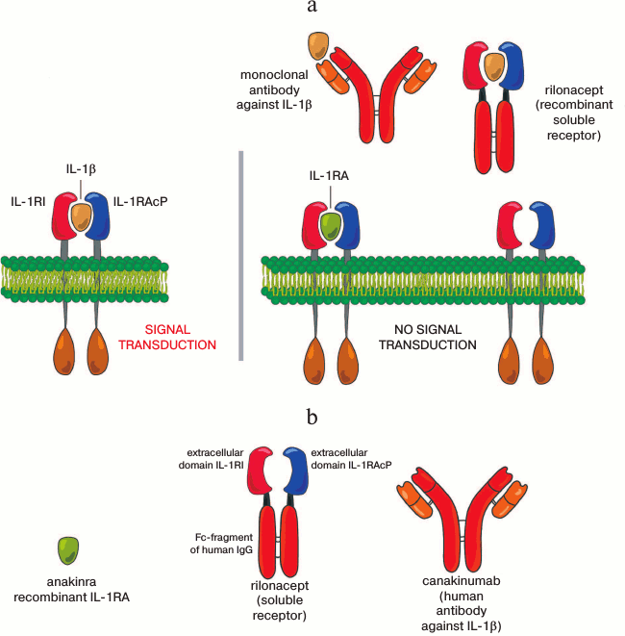
Biochemistry (Mosc). 2014 Dec;79(12):1308-21
Anti-IL-1

Slide 49
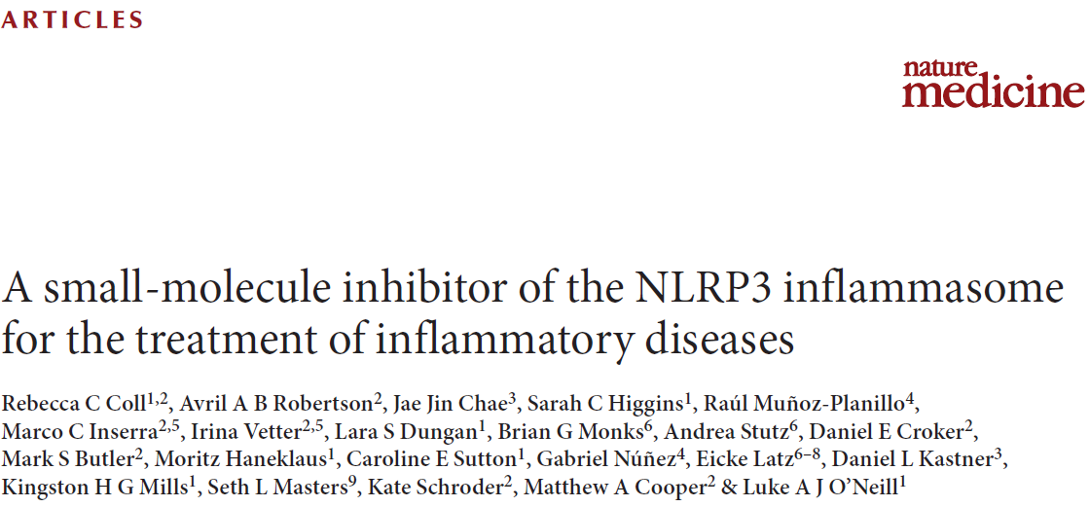
sulfonylurea MCC950 is a specific and potent synthetic inhibitor of NLRP3 inflammasome activation
- mouse models
- ex vivo samples from individuals with Muckle–Wells syndrome (CAPS)
Notes:
Coll et al.report the identification of a synthetic NLRP3 inhibitor of the inflammasome, MCC950, which was first described in a screen of IL-1β–processing inhibitors more than a decade ago
MCC950 is one of several diarylsulfony-lurea-containing compounds that were identified in 2001 as inhibitors of caspase-1-dependent IL-1b cleavage and secretion, before it had been appreciated that caspase- 1 activity was regulated by inflammasomes (2004)

Slide 50
Αυτοφλεγμονώδεις διαταραχές στις οποίες χορηγούνται αναστολείς της IL-1
Σχετιζόμενα με την κρυοπυρίνη περιοδικά σύνδρομα (CAPS) Οικογενής μεσογειακός πυρετός (FMF) Σύνδρομο πυογενούς αρθρίτιδας, γαγγραινώδους πυοδέρματος και ακμής (PAPA) Περιοδικό σύνδρομο που συνοδεύεται από υπεργαμμασφαιριναιμία D (HIDS) Περιοδικό σύνδρομο που σχετίζεται με τον υποδοχέα του TNFα (TRAPS) Σύνδρομο ανεπάρκειας του ανταγωνιστή του υποδοχέα της IL-1 (DIRA) και της IL-36 (DITRA) Σύνδρομο Schnitzler (πυρετός, ουρτικάρια, μονοκλωνική γαμμαπάθεια) Συστηματική νεανική ιδιοπαθής αρθρίτιδα (SoJIA) Ανθεκτική νόσος Still των ενηλίκων (AoSD) Υποτροπιάζουσα ιδιοπαθής περικαρδίτιδα Ουρική, ψευδουρική αρθρίτιδα Νόσος Αδαμαντιάδη-Behçet Σακχαρώδης διαβήτης τύπου ΙΙ (κλινικές δοκιμές) Στεφανιαία νόσος /αθηροσκλήρωση (κλινικές δοκιμές)

Slide 51

Ιnterleukin-1 family
Dinarello. Seminars in Immunology 2013

Slide 52
FMF: The prototype autoinfammatory disease
Οικογενής Μεσογειακός πυρετός
(Familial Mediterranean fever, FMF)
Το συχνότερο από τα κληρονομικά σύνδρομα περιοδικού πυρετού
  TRAPS, MKD (HIDS)
Συχνότερο σε χώρες της ανατολικής Μεσογείου: μη-Ασκενάζι Εβραίους, Αρμένιους, Tούρκους, Άραβες
Επιπολασμός
  Τουρκία: 1/1000 – 1/400, >100,000 ασθενείς
  Ισραήλ : 1/1000 , ~10,000 ασθενείς
  Αρμενία: 1/500 ~6,000 ασθενείς
Σπανιότερο νόσημα στον υπόλοιπο κόσμο παρότι έχουν αναφερθεί περιστατικά στην Γαλλία, Γερμανία, Ιταλία, Ισπανία, ΗΠΑ, Αυστραλία και Ιαπωνία
~80% των ασθενών εκδηλώνουν τη νόσο μέχρι την ηλικία των 10 ετών, και 90% μέχρι <18 ετών
Curr Opin Rheumatol. 2006;18:108-117, Arthritis Rheum. 2009;61:1447-53, Pediatr Rheumatol. 2013;11(suppl 1):A147
Genet Med. 2011;13:263-9, Eur J Pediatr. 1997;156:619-23
Notes:
Familial Mediterranean fever (FMF) is the most common hereditary periodic fever syndrome.¹
It is almost always limited to people of eastern Mediterranean origin, especially non-Ashkenazi Jews, Armenians, Turks, and Arabs.²
Turkey: highest prevalence, ie, >100,000
Israel: ~10,000
Armenia: ~6,000
FMF is rare in the rest of the world; however, cases have been reported in France, Germany, ltaly, Spain, the United States, Australia, and Japan.²
In the first 36 months of enrollment, the international EuroFever registry of autoinflammatory diseases has enrolled 787 FMF patients.³
Approximately 80% of affected individuals present by 10 years of age, and 90% at <20 years.⁴
References
Samuels J, Özen S. Familial Mediterranean fever and the other autoinflammatory syndromes: evaluation of the patients with recurrent fever. Curr Opin Rheumatol. 2006;18:108-17.
Ben-Chetrit E, Touitou I. Familial Mediterranean fever in the world. Arthritis Rheum. 2009;61:1447-53.
Federici S, Frenkel J, Özen S, et al. The Eurofever registry: 3 years of enrollment. Pediatr Rheumatol. 2013;11(suppl 1):A147.
Zadeh N, Getzug T, Grody WW. Diagnosis and management of familial Mediterranean fever: integrating medical genetics in a dedicated interdisciplinary clinic. Genet Med. 2011;13:263-9.

Slide 53


7 Ειδικότητες (αλφαβητικά) και 11 Πιθανές Διαγνώσεις
Γαστρεντερίτιδα
Ουρολοίμωξη
Περιτονίτιδα/Εξαρτηματίτιδα
Χρόνιο πυελικό άλγος
Κωλικός ουρητήρα
Οροαρνητική αρθρίτιδα
Κάκωση μηνίσκου
Λοίμωξη αναπνευστικού
ΙΦΝΕ
Ευερέθιστο έντερο
Άγχος/Σωματοποίηση
Γαστρεντερολόγος
Γυναικολόγος
Ορθοπεδικός
Παθολόγος
Ρευματολόγος
Χειρουργός
Ψυχίατρος

Slide 54
Κριτήρια Tel Hashomer για τη διάγνωση του FMF
Μείζονα Κριτήρια
1. Υποτροπιάζοντα εμπύρετα επεισόδια συνοδευόμενα από περιτονίτιδα, αρθρίτιδα ή πλευρίτιδα
2. Αμυλοείδωση τύπου ΑΑ χωρίς νόσο που να προδιαθέτει σε αυτήν
3. Καλή ανταπόκριση σε συνεχή θεραπεία με κολχικίνη
Ελάσσονα Κριτήρια
1. Υποτροπιάζοντα εμπύρετα επεισόδια
2. Ερυσιπελατοειδές ερύθημα
3. FMF σε συγγενή 1^{ου} βαθμού
Βέβαιη διάγνωση: 2 μείζονα κριτήρια ή 1 μείζον και 2 ελάσσονα κριτήρια
Πιθανή διάγνωση: 1 μείζον και 1 έλασσον κριτήριο

Slide 55
FMF και υποκλινική φλεγμονή
Ακόμη και σε περιόδους φαινομενικής κλινικής ύφεσης τα επίπεδα CRP και ESR ήταν αυξημένα, άνω των φυσιολογικών ορίων
Patients Above Normal, %
FMF
Controls
Korkmaz C, et al. Ann Rheum Dis. 2002;61:79-81.
Notes:
A Turkish study evaluated acute-phase responses in 49 patients with FMF compared with 58 controls (39 patients with other inflammatory diseases [ie, juvenile idiopathic arthritis and infectious diseases] and 19 healthy subjects).
As in patients with other inflammatory diseases, CRP and ESR levels were elevated above normal, including during FMF attack-free periods.
Reference
Korkmaz C, Özdogan H, Kasapçopur Ö, Yazici H. Acute phase response in familial Mediterranean fever. Ann Rheum Dis. 2002;61:79-81.

Slide 56


Pyrin
Marenostrin

Slide 57

V726A (12.2%)
E230K (6.1%)
R202Q (9,2%)
M694V (38.1%)
E148Q (10.9%)
M680I (19.7%)
Giaglis S et al. Clin Genet 2007: 71: 458–467
Notes:
The most common mutations identified were M694V (38.1%), M680I (19.7%), V726A (12.2%), E148Q (10.9%) and E230K (6.1%). The total carrier rate among healthy individuals was 0.7%.
Homozygosity of the R202Q alteration was detected in 14/152 (9.2%) FMF patients and in 1/140 (0.7%) healthy controls (p=0.001). Heterozygosity of the R202Q alteration was detected in 48/152 (31.6%) FMF patients and in 47/140 (33.6%) healthy controls (p=0.717).

Slide 58
Γενετικό «φορτίο» και Φαινότυπος
p <0.048
Μεταλλάξεις στο MEFV | Ασθενείς (N=152) | Υγιείς (N=140)
Καμία | 16.4% | 98.6%
1 | 40.8 | 1.4%
2 | 42.8 | 0
“Genetic dose effect”
Giaglis S et al. Clin Genet 2007: 71: 458–467
Notes:
Διάγνωση με βάση τα κριτήρια Livneh: Livneh A, Langevitz P, Zemer D et al. Criteria for the diagnosis of familial Mediterranean fever. Arthritis Rheum 1997: 40: 1879–1885.
Of the 140 healthy individuals included in the control group, two were found to be carriers of major MEFV alterations, M680I/0 and M694V/0.
Conclusions This clinical observation supports recent fi ndings contrasting the notion of FMF being a pure autosomal recessive disorder associated with recurrence of mutations leading to loss of protein function. A dosage effect could be invoked, giving rise to symptom onset even in the presence of one wild-type allele. Ann Rheum Dis 2012;71:1961–1965

Slide 59
FMF περιβάλλον και επιγενετικοί παράγοντες
Η εκδήλωση των κρίσεων σχετίζεται με σωματικό και συναισθηματικό stress
Δυτική Ευρώπη ηπιότερος φαινότυπος από Ανατολική Μεσόγειο
Λιγότερο σοβαρή νόσος σε άτομα με συγκεκριμένη καταγωγή και μεταλλάξεις όταν μεταναστεύουν
Ανεξάρτητα από τις μεταλλάξεις ο κίνδυνος εκδήλωσης ΑΑ αμυλοείδωσης σχετίζεται με την καταγωγή (Αρμένιοι, Τούρκοι, Άραβες)
Σε ασθενείς με 1 μετάλλαξη δεν ανιχνεύεται δεύτερη μετάλλαξη παρά την ευρεία ανάλυση (sequencing) όλων των MEFV εξονίων.
Άλλο γονίδιο ή επιγενετικές επιδράσεις MEFV;;;
Notes:
Özen S, et al. Front Immunol. 2017

Slide 60
Ο ρόλος της πυρίνης;;; (debate…)
Αναστολέας του NALP3 φλεγμονοσώματος
Μεταλλάξεις (loss-of-function) αλληλεπιδρούν με την ανασταλτική δράση της πυρίνης στο φλεγμονόσωμα με αποτέλεσμα την αυξημένη ενεργοποίηση και παραγωγή ΙL-1β
Φλεγμονόσωμα της πυρίνης
Η πυρίνη σχηματίζει το δικό της φλεγμονόσωμα το οποίο δρά ως υποδοχέας φυσικής ανοσίας (PRR) αναγνωρίζοντας τροποποιημένες από βακτηριακές τοξίνες πρωτεΐνες (Rho GTPases) οδηγώντας σε υπερπαραγωγή της IL-β
Chae JJ, et al. Proc Natl Acad Sci USA. 2006
Simon A, van de Meer JW. Am J Physiol Regul Integr Comp Physiol. 2007
Papin S, et al Cell Death Differ 2007
Hesker PR, et al. PLoS One 2012
Xu H, et al. Nature 2014
Park YH et al. Nat Immunol 2016

Slide 61

Notes:
Two different models have been proposed to explain how mutations in PYRIN lead to familial Mediterranean fever (FMF). In one
model pyrin is a positive regulator and promote the activation of caspase-1 in response to specific stimuli. Dominant gain-of-function
mutations lead to a constitutive active protein, similarly to what happen for the gain-offunction mutation in nucleotide-binding
domain and leucine-rich repeat containing family pyrin domain containing 3 (NLRP3).
Alternatively, pyrin is a negative regulator of caspase-1. According to this model, recessive
loss-of-function mutations fail to control the activation of caspase-1 leading to the inflammatory
response observed in FMF.

Slide 62

Ουδετερόφιλo (neutrophil):
το ένοχο κύτταρο της αυτοφλεγμονής
Αποτελούν το 50-70% των κυκλοφορούντων λευκών
Έλκονται χημειοτακτικά (C5α, IL-8) στη περιοχή της φλεγμονής
Βραχύβια κύτταρα (6 –8 ώρες in vivo)

Slide 63




Laboratory of Molecular Hematology,
DUTH, Alexandroupolis, Greece
Barnado A, et al J Leukoc Biol. 2016
Notes:
Immunostaining of NETs. Neutrophils were activated with10 ng of IL-8 for 30 min and stained for neutrophil elastase (A), DNA (B), and the
complex formed by H2A-H2BDNA (C)

Slide 64


Slide 65


NETosis
Cell Death and Differentiation 2011

Slide 66

Notes:
Yoshinori Ohsumi 2016 Medicine Nobel Prize

Slide 67

Autophagy/NETosis
markers of PMN activation or theurapeutic targets
in IL-1-driven auto-inflammation

Slide 68


Slide 69

Ελαττωμένα επίπεδα βασικής αυτοφαγίας στα ουδετερόφιλα FMF
v

Slide 70

TRIM 20 (pyrin)

Slide 71


Slide 72



ARD 2014

Slide 73

Neutrophils from FMF patients in remission are resistant to induction of NET release due to reduced basal autophagy levels
Apostolidou E Skendros P, Kambas K et al. Ann Rheum Dis 2016

Slide 74

Colchicine do not inhibt NETosis
BUT reduces IL-1β production by neutrophils
Apostolidou E Skendros P, Kambas K et al. Ann Rheum Dis 2016

Slide 75
FMF: μοντέλο φλεγμονώδους νόσου που χαρακτηρίζεται από διαταραχή στην ρύθμιση της αυτοφαγίας και στην διαμεσολαβούμενη από την αυτοφαγία ΝΕΤωσης
Επεισόδια νόσου: NETs που εκφράζουν βιοδραστική IL-β
Πως προκαλούνται τα φλεγμονώδη επεισόδια;;;
Notes:
Özen S, et al. Front Immunol. 2017

Slide 76



Σε ασθενείς με FMF που βρίσκονται σε κρίση αυξάνεται η ουδετεροφιλική έκφραση του γονιδίου DDIT4/REDD1
RNA-seq
Skendros P et al. J Allergy Clin Immunol. 2017

Slide 77



Η επαγωγή του REDD1 οδηγεί σε απελευθέρωση NETs από τα ουδετερόφιλα των ασθενών με FMF μέσω αύξησης των επιπέδων της αυτοφαγίας
Skendros P et al. J Allergy Clin Immunol. 2017

Slide 78

REDD1 αυτολυσόσωμα: τόπος αποδόμησης του φλεγμονοσώματος
Στον FMF η REDD1 αποτυγχάνει να αποδομήσει το φλεγμονόσωμα
Φυσιολογικό ουδετερόφιλο
FMF ουδετερόφιλο
Skendros P et al. J Allergy Clin Immunol. 2017

Slide 79

Η αδρεναλίνη επάγει την έκφραση του REDD1 στα ουδετερόφιλα
Skendros P et al. J Allergy Clin Immunol. 2017

Slide 80


Προτεινόμενος μηχανισμός επαγωγής της φλεγμονώδους κρίσης στον FMF
Notes:
Υδρολάση τριφωσφορικής γουανοσίνης (GTPase)

Slide 81



CYTONET assay

Slide 82

Skendros et al J Allergy Clin Immunol 2017

Slide 83



Ουδετερόφιλα και ΝΕΤs:
Αναδυόμενοι θεραπευτικοί στόχοι στην IL-1β-διαμεσολαβούμενη αυτοφλεγμονή
IL-1β
production
Autophagy
induction
v
v
IL-1β
INFLAMMATORY
ENVIROMENT
IL-1β
Other
cytokines
“IL-1 σχετιζόμενα
αυτοφλεγμονώδη
νοσήματα”
ΝΕΤs χωρίς IL-1β
Mφ

Slide 84


Papagoras C, Chrysanthopoulou A, Mitsios A, Arampatzioglou A, Ritis K, Skendros P.
Clin Exp Rheumatol 2017 (in press)

Slide 85


Notes:
Η ρεσερπίνη (reserpine) είναι ένας αδρενεργικός αποκλειστής που δρα μέσω αναστολής της αντλίας ATP/Mg2 +, που είναι υπεύθυνη για την απομόνωση των νευροδιαβιβαστών σε κυστίδια αποθήκευσης που βρίσκεται στο προσυναπτικό νευρώνα. Οι νευροδιαβιβαστές που δεν απομονώνονται στα κυστίδια αποθήκευσης μεταβολίζονται εύκολα από αναστολείς της μονοαμινοξειδάσης (ΜΑΟ) με επακόλουθο την μείωση των κατεχολαμινών.
Πηγή: Γαληνός Οδηγός Φαρμάκων

Slide 86



Δομιμασία metaraminol
(stress analogue)
REDD1
NETs
IL-1β+
Notes:
Metaraminol (INN; trade names Aramine, Metaramin, and Pressonex), also known as metaradrine, a stereoisomer of meta-hydroxynorephedrine (3,β-dihydroxyamphetamine), is a potent sympathomimetic amine used in the prevention and treatment of hypotension, particularly as a complication of anesthesia. It is an α₁-adrenergic receptor agonist with some β effect.^{[1]}
Metaraminol is also used in the treatment of priapism. Although not approved for this use, it appears to be effective

Slide 87
  Ευαισθητοποίηση σύνδεσης αυτοφλεγμονής με όλο και μεγαλύτερη ποικιλία κλινικών φαινοτύπων
  Μοριακή διάγνωση στην κλινική πράξη, σχέση κόστους-αποτελέσματος
  Ποιο είναι το κλινικό εύρος και εφαρμογές αναστολής μοριακών στόχων των φλεγμονοσωμάτων/ουδετεροφίλων/ΝΕΤs?

Slide 88















www.inflathrace.gr
E.I Παθολογίας & Αυτοάνοσων Νοσημάτων Α’ ΠΠ, ΠΓΝΑ
Εργαστήριο Μοριακής Αιματολογίας Δ.Π.Θ

Slide 89






Pr. Ioannis THEODOROU Group
UF d'Histocompatibilité et Immunogénétique Département d'Immunologie.
Groupe Hospitalier Pitié Salpêtrière Charles Foix.

Slide 90


