Slide 1

Τι Νεότερο στην Ανοσολογία
Verginis Panos
Laboratory of Cellular Immunology and Immune Regulation
Department of Immunology and Transplantation
Biomedical Research Foundation, Academy of Athens
pverginis@bioacademy.gr

Slide 2
Περίγραμμα
Στόχευση κυτταροκινών για τη θεραπεία των αυτοάνοσων νοσημάτων
Επαγωγή Τ ρυθμιστικών κυττάρων για την αποκατάσταση της ομοιόστασης
Τροποποίηση του μικροβιώματος στην ανάπτυξη νέων θεραπειών
Ανοσοθεραπεία στον καρκίνο

Slide 3
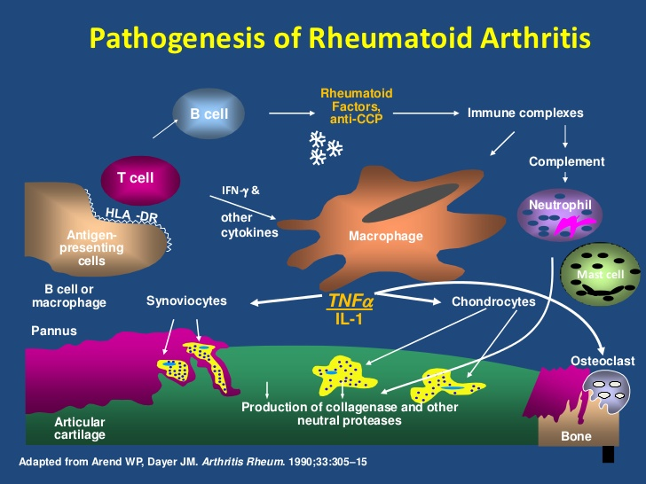

Slide 4
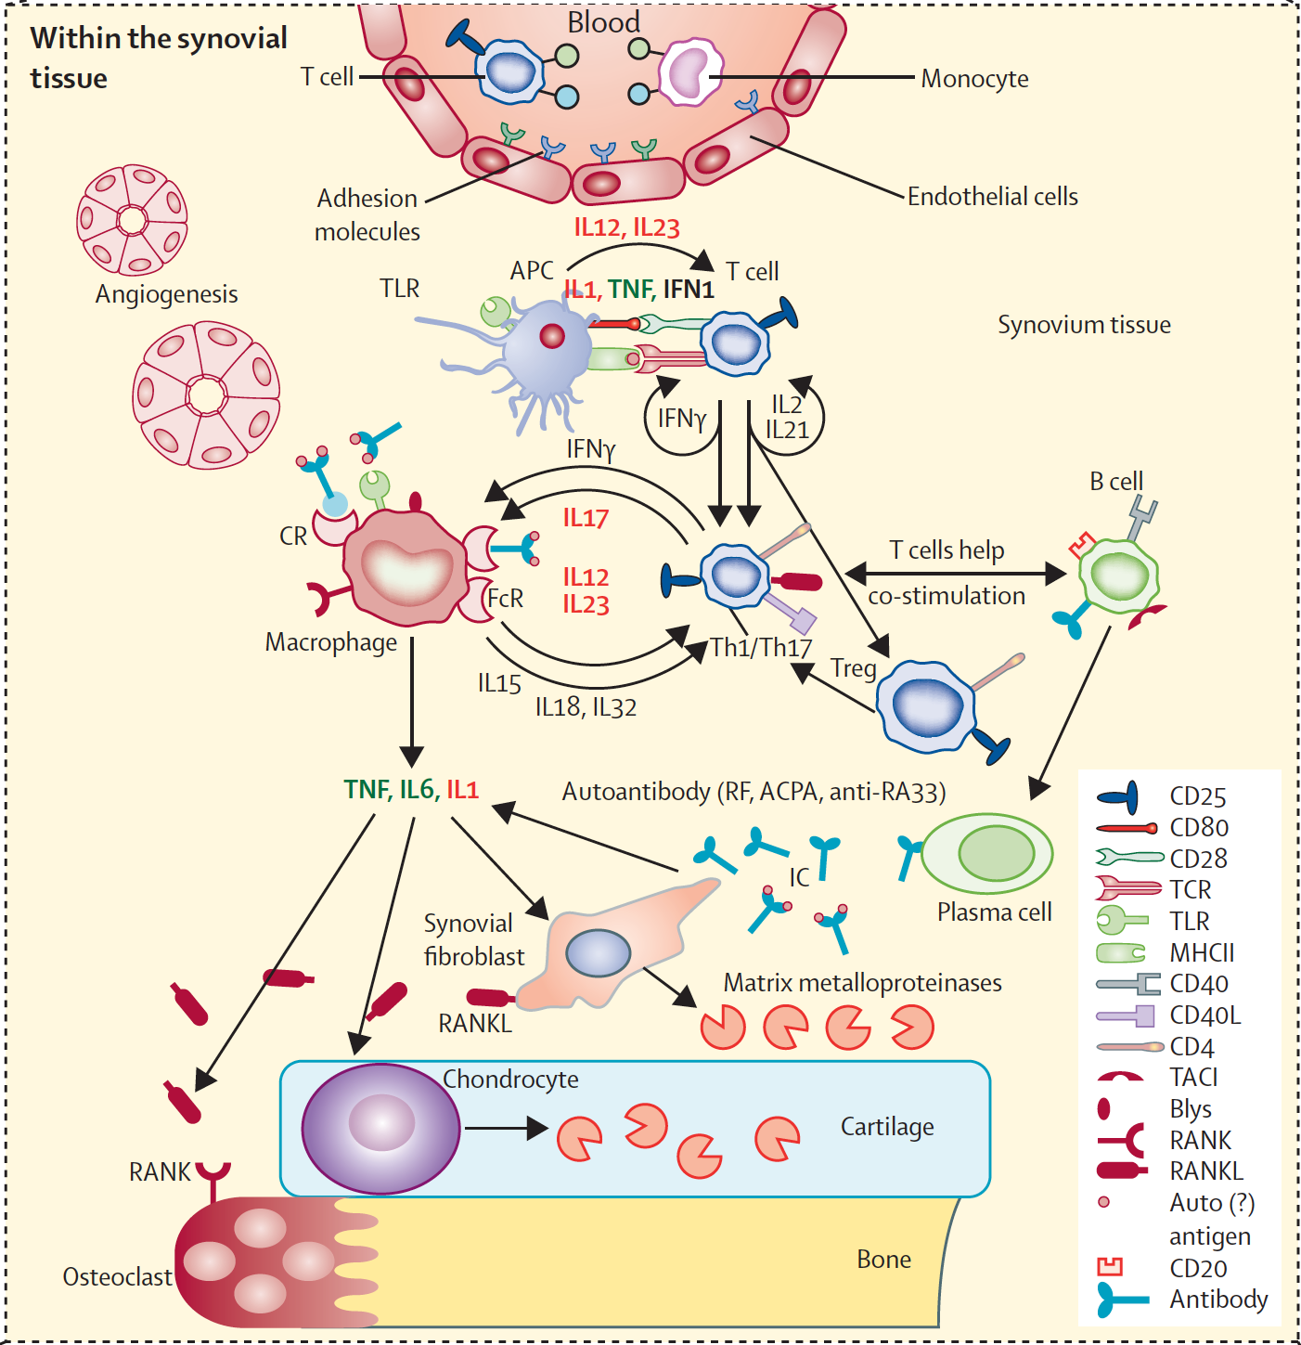
Ρευματοειδής αρθρίτιδα: ένα αυτοάνοσο νόσημα με ανοσολογική υπογραφή
Interplay between
Immune cells
Cytokines and
Adhesion molecules
In the pathogenesis
Of RA
Lancet 2016; 388: 2023–38

Slide 5
Στόχευση κυτταροκινών για τη θεραπεία των αυτοάνοσων νοσημάτων

Slide 6
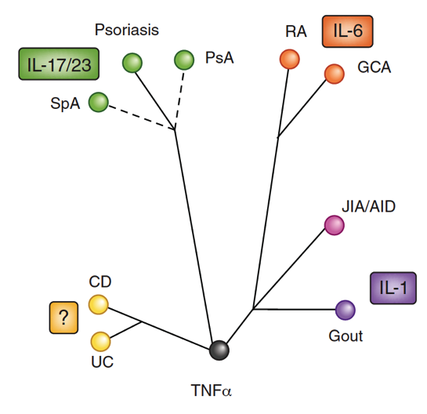
Κυτταροκινική ταξινόμηση των χρονίων φλεγμονωδών νοσημάτων
IL-12/23
Toward a cytokine-based disease taxonomy
Schett G, et al. Nature Med 2013

Slide 7
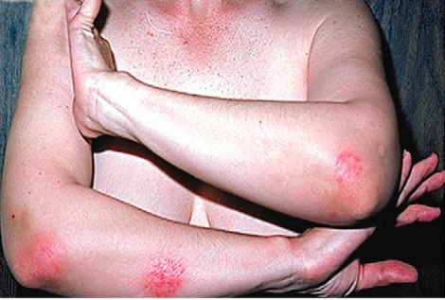
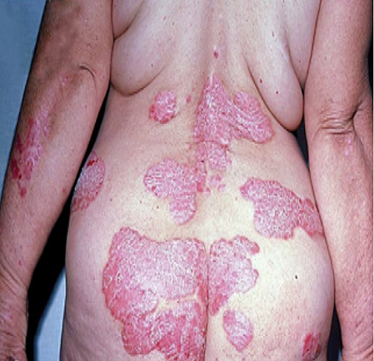
Η ψωρίαση είναι μια χρόνια και σοβαρή νόσος, ανοσολογικής αρχής που επηρεάζει κυρίως το δέρμα
Η ψωρίαση είναι μια χρόνια νόσος, ανοσολογικής αρχής που επηρεάζει κυρίως το δέρμα.^{1,2}
Προσβάλλει το 2-3% του πληθυσμού
Δεν είναι ιάσιμη, υπάρχουν όμως θεραπείες που στοχεύουν στην ανακούφιση των συμπτωμάτων.³
Ακόμα και με τις υπάρχουσες θεραπείες η νόσος παρουσιάζει εξάρσεις ή και επιδείνωση^{4,5}
Εμφανίζεται συνήθως μεταξύ 15-25 ετών αλλά μπορεί να εμφανιστεί σε οποιαδήποτε ηλικία.
35% ασθενών έχουν οικογενειακό ιστορικό
Το 1/3 ασθενών πάσχουν από μέτρια-σοβαρή ψωρίαση
Photos adapted
from Menter et al.

Slide 8

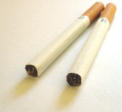
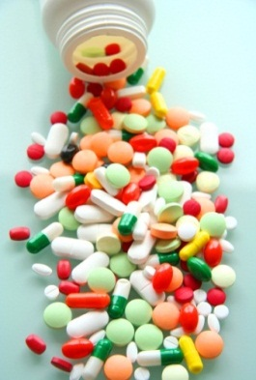
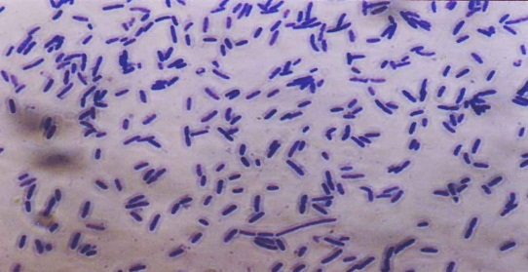
Στην ψωρίαση μια σειρά από γενετικούς και περιβαλλοντικούς παράγοντες επάγουν την απελευθέρωση φλεγμονογόνων κυτταροκινών από το κερατινοκύτταρο
ENVIRONMENT
Stress Trauma
Drugs Smoking
Microorganisms
PSORS1
IL-23A
IL-23R
IL-12B
IL-13
TRAF3IP2
TYK2
IL28RA
IFIH1
ZNF313
ERAP1
HLA-C
GENOTYPE
Keratinocytes
Φλεγμονογόνες κυτταροκίνες
Nestle F et al. N Engl J Med. 2009;361:496-509; Capon F et al. J Invest Dermatol. 2012;132:915-922.
Notes:
In psoriasis, genetic and environmental factors trigger keratinocytes to release pro-inflammatory cytokines
In psoriasis a variety of genetic and environmental factors can activate keratinocytes, causing them to release pro-inflammatory cytokines^{1,2}
1. Nestle FO, Kaplan DH, Barker J. Psoriasis. N Engl J Med. 2009;361:496-509.
2. Capon F, Burden AD, Trembath RC, et al. Psoriasis and other complex trait dermatoses: from Loci to functional pathways. J Invest Dermatol. 2012;132:915-922.

Slide 9
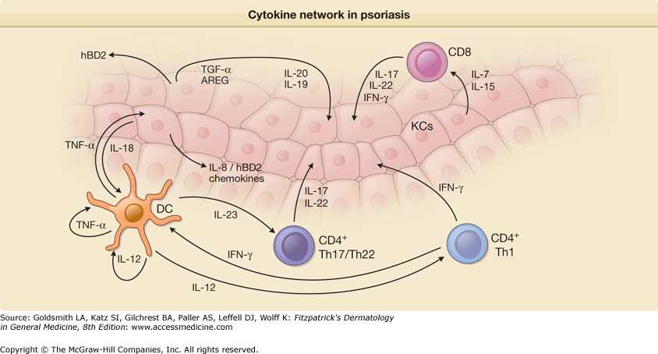

Slide 10
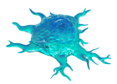
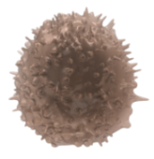

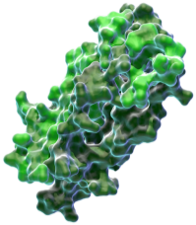
Η IL17A έχει πιο στοχευμένη δράση, γιατί δρα απευθείας στο κερατινοκύτταρο
3
1
TNF-α Inhibitors
Etanercept
Adalimumab
Infliximab
TNF
IL-12/IL-23 Inhibitors
Ustekinumab
IL-17A
IL-17 Inhibitors
Secukinumab (Cosentyx)
Brodalumab
Ixekizumab
Activated
dendritic cell
Th17 cell
2
Keratinocyte
IL-23
IL, interleukin; Th, helper T cells; TNF, tumor necrosis factor.
Adapted from Nestle FO et al. N Engl J Med. 2009;361:496-509; Kopf M et al. Nat Rev Drug Discov. 2010;9:703-718; Garber K. Nat Biotechnol. 2011;29:563-566.
Notes:
The most direct way to block IL-17A signaling is to block IL-17A
Blockade of IL-17A is the most direct way to block IL-17 pathway signaling compared with blocking IL-23 or TNF. Less direct IL-17 signal blockade might block more immune function than necessary.
While TNF inhibitors have efficacy for treatment of psoriasis the degree of immunosuppression induced by blocking TNF α can lead to adverse events. ⁴
In clinical trials IL-17A inhibitors have demonstrated the most rapid efficacy compared with inhibition of other cytokines.⁵
Nestle F, Kaplan DH, Barker J. Psoriasis. N Engl J Med. 2009;361:496-509.
Kopf M, Bachmann MF, Marsland BJ. Averting inflammation by targeting the cytokine environment. Nat Rev Drug Discov. 2010;9:703-718.
Garber K. Psoriasis: from bed to bench and back. Nat Biotechnol. 2011;29:563-566.
Johnson-Huang L, Lowes M and Krueger J. Putting together the psoriasis puzzle: an update on developing targeted therapies Disease Models and Mechanisms 2012;5:423-433
Lowes M, Russell C, Martin D et al. The IL-23/Th17 pathogenic axis in psoriasis is amplified by keratinocyte responses Trends in Immunology 2013;4:174-181

Slide 11
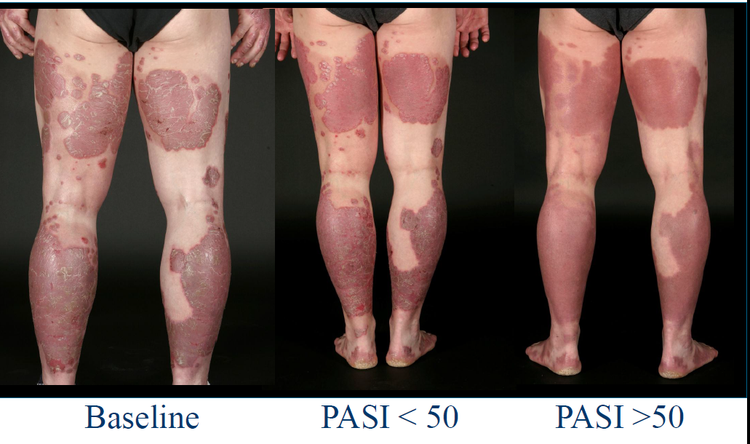
IL-17A a therapeutic target is psoriasis

Slide 12
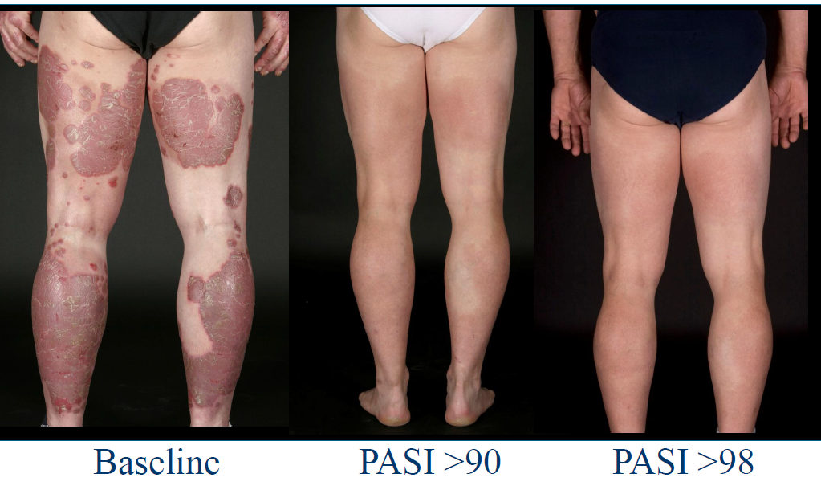
IL-17A a therapeutic target is psoriasis

Slide 13
Επαγωγή Τ ρυθμιστικών κυττάρων για την αποκατάσταση της ομοιόστασης

Slide 14
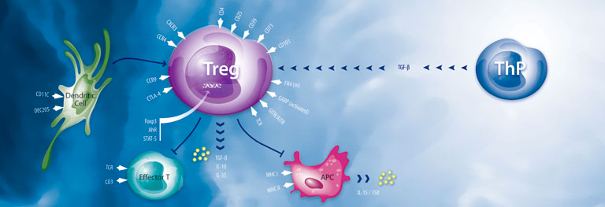

Slide 15
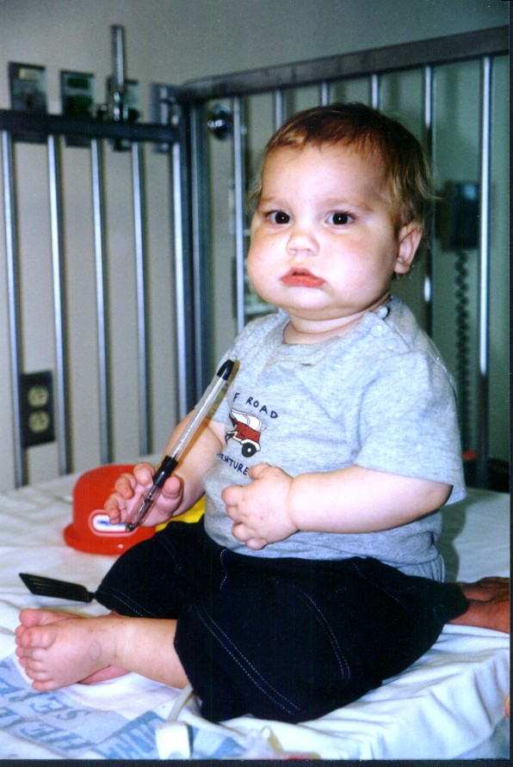
Immunedysregulation Polyendocrinopathy Enteropathy X-linked syndrome (IPEX)
Treg deficiency due to Foxp3 mutation
Neonatal onset diabetes mellitus
Hypothyroidism
Enteritis (diarrhea/villous atrophy)
Hemolytic anemia & thrombocytopenia.
Dermatitis
Dermatitis (eczema)
Death by 1-2 years of age

Slide 16
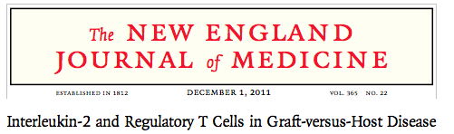


Slide 17
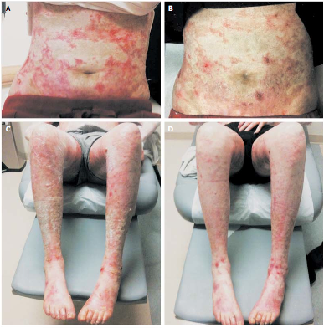
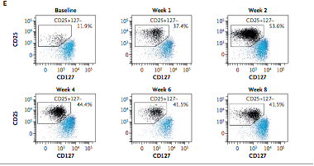
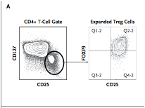

Slide 18

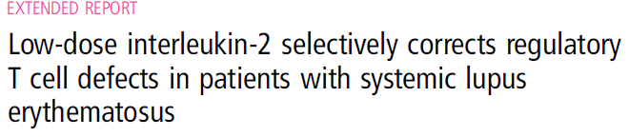
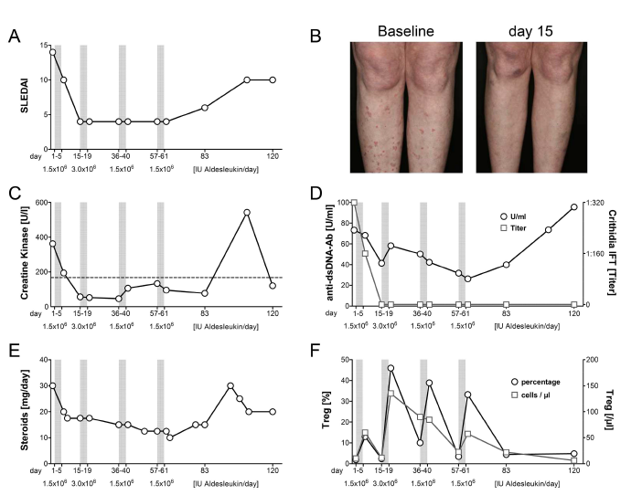
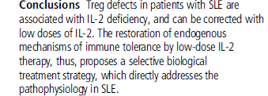

Slide 19
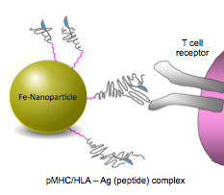
pMHC-based nanomedicines: a new class of drugs that offers a therapeutic solution to the immunological complexity of autoimmune disease
Tsai et al., Immunity 32:568, 2010;
Clemente et al., Nature, 530:434, 2016
Cognate T-cell (CD8+ or CD4+)

Slide 20
Immunizing with one antigen – Treating with a Navacim displaying either an epitope from a different CNS autoantigen or an EAE-irrelevant autoantigen
Treatment regimen: twice a week for 5 weeks
Clemente et al., Nature, 530:434, 2016

Slide 21
Τροποποίηση του μικροβιώματος στην ανάπτυξη νέων θεραπειών

Slide 22
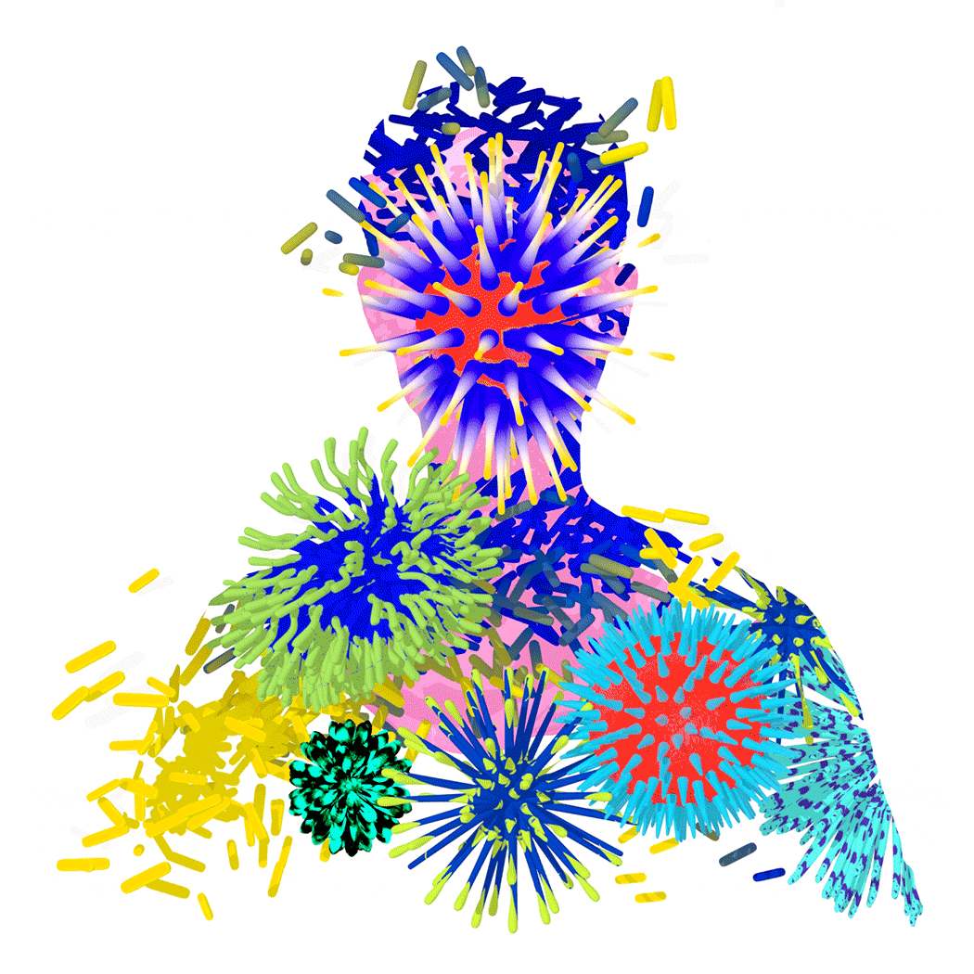

Educate Your Immune System
Our bodies are confused by this
21st-century world.
By MOISES VELASQUEZ-MANOFFJUNE 3, 2016

Slide 23
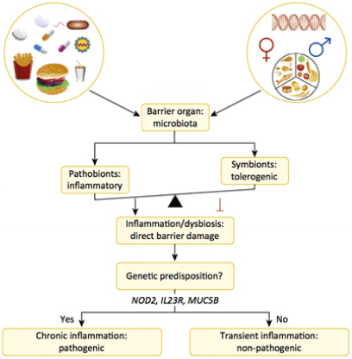
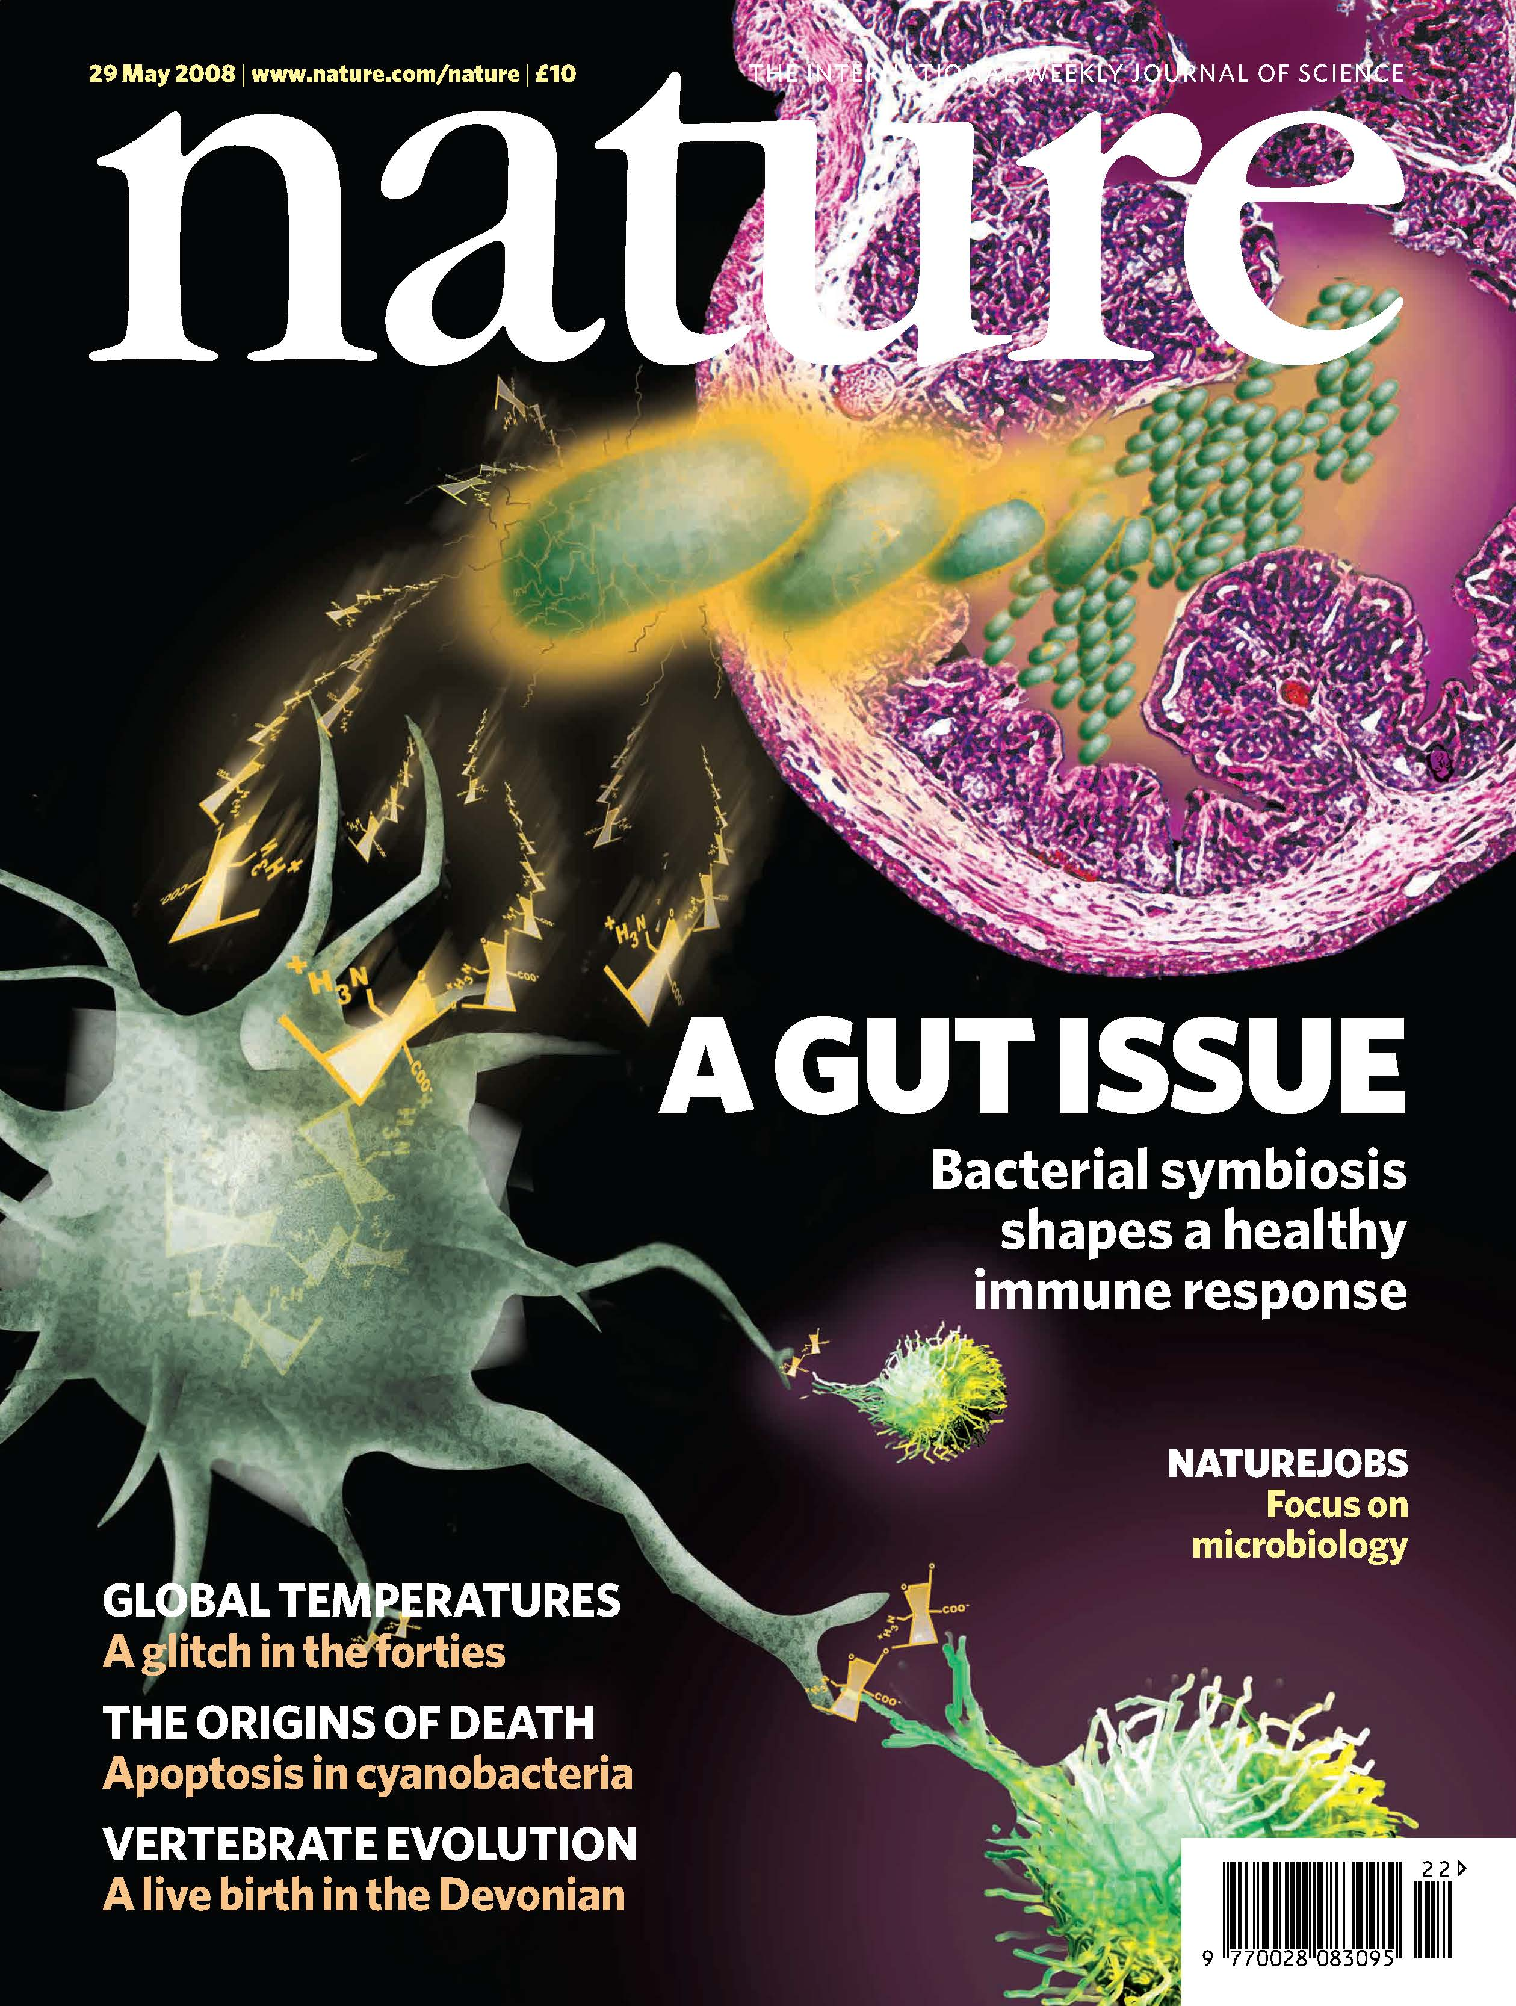
“Harmless” bacteria cause autoimmune diseases

Slide 24
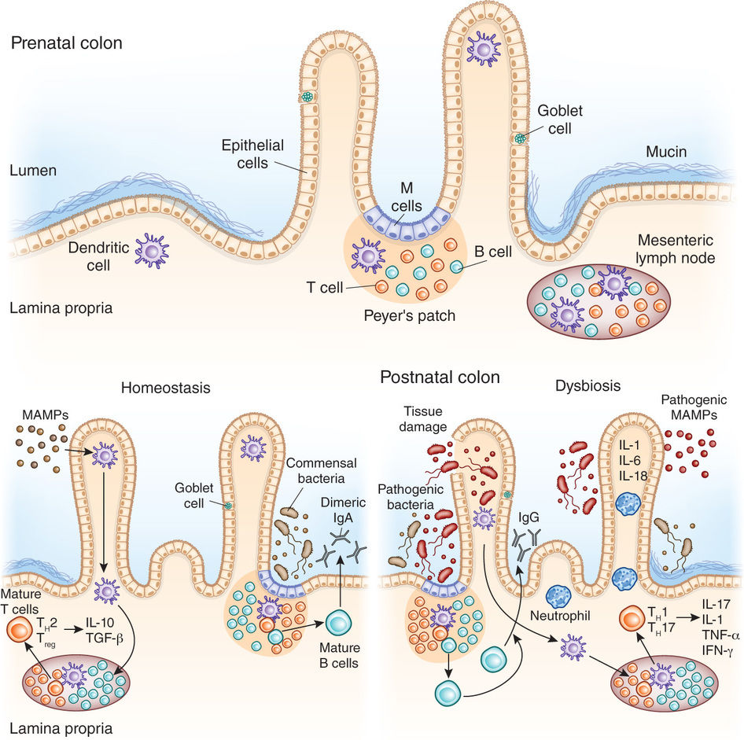

Slide 25
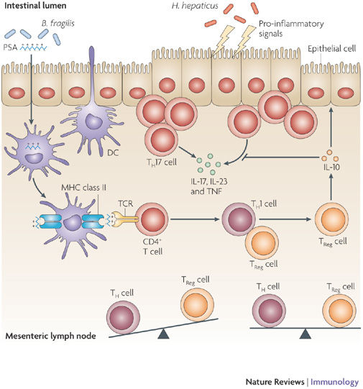

Slide 27
Έγχυση εντερικού περιεχομένου από υγιή δότη αποτελεί αποτελεσματική και ασφαλή θεραπεία κατά της λοιμώξης από C. difficile

Slide 28
Ανοσοθεραπεία στον καρκίνο

Slide 29
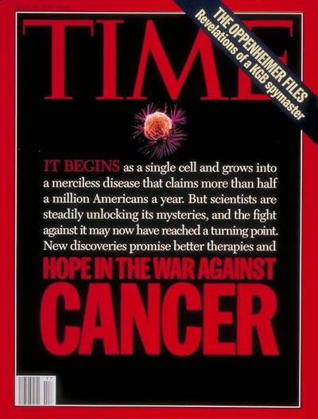
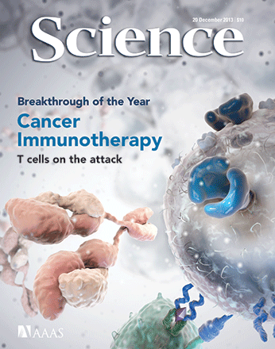

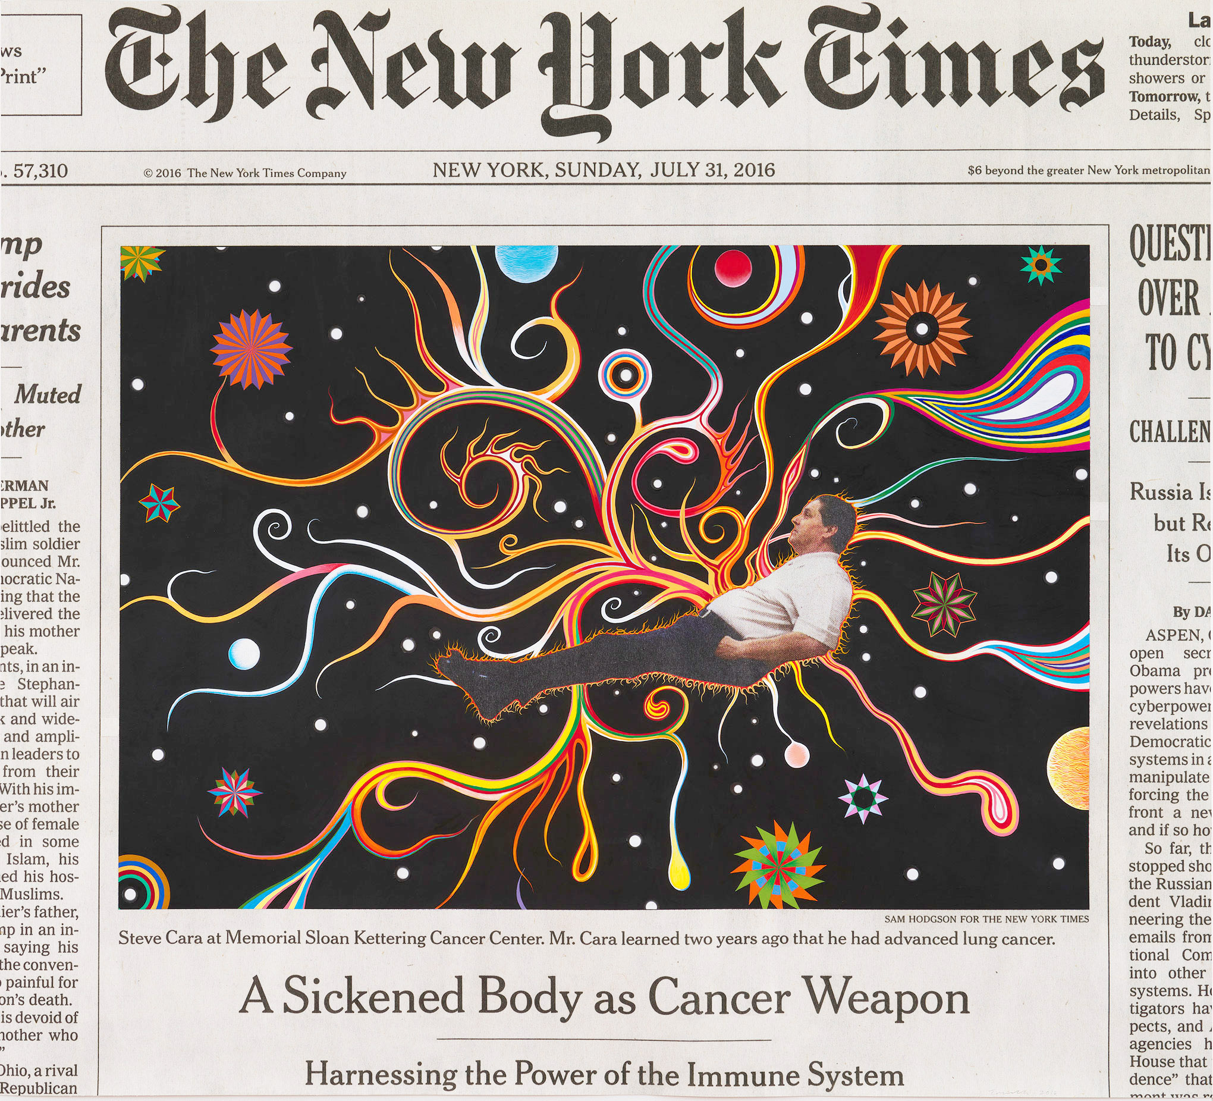
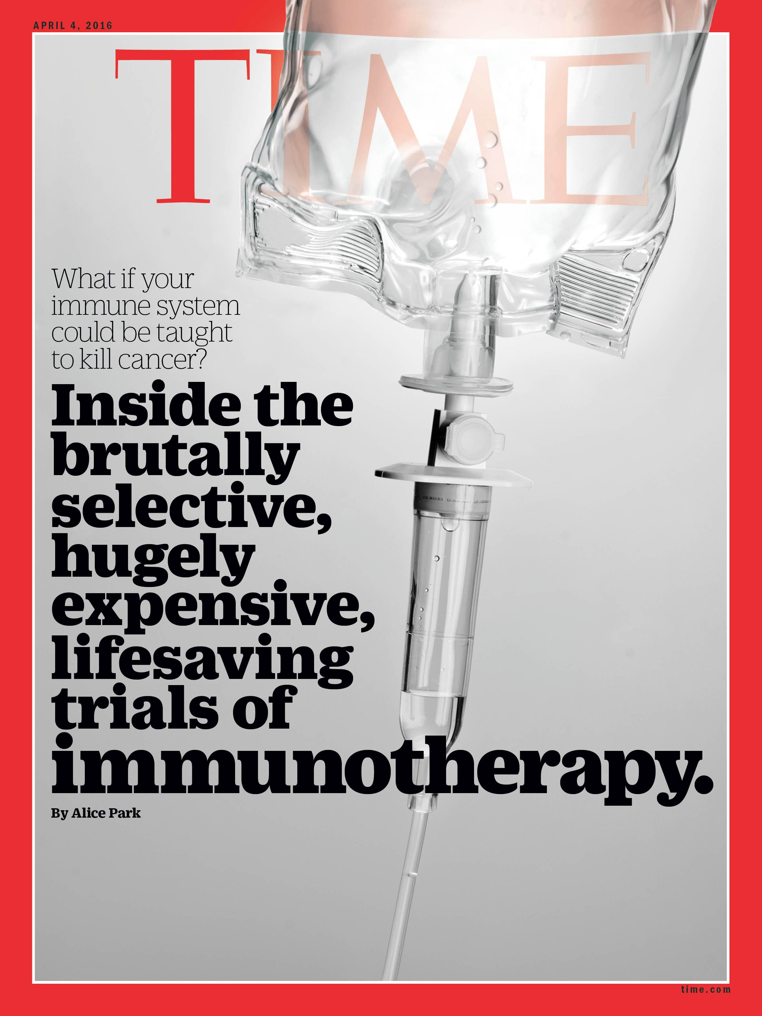

Slide 30
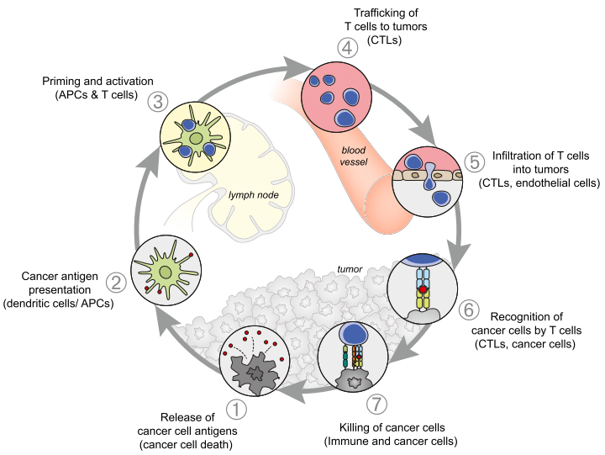
Tumors Use Complex, Overlapping Mechanisms to Evade and Suppress the Immune System
Peripheral Tolerance
tumor milieu
hypoxia, pH and factors
tolerogenic/immature DCs
chemokine regulation
physical barrier
suppressive molecules
recruitment of Tregs
and MDSCs
block cytotoxic machineries
counter-attack

Slide 31
Regulation of T-Cell Activation:
Balancing Activating and Inhibitory Signals
Immune checkpoints limit, or “check,” an ongoing immune response
Prevents damage to the body’s healthy tissues
  Negative co-stimulation, also called “co-inhibition,” helps shut down immune responses
  PD-1, CTLA-4, and LAG-3 are examples of co-inhibitory “checkpoint” molecules
Amplitude and quality of a
T-cell response is regulated by a balance of activating and inhibitory signals
APC/
Tumor
T cell
B7-2 (CD86)
CD28
Activation
B7-1 (CD80)
CTLA-4
Inhibition
PD-L1
PD-1
Inhibition
PD-L2
B7-1 (CD80)
Inhibition
LAG-3
Inhibition
MHC
TCR
CD40
CD40L
Activation
CD137L
CD137
Activation
OX40L
OX40
Activation
CTLA-4 = cytotoxic T-lymphocyte antigen-4; LAG-3 = lymphocyte activation gene-3; PD-1 = programmed death-1; PD-L1 = programmed death-ligand 1.
Pardoll DM. Nat Rev Cancer. 2012;12:252–264.

Slide 32
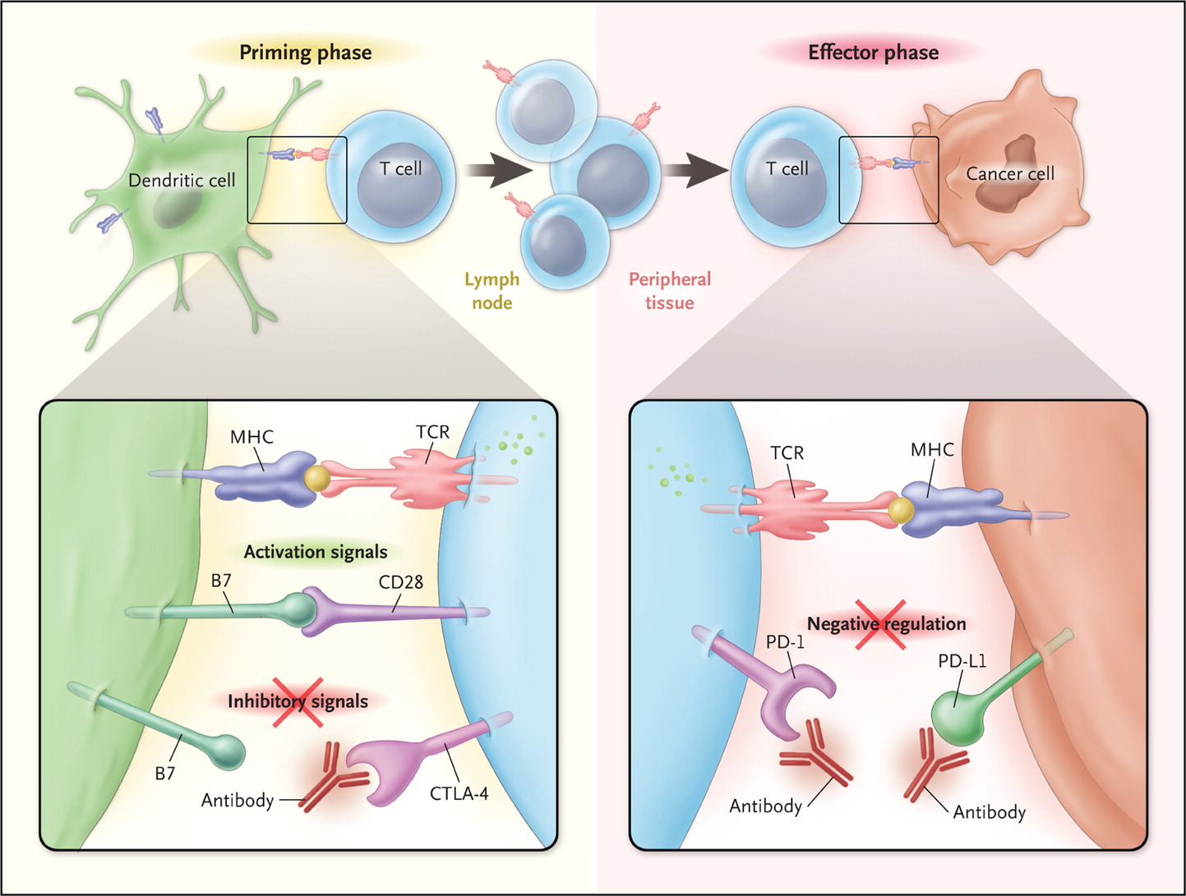
Checkpoint blockade for cancer immunotherapy
e.g. ipilimumab
e.g. nivolumab, pembrolizumab
Ribas A. N Engl J Med 2012;366:2517-2519.

Slide 33
T-Cell Checkpoint Pathway Inhibition Using Ipilimumab
in Patients With Melanoma
Ipilimumab was the first therapy for unresectable or metastatic melanoma to improve OS in a phase III trial¹
100
 | Median OS, months | 95% CI | HR | P value | Survival rate (%)
 |  |  |  |  | 1-year | 2-year
Ipilimumab + gp100 | 10.0 | 8.5–11.5 | 0.68 | <0.001 | 43.6 | 21.6
Ipilimumab | 10.1 | 8.0–13.8 | 0.66 | 0.003 | 45.6 | 23.5
gp100 | 6.4 | 5.5–8.7 |  |  | 25.3 | 13.7
80
60
Proportion of Patients Alive (%)
40
20
0
0
1
2
3
4
Years
In clinical trials, most AEs associated with ipilimumab were immune related and were managed using ipilimumab-specific treatment algorithms²
The most frequently reported irAEs associated with ipilimumab monotherapy (≥10%, all grades) in a phase III trial were: diarrhea (28%), pruritus (24%), and rash (19%)¹
AEs = adverse events; irAEs = immune-related adverse events. .
1. Adapted from Hodi FS, et al. N Engl J Med. 2010;363:711–723; 2. Data on file; Bristol-Myers-Squibb Company, Princeton, NJ.

Slide 34
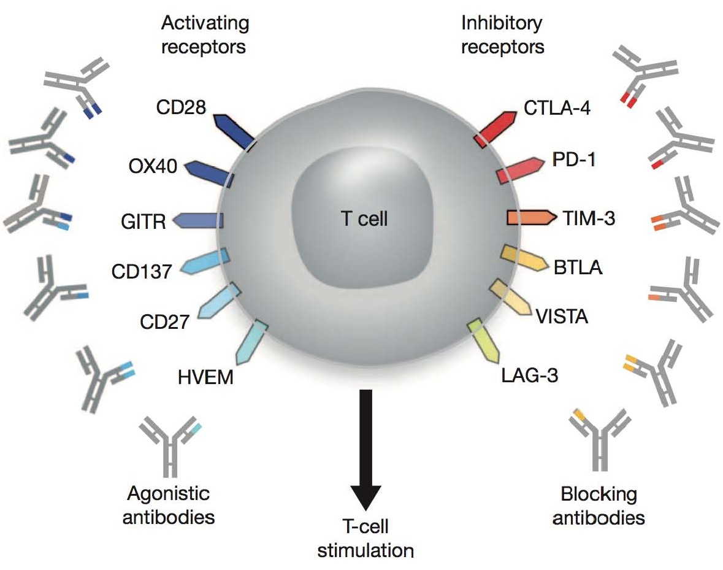
How many check-point inhibitors?
TIGIT

Slide 35
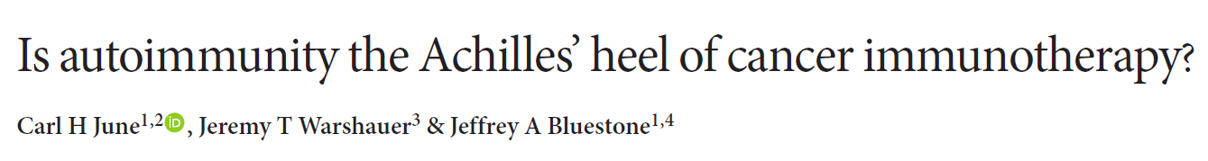
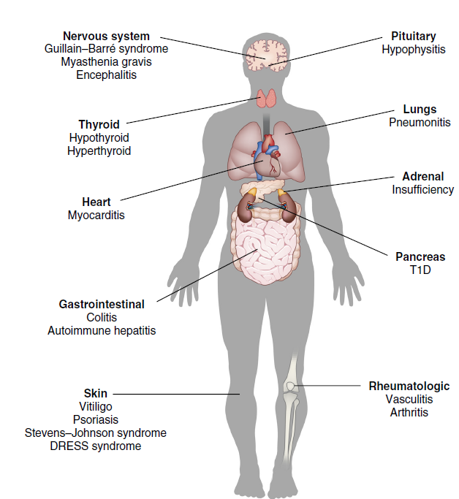
Challenges and pitfalls

Slide 36
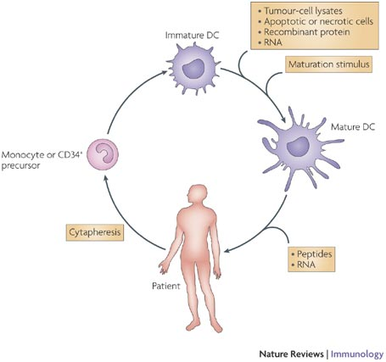
Dendritic cell vaccination

Slide 37
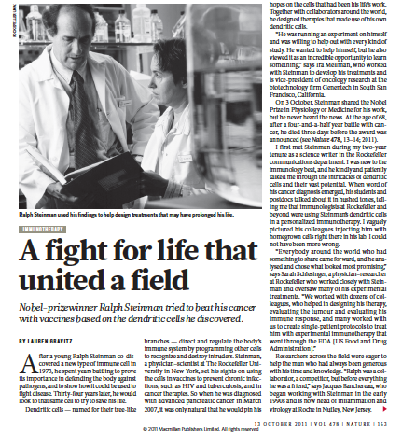

Slide 39
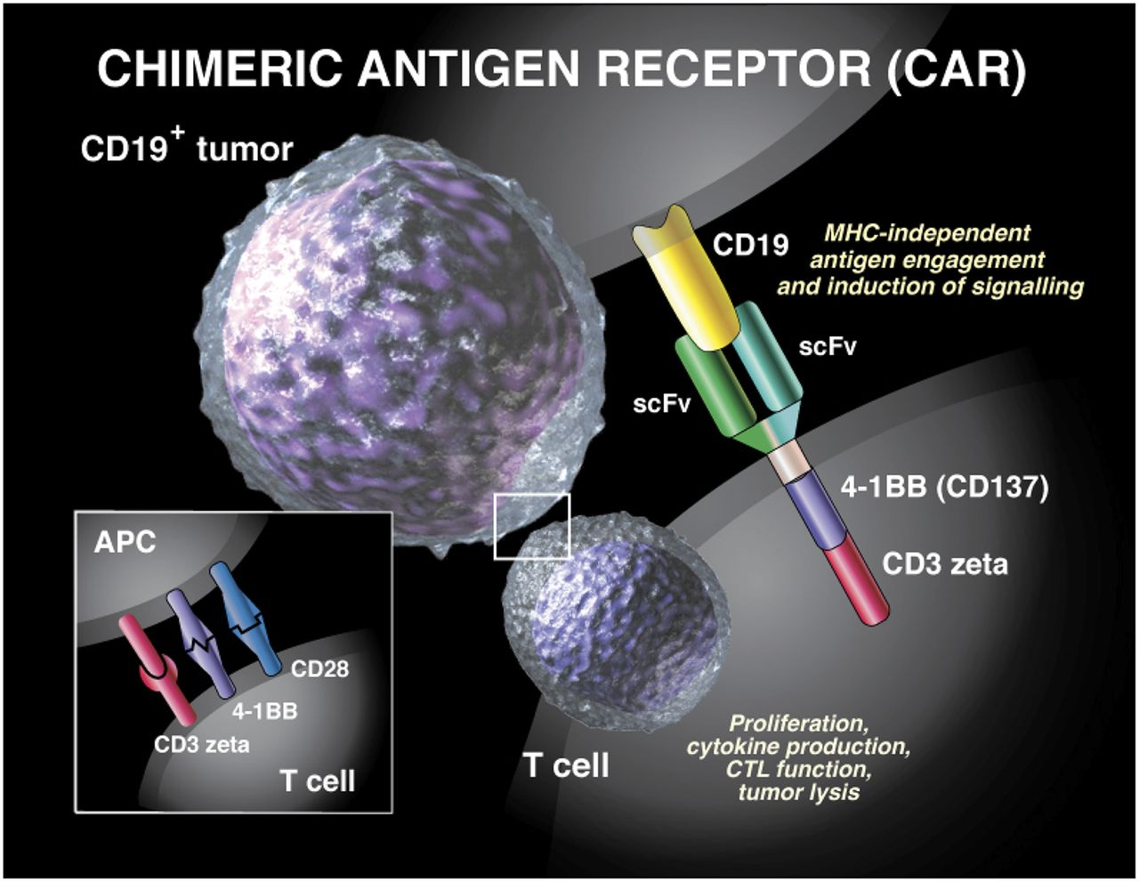

Slide 40
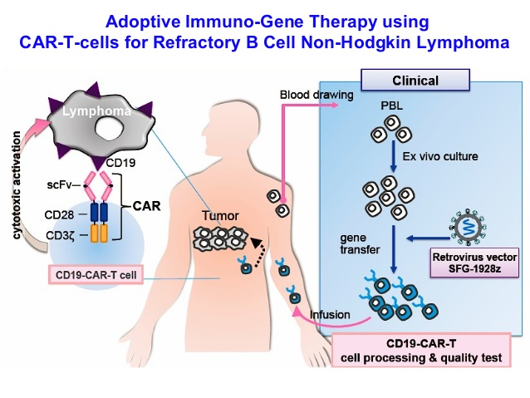

Slide 42
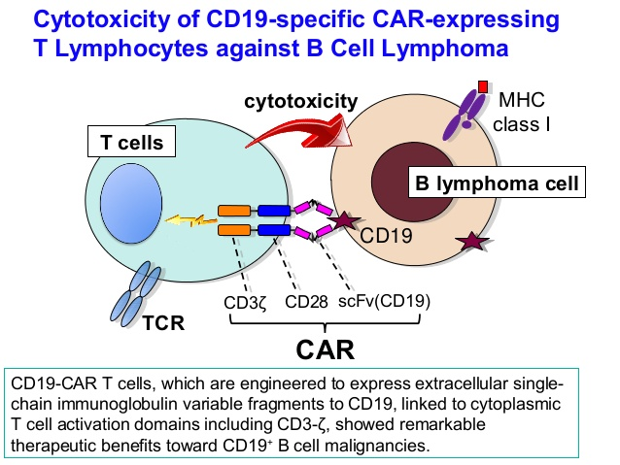

Slide 43
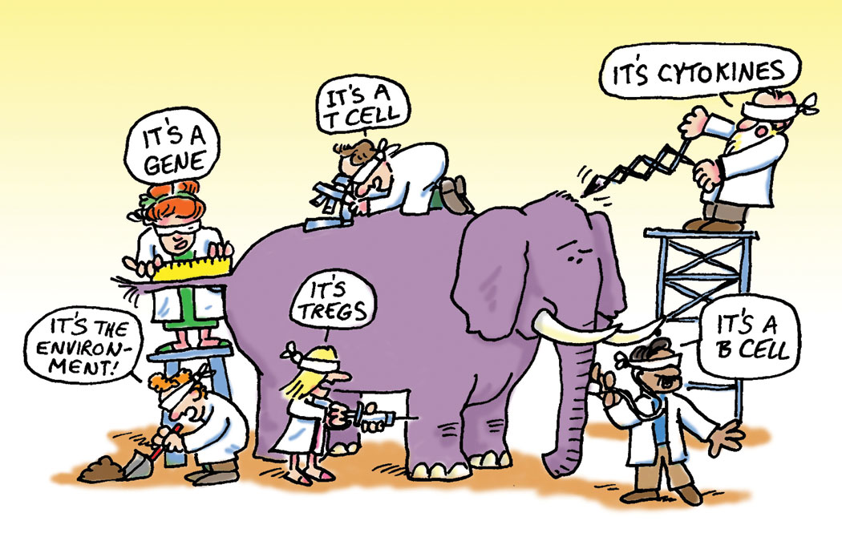
Ευχαριστώ για την προσοχή σας

