Slide 1



««Bench to bed-side»: Επιτυχή παραδείγματα και αποτυχίες θεραπευτικών παραγόντων βασισμένων σε ζωικά πειραματικά δεδομένα
Π. Σιδηρόπουλος
Ρευματολογία, Κλινική Ανοσολογία, Αλλεργιολογία
Ιατρική Σχολή, Παν. Κρήτης
www.rheumatology-uoc.gr
sidiropp@uoc.gr
ΠΑΝΕΠΙΣΤΗΜΙΑΚΟ ΝΟΣΟΚΟΜΕΙΟ ΗΡΑΚΛΕΙΟΥ
ΠΑΝΕΠΙΣΤΗΜΙΟ ΚΡΗΤΗΣ
ΙΑΤΡΙΚΗ ΣΧΟΛΗ
1ο Σχολείο Βασικής Ανοσολογίας για Κλινικούς
6-8/10/2017, Ηράκλειο Κρήτης

Slide 2
Outline
Animal Models of RA
Success stories
  Cytokine blockers
  CTLA4-Ig
“Failures”
  Anti-IL-1β
  Anti-IL-17
  Small molecule inhibitors
Lessons learned

Slide 3

RA Animal models
Pros
Tools to study RA pathogenesis
Provide the possibility to address the role of individual components of the immune system (T & B-cells, cytokines, innate-immunity)
Τools for the assessment of new therapeutic agents
Cons
Humans are not mice
High cost

Slide 4
Animal models of inflammatory arthritides
Induced models |  | Spontaneous models
Antigen-induced | Auto-Antibody transfer | Altered Cytokine Responses | TCR transgenic | T-cell mutations
Collagen Induced arthritis (CIA) Collagen Antigen Induced arthritis (AIA) bovine serum albumin | Collagen-antibody induced arthritis Anti-collagen antibody mixture K/BxN serum transfer Anti-G6PI | hTNFα transgenic IL-1Ra -/- IL-6R family (gp130) gp130 ^{F759/F759} | K/BxN G6PI | SKG ZAP-70 mutation MRL-lpr/lpr Fas gene mutation PD-1 -/-

Slide 5
Animal models of inflammatory arthritides
Induced models |  | Spontaneous models
Antigen-induced | Auto-Antibody transfer | Altered Cytokine Responses | TCR transgenic | T-cell mutations
Collagen Induced arthritis (CIA) Collagen Antigen Induced arthritis (AIA) bovine serum albumin | Collagen-antibody induced arthritis Anti-collagen antibody mixture K/BxN serum transfer Anti-G6PI | hTNFα transgenic IL-1Ra -/- IL-6R family (gp130) gp130 ^{F759/F759} | K/BxN G6PI | SKG ZAP-70 mutation MRL-lpr/lpr Fas gene mutation PD-1 -/-

Slide 6
Collagen Induced Arthritis
Inducible in susceptible strains of mice following inoculation with type II heterologous collagen in complete Freund’s adjuvant.
Susceptibility has been linked to strains that have MHC Class II I-Aq haplotypes
  however, it is clear that many mouse strains have variable degrees of susceptibility to CIA.
DBA/1 mice are most widely used in the CIA model.
Clinical signs of disease typically develop 21–25 days after the initial inoculation and presents as a polyarthritis

Slide 7
EXPERIMENTAL SETUP
CIA mouse model
Papadaki G. Eur J Immunol. 2016;46(11):2542

Slide 8
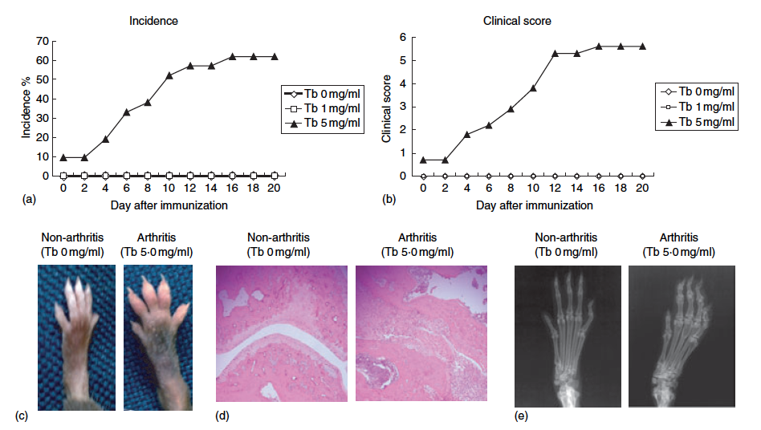
CIA: kinetics of arthritis
Immunology, 2006. 118, 233
Notes:
Induction of CIA in C57BL/6 mice. C57BL/6 mice were injected i.d. twice at day )21 and 0 with 100 lg CII emulsified in either IFA
(Tb 0 mg/ml) (e), or CFA containing M. tuberculosis at a concentration of 1 or 5 mg/ml (h and m, respectively) (n 1/4 21 in each group). Incidences
of CIA and clinical scores were determined, as described in Materials and methods. Data are shown as cumulative incidence (a) and mean
clinical score (b) of each group. A hind paw swelling in CIA-induced mouse 10 days after the second immunization and a control non-arthritis
paw are shown (c). Representative histological (d) and radiological (e) findings on an affected joint of a CIA-induced C57BL/6 mouse (12 days
(d) and 12 weeks (e)) after the second immunization and control joints are also shown (H&E, original magnification ·100).

Slide 9
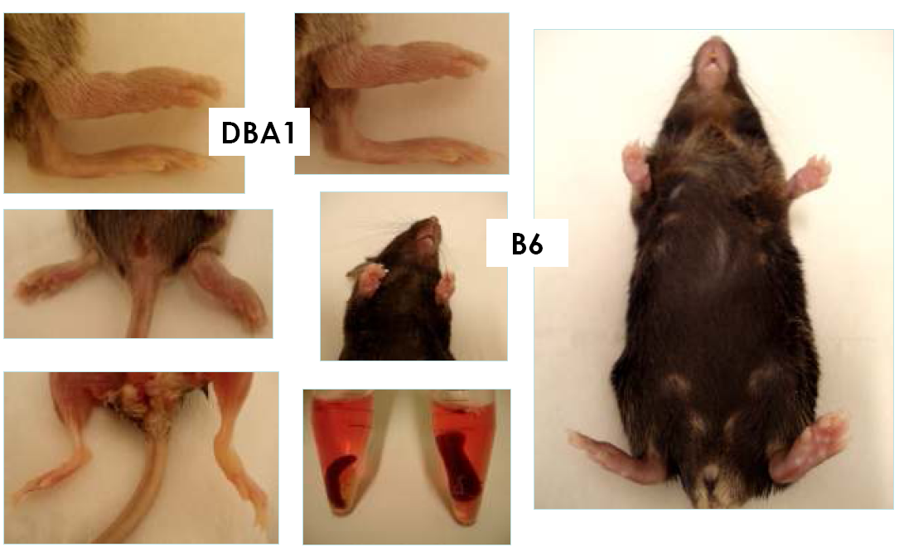
Collagen Induced Arthritis
Raptopoulou A. Arthritis Rheum. 2010 Jul;62(7):1870

Slide 10
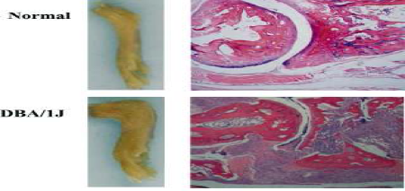
CIA: erosive arthritis
Raptopoulou A. Arthritis Rheum. 2010 Jul;62(7):1870

Slide 11
Collagen induced arthritis: TH1 mediated pathology
Mauri. Eur. J. Immunol. 1996.26: 1511
Notes:
Figure 3. IL-1P and TNF production in LNC supernatants isolated
during the clinical progression of arthritis. LNC were cultured
in the presence (hatched bars) or in absence (black bars) of
50 pg/ml CII. Time zero is representative of IL-1P and TNF in
healthy mice.
Figure 2. IL-4, IL-10 and IFN-y production in LNC in relation to
progression of clinical CIA. Supernatants were collected and analyzed
at different time points as outlined in Sect. 2.3. Sample
groups are representative of normal uninjected mice, or mice at
various stages after immunization.

Slide 12
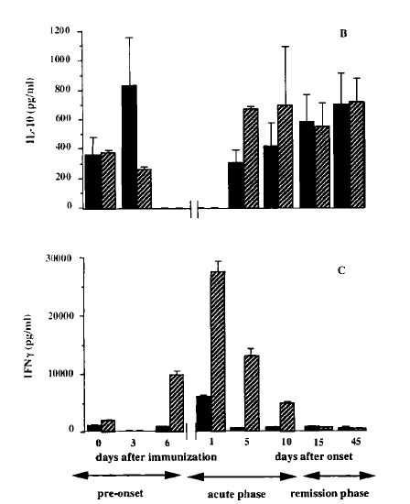
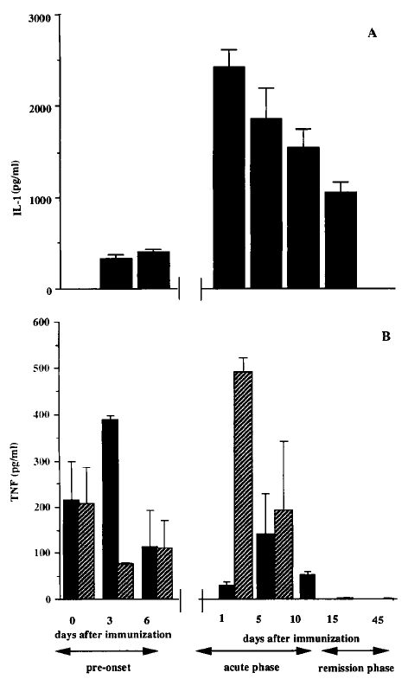
Collagen induced arthritis: TH1 mediated pathology
Th1responses are predominant at the time of onset of arthritis: IFN-y production declined progressively during the
Progression and subsequent remission of arthritis whereas levels of IL-10 increased
Mauri. Eur. J. Immunol. 1996.26: 1511
Notes:
Figure 3. IL-1P and TNF production in LNC supernatants isolated
during the clinical progression of arthritis. LNC were cultured
in the presence (hatched bars) or in absence (black bars) of
50 pg/ml CII. Time zero is representative of IL-1P and TNF in
healthy mice.
Figure 2. IL-4, IL-10 and IFN-y production in LNC in relation to
progression of clinical CIA. Supernatants were collected and analyzed
at different time points as outlined in Sect. 2.3. Sample
groups are representative of normal uninjected mice, or mice at
various stages after immunization.

Slide 13
Collagen induced arthritis:
Tool to assess pathogenic mechanisms. NETosis
Papadaki G. Eur J Immunol. 2016 Nov;46(11):2542

Slide 14
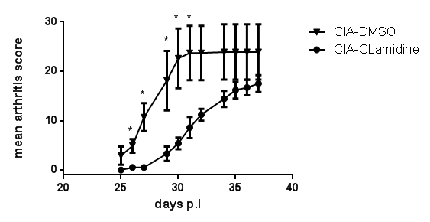
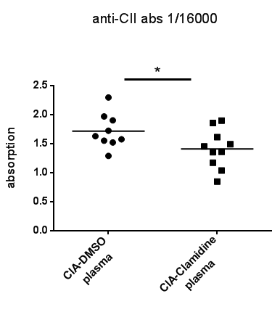
Collagen induced arthritis:
Tool to assess pathogenic mechanisms. NETosis
Cl-amidine administration attenuates CIA severity
Papadaki G. Eur J Immunol. 2016 Nov;46(11):2542

Slide 15
Collagen induced arthritis:
Tool to assess pathogenic mechanisms. NETosis
Cl-amidine administration reduces joint destruction in CIA
Proximal joint
Small joints in the distal limb
CIA-DMSO
CIA-Clamidine
Papadaki G. Eur J Immunol. 2016 Nov;46(11):2542

Slide 16
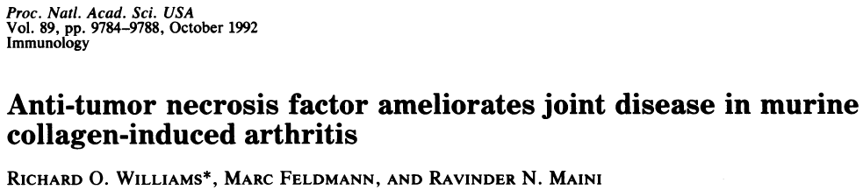
Collagen induced arthritis: tool to assess novel treatments
Proc. Natl. Acad. Sci. USA 89 (1992)

Slide 17
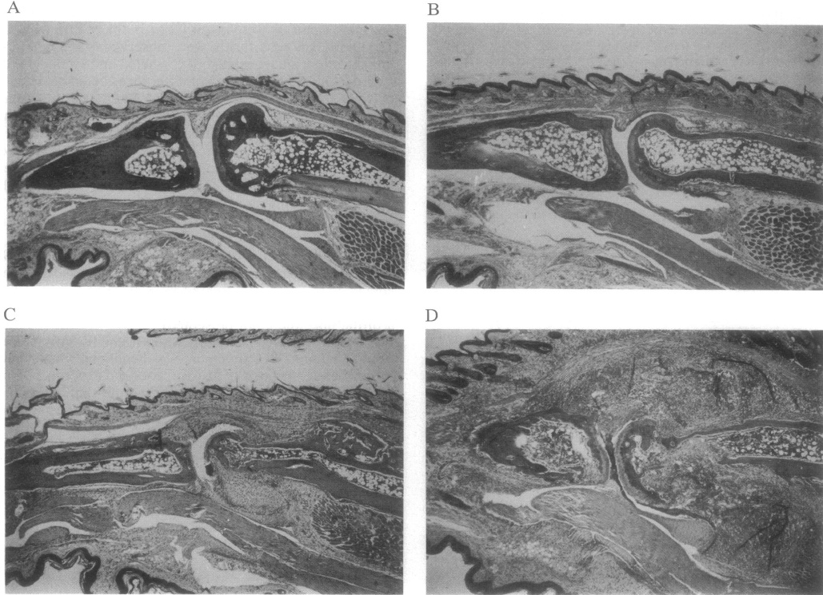
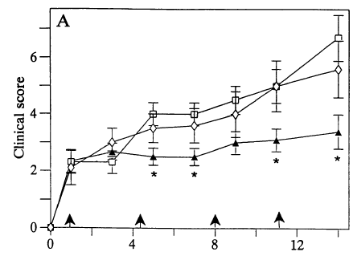
Collagen induced arthritis: tool to assess novel treatments
Normal
minimal synovitis
300 ,ug
Moderate
TN3-19.12 (50 jig).
Severe
control mAb
Proc. Natl. Acad. Sci. USA 89 (1992)

Slide 18
Animal models of inflammatory arthritides
Induced models |  | Spontaneous models
Antigen-induced | Auto-Antibody transfer | Altered Cytokine Responses | TCR transgenic | T-cell mutations
Collagen Induced arthritis (CIA) Collagen Antigen Induced arthritis (AIA) bovine serum albumin | Collagen-antibody induced arthritis Anti-collagen antibody mixture K/BxN serum transfer Anti-G6PI | hTNFα transgenic IL-1Ra -/- IL-6R family (gp130) gp130 ^{F759/F759} | K/BxN G6PI | SKG ZAP-70 mutation MRL-lpr/lpr Fas gene mutation PD-1 -/-

Slide 19
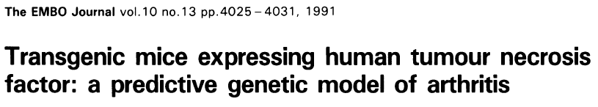
The EMBO Journal vol.10 no.13 pp.4025, 1991
Notes:
Since then multiple lines of TNF transgenic
mice have highlighted the importance
of TNF-a in the cytokine hierarchy
of RA, and given the success of anti-
TNF-a therapy in humans the TNF
transgenic mice provide a useful tool
for evaluating the efficacy of novel
therapies in RA, particularly in which
novel targets are considered to operate
downstream of TNF. Moreover, the
model has proven particularly useful
in defining the distinct contribution of
effector cytokines that regulate inflammation
and those that regulate cartilage
and bone destruction, e.g. RANKL.

Slide 20
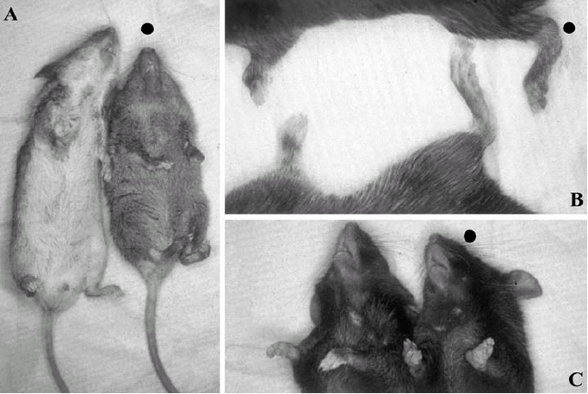
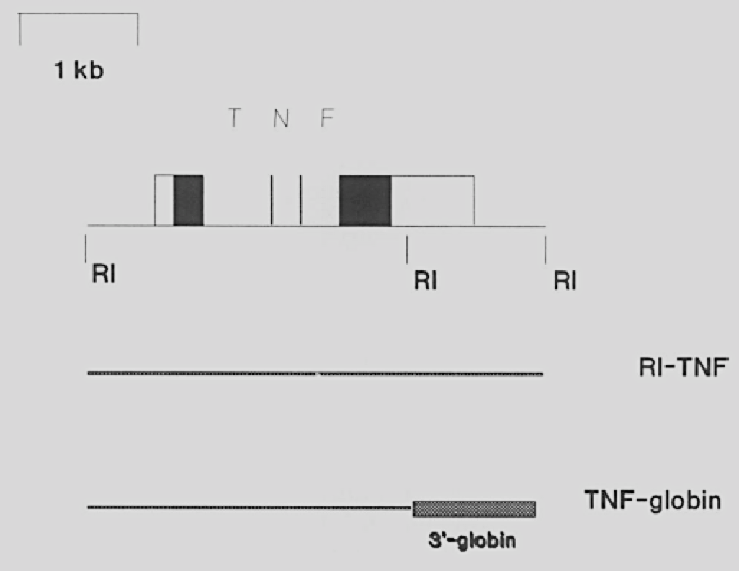
The EMBO Journal vol.10 no.13 pp.4025, 1991
Notes:
Since then multiple lines of TNF transgenic
mice have highlighted the importance
of TNF-a in the cytokine hierarchy
of RA, and given the success of anti-
TNF-a therapy in humans the TNF
transgenic mice provide a useful tool
for evaluating the efficacy of novel
therapies in RA, particularly in which
novel targets are considered to operate
downstream of TNF. Moreover, the
model has proven particularly useful
in defining the distinct contribution of
effector cytokines that regulate inflammation
and those that regulate cartilage
and bone destruction, e.g. RANKL.

Slide 21
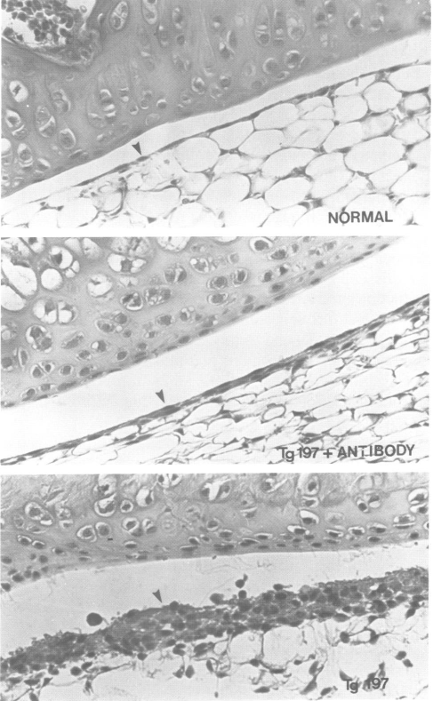
Suppression of arthritis in anti TNF a monoclonal antibody (Tgl97) treated animals
Normal (A)
TNF tg not treated
TNF tg
Anti TNFα-treated
The EMBO Journal vol.10 no.13 pp.4025, 1991
Notes:
Suppression of arthritis in monoclonal antibody treated Tgl97
mice. Sections through the knee joints of normal (A), monoclonal
antibody treated Tgl97 progeny (B) and non-treated Tg197 progeny
(C). Thickening of the synovial layer (arrowheads) is completely
suppressed in the antibody treated transgenic mice.

Slide 22

Normal
minimal synovitis
300 ,ug
Moderate
TN3-19.12 (50 jig).
Severe
control mAb
Proc. Natl. Acad. Sci. USA 89 (1992)

Slide 23
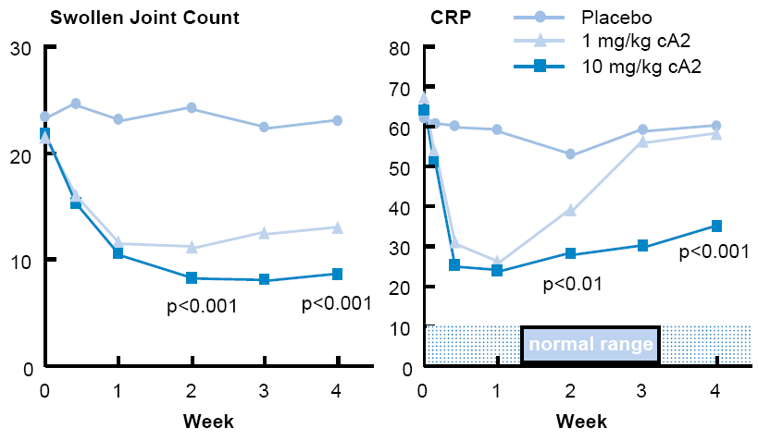
1st «Proof of concept» clinical study:
TNFα blocking (infliximab) improves HUMAN rheumatoid arthritis
anti-TNF MaB (infliximab)
Elliott MJ et al. Lancet 1994;344: 1105
Notes:
23
Elliott MJ et al. Randomised double-blind comparison of chimeric monoclonal antibody to tumour necrosis factor alpha (cA2) versus placebo in rheumatoid arthritis. Lancet 1994; 344:
1105–1110.

Slide 24
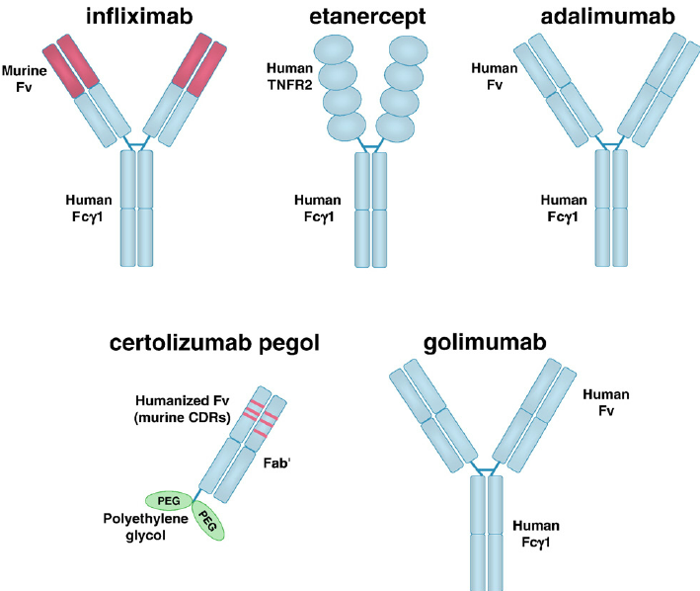
Anti-TNF agents

Slide 25
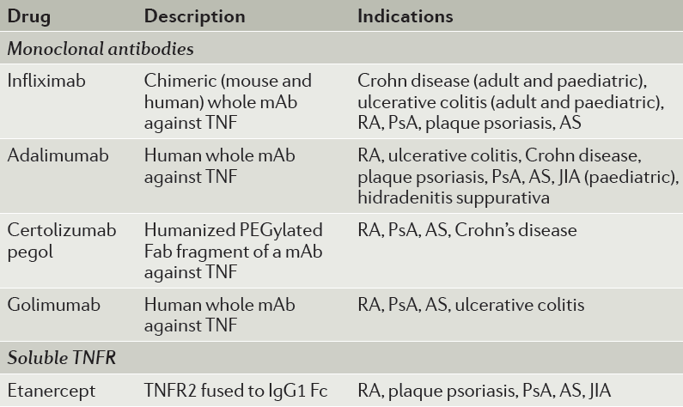
Anti-TNF agents: Current status
Anti-TNF sales globally (for all treatment indications) in 2013: greater than $25 billion (US)
Nat Rev Rheumatol. 2016 Jan;12(1):49

Slide 26
Animal models of inflammatory arthritides
Induced models |  | Spontaneous models
Antigen-induced | Auto-Antibody transfer | Altered Cytokine Responses | TCR transgenic | T-cell mutations
Collagen Induced arthritis (CIA) Collagen Antigen Induced arthritis (AIA) bovine serum albumin | Collagen-antibody induced arthritis Anti-collagen antibody mixture K/BxN serum transfer Anti-G6PI | hTNFα transgenic IL-1Ra -/- IL-6R family (gp130) gp130 ^{F759/F759} | K/BxN G6PI | SKG ZAP-70 mutation MRL-lpr/lpr Fas gene mutation PD-1 -/-

Slide 27
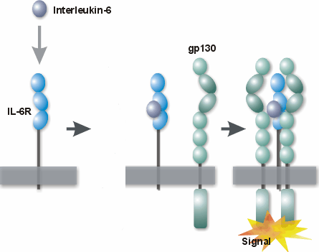
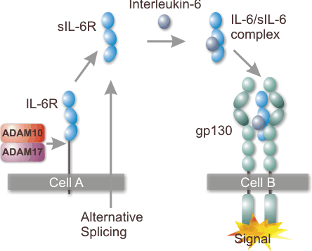
IL-6 signaling
Classical IL-6 Signaling
(hepatocytes,monocytes, PMNs, Τ- & Β-cells)
IL-6 Trans-signaling
(all cells)
Innate Immunity, APR
Chronic inflammation

Slide 28
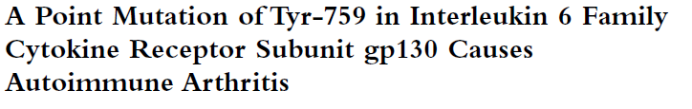
JExpMed 2002 Oct 7;196(7):979
Notes:
Figure 1. Development of spontaneous arthritis in gp130F759/F759 mice. (a) Incidence of arthritis in gp130F759/F759 mice of three age groups. Each joint
of gp130WT/WT (male n 26, female n 23) and gp130F759/F759 (male n 29, female n 15) mice was regularly examined and the severity was scored
according to a set of defined criteria (see Materials and Methods). White and black bars indicate the incidence of arthritis in gp130WT/WT and gp130F759/F759
mice of each age group, respectively. (b) Relationship between age and severity of arthritis in gp130F759/F759 (black circle: male n 29, female n 15)
and control gp130WT/WT (white square, male n 26, female n 23) mice. (c) Hindlimb of an 11-mo-old gp130WT/WT mouse. (d) Swelling and redness
of the hindlimb of an 11-mo-old gp130F759/F759 mouse. (e and f) Radiologic analysis of hindlimbs from gp130WT/WT (e) and gp130F759/F759 (f) mice. Representative
cases (18 mo old) from the radiological analysis of 18 mice with arthritis are shown. (g and h) Control gp130WT/F759 mouse (g) and ankylosis of
the large joints of a gp130F759/F759 mouse (h) (28 mo old). (i–p) Histological analyses of H&E-stained sections of joints. Ankle joints of gp130WT/WT (i) and
gp130F759/F759 (j) mice. Inset in (j) shows infiltration of neutrophils in the synovium in larger magnification. Knee joints of gp130WT/WT (k) and gp130F759/F759
(l) mice. Ankylotic ankle joint of gp130F759/F759 (n) mouse, whose X-ray photographs are shown in (h), and a control gp130WT/F759 (m) mouse. (o) Pannus
formation and activated osteoclasts in the ankle joint of a gp130F759/F759 mouse. (p) TRAP staining of a serial section from the section used in (o) with hematoxylin
counter staining. Representative cases from the histological analysis of gp130F759/F759 mice with arthritis (n 18) are shown

Slide 29
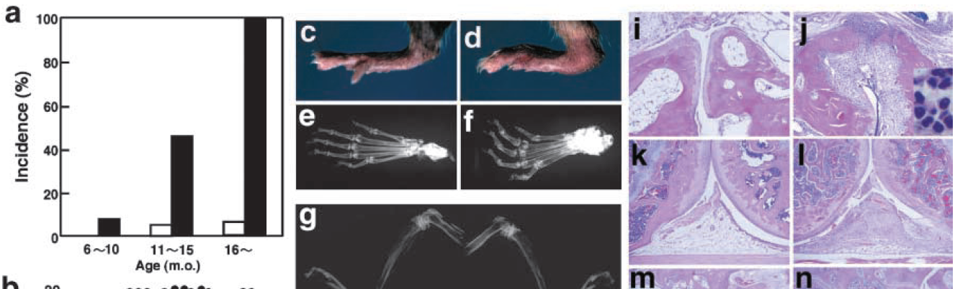
gp130 ^{WT/WT} gp130F ^{759/F759}
Development of spontaneous arthritis in gp130 ^{F759/F759} mice.
JExpMed 2002 Oct 7;196(7):979
Notes:
Figure 1. Development of spontaneous arthritis in gp130F759/F759 mice. (a) Incidence of arthritis in gp130F759/F759 mice of three age groups. Each joint
of gp130WT/WT (male n 26, female n 23) and gp130F759/F759 (male n 29, female n 15) mice was regularly examined and the severity was scored
according to a set of defined criteria (see Materials and Methods). White and black bars indicate the incidence of arthritis in gp130WT/WT and gp130F759/F759
mice of each age group, respectively. (b) Relationship between age and severity of arthritis in gp130F759/F759 (black circle: male n 29, female n 15)
and control gp130WT/WT (white square, male n 26, female n 23) mice. (c) Hindlimb of an 11-mo-old gp130WT/WT mouse. (d) Swelling and redness
of the hindlimb of an 11-mo-old gp130F759/F759 mouse. (e and f) Radiologic analysis of hindlimbs from gp130WT/WT (e) and gp130F759/F759 (f) mice. Representative
cases (18 mo old) from the radiological analysis of 18 mice with arthritis are shown. (g and h) Control gp130WT/F759 mouse (g) and ankylosis of
the large joints of a gp130F759/F759 mouse (h) (28 mo old). (i–p) Histological analyses of H&E-stained sections of joints. Ankle joints of gp130WT/WT (i) and
gp130F759/F759 (j) mice. Inset in (j) shows infiltration of neutrophils in the synovium in larger magnification. Knee joints of gp130WT/WT (k) and gp130F759/F759
(l) mice. Ankylotic ankle joint of gp130F759/F759 (n) mouse, whose X-ray photographs are shown in (h), and a control gp130WT/F759 (m) mouse. (o) Pannus
formation and activated osteoclasts in the ankle joint of a gp130F759/F759 mouse. (p) TRAP staining of a serial section from the section used in (o) with hematoxylin
counter staining. Representative cases from the histological analysis of gp130F759/F759 mice with arthritis (n 18) are shown

Slide 30
Mutation in the IL-6 Family of receptors gp130 (gp130 ^{F759/F759} mice)
Spontaneously developed arthritis dependent on lymphocytes accompanied by autoantibody production and T cell abnormalities at 1 year of age.
Increased production of Th1-type cytokines and Igs
Effects probably mediated through positive STAT-3 signaling
Unique animal model in which a point mutation in a cytokine receptor results in a RA-like autoimmune disease.
JExpMed 2002 Oct 7;196(7):979
Notes:
Figure 1. Development of spontaneous arthritis in gp130F759/F759 mice. (a) Incidence of arthritis in gp130F759/F759 mice of three age groups. Each joint
of gp130WT/WT (male n 26, female n 23) and gp130F759/F759 (male n 29, female n 15) mice was regularly examined and the severity was scored
according to a set of defined criteria (see Materials and Methods). White and black bars indicate the incidence of arthritis in gp130WT/WT and gp130F759/F759
mice of each age group, respectively. (b) Relationship between age and severity of arthritis in gp130F759/F759 (black circle: male n 29, female n 15)
and control gp130WT/WT (white square, male n 26, female n 23) mice. (c) Hindlimb of an 11-mo-old gp130WT/WT mouse. (d) Swelling and redness
of the hindlimb of an 11-mo-old gp130F759/F759 mouse. (e and f) Radiologic analysis of hindlimbs from gp130WT/WT (e) and gp130F759/F759 (f) mice. Representative
cases (18 mo old) from the radiological analysis of 18 mice with arthritis are shown. (g and h) Control gp130WT/F759 mouse (g) and ankylosis of
the large joints of a gp130F759/F759 mouse (h) (28 mo old). (i–p) Histological analyses of H&E-stained sections of joints. Ankle joints of gp130WT/WT (i) and
gp130F759/F759 (j) mice. Inset in (j) shows infiltration of neutrophils in the synovium in larger magnification. Knee joints of gp130WT/WT (k) and gp130F759/F759
(l) mice. Ankylotic ankle joint of gp130F759/F759 (n) mouse, whose X-ray photographs are shown in (h), and a control gp130WT/F759 (m) mouse. (o) Pannus
formation and activated osteoclasts in the ankle joint of a gp130F759/F759 mouse. (p) TRAP staining of a serial section from the section used in (o) with hematoxylin
counter staining. Representative cases from the histological analysis of gp130F759/F759 mice with arthritis (n 18) are shown

Slide 31

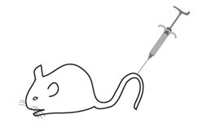
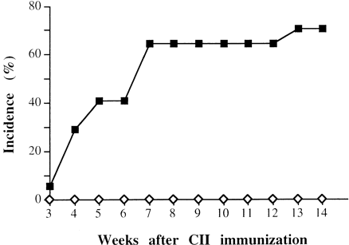
CIA
CII-
H37Ra
IL6 -/- in the
DBA/1J background.
No Arthritis
IL-6 ^{-/-}
WT
(12/17 mice)
IL-6^{-/-}
(0/16 mice)
IL-6 is absolutely required for the development of CIA
Our data support the idea that IL-6 blockade could be beneficial for the treatment of human autoimmune arthritis.
Alonzi, T et al., 1998 J. Exp. Med., 187(4): 461-468

Slide 32
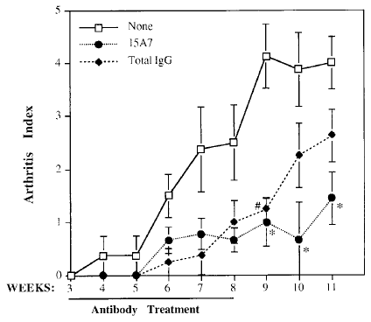
Anti IL-6R monoclonal ab (15A7) significantly decreased arthritis development in CIA mouse
(Anti IL6R)
⬅
Anti IL6R
Alonzi, T et al., 1998 J. Exp. Med., 187(4): 461-468

Slide 33
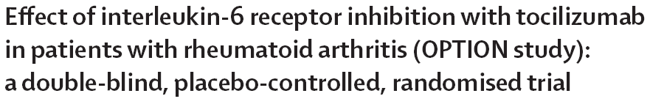
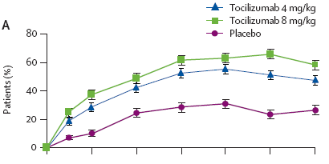

Interpretation:
Tocilizumab could be an effective therapeutic approach in patients with moderate to severe active rheumatoid arthritis.
anti IL-6R (tocilizumab)
ACR20 response
Lancet 2008; 371: 987–97

Slide 34
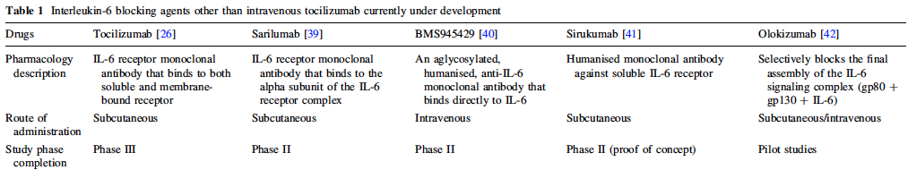
Interleukin-6 blocking agents other than tocilizumab currently under development
Drugs (2013) 73:341

Slide 35
Animal models of inflammatory arthritides
Induced models |  | Spontaneous models
Antigen-induced | Auto-Antibody transfer | Altered Cytokine Responses | TCR transgenic | T-cell mutations
Collagen Induced arthritis (CIA) Collagen Antigen Induced arthritis (AIA) bovine serum albumin | Collagen-antibody induced arthritis Anti-collagen antibody mixture K/BxN serum transfer Anti-G6PI | hTNFα transgenic IL-1Ra -/- IL-6R family (gp130) gp130 ^{F759/F759} | K/BxN G6PI | SKG ZAP-70 mutation MRL-lpr/lpr Fas gene mutation PD-1 -/-

Slide 36
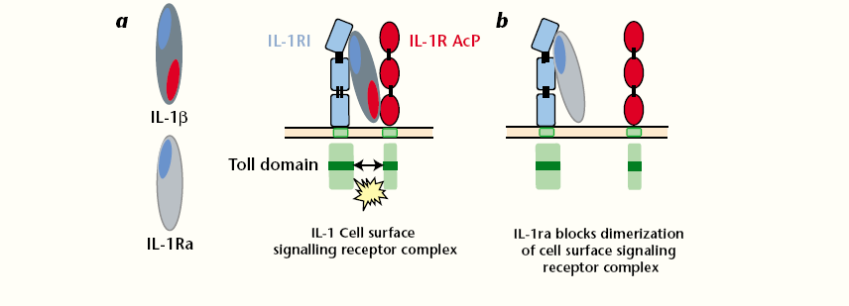
IL-1β & IL-1Ra
NATURE MEDICINE. 2003; 9(1): 47

Slide 37
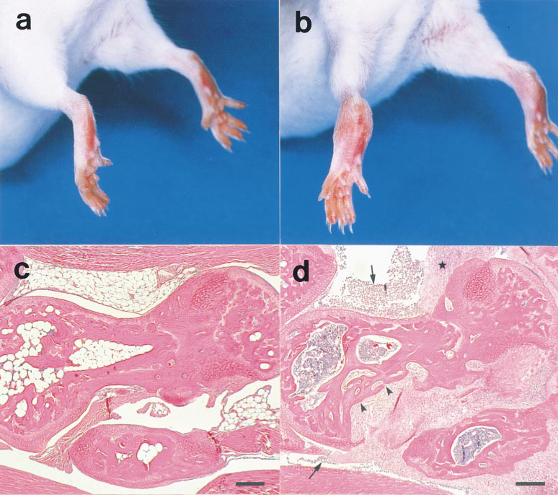
Development of Chronic Inflammatory Arthropathy
Resembling Rheumatoid Arthritis in Interleukin 1 Receptor
Antagonist–deficient Mice
IL-1Ra -/- mice to BALB/cA background spontaneously developed chronic inflammatory arthropathy
normal IL-1Ra wild type
affected IL-1ra -/- mouse
Clinical
⬅
Histology
J Exp Med. 2000 Jan 17;191(2):313

Slide 38
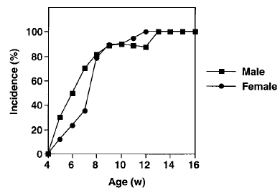
Development of Chronic Inflammatory Arthropathy
Resembling Rheumatoid Arthritis in Interleukin 1 Receptor
Antagonist–deficient Mice
IL-1Ra -/- mice to BALB/cA background spontaneously developed chronic inflammatory arthropathy
⬅
Incidence: 100%!!
J Exp Med. 2000 Jan 17;191(2):313

Slide 39
Development of Chronic Inflammatory Arthropathy
Resembling Rheumatoid Arthritis in Interleukin 1 Receptor
Antagonist–deficient Mice
IL-1ra gene deficiency causes autoimmunity
  elevated levels of antibodies to immunoglobulins, type II collagen, and dsDNA
Joint-specific inflammation
IL-1ra is important in maintaining homeostasis of the immune system.
J Exp Med. 2000 Jan 17;191(2):313

Slide 40
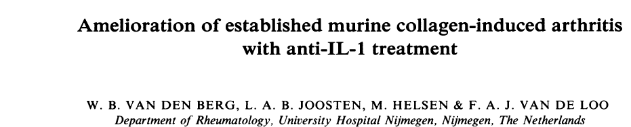
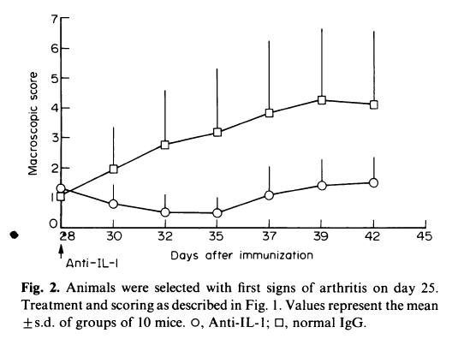
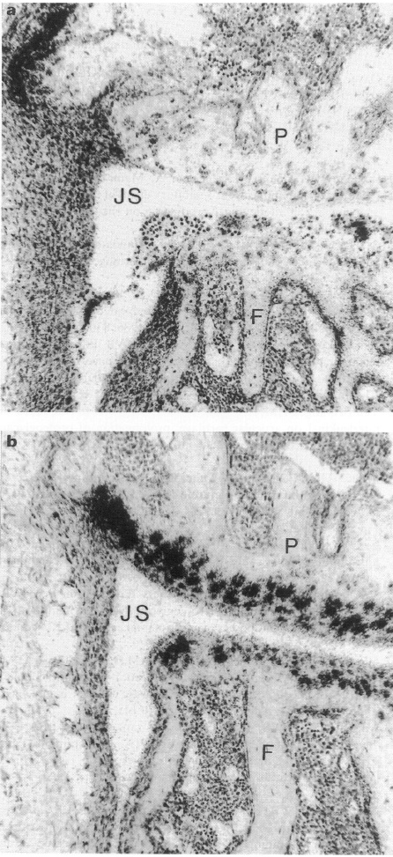
(a) Arthritic control. (b) Anti-IL- 1-treated
Clin Exp Immunol 1994; 95:237-243
Notes:
Fig. 3. Time course ofcollagen arthritis. A single treatment with anti-ILlaB
was given in separate groups at the time points indicated with
arrows. Groups consist of 11, eight and six mice at the subsequent time
points. For details see legend of Fig. 1. 0, Normal IgG; *, anti-IL- a, fl;
anti-IL-la, fl; 0, anti-IL-la,b

Slide 41
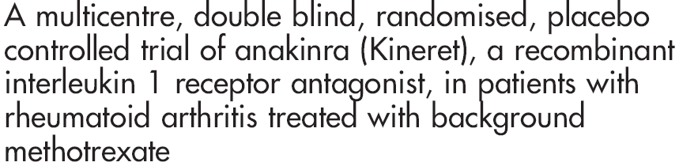
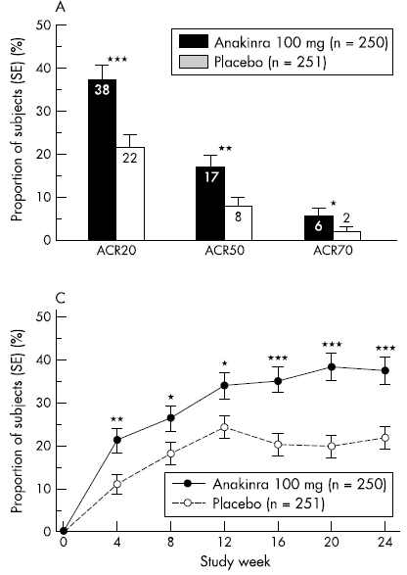
anti IL-1Ra (anakinra)
Ann Rheum Dis 2004;63:1062–1068
Notes:
This study confirms previous observations from a dose-ranging study showing that anakinra,
in combination with MTX, is an effective and safe treatment for patients with RA who have inadequate
responses to MTX alone.

Slide 42
NICE recommendation for IL-1R antagonist
“…..On the balance of its clinical benefits and cost effectiveness, anakinra is not recommended for the treatment of rheumatoid arthritis, except in the context of a controlled, long-term clinical study …..”

Slide 43
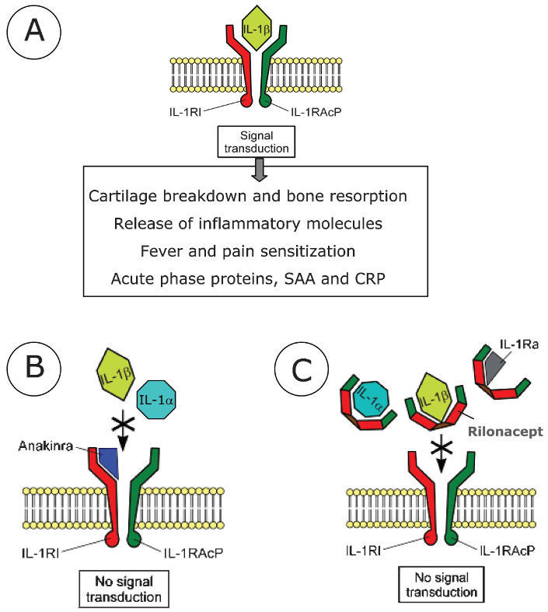
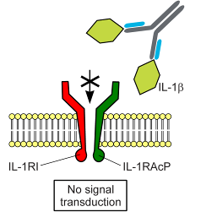
Αναστολή της IL-1β με βιολογικούς παράγοντες: anakinra - rilonacept - canakinumab
D
Canakinumab

Slide 44
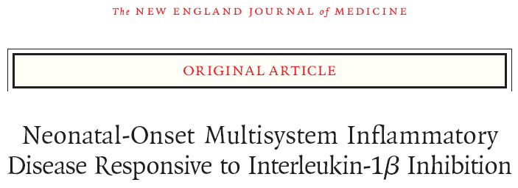
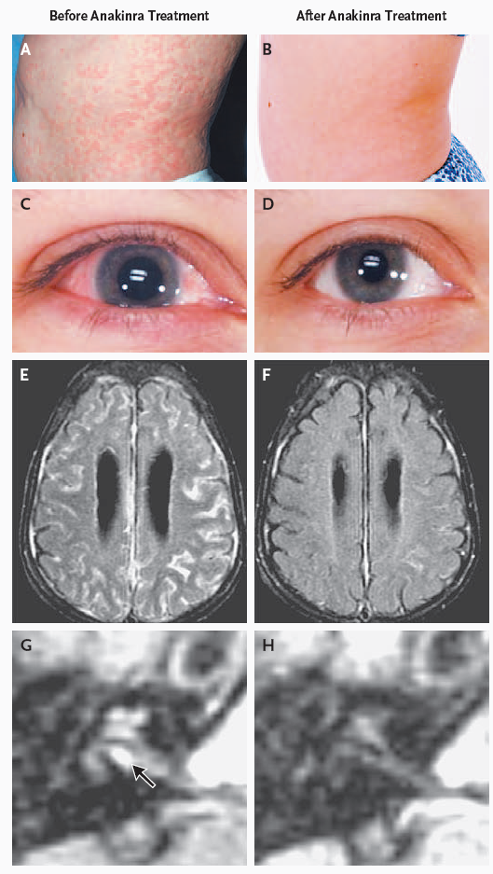
anti IL-1Ra (anakinra)
Anakinra improves rash, conjunctivitis, leptomeningeal and cochlear inflammation
N Engl J Med 355;6 : 2006
Notes:
Figure 1. Inflammatory Organ Manifestations in Neonatal-Onset Multisystem
Inflammatory Disease before (Panels A, C, E, and G) and after (Panels
B, D, F, and H) Treatment with Anakinra.
The severity of rash, conjunctivitis, and leptomeningeal and cochlear enhancement
on MRI is shown at baseline (Panels A, C, E, and G [arrow], respectively)
and after three months (Panels B, D, F, and H) of anakinra therapy

Slide 45
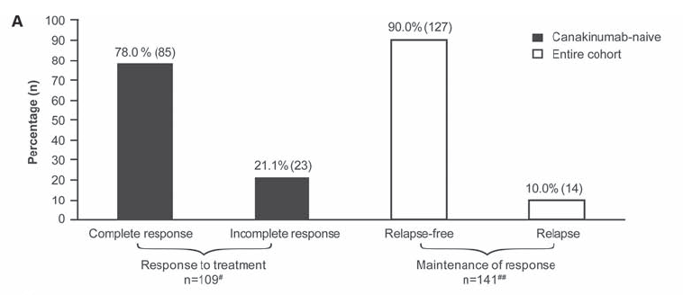
Canakinumab in patients with cryopyrin-associated periodic syndrome (CAPS) across different severity phenotypes
Clinical response to canakinumab during 2 years. Sustained remission with canakinumab
anti IL-1β (canakinumab)
Conclusions Subcutaneous canakinumab 150 mg every 8 weeks was well tolerated and provided substantial disease control in children and adults across all CAPS phenotypes.
Ann Rheum Dis 2011;70:2095

Slide 46
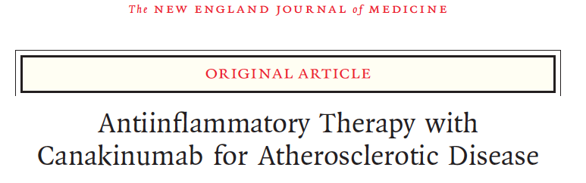
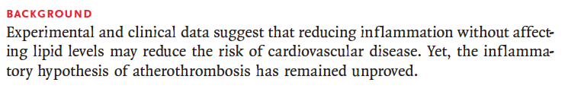
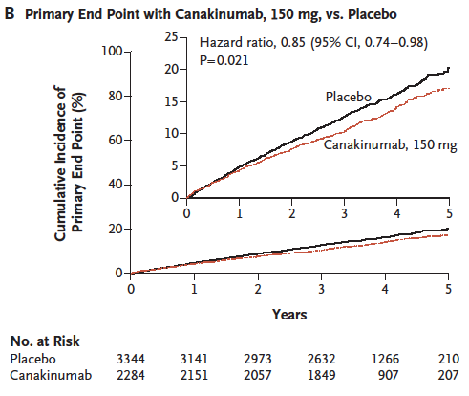
anti IL-1β (canakinumab)
N Engl J Med. 2017 Sep 21;377(12):1119

Slide 47
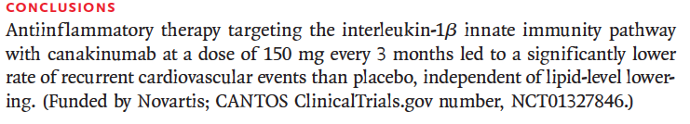
anti IL-1β (canakinumab)
N Engl J Med. 2017 Sep 21;377(12):1119

Slide 48
Animal models of inflammatory arthritides
Induced models |  | Spontaneous models
Antigen-induced | Auto-Antibody transfer | Altered Cytokine Responses | TCR transgenic | T-cell mutations
Collagen Induced arthritis (CIA) Collagen Antigen Induced arthritis (AIA) bovine serum albumin | Collagen-antibody induced arthritis Anti-collagen antibody mixture K/BxN serum transfer Anti-G6PI | hTNFα transgenic IL-1Ra -/- IL-6R family (gp130) gp130 ^{F759/F759} | K/BxN G6PI | SKG ZAP-70 mutation MRL-lpr/lpr Fas gene mutation PD-1 -/-

Slide 49
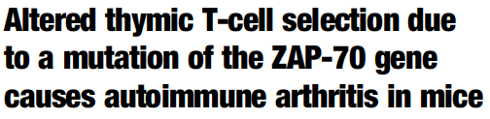
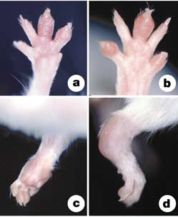
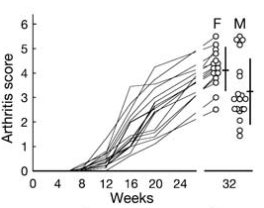
Sakaguchi S. Nature. 2003 Nov 27;426(6965):454
The SKG strain, (BALB/c background) spontaneously develops chronic arthritis
Swelling of joints: fingers and toes of a 4-month-old SKG mouse
Time course of joint swelling in female SKG mice

Slide 50
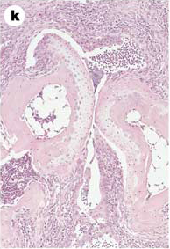
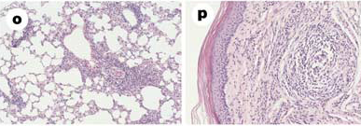
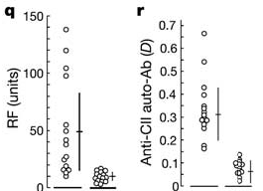
Sakaguchi S. Nature. 2003 Nov 27;426(6965):454
Histology of arthritis and extra-articular lesions in SKG mice
Synovitis
Rheumatoid nodule-like lesion
Interstitial pneumonitis
Autoimmunity

Slide 51

Thymic production of arthritogenic T cells due to a genetically determined selection shift of the T-cell repertoire towards high self-reactivity
The primary cause of the arthritis in SKG mice is a genetic abnormality
  A mutation of the ZAP-70 kinase (ZAP-70^{W163C})
ZAP-70^{W163C} mutation might impair signal transduction mediated by TCR (TCR-z and CD3 chains)
This results in a ‘selection shift’ of the T-cell repertoire towards high reactivity to self-peptide/MHC ligands in the thymus, leading to the thymic production of highly self-reactive T cells that would not be produced by the normal thymuses of ZAP-70-intact animals.
Lower proliferative responses of SKG
T cells to various T-cell stimulation
Notes:
These results
collectively indicate that the ZAP-70W163C mutation might impair
the recruitment and association of ZAP-70 to tyrosine-phosphorylated
immunoreceptor tyrosine-based activation motifs (ITAMs) of
TCR-z and CD3 chains, thereby altering signal transduction
through ZAP-70.
In accord with this attenuated signal transduction through
ZAP-70, SKG T cells were hyporesponsive to polyclonal TCR
stimulation in vitro, for example with anti-CD3 mAb,

Slide 52

Tcell receptor (TCR) transgenic: K/BxN
TCR transgenic (epitope of bovine Rnase) KRN line crossed to mice expressing the MHC class II molecule A^{g7} (NOD)
K/BxN mice develop severe and destructive inflammatory arthritis.
They have high titers of autoantibodies recognizing glucose-6-phosphate Isomerase
serum from these mice induces arthritis in a wide range of normal recipient mouse strains (serum transfer model).
Cell, Vol. 87, 811–822, November 29, 1996

Slide 53

Dual specificity of the KRN TCR responsible for an autoimmune response
Arthritis
Springer Semin Immunopathol (2003) 25:79
Notes:
Fig. 1. Dual specificity of the KRN TCR responsible for an autoimmune response. The KRN T cells (T)
bear a transgenic TCR which has a dual specificity for the bovine RNase peptide 42–56 in the context of
I-Ak (shown in the left half of the figure), as well as for the peptide GPI 282–294 in the context of I-Ag7
(right half) [2]. In K/BxN mice B cells (B) displaying I-Ag7 can function as antigen-presenting cells
(APC) and present the autoantigen peptide GPI 282–294 to specific T cells and in turn receive help to differentiate
into plasma cells (P) producing the arthritogenic anti-GPI autoantibodies (GPI glucose-6-phosphate
isomerase)

Slide 54

T cell immunomodulation
T cell surface antigens that served as therapeutic targets

Slide 55


L3T4 antigen analogous to the OKT4/Leu-3 (CD4) antigen on human T cells
“In this paper we demonstrate the prevention of murine CIA by in vivo treatment with monoclonai antibody to the L3T4 antigen”
J. ExP. MED Volume 162 ; 1985 :1105

Slide 56


CD3⁺ T cells
CD4⁺ cells
Mab67⁺ type B synoviocytes
CD68⁺ macrophages
anti CD4
(cM-T412)
Conclusion.
The decline of inflammatory cells and adhesion molecules in synovial
tissue after CD4+ cell depletion supports the view that CD4+ T cells orchestrate local cellular infiltration.
The lack of clinical effect of anti-CD4 therapy might be explained by an insufficient decrease in the number of synovial CD4+ cells and by the persistence of cytokines.
PP Tak. A & R Vol. 38, 1995, pp 1457

Slide 57


anti CD4
(cM-T412)
No clinical efficacy of CD4 depletion in RA
Conclusion.
Treatment with cM-T412 combined with methotrexate was not associated with clinical efficacy, despite significant peripheral CD4+ T cell depletion.
L. Moreland. A&R. 38, No. 11, 1995, pp 1581

Slide 58

Nat Rev Drug Discov. 2007 Jan;6(1):75

Slide 59

1989 -1995 anti-CD4 Mab RA
positive clinical benefits in 8 of the studies, which were open trials (n=129)
no clinical benefit in 3 of the studies, which were blinded, PCB trials (n=133)
Reasons for failure
Inadequate tissue T-cell depletion
Resistance of pathogenic memory T-cells
Inadequate dosing
Short-term observation might have missed clinical benefit
Immunogenicity
Prolonged Lymphopenia
Current Opinion in Rheumatology 2003, 15:253

Slide 60

Costimulation of T-cells as a therapeutic target
Roles of the B7–CD28/CTLA-4 Pathway in Regulating T-Cell Activation
N Engl J Med. 2006 Sep 7;355(10):973
Notes:
. Roles of the B7–CD28/CTLA-4 Pathway in Regulating T-Cell Activation
Resting antigen-presenting cells (APCs) express few or no B7 costimulatory molecules and fail to
activate naive T cells (top panel). Microbes and cytokines produced in response to microbes activate
APCs and stimulate the expression of B7 costimulators. B7–CD28 interactions stimulate the
expansion and differentiation of naive T cells (middle panel). CTLA-4, the high-affinity receptor for
B7-1 and B7-2, is up-regulated on activated T cells. B7–CTLA-4 interactions inhibit T-cell responses
(bottom panel). MHC denotes major histocompatibility complex
60

Slide 61
CTLA4-Ig (abatacept) vs antiTNF (adalimumab):
Similar ACR responses through 2 years
Abatacept SC
CTLA4-Ig (abatacept)
Adalimumab
ACR 20
60.1%
59.7%
ACR Response Rate (%)
ACR 50
46.6%
44.7%
ACR 70
31.1%
29.3%
ACR 90
14.5%
8.2%
0
15
29
57
85
113
141
169
197
225
253
281
309
337
365
449
533
617
729
Day
ITT Population (NRI). Error bars represent 95% CI
Schiff M, et al. Ann Rheum Dis 2014;73:86–94.

Slide 62
IL-17 & IL-23

Slide 63

CD4+ memory T‑helper cells consist of different subpopulations.
Nat Rev Rheumatol. 2015 Oct;11(10):562

Slide 64

Absence of Interleukin-17 Receptor A Signaling Prevents Autoimmune Inflammation of the Joint in Collagen-Induced Arthritis
IL-17RA–deficient comparable to IL-23p19–deficient mice, were completely
protected against the development of collagen-induced arthritis (CIA).
IL-17RA–KO mouse IL-23–KO mouse
A&R 66, 2014, pp 340
Notes:
Conclusion. These results demonstrate that absence
of IL-17RA leads to a Th2-like phenotype characterized
by IL-4 production and suggest that IL-17RA
signaling plays a critical role in the regulation of IL-4 in
CIA and the development of autoimmune inflammation
of the joint

Slide 65

Efficacy and safety of secukinumab in patients with rheumatoid arthritis: a phase II, dose-finding, double-blind, randomised, placebo controlled study
Objective:
To assess the safety and efficacy of secukinumab, a fully human monoclonal anti-interleukin-17A antibody, in patients with rheumatoid arthritis (RA).
anti IL-17A (secukinumab)
20% response (ACR20) at week 16.
All patients
Genovese. Ann Rheum Dis 2013;72:863

Slide 66
Efficacy and safety of secukinumab in patients with rheumatoid arthritis: a phase II, dose-finding, double-blind, randomised, placebo controlled study
anti IL-17A (secukinumab)
20% response (ACR20) at week 16.
Subgroups based on CRP
Genovese. Ann Rheum Dis 2013;72:863

Slide 67
Efficacy and safety of secukinumab in patients with rheumatoid arthritis: a phase II, dose-finding, double-blind, randomised, placebo controlled study
anti IL-17A (secukinumab)
CONCLUSIONS
In this study, the primary endpoint was not achieved.
The differences in response rates seen between active drug and placebo in ACR and DAS28 scores, particularly in 75 mg, 150 mg and 300 mg subcutaneously every 4-week arms, have led to the initiation of further studies.
Genovese. Ann Rheum Dis 2013;72:863

Slide 68
Secukinumab in Active Rheumatoid Arthritis after TNFi failure:
A Phase III Randomized, Double-Blind, Active Comparator– and Placebo-Controlled Study
secukinumab vs abatacept vs placebo after TNFi failure
Objective. To evaluate the efficacy and safety of secukinumab in patients with active rheumatoid arthritis (RA) who had an inadequate response to or intolerance of TNF inhibitors.
Methods. In this phase III study, 551 patients were randomized (1:1:1:1) to receive intravenous secukinumab at a dose of 10 mg/kg (at baseline and weeks 2 and 4) followed by subcutaneous secukinumab at a dose of either
150 mg or 75 mg every 4 weeks or, alternatively, abatacept or placebo on the same dosing schedule.
Blanco. A & R Vol. 69, June 2017, pp 1144

Slide 69

Secukinumab in Active Rheumatoid Arthritis after TNFi failure:
A Phase III Randomized, Double-Blind, Active Comparator– and Placebo-Controlled Study
secukinumab vs abatacept vs placebo after TNFi failure
CTLA4Ig
anti-IL17A
Blanco. A & R Vol. 69, June 2017, pp 1144

Slide 70
Limited clinical efficacy of IL-17A as compared to CTLA4-Ig in RA
secukinumab vs abatacept vs placebo after TNFi failure
Conclusion.
Secukinumab at a dose of 150 mg resulted in improvement in signs and symptoms and reduced disease activity in patients with active RA who had an inadequate response to TNF inhibitors.
Improvements observed with abatacept were numerically higher than with secukinumab.
No incremental benefit of IL-17A inhibition was seen over other agents currently approved for use in patients in whom TNF inhibitors have failed.
These data, along with the findings from phase II studies and data related to the use of other anti–IL-17A agents suggest that IL-17A plays a lesser role in the pathogenesis of RA.
Blanco. A & R Vol. 69, June 2017, pp 1144

Slide 71
Kinase inhibitors

Slide 72

MAP Kinase inhibitors
Firestein. Nat Clin Pract Rheumatol 2007;3:651–60

Slide 73

Prevention of the Onset and Progression of
Collagen-Induced Arthritis in Rats by the
Potent p38 Mitogen-Activated Protein Kinase Inhibitor FR167653
Clinical findings in rats with collagen-induced arthritis (CIA), showing the prophylactic effect (A) and therapeutic effect (C) of FR167653.
Conclusion.
FR167653 prevents the onset of arthritis in a prophylactic treatment model and suppresses the progression of joint destruction in a therapeutic treatment model, suggesting that p38 MAPK is a potential therapeutic target for rheumatoid arthritis
A & R Vol. 48, No. 9, September 2003, pp 2670

Slide 74

Pamapimod, a p38 MAP Kinase Inhibitor, in a Double-Blind,
Methotrexate-Controlled Study of Patients With Active Rheumatoid Arthritis
Objective.
To determine the efficacy and safety of pamapimod (a selective inhibitor of the α-isoform of p38 MAP kinase) as monotherapy in comparison with methotrexate (MTX) treatment in adult patients with active rheumatoid arthritis (RA).
p38 MAP Kinase Inhibitor (pamapimod)
Cohen. A & R 2009, p 335

Slide 75
Pamapimod, a p38 MAP Kinase Inhibitor, in a Double-Blind,
Methotrexate-Controlled Study of Patients With Active Rheumatoid Arthritis
Conclusion:
The present results showed that pamapimod was not as effective as MTX in the treatment of active RA.
p38 MAP Kinase Inhibitor (pamapimod)
Cohen. A & R 2009, p 335

Slide 76
Pamapimod, a p38 MAP Kinase Inhibitor, in a Double-Blind,
Methotrexate-Controlled Study of Patients With Active Rheumatoid Arthritis
Conclusion:
The present results showed that pamapimod was not as effective as MTX in the treatment of active RA.
Cohen. A & R 2009, p 335
Conclusion. The modest clinical efficacy plus the transient suppression of biomarkers of inflammation observed in this study suggest that p38 MAPK inhibition may not provide meaningful, sustained suppression of the chronic inflammation seen in RA
Damjanof. Α & Ρ 2009, pp 1232

Slide 77
p38a Kinase and Syk inhibitors: case closed?
At least 22 different p38 inhibitors have been investigated in phase I/II clinical trials for a variety of clinical indications and none have progressed to phase III.
WHAT HAS GONE WRONG? While many p38a inhibitors have been evaluated in phase I/II clinical trials, the relative lack of therapeutic efficacy in RA was a major surprise and unexpected. It is not clear why they have failed.
  Dosing
  Biodistribution
  Relevance of the animal models
  Redundant Kinases networks
Firestein. Ann Rheum Dis 2010;69(Suppl I):i77

Slide 78
Διαφορετικές κυτταροκίνες σηματοδοτούν μέσω διαφορετικών JAK/STAT μορίων
Οι STATs ρυθμίζουν την έκφραση δεκάδων χιλιάδων γονιδίων (δράσεις σε ανοσοποιητικό, αιμοποιητικό, νευρο-αναπτυξιακές, μεταβολισμό)
Η σχετική ειδικότητα ερμηνεύει (εν μέρει) το αποτέλεσμα διαφορετικών αναστολέων
Οι υποδοχείς κυτταροκινών όπως TNF, IL-1, IL-17 δεν σηματοδοτούν μέσω JAKs
O’Shea JJ, et al. Annu Rev Med. 2015; 66:311-28; Ann Rheum Dis. 2013; 72 Suppl 2: ii111-5

Slide 79
1^{η} γενιά εκλεκτικών αναστολέων JAK και θεραπευτική χρήση σε ρευματικά νοσήματα
RA synovium
tofacitinib (CP-690,550)
JAK3/1 > JAK2 >>> TYK2
IL-6: ↑ STAT3 σε κύτταρα αρθρικού υμένα
Thomas S, et al. PLoS One. 2015; 10: e0130078; Tanaka Y, et al. Mod Rheumatol. 2013; 23: 415-24; Walker JG, et al. Ann Rheum Dis. 2006; 65:149–156; Ivashkiv LB, et al. Arthritis Rheum. 2003; 48: 2092-6; IsomaKi P, et al. Rheumatology. 2015; 54:1103-13

Slide 81

Development of drugs for immune mediated inflammatory that target Janus kinases (JAKs).
Baker KF, Isaacs JD. Ann Rheum Dis 2017;0:1

Slide 82
Lessons learned (I)
Mouse models do not always predict therapeutic value in human diseases
The presence of a cytokine in a tissue/blood doesn’t prove a dominant pathogenic role
Clinical and ex-vivo human studies places TNF at the centre of rheumatoid arthritis pathogenesis.

Slide 83
Lessons learned (II)
Clinical failure of cytokine inhibitors (IL-1b, IL-17) does not infer that such cytokines are not functionally active in synovium of patients with rheumatoid arthritis (they probably are), but simply implies:
  that these cytokines do not have a sufficiently important hierarchical or non-redundant role in promoting inflammation
  that they are targeted at a disease stage when their functional contribution is no longer important
The variable responses to discrete kinase inhibitors, however, reflect our relatively limited understanding of the true intracellular hierarchy of these pathways in the pathogenesis of synovial inflammation.

Slide 84
Μany challenges remain
Τhe ability to target these various approaches to both the diseases and the patients who are most likely to benefit.
Ηead-to-head comparisons between different agents, to reliably dissect the relative contributions of distinct pathways to a particular disease
Future trials will need to become increasingly sophisticated in order to address these varying requirements.

Slide 85
“….But it is clear that the revolution is incomplete—it
has not resulted in “cures.” As a medical community, we
need to pick up the challenge again and get the job completed.
We have new powerful tools and much more
knowledge. Do we have the ambition and the will?”
Marc Feldmann and Ravinder N. Maini. A & R No. 9, September 2015, pp 2283

